Slide 1
Identity: belongings
Describing what people have [1]
avoir (je, tu, il/elle) l’alphabet SSC [u]
Y7 French Term 1.1 - Week 4 - Lesson 7 Stephen Owen / Rachel Hawkes / Catherine Morris
Artwork by: Chloé Motard
Date updated: 20.05.23
Notes:
Note: all words (new and revisited) in this week of the SOW appear on all three GCSE wordlists, with this exception: AQA list does not have prudent.
Learning outcomes (lesson 1):
Introduction of SSC [u]
Introduction and practice of French alphabet
Consolidation of first and third person singular forms of avoir
Introduction of second person singular form of avoir
Word frequency (1 is the most frequent word in French):
7.1.1.4 (introduce) frère [1043], sœur [1558], parent [546], ouvert [897], prudent [1529], strict [1859], jeune [152]
7.1.1.1 (revisit) être [5], es [5], suis [5], lire [278], écrire [382], écouter [429], parler [429], je [22], tu [112], anglais¹ [784], anglaise¹ [784], français¹ [251], française¹ [251], grand¹ [59], petit¹ [138], grande² [59], petite² [138], et [6], au revoir [1274], bonjour [1972]
Source: Londsale, D., & Le Bras, Y. (2009). A Frequency Dictionary of French: Core vocabulary for learners London: Routledge.
The additional English meanings of the following words have been added to Quizlet since the creation of this resource: voici, voilà: here is, this is, there is, there are

Slide 2
u
tu
Notes:
Timing: 1 minute
Aim: To introduce SSC [u]
Procedure: 1. Present the letter(s) and say the [u] sound first, on its own. Students repeat it with you. 2. Bring up the word ”tu” on its own, say it, students repeat it, so that they have the opportunity to focus all of their attention on the connection between the written word and its sound.
3. A possible gesture for this would be to point to someone else as though addressing him/her ‘you’. 4. Roll back the animations and work through 1-3 again, but this time, dropping your voice completely to listen carefully to the students saying the [u] sound, pronouncing ”tu” and, if using, doing the gesture.
Word frequency (1 is the most frequent word in French):
tu [112]
Source: Londsale, D., & Le Bras, Y. (2009). A Frequency Dictionary of French: Core vocabulary for learners London: Routledge.

Slide 3
u
tu
Notes:
With sound and no pictures to focus all attention on the sound-symbol correspondence.

Slide 4
u
tu
Notes:
Without sound to elicit pronunciation (without first hearing the teacher).
Teacher to elicit pronunciation by asking “Comment dit-on …"

Slide 5
u
Salut !
vue
amusant
tu
utiliser
[to use]
sur
[on]
Notes:
Timing: 2 minutes
Aim: To introduce SSC [u]
Procedure:
1. Introduce and elicit the pronunciation of the individual SSC [u] and then the source word again ‘tu’ (with gesture, if using). 2. Then present and elicit the pronunciation of the five cluster words.
The cluster words have been chosen for their high-frequency, from a range of word classes, with the SSC (where possible) positioned within a variety of syllables within the words (e.g. initial, 2nd, final etc.). Additionally, we have tried to use words that build cumulatively on previously taught SSCs (see the Phonics Teaching Sequence document) and do not include new SSCs. Where new SSCs are used, they are often consonants which have a similar symbol-sound correspondence in English.
Word frequency (1 is the most frequent word in French): tu [112]; salut ! [2205] vue [191]; sur [16]; amusant [4695]; utiliser [345]. Source: Londsale, D., & Le Bras, Y. (2009). A Frequency Dictionary of French: Core vocabulary for learners London: Routledge.

Slide 6
u
Salut !
vue
amusant
tu
utiliser
sur
Notes:
With sound and no pictures to focus all attention on the sound-symbol correspondence.

Slide 7
u
Salut !
vue
amusant
tu
utiliser
sur
Notes:
Without sound to elicit pronunciation (without first hearing the teacher).
Teacher to elicit pronunciation by asking “Comment dit-on …"

Slide 8
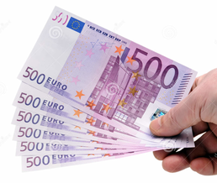
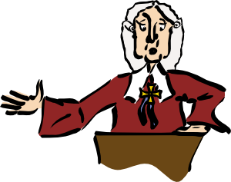
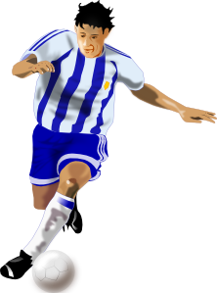
Phonétique
[u]
[eu]
écouter
Écoute. C’est [u] ou [eu] ?
2
pl u s
généreux
cell u le
deux
diff u ser
_
_
_
_
_
j u ry
joueur
véhic u le
fameux
_
_
_
_
Notes:
Timing: 2 minutes
Aim: Aural recognition of SSC [u], and revision of SSC [eu] introduced in week 1.1.2.
Procedure:
1. Click on a picture to hear the word said aloud.
2. Students point left for [u] and right for [eu].
3. Answer revealed on a click.
4. Clarify the meaning of the word.
Transcript and word frequency (1 is the most frequent word in French): plus [19], généreux [2015], deux [41], fameux [2060], cellule [2151], véhicule [1959], diffuser [1995], joueur [2003]
Source: Londsale, D., & Le Bras, Y. (2009). A Frequency Dictionary of French: Core vocabulary for learners London: Routledge.

Slide 9
Vocabulaire
parler
français
anglais
un ordinateur
a computer
article/determiner + noun
un vélo
a bike
un livre
a book
une voiture
a car
cher
expensive, dear (m)
chère
expensive, dear (f)
adjective
moderne
modern
rapide
fast, quick
Notes:
Timing: 5 minutes
Aim: recognition of nouns and adjectives introduced this week
Procedure:
1. Class repetition of the French modelled by the teacher, each French word followed by the teacher showing the written English equivalent.
2. Check the students know what type (part of speech) these words are (this will be useful later and is revision). Use the animations to illustrate which are the: a) articles or the determiners (they might know them as ‘determiners’ from primary school – both terms are fine). Remind them ‘un’ and ‘une’ are the words for ‘a’ and ‘an’ b) nouns c) adjectives – remind them, these words describe nouns.
3. DESCRIBING WHAT A NOUN IS. Very briefly remind students that “nouns are the words for the ‘who’ or the ‘what’ of a sentence. They are the words that ‘drive’ the verbs (the dog eats the food) or ‘receive’ the verbs (the dog eats the food). Nouns are things (grass, air), people (girl, Mary), or abstract ideas (peace, love), or even the idea of an action (‘running is good’).”
Note. Notice that this definition emphasises the roles of nouns in sentences. Definitions that just rely on ‘a noun is a thing or a person’ misleads students, because nouns are not always things or people. There is no need to dwell on this definition. Just a brief reminder here is sufficient.
4. French to English practice. This should provide lots of opportunities to hear and read the French. Some practice will use this slide i.e., providing the written form. Animations are provided in the slide for this. Critically, however, some practice should AURAL INPUT only. Say the French and the students either say or write down the English.

Slide 10
Using the verb avoir
grammaire
Remember, to talk in French about what you have, use the verb avoir.
j’ai I have
il a he has
elle a she has
tu as you have
_____
_____
Tu as
Don’t say the final –s!
_____
To say ‘you have’, use ‘tu as’:
_____
J’ai un animal. I have an pet. Tu as un vélo. You have a bike.
Il a un chien. He has a dog. Elle a une idée. She has an idea.
Notes:
Timing: 2 minutes
Aim: to recap the first and third persons singular of avoir; to introduce the 2nd person singular of avoir.
Procedure: 1. Elicit the previously taught parts of avoir.
2. Click to present the new form.
3. Elicit the English meanings of the four example sentences.
NB: There will be opportunities later to talk about the differences between tu and vous. For now, ‘tu’ is being introduced and practised as the word for ‘you’.

Slide 11
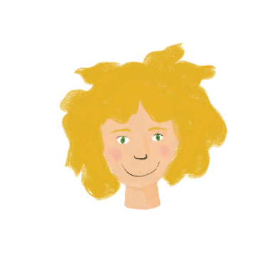
Léa a un message !
lire
Léa writes to Amir about what she has (I have - j’ai) and what he has (you have - tu as). Her computer has a bug! It deleted the pronouns: je/j’ (I) and tu (you). Write the items, in English, in the table. C’est qui – Léa ou Amir ?
1 | ai un vélo. | 4 | ai une voiture.
2 | as un ordinateur. | 5 | ai un portable.
3 | as un animal. | 6 | as une chambre.
Léa | Amir
a computer
a bike
a car
a pet
a bedroom
a phone
Notes:
Timing: 5 minutes
Aim: to connect the written form of the first and second person singular forms of avoir with their meanings.
Procedure:
Explain, if necessary, that Léa is writing about herself in the first person, whereas she is talking about Amir using the second person.
Students sketch a grid in their books with the column headers ‘Léa’ and ‘Amir’.
Students complete their tables by writing English nouns in the appropriate columns. Remind students that it is the form of the verb that will give them the necessary information. NB: masculine and feminine nouns are equally distributed between Léa and Amir to avoid any potential for the incorrect supposition at any point on the part of the student that the indefinite article is the key to the answer here.
Click for answers.

Slide 12
Asking questions
grammaire
Remember, to ask a question in French, raise the pitch of your voice at the end of a sentence:
Tu as un animal. You have a pet.
Tu as un animal ? Do you have a pet?
Tu as
Don’t say the final –s!
There is no phrase for ‘do you’ in French. We translate this with raised pitch.
Notes:
Timing: 2 minutes
Aim: Very quick listening and oral rehearsal to remind students about raised intonation and to increase confidence.
Procedure:
Provide a model for the students by reading out the French with a ‘flat intonation’ then with the raised intonation.
Ask the whole class to say this then to to repeat it to their partner.
Ask a few individuals to repeat it out loud to the class.
Remind the students – ‘do you’ is the way we ask questions in English - there is no way of saying ‘do you’ in French.

Slide 13
Statement or question?
écouter
Léa leaves Amir a voicemail. Is she telling Amir what he has, or asking him?
Statement
Question
Statement
Question
1
4
2
5
3
6
Notes:
Timing: 6 minutes
Aim: To determine whether utterances are statements or a questions, using the intonation alone.
Procedure:
Students write 1-6.
Click on a number to hear a sentence.
Students write whether what they hear is a question or a statement.
Click to check.
NB: For a more difficult task, the items can be played in a mixed order. Students then have to do TWO things: they have to (a) listen to intonation and connect it to a statement versus a question (b) listen to the noun and understand which image it belongs to.
The activity could be done twice: once with a lower cognitive load, where students just focus on the grammar (intonation functioning as a question) and again where they have to also focus on the meaning of the vocabulary.
Word frequencies of cognates used (1 is the most frequent word in French):
photo [1412]
Source: Londsale, D., & Le Bras, Y. (2009). A Frequency Dictionary of French: Core vocabulary for learners London: Routledge.
Transcript
Tu as un chien.
Tu as un livre ?
Tu as une règle.
Tu as une photo ?
Tu as un portable.
Tu as un ordinateur ?

Slide 14
Un dialogue français
lire
Voici un dialogue! Complète. Use each word only once!
Tu as ____________ ?
____ , c’est ______ !
Ah.
Mais j’ai _______ .
C’est ______ ?
- ____ !
oui
un vélo
cher
rapide
non
une voiture
Notes:
Timing: 5 minutes (two slides)
Aim: to use some of this week’s new words in context.
Procedure:
1. Check understanding of the blue words in the gap fill, introduced in weeks 7.1.1.1-7.1.1.3.
2. Students fill the gaps with words, paying attention to the context. NB: if students query why cher is not presented in the feminine form, explain briefly that this is a ‘standalone adjective’ referring to ‘owning a car’, rather than describing the car itself, but don’t labour the point.
3. A solution is provided on the next slide.
Word frequency (1 is the most frequent word in French): ah [1405]
Source: Londsale, D., & Le Bras, Y. (2009). A Frequency Dictionary of French: Core vocabulary for learners London: Routledge.

Slide 15
Un dialogue français
lire
parler
Une solution
Do you have a car?
- No, it’s expensive!
Ah.
- But I have a bike.
Is it fast?
- Yes!
T_ a_ u_ v_____e ?
- N_, c’__ ch____ !
Ah.
- M__ j’_ u_ v___.
C’__ r_____ ?
- O__ !
Tu as une voiture ?
- Non, c’est cher !
Ah.
- Mais j’ai un vélo.
C’est rapide ?
- Oui !
Notes:
Procedure: 1. Read through the suggested solution.
2. Click to ‘disappear’ the dialogue and bring up the gapped version.
3. Invite pupils to try to recall the dialogue in pairs.
4. Click to bring back the full dialogue for a moment.
5. Click to ‘disappear’ the dialogue again and bring up the English translation.
6. Invite pupils to try to recall the French dialogue again in pairs.
7. Click to bring back the full dialogue.

Slide 16
L’alphabet
écouter / parler
A
B
C
D
E
F
G
H
I
J
K
L
M
N
O
P
Q
R
S
T
U
V
W
X
Y
Z
Notes:
Timing: 5 minutes
Aim: To present and practise the names of the letters of the alphabet in French. As well as being of general use, e.g. to permit the giving/understanding of word spellings in the target language, this will facilitate entry into the Spelling Bee competition for those who wish to participate (see next slide but one for more details).
Procedure:
1. Click on the letter for audio.
2. Suggest a chant/song to help students memorise the alphabet. Teacher will lead first but after some practice, individuals can take on this role, or class can be split into two halves etc. Have fun with it.

Slide 17
L’alphabet
parler
 | A | B | C | D | E | F | G | H | I | J | K | L | M
R | c | n | z | k | v | g | r | d | o | a | l | l | j
S | d | o | a | l | w | h | s | e | p | b | m | x | u
T | e | p | b | m | x | i | t | f | q | c | n | i | f
U | f | r | c | n | y | j | u | g | r | d | o | t | q
V | g | s | d | o | z | k | v | h | s | e | p | e | c
W | h | t | e | p | a | l | w | i | t | f | q | p | n
X | i | u | f | q | b | m | x | j | u | g | r | b | z
Y | j | v | g | r | c | n | y | k | v | h | s | m | k
Z | k | w | h | s | d | o | z | l | w | i | t | y | a
Notes:
Timing: 5 minutes
Aim: Oral production of alphabet letter names.
Procedure
Students pair up.
Student A chooses grid coordinates (e.g. C, X) and student B says the letter at which those coordinates meet at (e.g. F).

Slide 18
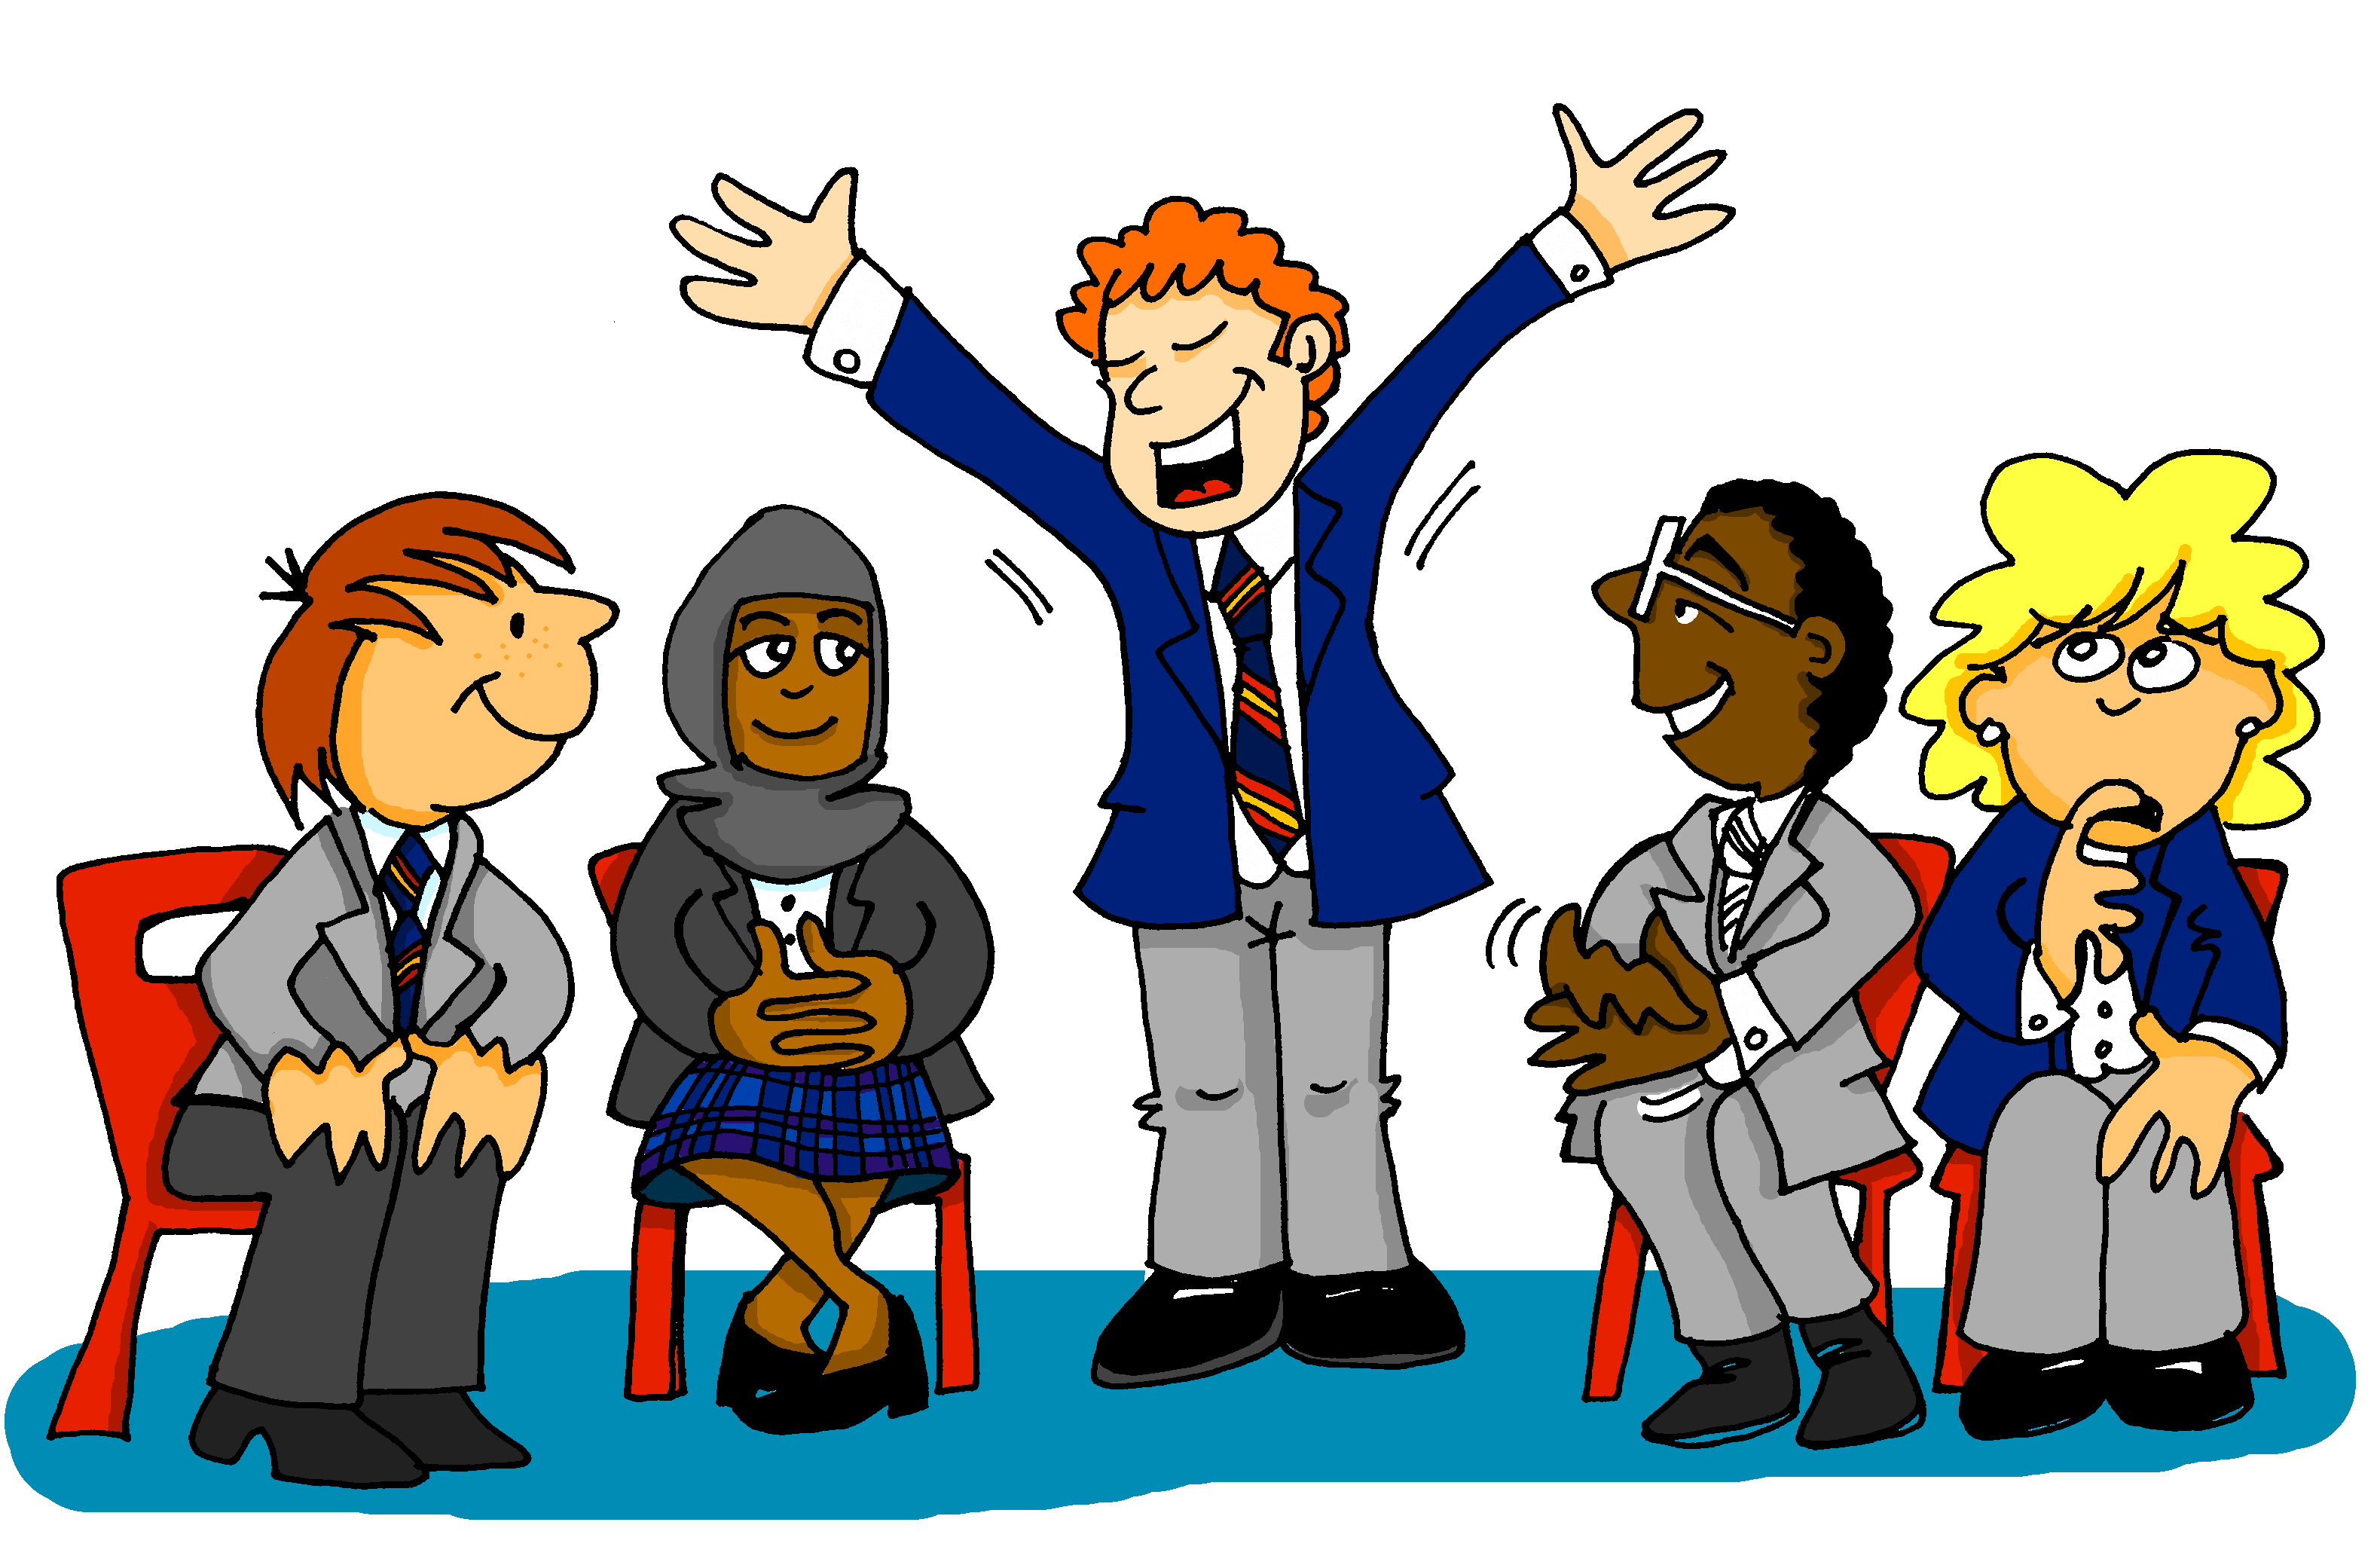
SPELLING BEE
Listen and write!
Notes:
Timing: 1 minute
Aim: to introduce the Foreign Language Spelling Bee, a national competition open to all schools in England. Procedure: 1. Tell students that they may want to put themselves forward for the Spelling Bee where they have to spell words aloud within a time limit.
2. Tell students that even if they don’t want to enter the competition, practising spelling words with a partner is fun and helps to speed up word retrieval, which you need for having conversations!

Slide 19
Comment ça s'écrit ?
écouter
Comment ça s'écrit ?
[How do you spell that?]
Notes:
Timing: 1 minute Aim: to introduce the phrase Comment ça s'écrit ?
Procedure: 1. Tell students that this phrase is a very important one to use in class when they want to check spellings with a teacher or classmate. 2. Click to hear and repeat the phrase several times.

Slide 20
Comment ça s'écrit ?
parler
a car - une voiture
English (m) - anglais
a bedroom - une chambre
and - et
to speak, speaking - parler
goodbye - au revoir
short (f) - petite
computer – un ordinateur
a dog - un chien
tall (m.) - grand
hello - bonjour
you are - tu es
I am - je suis
to read, reading - lire
Notes:
Timing: 5 minutes Aim: Recall and spelling of words learned so far.
Procedure:
Students pair up.
Click to reveal a known word.
Student A calls in English, Student B faces away from the board, translates the word into French (saying the article for nouns, but not spelling the article) and spells the word.
Student A says ‘oui’ or ‘non’.
Student B turns round to check.
Swap roles (either alternate words, or a column each).
NB: alternatively, students could just test each other on recall of the whole words, using the same slide (rather than spelling the words out). Lower proficiency learners will benefit from this additional vocabulary practice.

Slide 21
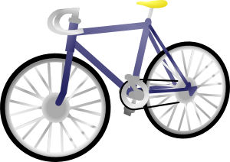
Identity: possessions
Describing what people have [2]
position of adjectives after nouns SSC [ou]
Y7 French Term 1.1 - Week 4 - Lesson 8 Stephen Owen / Rachel Hawkes / Catherine Morris
Artwork by: Chloé Motard
Date updated: 20.05.23
Notes:
Learning outcomes (lesson 2):
Introduction of SSC [ou]
Consolidation of first and third person singular forms of avoir
Introduction of second person singular form of avoir
Word frequency (1 is the most frequent word in French):
7.1.1.4 (introduce) frère [1043], sœur [1558], parent [546], ouvert [897], prudent [1529], strict [1859], jeune [152]
7.1.1.1 (revisit) être [5], es [5], suis [5], lire [278], écrire [382], écouter [429], parler [429], je [22], tu [112], anglais¹ [784], anglaise¹ [784], français¹ [251], française¹ [251], grand¹ [59], petit¹ [138], grande² [59], petite² [138], et [6], au revoir [1274], bonjour [1972]
Source: Londsale, D., & Le Bras, Y. (2009). A Frequency Dictionary of French: Core vocabulary for learners London: Routledge.
The additional English meanings of the following words have been added to Quizlet since the creation of this resource: voici, voilà: here is, this is, there is, there are

Slide 22
ou
nous
Notes:
Timing: 1 minute
Aim: To introduce SSC [ou]
Procedure: 1. Present the letter(s) and say the [ou] sound first, on its own. Students repeat it with you. 2. Bring up the word ”nous” on its own, say it, students repeat it, so that they have the opportunity to focus all of their attention on the connection between the written word and its sound.
3. A possible gesture for this would be to have both hands draw semi-circles out away from the body. Hands start by the sides of the body, circle swiftly outwards and join up again in front, indicating the inclusion of the self in a larger group. 4. Roll back the animations and work through 1-3 again, but this time, dropping your voice completely to listen carefully to the students saying the [ou] sound, pronouncing ”nous” and, if using, doing the gesture.
Word frequency (1 is the most frequent word in French):
nous [31]
Source: Londsale, D., & Le Bras, Y. (2009). A Frequency Dictionary of French: Core vocabulary for learners London: Routledge.

Slide 23
ou
nous
Notes:
With sound and no pictures to focus all attention on the sound-symbol correspondence.

Slide 24
ou
nous
Notes:
Without sound to elicit pronunciation (without first hearing the teacher).
Teacher to elicit pronunciation by asking “Comment dit-on …"

Slide 25
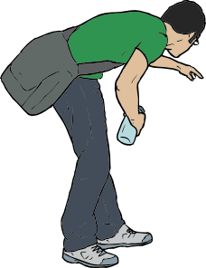
ou
trouver
jouer
Bonjour !
nous
douze
toujours
[always; still]
Notes:
Timing: 2 minutes
Aim: To introduce SSC [ou]
Procedure:
1. Introduce and elicit the pronunciation of the individual SSC [ou] and then the source word again ‘nous’ (with gesture, if using). 2. Then present and elicit the pronunciation of the five cluster words.
The cluster words have been chosen for their high-frequency, from a range of word classes, with the SSC (where possible) positioned within a variety of syllables within the words (e.g. initial, 2nd, final etc.). Additionally, we have tried to use words that build cumulatively on previously taught SSCs (see the Phonics Teaching Sequence document) and do not include new SSCs. Where new SSCs are used, they are often consonants which have a similar symbol-sound correspondence in English.
Word frequency (1 is the most frequent word in French): nous [31]; trouver [83] jouer [219]; bonjour [1972]; toujours [103]; douze [1664].
Source: Londsale, D., & Le Bras, Y. (2009). A Frequency Dictionary of French: Core vocabulary for learners London: Routledge.

Slide 26
ou
trouver
jouer
Bonjour !
nous
douze
toujours
Notes:
With sound and no pictures to focus all attention on the sound-symbol correspondence.

Slide 27
ou
trouver
jouer
Bonjour !
nous
douze
toujours
Notes:
Without sound to elicit pronunciation (without first hearing the teacher).
Teacher to elicit pronunciation by asking “Comment dit-on …"

Slide 28
Phonétique
couple
parler
pur
public
mesure
troupe
double
couleur
soupe
super
culture
adulte
touriste
groupe
stupide
nature
multiple
Notes:
Timing: 3 minutes
Aim: to practise production of SSC [u] and [ou]; to raise awareness of cross-linguistic pronunciation differences. Words chosen are cognates or near-cognates consisting of SSC [u] and [ou] and consonants which are equivalent or near-equivalent to the English SSC, purposefully chosen for unlearning the connection between the SSC and the English sound. The pronunciation of letters ‘u’ and ‘ou’ in the English translations of these words varies. Students should be made aware that as the pronunciation of [u] in French is consistent, SSC equivalence with English is variable – sometimes it will differ, sometimes it will be the same.
Procedure:
1. Students work in pairs, alternately saying one of the words, following the arrows from top to bottom and listening to spot errors in their partner’s pronunciation.
2. Students get one point for each correct French pronunciation of the SSC and lose a point if they say the English equivalent!
3. Click on the words to check pronunciation. Students repeat.
4. Go over the meaning of the words.
Word frequency (1 is the most frequent word in French): public [285], pur [1643], mesure [262], culture [993], super [2993], adulte [1580], multiple [2072], stupide [3407], nature [542] double [574], couple [1167], couleur [1211], soupe [4563], troupe [1282], groupe [187], courage [1431], touriste [6253], routine [3120]
Source: Londsale, D., & Le Bras, Y. (2009). A Frequency Dictionary of French: Core vocabulary for learners London: Routledge.

Slide 29
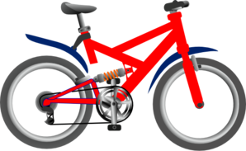
Vocabulaire (1/3)
parler 1/8
parler
5
Secondes
un ordinateur
un vélo
une voiture
0
DÉBUT
Notes:
Timing: 1 minute for three slides Aim: Productive (oral) recall of three words within a given time. This is slide 1/3.
Procedure:
1. Say all three words before three seconds elapse.
2. Click to reveal answers.
3. Repeat if additional practice needed.

Slide 30
Vocabulaire (2/3)
parler 1/8
parler
5
€1.000,000
[fast]
[here is/this is, there is/are]
expensive (m)
Secondes
rapide
voici
cher
0
DÉBUT
Notes:
[2/3]

Slide 31
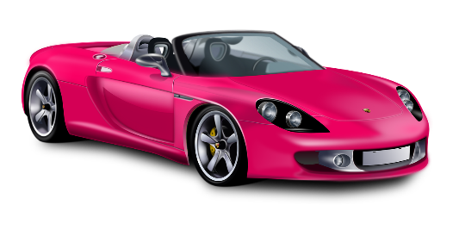
Vocabulaire (2/3)
parler 1/8
parler
5
€250.000,000
[modern]
expensive (f)
Secondes
moderne
un livre
chère
0
DÉBUT
Notes:
[3/3]

Slide 32
Révisions : être
parler 1/8
parler
Tu es Léa. C’est ‘je suis’ (Léa) ou ‘tu es’ (Amir) ?
1. Je suis française.
2. Je suis petite.
3. Tu es grand.
4. Je suis intelligente.
?
5. Je suis/tu es malade.
6. Tu es amusant.
7. Je suis /tu es calme.
8. Tu es content.
?
?
?
?
?
?
?
Notes:
Timing: 5 minutes
Aim: to revisit vocabulary introduced in week 7.1.1.1, combined with vocabulary introduced in later weeks. To revise adjective agreement rules in preparation for extending this knowledge to nouns in the slides that follow.
Procedure:
Check students understand the task instructions. Draw attention to SSC [é] in révisions.
Ask students where they need to look to find the solutions (the end of the adjective) because Léa is a girl and Amir is a boy. Alert them to the fact that sometimes it could be either, if the adjective already ends in an –e.
Students work with a partner or individually, saying each sentence in full.
Click to reveal the answers.
Elicit oral translations of each sentence.
Word frequency of near-cognates used in task instructions (1 is the most frequent word in French): révision (2748)
Source: Londsale, D., & Le Bras, Y. (2009). A Frequency Dictionary of French: Core vocabulary for learners London: Routledge.

Slide 33
Position of adjectives
grammaire
In English, adjectives come before the noun.
In French, they normally come after the noun.
un ordinateur cher an expensive computer
un vélo rapide a fast bike
un livre anglais an English book
une voiture française a French car
Notes:
Timing: 2 minutes
Aim: to highlight the difference between the positioning of adjectives in French and English. Procedure:
Present the new information.
Click to present four examples.
Elicit the English meaning from students each time, to practise comprehension of the different word order.

Slide 34
J’ai… ?
Écoute. Écris en anglais.
écouter
1
I have a modern car.
2
I have a fast computer.
3
I have a French thing.
4
I have an expensive bike.
Notes:
Timing: 5 minutes
Aim: Aural recognition of adjectives.
Procedure:
Students write 1-4 in their books.
Students write down the English for the noun and the adjective that they hear.
Check answers on the following slide.
Transcript
J’ai une voiture moderne.
J’ai un ordinateur rapide.
J’ai une chose française.
J’ai un vélo cher.

Slide 35
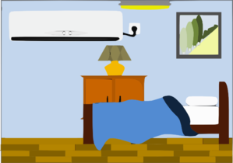
Un dialogue
parler
Partenaire A: Write down four things that you have, without your partner seeing.
Partenaire B: Ask your partner if they have four of these things. How many did you get? Then swap roles.
Notes:
Timing: 5 minutes
Aim: to practise spoken production of vocabulary and grammar learned this week.
Procedure:
Student As select four things and write them down – challenge them to write them down in French.
Student Bs look at the board and ask 4 questions. E.g., Tu as un livre ?
Student As answer Oui or Non.
Student B gets a point for each item he has guessed correctly.
Students swap roles.

Slide 36
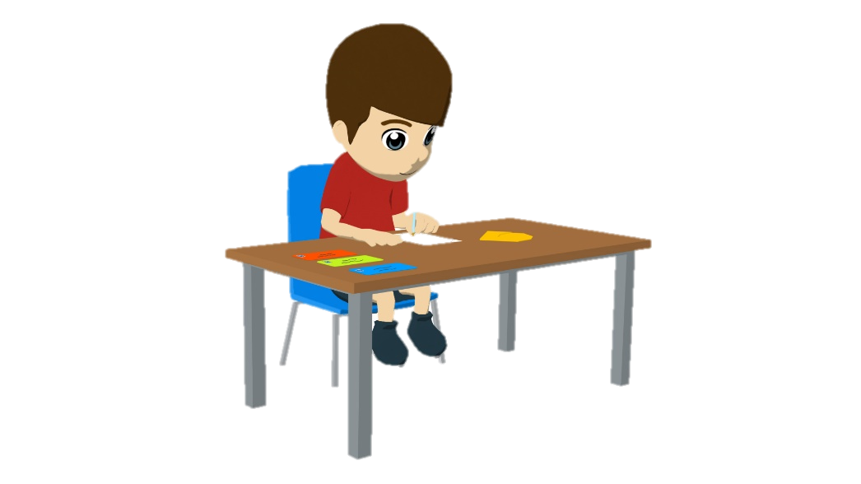
Écris !
écrire
1. I have a fast car.
Translate the sentences into French.
Remember to agree adjectives for feminine nouns
J’ ai une voiture rapide.
2. You have an expensive computer.
Tu as un ordinateur cher.
3. I have a modern bike.
J’ ai un vélo moderne.
4. You have an intelligent idea.
Tu as une idée intelligente.
Notes:
Note: In theory there is ample time for this longer written consolidation activity. In practice, if more time is needed, the lesson could finish here and this activity can be considered extension, or homework, or used as a starter to a future lesson.
Timing: 10 minutes
Aim: L1 > L2 translation exercise bringing together vocabulary and grammar structures practised in this and previous lessons (j’ai and tu as, vocabulary knowledge, order of nouns & adjectives, indefinite articles (un/une), adjective agreement).
Procedure:
1. Recap the grammar points outline above as ‘things to remember’ before students begin the task.
2. Ask students to translate the first two sentences. Give the them time and ensure these are done correctly before letting them do more.
3. Click to reveal answers.
4. Move on to the next slide which contains more challenging items.

Slide 37
Écris !
écrire
5. You have a fast car.
Translate the sentences into French.
Remember to agree adjectives for feminine nouns
Tu as une voiture rapide.
6. Do you have a modern bike?
Tu as un vélo moderne ?
7. I have an expensive computer.
J’ ai un ordinateur cher.
8. Do you have an intelligent idea?
Tu as une idée intelligente ?
Notes:
These are extension items which require learners to remember that ‘do you’ does not have a direct translation equivalent in French.
Learners are expected to simply put a question mark at the end of the sentence.

Slide 38
Devoirs
Vocabulary Learning Homework (Y7, Term 1.1, Week 5)
Audio file
Student worksheet
In addition, revisit: Term 1.1 Week 2
Notes:
Use this slide to set the homework.
For Y7, the typical homework will be to pre-learn vocabulary for the next lesson. There is an audio file to accompany the student worksheet.
Notes:
i) Teachers may, in addition, want to recommend use of a particular online app for the pre-learning of each week’s words. ii) Quizlet now requires parental involvement / registration / permissions for users below the age of 13, so it is perhaps most suitable for Y9 – 11 students. iii) Language Nut hosts LDP vocabulary lists and these are free for schools to use, though there is a registration process. One benefit is that all of the student tracking data that Language Nut offers are also available to schools that use the LDP lists for practice. Perhaps this makes it a good option for Y7/8.
iv) There are other free apps, and new ones are always appearing. Teachers have told us that they are currently using: Flippity, Wordwall (where using previously-created activities is free).
v) Gaming Grammar has been acquired by Language Nut. Its original content should still be available to teachers and much of it is appropriate for Y7 learners. For example, this lesson students could practise Indefinite articles: Gender (Article Agreement) and To have and to be: 1st person and 3rd person singular.

