Slide 1
Identity: description
Describing a person or a thing [1]
être (je, il, elle)
[i]
Y7 French
Term 1.1 - Week 1 - Lesson 3 Stephen Owen/Rachel Hawkes/Catherine Morris Artwork by: Chloé Motard Date updated: 20/05/23
Notes:
Note: all words (new and revisited) in this week of the SOW appear on all three GCSE wordlists, with the following exceptions: i) Edexcel and Eduqas lists do not have intelligent, méchant. (Intelligent may be used in the reading paper as a cognate).
Learning outcomes (lesson 2):
Introduction of SSC [eu]
Consolidation of regular adjective gender agreement – as complement to verb only
Introduction of intonation questions
Word frequency (1 is the most frequent word in French):
1.1.2 (consolidate) est [5], il [13], elle [38], amusant [4695], calme [1731], content [1841], intelligent [2509], malade [1066], méchant [3184], triste [1843], mais [30], ou [33], merci [1070]
Source: Londsale, D., & Le Bras, Y. (2009). A Frequency Dictionary of French: Core vocabulary for learners London: Routledge.

Slide 2
i
midi
Notes:
Timing: 1 minute
Aim: To introduce SSC [i]
Procedure: 1. Present the letter(s) and say the [i] sound first, on its own. Students repeat it with you. 2. Bring up the word ”midi” on its own, say it, students repeat it, so that they have the opportunity to focus all of their attention on the connection between the written word and its sound.
3. A possible gesture for this would be to draw a circle representing a clock face with one hand, with the other arm and hand pointing straight up (representing the hands on 12) within the circle. 4. Roll back the animations and work through 1-3 again, but this time, dropping your voice completely to listen carefully to the students saying the [i] sound, pronouncing ”midi” and, if using, doing the gesture.
Word frequency (1 is the most frequent word in French):
midi [2483].
Source: Londsale, D., & Le Bras, Y. (2009). A Frequency Dictionary of French: Core vocabulary for learners London: Routledge.

Slide 3
i
midi
Notes:
With sound and no pictures to focus all attention on the sound-symbol correspondence.

Slide 4
i
midi
Notes:
Without sound to elicit pronunciation (without first hearing the teacher).
Teacher to elicit pronunciation by asking “Comment dit-on …"

Slide 5
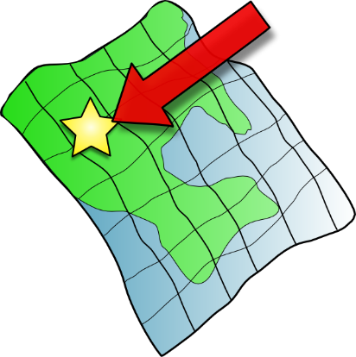
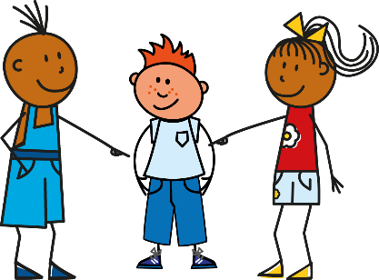
i
petit
lit
midi
ici
qui ?
il
?
Notes:
Timing: 2 minutes
Aim: To introduce SSC [i]
Procedure:
1. Introduce and elicit the pronunciation of the individual SSC [i] and then the source word again ‘midi’ (with gesture, if using). 2. Then present and elicit the pronunciation of the five cluster words.
The cluster words have been chosen for their high-frequency, from a range of word classes, with the SSC (where possible) positioned within a variety of syllables within the words (e.g. initial, 2nd, final etc.). Additionally, we have tried to use words that build cumulatively on previously taught SSCs (see the Phonics Teaching Sequence document) and do not include new SSCs. Where new SSCs are used, they are often consonants which have a similar symbol-sound correspondence in English.
Word frequency (1 is the most frequent word in French): midi [2483]; petit [138]; lit [1837] ici [167]; il[13]; qui [14]. Source: Londsale, D., & Le Bras, Y. (2009). A Frequency Dictionary of French: Core vocabulary for learners London: Routledge.

Slide 6
i
petit
lit
midi
ici
qui ?
il
Notes:
With sound and no pictures to focus all attention on the sound-symbol correspondence.

Slide 7
i
petit
lit
midi
ici
qui ?
il
Notes:
Without sound to elicit pronunciation (without first hearing the teacher).
Teacher to elicit pronunciation by asking “Comment dit-on …"

Slide 8
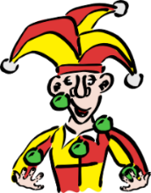
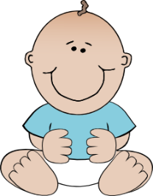
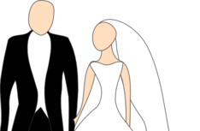
Phonétique
écouter
1
a) b) c)
innocent
3
a) b) c)
idée
2
a) b) c)
mari
4
a) b) c)
ville (town)
Notes:
Timing: 5 minutes
Aim: practicing aural recognition of SSC [i]
Procedure:
1. Click the numbers to play the audio. Tell students they are going to hear the letters ‘a’, ‘b’ and ‘c’ said in French.
2. Write 1-4 and choose if ‘a’, ‘b’ or ‘c’ is a word containing the SSC [i].
3. Click to reveal the answers.
Transcript:
a) innocent, b) méchant, c) amusant
a) jeune, b) mari, c) médecin
a) idée, b) étape, c) carré
a) égal, b) treize, c) ville
Word frequency (1 is the most frequent word in French): innocent [2059], méchant [3184], amusant [4695], jeune [152], mari [1589], médecin [827], idée [239], étape [1145], carré [3162], égal [1183], treize [3245], ville [260]
Source: Londsale, D., & Le Bras, Y. (2009). A Frequency Dictionary of French: Core vocabulary for learners London: Routledge.

Slide 9
Odd one out
lire
‘Grand’ is not a nationality.
‘Intelligent’ has a silent final consonant (SFC).
français | anglais | grand | française
triste | intelligent | malade | calme
contente | amusant | méchant | intelligente
mais | parler | lire | écouter
‘Méchant’ is a negative description.
The other words are verbs.
Notes:
Timing: 3 minutes
Aim: identifying connections between vocabulary items
Procedure:
Students identify which of the three words is the odd one out from each row.
Answers and justifications appear on clicks.

Slide 10
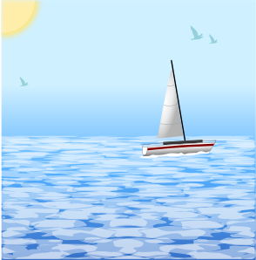
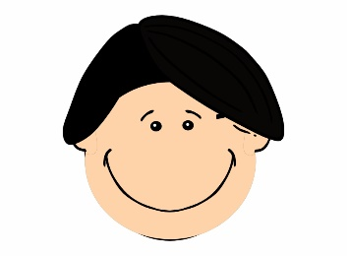
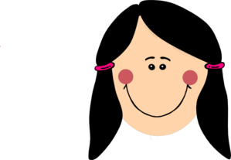
Vocabulaire
écouter
 | thank you | but
1
méchant
5
calme
anglais
il
2
6
il
merci
grand
3
merci
7
intelligent
intelligent
triste
4
8
triste
Notes:
Timing: 5 minutes
Aim: practising aural recognition of this week’s vocabulary
Procedure:
Click on a number to hear a word said out loud.
Students match what they hear with the image that best represents it.
On a click, a transcription is revealed. Students use this to check their answers.
Answer appears on a click.
At more advanced levels, ask students if they can recall the word that represents the other picture.
Ask students to identify which words contain the SSC [i].
Answers on clicks.
Transcript:
méchant
anglais
merci
intelligent
calme
il
grand
triste
Word frequency (1 is the most frequent word in French): méchant [3184], anglais [784], merci [1070], intelligent [2509], calme [1731], il [13], grand [59], triste [1843]
Source: Londsale, D., & Le Bras, Y. (2009). A Frequency Dictionary of French: Core vocabulary for learners London: Routledge.

Slide 11
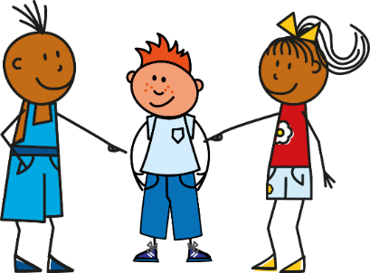
‘He is’ and ‘she is’
grammaire
As you know, je suis (I am) and tu es (you are) are parts of the verb être (to be).
To say ‘he is’, use il est. To say ‘she is’, use elle est.
Je suis
Il est
Elle est
Je suis malade.
Il est malade.
Elle est malade.
I am unwell.
He is unwell.
She is unwell.
Il est and elle est are the third person singular form of the verb être (to be).
Notes:
Timing: 3 minutes
Aim: to teach students the written and spoken forms of the verb être in the third person singular.
Procedure:
1. Read out the slide to the pupils, so that they are sure how to pronounce ‘suis’ and ‘est’.
2. Remind students about the ‘silent final consonant’ rule – we don’t pronounce the ‘s’ or the ‘t’ on the end of the verbs.
3. Remind students that ‘am’ and ‘is’ are part of the English verb ‘be’ – this is a very irregular verb in English! And it is irregular in French too!
4. Tell students, in this series of activities we will only use ‘il’ which means ‘he’.
5. We will practise the word for ‘she’ (elle) in later activities.

Slide 12
Écouter – je ou il?
écouter
You hear a man arguing with his partner about their dog! Bits of the conversation are not clear. Is the man talking about himself (‘I am …’) or about the dog (‘he is …’)?
1
4
2
5
3
6
Notes:
Timing: 6 minutes
Aim: to practise aural recognition of the third person singular form of être.
Procedure:
1. Click the numbers to play the audio with pronoun beeped out.
2. Write 1-6 and choose ‘I’ or ‘he’.
3. Click to reveal the answers.
4. Full audio (including pronoun) can be found on the next slide so that students can hear complete French sentences.
Transcript
[beep] est méchant.
[beep] suis amusant.
[beep] suis intelligent.
[beep] est stupide.
[beep] suis calme.
6) [beep] est content.
Note that all the adjectives are compatible with a male noun (the dog). This is so that we steer clear of adjectival agreement for now.
Word frequency of unknown cognates used (1 is the most frequent word in French): stupide [3407]
Source: Londsale, D., & Le Bras, Y. (2009). A Frequency Dictionary of French: Core vocabulary for learners London: Routledge.

Slide 13
Écouter – je ou il?
écouter
Now you can hear clearly again. Listen and say the English meaning for your friend who doesn’t know French.
1
He is naughty.
4
He is stupid.
2
I am fun/funny.
5
I am calm.
3
I am intelligent.
6
He is pleased.
Notes:
Timing: 2 minutes
Aim: to practise aural comprehension of this week’s language.
Procedure:
1. Click to listen. 2. Pupils say the English meaning out loud. 3. Click to confirm.
Transcript
Il est méchant.
Je suis amusant.
Je suis intelligent.
Il est stupide.
Je suis calme.
Il est content.
Word frequency of unknown cognates used (1 is the most frequent word in French): stupide [3407]
Source: Londsale, D., & Le Bras, Y. (2009). A Frequency Dictionary of French: Core vocabulary for learners London: Routledge.

Slide 14
Lire
lire
Cognates are words which share most of the same letters in two languages (e.g., English and French). Which cognates do you see here?
You are reading a blog. Some of the text has not downloaded properly. Is the person talking about himself or his ideal penfriend? Look carefully at the verb.
1 | đĦĦċđø est cool. |  |  | 5 | đĦĦċđø suis actif.
2 | đĦĦċđø est français. |  |  | 6 | đĦĦċđø est sportif.
3 | đĦĦċđø suis anglais. |  |  | 7 | đĦĦċđø suis triste.
4 | đĦĦċđø est intelligent. |  |  | 8 | đĦĦċđø suis amusant.
I
he
I
he
Notes:
Timing: 6 minutes
Aim: practising written recognition of the third person singular form of être.
Procedure:
1. Write 1-8 and choose ‘I’ or ‘he’.
2. Click to reveal answers.
3. Click to bring up the callout about cognates and elicit suggestions from students.
4. Click to reveal. Note: amusant (fun, funny) is only a cognate if you give the meaning ‘amusing’.
Word frequency of unknown cognates used (1 is the most frequent word in French): actif [1219] cool [>5000] sportif [2670] amusant [4695]
Source: Londsale, D., & Le Bras, Y. (2009). A Frequency Dictionary of French: Core vocabulary for learners London: Routledge.

Slide 15
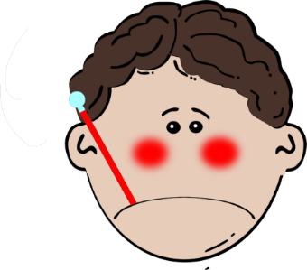
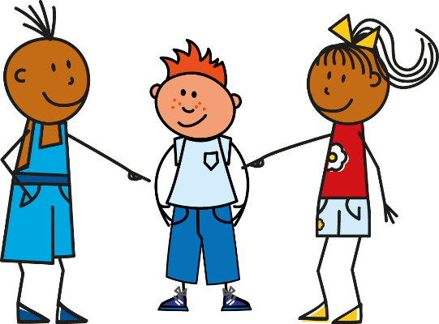
Écrire
écrire
Je suis triste.
Il est anglais.
Il est petit.
Il est malade.
Je suis français.
Je suis grand.
Notes:
Timing: 8 minutes
Aim: practising written production of the third person singular form of être
Procedure:
1. Each click produces a new combination of a pronoun (I or he) plus adjective.
2. Using mini whiteboards/paper as the teacher sees fit, students write each sentence that is generated after each click.
3. Feedback could be given after the first two or three to check that all learners are producing ‘je suis’ or ‘il est’ correctly.
4. NB Only ‘il est’ is practised here, to eliminate the need for adjective agreement to reduce cognitive load. Adjective agreement is practised as a separate teaching points in two sets of activities for Year7 Week 1 and Year 7 Week 2.

Slide 16
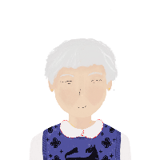
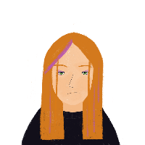
Identity: description
Describing a person or a thing [2]
regular adjective gender agreement intonation questions SSC [eu]
Y7 French
Term 1.1 - Week 1 - Lesson 4 Stephen Owen/Rachel Hawkes/Catherine Morris Artwork by: Chloé Motard Date updated: 20/05/23
Notes:
Learning outcomes (lesson 2):
Introduction of SSC [i]
Introduction of third person singular form of être
Word frequency (1 is the most frequent word in French):
1.1.2 (introduce) est [5], il [13], elle [38], amusant [4695], calme [1731], content [1841], intelligent [2509], malade [1066], méchant [3184], triste [1843], mais [30], ou [33], merci [1070]
Source: Londsale, D., & Le Bras, Y. (2009). A Frequency Dictionary of French: Core vocabulary for learners London: Routledge.

Slide 17
eu
deux
Notes:
Timing: 1 minute
Aim: To introduce SSC [eu]
Procedure: 1. Present the letter(s) and say the [eu] sound first, on its own. Students repeat it with you. 2. Bring up the word ”deux” on its own, say it, students repeat it, so that they have the opportunity to focus all of their attention on the connection between the written word and its sound.
3. A possible gesture for this would be to hold up two fingers (N.B. palm of the hand facing the class!). 4. Roll back the animations and work through 1-3 again, but this time, dropping your voice completely to listen carefully to the students saying the [eu] sound, pronouncing ”deux” and, if using, doing the gesture.
Word frequency (1 is the most frequent word in French):
deux [41].
Source: Londsale, D., & Le Bras, Y. (2009). A Frequency Dictionary of French: Core vocabulary for learners London: Routledge.

Slide 18
eu
deux
Notes:
With sound and no pictures to focus all attention on the sound-symbol correspondence.

Slide 19
eu
deux
Notes:
Without sound to elicit pronunciation (without first hearing the teacher).
Teacher to elicit pronunciation by asking “Comment dit-on …"

Slide 20
eu
jeudi
lieu
[place]
deux
feu
jeu
un peu
[a little]
Notes:
Timing: 2 minutes
Aim: To introduce SSC [eu]
Procedure:
1. Introduce and elicit the pronunciation of the individual SSC [eu] and then the source word again ‘deux’ (with gesture, if using). 2. Then present and elicit the pronunciation of the five cluster words.
The cluster words have been chosen for their high-frequency, from a range of word classes, with the SSC (where possible) positioned within a variety of syllables within the words (e.g. initial, 2nd, final etc.). Additionally, we have tried to use words that build cumulatively on previously taught SSCs (see the Phonics Teaching Sequence document) and do not include new SSCs. Where new SSCs are used, they are often consonants which have a similar symbol-sound correspondence in English.
Word frequency (1 is the most frequent word in French): deux {41]; jeudi[1112]; lieu [117] feu [786]; un peu [138/91]; jeu [291]. Source: Londsale, D., & Le Bras, Y. (2009). A Frequency Dictionary of French: Core vocabulary for learners London: Routledge.

Slide 21
eu
jeudi
lieu
deux
feu
jeu
un peu
Notes:
With sound and no pictures to focus all attention on the sound-symbol correspondence.

Slide 22
eu
jeudi
lieu
deux
feu
jeu
un peu
Notes:
Without sound to elicit pronunciation (without first hearing the teacher).
Teacher to elicit pronunciation by asking “Comment dit-on …"

Slide 23
Phonétique
écouter
Tally how many times you hear [eu] |  | Phrases
1
De nombreux animaux vivent à la ferme.
I
A lot of animals live at the farm.
2
IIII
Ceux qui font la queue sont heureux.
Those who queue are happy.
3
Il veut être courageux, mais c’est douteux.
III
He wants to be brave, but it’s doubtful.
Notes:
Timing: 2 minutes
Aim: practising recognition of SSC [eu]
Procedure:
1. Click the numbers to play the audio.
2. Students write 1-3 and tally how many times they hear the SSC [eu].
Transcript:
De nombreux animaux vivent à la ferme.
Ceux qui font la queue sont heureux.
Il veut être courageux, mais c’est douteux.
Word frequency (1 is the most frequent word in French): nombreux [366], animal [1002], celui [45], queue [3255], heureux [764], vouloir [57], courageux [2198], douteux [>5000]
Source: Londsale, D., & Le Bras, Y. (2009). A Frequency Dictionary of French: Core vocabulary for learners London: Routledge.

Slide 24
Vocabulaire
parler
intelligent
contente
calme
ou
triste
merci
glad, pleased (f)
mean (f)
intelligent (m)
she
he
or
but
calm, quiet
ill
sad
thank you
fun, funny
méchante
malade
amusant
elle
mais
il
Notes:
Timing: 2 minutes
Aim: to practise written recognition and read aloud of vocabulary from this the previous week.
Procedure: 1. Click for an English word to appear in the middle. Elicit the French translation from pupils. Emphasis here is on good pronunciation as well as finding the correct word.
2. Continue until all the words have been practised. 3. Elicit choral pronunciation of all words again, clicking to provide an emphasis animation. Encourage pupils to focus on pronunciation and avoid anglicism of the cognates.
24

Slide 25
Using adjectives
grammaire
Using adjectives
The spelling and sound of adjectives sometimes change in the feminine form.
The most common change is adding an ‘e’ to the end of the adjective. This does not happen if the masculine adjective already ends in –e.
Masculine
Il est triste.
He is sad.
Je suis petit.
I (a boy) am short.
Tu es anglais.
You (a boy) are English.
Feminine
Elle est triste.
She is sad.
Je suis petite.
I (a girl) am short.
Tu es anglaise.
You (a girl) are English.
Notes:
Timing: 1 minute
Aim: To revise regular adjective gender agreement and introduce the idea that adjectives ending in –e don’t change.
Teachers may wish to ask students if they can remember the rule before showing the text.
Teachers may wish to ask students which adjectives (of those they have learnt so far) will fall into this category and which won’t. By week 2 these are: grand, petit, français, anglais, content, méchant, amusant, intelligent. The three already ending in –e are: triste / calme / malade. You then may wish to flag up that we don’t need to practise these ones as they stay the same for feminine.

Slide 26
Using adjectives
grammaire
Pronunciation can change when adding an ‘e’ to an adjective in feminine form.
Remember the rule: Silent Final Consonant
Masculine
Il est intelligent.
Silent final consonant.
The ‘t’ is not pronounced.
An ‘e’ at the end, means you do pronounce the consonant.
Feminine
Elle est intelligente.
The ‘t’ is pronounced.
The ‘e’ is not pronounced.
Notes:
Timing: 1 minute
Aim: recapping pronunciation changes with regular adjective gender agreement
Teachers may wish to ask students how the adjectives will be pronounced, before the text appears.

Slide 27
Lire
lire
Léa is reading a book about Chloé (a girl) and Isaac (a boy). The book has been read so often that some of the text has worn away. Who is being described - Isaac (I) ou Chloé (C) ?
1 | grand |  |  | 5 | intelligente
2 | content |  |  | 6 | petite
3 | méchante |  |  | 7 | triste
I
C
I
C
Notes:
Timing: 5 minutes
Aim: practising written recognition of regular adjective gender agreement
Procedure:
1. Write 1-6 and choose ‘C’ for Chloé or ‘I’ for Isaac.
2. Click to reveal the answers.

Slide 28
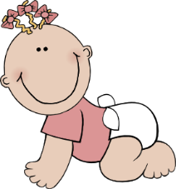
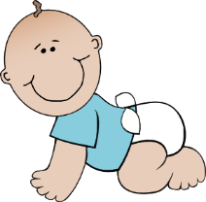
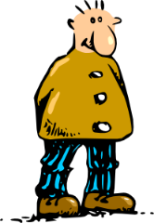
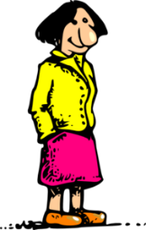
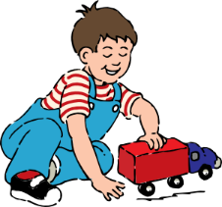
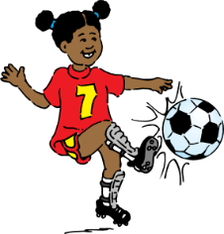
Écouter
écouter
Il ou elle ?
There is also an audio book. This chapter describes Chloé’s family. Some of the sound hasn’t downloaded properly. Who is being described – the male or the female?
1
4
2
5
3
6
Notes:
Timing: 5 minutes
Aim: practising aural recognition of regular adjective gender agreement
Procedure:
1. Click the numbers to play the audio.
2. Write 1-6 and choose ‘male’ or ‘female’.
3. Click to reveal the answers.
4. Full audio (including pronouns) can be found on the next slide so that students can hear complete French sentences.
Transcript
1) [beep] est petit
2) [beep] est grande
3) [beep] est amusant
4) [beep] est française
5) [beep] est contente
6) [beep] est anglais

Slide 29
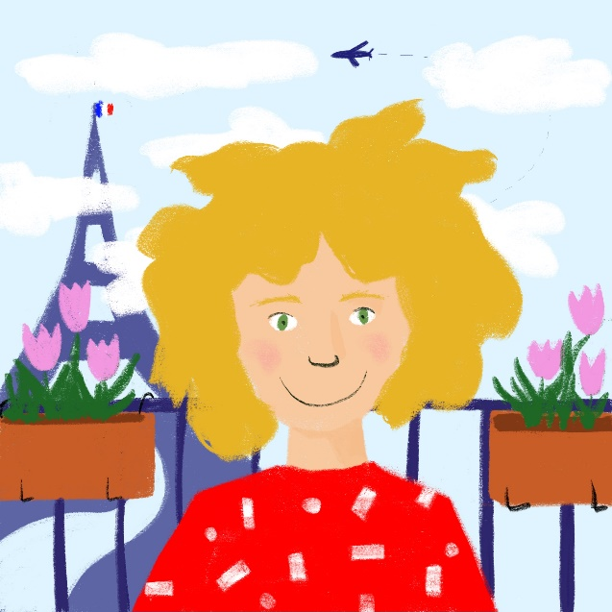
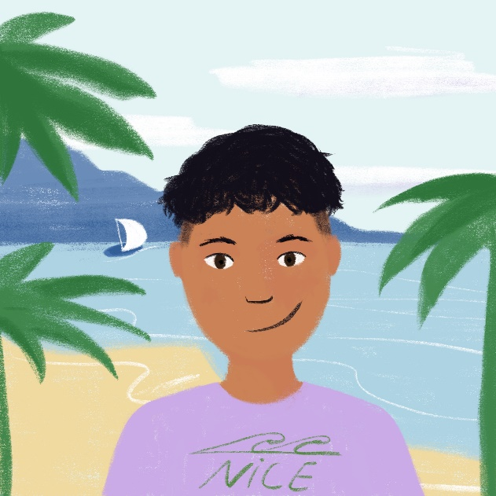
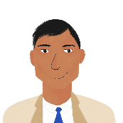
Il / elle est...
écrire
The following people are members of Léa and Amir’s families.
Use your imagination. Write four sentences describing four family members.
Remember:
Il = ‘he’
Elle = ‘she’
1 | Noura
2 | Romain
3 | Renée
4 | Bilal
5 | Elodie
6 | Abdel
e.g. 1) Elle est intelligente.
fun, funny
short
tall
French
English
ill
glad, pleased
mean, naughty
sad
Notes:
Timing: 8 minutes
Aim: practising written production of regular adjective gender agreement
Procedure:
Write 1-4 and write a sentence to describe each character using il or elle + adjective.

Slide 30
Asking questions
grammaire
To change a statement into a question, raise your voice at the end:
Elle est malade.
Statement
In French, we add a space before a question mark!
She is ill.
Elle est malade ?
Question
Is she ill?
Notes:
Timing: 1 minute
Aim: introducing intonation questions
Teachers will need to model raised intonation when introducing the question.

Slide 31
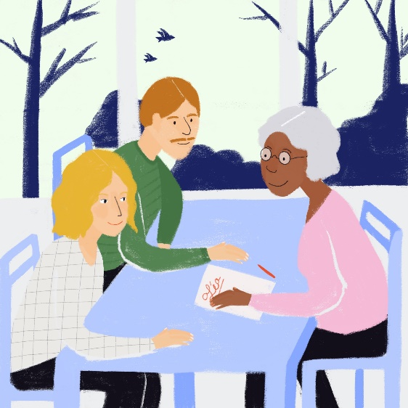
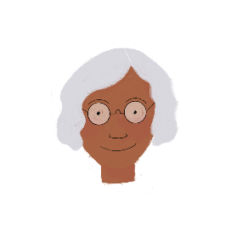
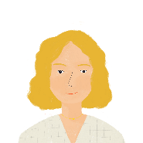
Réunion parents-professeurs !
écouter
It is parents’ evening! Léa’s mum is asking questions. Léa’s teacher answers. Who is talking? Write 1-8 and teacher OR mum ?
?
?
1
4
2
5
3
6
Notes:
Timing: 5 minutes
Aim: practising recognition of intonation questions
Procedure:
1. Students should try to work out the meaning of the title. They do not know these near cognates, but they should be encouraged to draw on their knowledge of English.
2. Write 1-6 and choose ‘teacher’ for a statement or ‘mum’ for a question.
3. Click to reveal the answers.
Transcript
Elle est intelligente
Elle est contente?
Elle est calme?
Elle est méchante
Elle est triste?
Elle est contente
Word frequency of unknown near-cognates used (1 is the most frequent word in French): réunion [971], parent [546], professeur [1150]
Source: Londsale, D., & Le Bras, Y. (2009). A Frequency Dictionary of French: Core vocabulary for learners London: Routledge

Slide 32
Who am I?
parler
Partner A
Partner B
Je suis (+ adjective)
Tu es (+ name) ?
Oui / Non
(Yes / No)
Notes:
Timing: 10 minutes
Aim: practising oral production of regular adjective agreement and yes/no intonation questions
Procedure:
Teachers may wish to use this slide to model/aid the instructions for the pair work before displaying the master, or print this out as a prompt for those pairs who need support.
Master – display this on the IWB whilst the speaking activity is taking place.
Players write down 6 names each, without letting their partner see. They imagine they are the person they have picked.
They give a sentence to describe themselves (I am …). e.g. ‘Je suis grand’. The other player has to identify who is being described.
Explain to the pupils that they have to pronounce the adjective correctly, with the correct ending, otherwise their partner cannot guess who they are.
Partner B looks at the master on the board and says ‘Tu es Marc ?’ with raised intonation.
Partner A would reply ‘Oui’ if correct or ‘Non’ if incorrect. Teachers may need to explain ‘oui’ and ‘non’ if some learners aren’t familiar with these words.
For each correct identification players could tally their scores.
The English adjective is given underneath so that students know which to use in case it is not obvious from the picture.

Slide 33
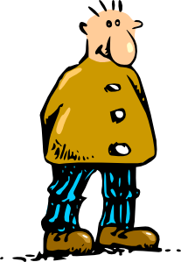
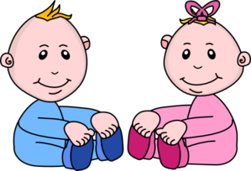
Who am I?
parler
Marc
Hélène
Clara
Philippe
(tall)
(tall)
(intelligent)
(intelligent)
Lucie
Pierre
Isaac
Emilie
(naughty)
(naughty)
(French)
(French)
Chloé
Luc
Oscar
Ella
(pleased)
(pleased)
(English)
(English)
Anna
Manon
Félix
Paul
Anna
(funny)
(funny)
(short)
(short)
Notes:
Procedure:
1. Master – display this on the IWB whilst the speaking activity is taking place.
2. Players write down 6 names each, without letting their partner see. They imagine they are the person they have picked.
3. They give a sentence to describe themselves (I am …). The other player has to identify who is being described.
4. Explain to the pupils that they have to pronounce the adjective correctly, with the correct ending, otherwise their partner cannot guess who they are.
5. The English adjective is given underneath so that students know which to use in case it is not obvious from the picture.

Slide 34
Devoirs
Vocabulary Learning Homework (Term 1.1, Week 3)
Audio file
Student worksheet
Notes:
Use this slide to set the homework.
For Y7, the typical homework will be to pre-learn vocabulary for the next lesson. There is an audio file to accompany the student worksheet.
Notes:
i) Teachers may, in addition, want to recommend use of a particular online app for the pre-learning of each week’s words. ii) Quizlet now requires parental involvement / registration / permissions for users below the age of 13, so it is perhaps most suitable for Y9 – 11 students. iii) Language Nut hosts LDP vocabulary lists and these are free for schools to use, though there is a registration process. One benefit is that all of the student tracking data that Language Nut offers are also available to schools that use the LDP lists for practice. Perhaps this makes it a good option for Y7/8.
iv) There are other free apps, and new ones are always appearing. Teachers have told us that they are currently using: Flippity, Wordwall (where using previously-created activities is free).
v) Gaming Grammar has been acquired by Language Nut. Its original content should still be available to teachers and much of it is appropriate for Y7 learners.

