Slide 1
Organising a surprise party
present tense -er/-ir verbs (-o, -es, -e)
verbs like conocer (c>zc)
direct object pronouns in one verb constructions
definite articles
Year 10 Term 1.1 Week 3 – Lesson 1
Louise Caruso / Amanda Izquierdo
Artwork: Mark Davies
Date updated 22/01/23
Notes:
All words from this lesson’s vocabulary are on the three AO GCSE wordlists, with the following exception(s): AQA: caber, mueble, luna, colocar Edexcel: aguantar, caber, salón, ¡Enhorabuena! mueble, volume, diseñar, ingeniero, luna, piedra, controlar, engañar, charlar, encender, colocar
Artwork by Mark Davies. All additional pictures selected are available under a Creative Commons license, no attribution required.
With thanks to Rachel Hawkes for her input on the lesson material and Jo Cairns for teacher feedback.
New grammar features:
word order of direct object pronouns in two verb constructions (e.g. quiere llamarlo)
Revisited grammar features:
object-first word order only
direct object 'lo', 'la', 'los', 'las'
present tense -er/-ir verbs in 1st, 2nd, 3rd person singular (-o, -es, -e)
direct object pronouns in one verb constructions (e.g. los llama)
modals querer, poder, deber, tener que, sé + infinitive
definite articles 'el' and 'la'
definite articles 'los' and 'las'
verbs like conocer (c>zc) (1st person singular)
adjective agreement
number agreement
position of adjectives in relation to the nouns they refer to: mostly after nouns
prenominal adjectives (e.g. primer, segundo)
position of adjectives and change of meaning (e.g. único)
Phonics: [z] and [co]
Word frequency (1 is the most frequent word in Spanish):
New vocabulary: aguantar [1879]; arreglar¹ (to tidy) [1314]; caber [1187]; letra² (lyrics) [977]; montón [1736]; salón [1722]; sorpresa [1295]; alto² (loud volume) [231]; bajo² (as 'low') [452]; ¡Enhorabuena! [>5000] (10) / H Only: agradecer [1428]; esquina [1536]; mueble [2342]; el volumen [1568] (4)
Spaced repetition: diseñar [2010]; espacio [451]; ingeniero [1937]; luna [1240]; piedra [774]; faltar [524]; amor [283]; aire [401]; ese [35]; esa [35]; esos, esas [35](12) / H only: controlar [1169]; engañar [1981]; responsable [649]; mover [467] (5)
Thematic revisited vocabulary: ventana [725]; bajar [484]; música [340]; cumpleaños [3372]; celebrar [886]; mesa [525]; plato [1808]; comida [906]; gente [137]; alto [231]; jardín [1195]; familia [233]; familiar (relative) [1922]; organizar [1053]; ofrecer [351]; invitar [820]; llamar [122]; venir [118]; comer [347]; beber [1085]; charlar [2968]; bailar [1323]; bebida [2787]; cosa [69]; papá [365]; único [213]; puerta [274]; suelo [552]; arroz [2882]; ligero [1930]; gato [1728]; reloj [1684]; compra [1662]; temprano [1578]; encender [1431]; vecino [808]; colocar [801]; mamá [375] (39) Revisited function words: el [1]; la [1]; lo [18]; la [61]; los [18]; las [61]; querer [58]; poder [32]; deber [71]; tener que [n/a]; conocer [128]; para [16]; pedir [217] (13)
Source: Davies, M. & Davies, K. (2018). A frequency dictionary of Spanish: Core vocabulary for learners (2nd ed.). Routledge: London
The frequency rankings for words that occur in this PowerPoint which have been previously introduced in NCELP resources are given in the NCELP SOW and in the resources that first introduced and formally re-visited those words.
For any other words that occur incidentally in this PowerPoint, frequency rankings will be provided in the notes field wherever possible.

Slide 2
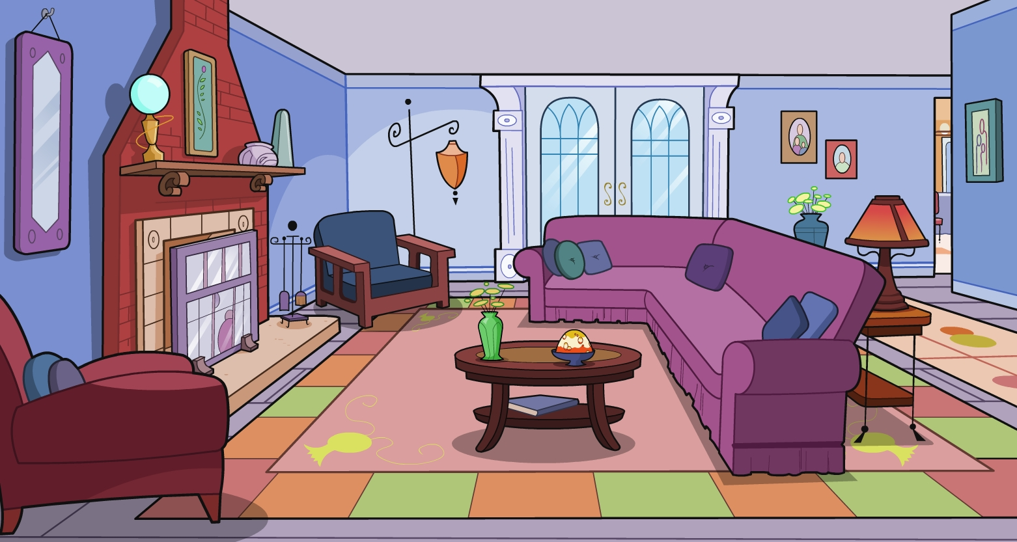
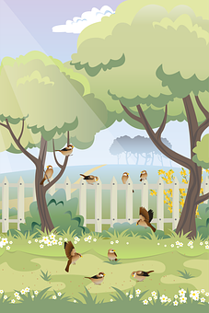
Vocabulario
1
1. Lucía y Daniel están en el s_____ .
2. En la pared hay una foto de m______ y ____.
2. Encima del sofá hay un g_____.
3. Detrás de la p______ puedo ver el j_____.
4. Daniel enciende la m______.
5. En la mesa hay un vaso con una b________.
¿Qué ves en la imagen?
Completa las frases de Lucía.
salón
mamá
papá
gato
puerta
jardín
música
fiesta
bebida
Notes:
[1/2]
Timing: 8 minutes
Aim:
revise this week’s revisited vocabulary sets.
provide students with example phrases for the last activity in lesson 3.
Procedure:
Students have to complete each phrase with words from the vocabulary list for this week.
Click to reveal the responses.
Students can be asked to name anything else in the room in Spanish.

Slide 3
Vocabulario
2
6. ¡Son las cinco! Sé la hora porque hay un r____.
7. Lucía lleva una f_____ negra.
8. Hay un libro en el s______.
9. En este momento organiza una fiesta de c__________.
10. Encima de la m_____ hay un p_____ amarillo con una *tarta muy a____.
¿Qué ves en la imagen?
Completa las frases de Lucía
reloj.
falda
suelo
cumpleaños
mesa
fiesta
plato
alta.
*tarta = cake
Notes:
[2/2]
Frequency of unknown vocabulary:
tarta [>5000]

Slide 4
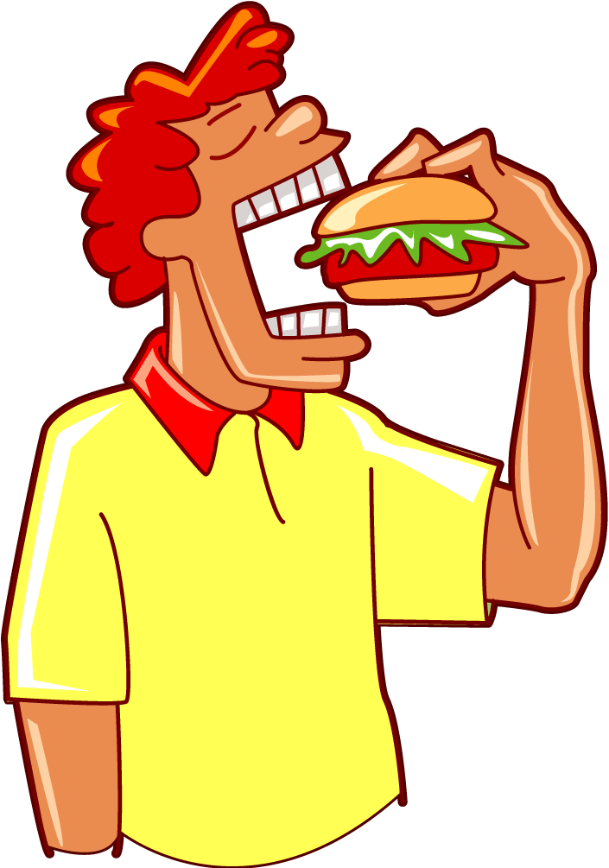
Talking about actions in the present Verb endings in singular for –er/-ir verbs
gramática
Remember that to form the present tense of verbs ending with -er, we take the following steps.
Infinitive
Remove -er
Add endings
comer
[to fit]
com-
yo: -o
tú: -es
él/ella: -e
como
comes
come
Present tense verbs in Spanish can refer to what normally happens, what’s happing now and sometimes future plans.
As well as changing the ending, encender has a e>ie spelling change in the 1st, 2nd,3rd person singular and 3rd person plural e.g.
yo enciendo
Tu enciendes
Él/ella enciende
Ellos/ellas encienden
Papá bebe una copa de vino.
Dad is drinking a glass of wine.
¿Ofreces una bebida a mamá?
Are you offering a glass to mum?
Si hay una fiesta, enciendo las luces del jardín.
If there’s a party, I switch on the garden lights.
Notes:
Timing: 2 minutes
Aim: To revise the formation of -ER verbs in the present tense.
Procedure:
Click to reveal the information.
Elicit English translations from students
Click to reveal answers.

Slide 5
Irregular verbs in the present -zco for verbs ending in –er/-ir
gramática
There are some verbs that end in –cer or –cir that have a spelling change in the 1st person singular. Conocer and conducir are two of these verbs.
To say ‘I know’ in Spanish, we say: conozco.
To say ‘I drive’ in Spanish we say: conduzco.
A ‘z’ is added before the ‘co’ to keep the soft ‘c’ sound in verbs ending in ‘-cer’ or ‘-cir’.
I thank everyone for coming to the party:
Agradezco
___________ a todos por venir a la fiesta.
(agradecer = to thank (H))
I recognise that neighbour (f):
Reconozco
(reconocer = to recognise)
___________ a esa vecina.
Notes:
Timing: 2 minutes
Aim: To revise the cer>zco spelling change for the 1st person singular present tense
Procedure:
Click to reveal the information.
Elicit English translations from students
Click to reveal answers.

Slide 6
El cumpleaños de Lucía
leer
Es el cumpleaños de Lucía y sus padres organizan una fiesta. Ana habla con Diego sobre las cosas que hacen normalmente en los cumpleaños.
Bebo unas copas de vino.
¿Las frases son verdaderas o falsas? | V | F
1. I hide the presents
2. You eat too many sweets.
3. He comes to visit Lucía.
4. I recognise her friends.
5. You put the music on in the living room.
6. You offer plates of food to the neighbour.
7. I drink some glasses of wine.
Enciendo la música en el salón.
Ana
Come demasiado dulces.
Escondes regalos por la casa.
Viene a visitar a Lucía.
Ofreces platos de comida al vecino.
Reconozco a sus amigos.
Diego
Notes:
Timing: 6 minutes
Aim: to recognise 1st, 2nd and 3rd present tense –er/-ir verb endings and associate them with the correct subject; to recognise ‘-zco’ as the 1st person present tense verb ending for verbs ending in -cer
Procedure:
Read Ana’s speech bubbles.
Note who the action is referring to in each one.
Read the phrases in English and tick either the true (V) or false (F) column according to whether the subject of the verb is correct or not.
Click to reveal responses,

Slide 7
Saying who or what receives the action Using the pronouns ‘lo’ and ‘la’ in one verb constructions
gramática
Use ‘lo’ to mean ‘him’ or ’it’ (for masculine objects) and ‘la’ to mean ‘her’ or ’it’ (for feminine objects). Remember that Spanish object pronouns go before the verb.
Arreglo el salón. →
I tidy up the living room.
Lo arreglo. →
I tidy it up.
Promete una sorpresa. →
S/he promises a surprise.
La promete. →
S/he promises it.
Notes:
Timing: 2 minutes
Aim: to revisit the use of singular object pronouns.
Procedure:
1. Go through the explanation with the students.
2. Elicit the English for the Spanish examples.

Slide 8
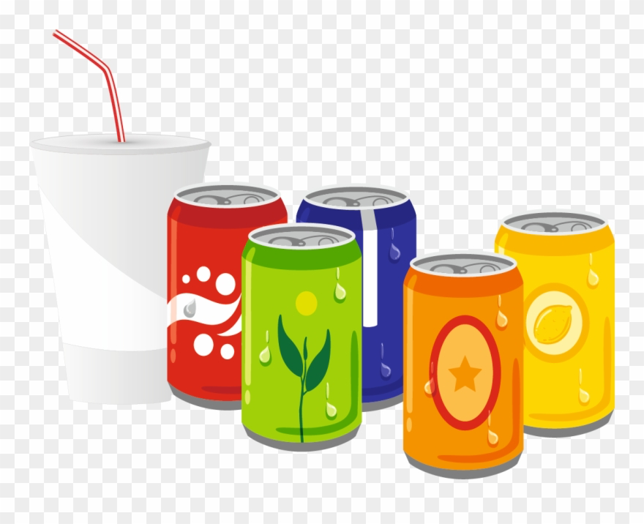
Durante la fiesta
Ana y Daniel hablan en la fiesta. Escucha las frases. ¿Cuál es el objeto directo en cada frase? ¿quién hace la acción?
leer
¿Quién?
Yo | Tú | Él/ella
*tarta = cake *postre=dessert *refresco = soft drink
1. | regalo (m) | b. sorpresa (f)
 | música (f) | b. chico (m)
 | tarta* (f) | b. postre* (m)
 | carne (f) | b. pescado (m)
 | novia (f) | chico (m)
 | comida (f) | dulce (m)
 | regalo (m) | puerta (f)
 | falda (f) | reloj (m)
 | pizza (f) | refresco* (m)
 | mueble (m) | comida (f)
 | mesa(f) | sofá (m)
1. Lo esconde detrás de la puerta.
1
2. No la reconozco.
2
3. ¿La ves allí?
3
4. No lo come.
4
5
5. No la conoces.
6
6. Lo comparte con la amiga.
7. ¿La abres por favor?
7
8. La recoge por la tarde.
8
9. La pido por teléfono.
9
10. Lo pone en el salón
10
11. Lo muevo mañana.
11
Notes:
Timing: 6 minutes
Aim: to associate masculine and feminine nouns with the correct direct object pronoun ‘lo’ or ‘la’.
Procedure:
Listen each phrase and select the correct word from the 2 options on the right according to the gender of the direct object pronoun.
Then, tick who does the action according to the verb ending.
Click to reveal answers.
Transcript:
1. Lo esconde detrás de la puerta.
2. No la reconozco
3. ¿La ves allí?
4. No lo come.
5. No la conoces.
6. Lo comparte con la amiga.
7. ¿La abres por favor?
8. La recoge por la tarde.
9. La pido por teléfono.
10. Lo pone en el salón
11. Lo muevo mañana.
Frequency of unknown words:
tarta [>5000]; postre [4499]; refresco [>5000]

Slide 9
Saying who or what receives the action Using the pronouns ‘los’ and ‘las’ in one verb constructions
gramática
Use ‘los’ to mean ‘them’ (for masculine objects) and ‘las’ to mean ‘them’ (for feminine objects). Remember that Spanish object pronouns go before the verb.
No aguanta a los vecinos. →
S/he can’t stand the neighbours.
No los aguanta. →
S/he can’t stand them.
Sirvo unas bebidas. →
I serve some drinks.
Las sirvo. →
I serve them.
Notes:
Timing: 2 minutes
Aim: to revisit the use of plural object pronouns.
Procedure:
1. Go through the explanation with the students.
2. Elicit the English for the Spanish examples.

Slide 10
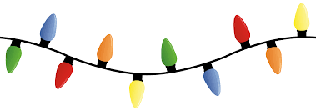
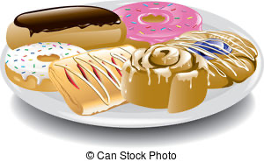
Lee las frases durante la fiesta. ¿De qué habla? Elige la palabra correcta.
escuchar
¡Atención! Hay una palabra extra que no necesitas
1. Las reparto con la comida.
bebidas
2. ¿No lo reconoces?
chico | letra | luces
amiga | bebidas | dulces
vino | volumen | platos
muebles | ventana | regalos
chico
3. Los abre con mucha alegría.
regalos
4. No, no lo bebo, gracias.
vino
5. No lo permite demasiado alto.
volumen
6. Si vamos al jardín, las enciendo.
luces
7. La sabe cantar muy bien.
letra
ventana
8. La abre porque hace calor.
9. ¿Quién los recoge ? Hay un montón sucios.
platos
amiga
10. La convence para ir a la fiesta.
muebles
11. ¿Dónde los muevo?
Notes:
Timing: 6 minutes
Aim: to recognise the meaning of phrases using –er/-ir verbs in present + direct object pronouns ‘lo’, ‘la’, ‘los’ and ‘las’.
Procedure:
Students readeach phrase and think about the meaning of the sentence. Students can be prompted to provide the meaning of each sentence in English.
Look at the 12 options on the right. Which word is the object of the sentence? It must fit both the grammar and meaning of the sentence.
Click to reveal the answers.
Notes:
1. Note that there is one more option than the number of sentences.

Slide 11
Naming things Using definite articles
gramática
Definite articles, el, la, los and las come before a noun.
Direct object pronouns, lo, la, los and las come before a verb.
El suelo →
The ground
Lo celebro →
I celebrate it
La falda →
The skirt
La llama →
S/he calls her
Las ventanas →
The windows
Los como →
I eat them
Los vecinos →
The neighbours
Las invitas →
You invite them
Notes:
Timing: 2 minutes
Aim: to compare and contrast the use of definite articles and direct object pronouns.
Procedure:
Click to show explanation
Elicit English translations of examples
Click to reveal answers.

Slide 12
¡Encuentra las frases!
*subrayada = underlined
leer
Hay seis frases donde la palabra subrayada* significa ‘them’. ¿Cuáles son?
los comes
las sorpresas
las invitas
las enciendo
los platos
los cumpleaños
las piedras
las comidas
las bebes
los diseña
las letras
las arreglas
Notes:
Timing: 4 minutes
Aim: to practise differentiation between ‘los’ and ‘las’ as direct object pronouns and ‘los’ and ‘las’ as definite articles.
Procedure:
Find all the phrases where the underlined word means ‘them’
Click to reveal responses and elicit the English translation from students.
Note:
1. This activity can be played as noughts and crosses in pairs, where students have to translate the phrase in English when they choose a square. It can also be a class game where volunteers/students are choose to pick one of the correct squares and avoid the crosses underneath.
Frequency of unknown vocabulary:
subrayar [2881]

Slide 13
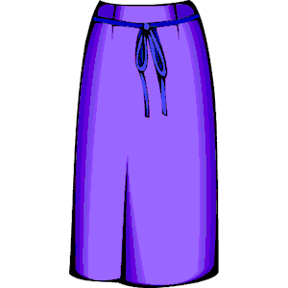
escribir / hablar
¿Qué es?
Mira los objetos y elige tres.
Escribe dos pistas* para cada objeto.
Debes usar el pronombre de objeto directo correcto.
Luego, lee las frases a tu pareja. Tu pareja debe adivinar* tus tres objetos.
¡Intenta escribir pistas* no demasiado fáciles!
*pista = clue
*adivinar = guess
Ejemplo:
La compro en una tienda.
La chica la usa en el colegio.
Estudiante A escribe tres frases y las lee a su pareja:
Estudiante B:
¿Es la falda?
La compro en una tienda.
La chica la usa en el colegio.
falda (f)
¡Sí!
Notes:
Timing: 10 min.
Aim: to practise producing and understanding sentences describing an object using direct object pronouns.
Procedure:
Students have to choose three out of the 10 objects in the next slide and write two clues for each of them using direct object pronouns.
The, students work in pairs. In each turn, student A reads out their 2 phrases whilst student B listens. Then, student B can have a guess. Studenty B can also try to translate the clues into English.
Teachers can walk around the classroom checking students’ phrases and interactions.
Then, students swap roles.
Frequency of unknown words:
pista [2150]; adivinar [2201]

Slide 14
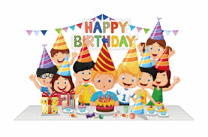
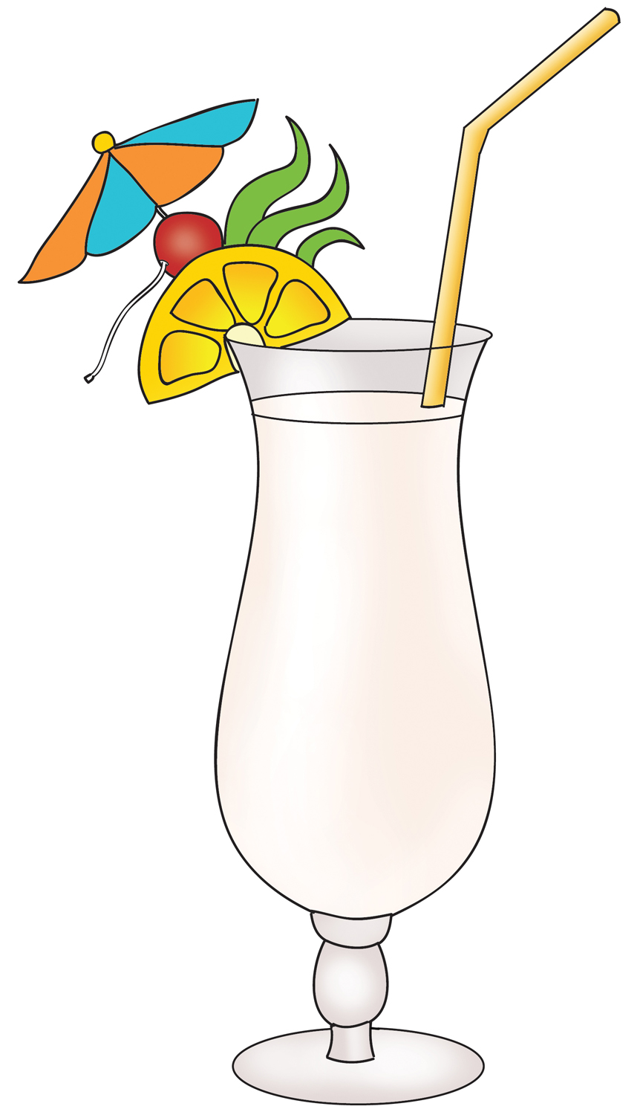
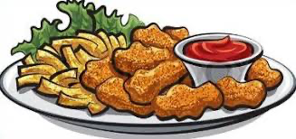
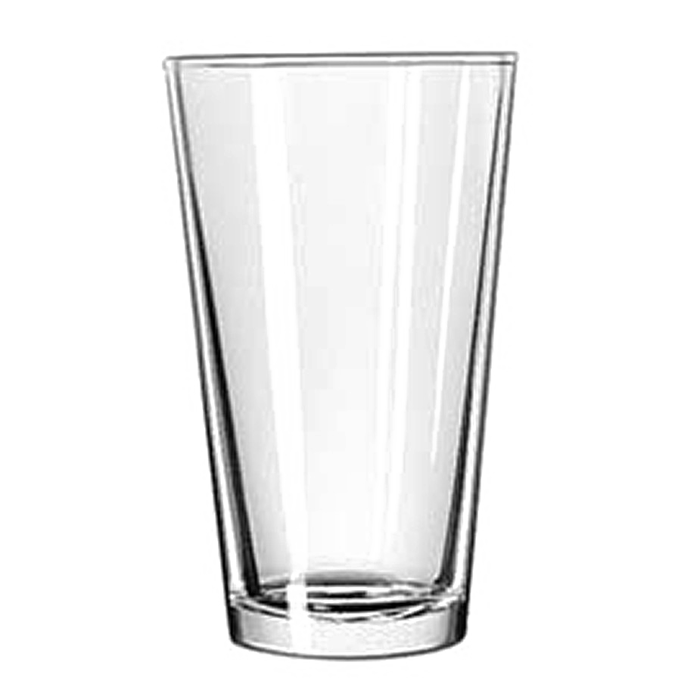
escribir / hablar
¿Qué es?
La compro en una tienda.
La chica la usa en el colegio.
Mira los objetos y elige tres.
falda (f)
Escribe dos pistas* para cada objeto.
Feminine singular direct object pronoun
Puedes usar estos verbos
*pista = clue
usar
abrir
encender
escuchar
comer
beber
ver
tomar
celebrar
disfrutar
cantar
ofrecer
poner
preparar
lavar…
bebidas (f)
fiesta (f)
cumpleaños (m)
música (f)
Celebro la vida…
letra (f)
platos (m)
comida (f)
reloj (m)
regalos (m)
fotos (f)
ventanas (f)
vasos (m)
Notes:
SHOW DURING ACTIVITY

Slide 15
At a birthday party I
modals querer, poder, deber, tener que, sé + infinitive
word order of direct object pronouns in two verb constructions
Year 10 Term 1.1 Week 3 – Lesson 2
Louise Caruso / Amanda Izquierdo
Artwork: Mark Davies
Date updated 22/01/23
Notes:
All words from this lesson’s vocabulary are on the three AO GCSE wordlists, with the following exception(s): AQA: caber, mueble, luna, colocar Edexcel: aguantar, caber, salón, ¡Enhorabuena! mueble, volume, diseñar, ingeniero, luna, piedra, controlar, engañar, charlar, encender, colocar
Artwork by Mark Davies. All additional pictures selected are available under a Creative Commons license, no attribution required.
With thanks to Rachel Hawkes for her input on the lesson material and Jo Cairns for teacher feedback.
New grammar features:
word order of direct object pronouns in two verb constructions (e.g. quiere llamarlo)
Revisited grammar features:
object-first word order only
direct object 'lo', 'la', 'los', 'las'
present tense -er/-ir verbs in 1st, 2nd, 3rd person singular (-o, -es, -e)
direct object pronouns in one verb constructions (e.g. los llama)
modals querer, poder, deber, tener que, sé + infinitive
definite articles 'el' and 'la'
definite articles 'los' and 'las'
verbs like conocer (c>zc) (1st person singular)
adjective agreement
number agreement
position of adjectives in relation to the nouns they refer to: mostly after nouns
prenominal adjectives (e.g. primer, segundo)
position of adjectives and change of meaning (e.g. único)
Phonics: [z] and [co]
Word frequency (1 is the most frequent word in Spanish):
New vocabulary: aguantar [1879]; arreglar¹ (to tidy) [1314]; caber [1187]; letra² (lyrics) [977]; montón [1736]; salón [1722]; sorpresa [1295]; alto² (loud volume) [231]; bajo² (as 'low') [452]; ¡Enhorabuena! [>5000] (10) / H Only: agradecer [1428]; esquina [1536]; mueble [2342]; el volumen [1568] (4)
Spaced repetition: diseñar [2010]; espacio [451]; ingeniero [1937]; luna [1240]; piedra [774]; faltar [524]; amor [283]; aire [401]; ese [35]; esa [35]; esos, esas [35](12) / H only: controlar [1169]; engañar [1981]; responsable [649]; mover [467] (5)
Thematic revisited vocabulary: ventana [725]; bajar [484]; música [340]; cumpleaños [3372]; celebrar [886]; mesa [525]; plato [1808]; comida [906]; gente [137]; alto [231]; jardín [1195]; familia [233]; familiar (relative) [1922]; organizar [1053]; ofrecer [351]; invitar [820]; llamar [122]; venir [118]; comer [347]; beber [1085]; charlar [2968]; bailar [1323]; bebida [2787]; cosa [69]; papá [365]; único [213]; puerta [274]; suelo [552]; arroz [2882]; ligero [1930]; gato [1728]; reloj [1684]; compra [1662]; temprano [1578]; encender [1431]; vecino [808]; colocar [801]; mamá [375] (39) Revisited function words: el [1]; la [1]; lo [18]; la [61]; los [18]; las [61]; querer [58]; poder [32]; deber [71]; tener que [n/a]; conocer [128]; para [16]; pedir [217] (13)
Source: Davies, M. & Davies, K. (2018). A frequency dictionary of Spanish: Core vocabulary for learners (2nd ed.). Routledge: London
The frequency rankings for words that occur in this PowerPoint which have been previously introduced in NCELP resources are given in the NCELP SOW and in the resources that first introduced and formally re-visited those words.
For any other words that occur incidentally in this PowerPoint, frequency rankings will be provided in the notes field wherever possible.

Slide 16
Un juego de palabras
¡Dobble es mi juego favorito!
leer
Una de las palabras en ‘A’ tiene la traducción en inglés en B. ¿Cuál es?
Si la encuentras, ¡grita la palabra!
A
B
un montón
mum
reloj
thing
to invite
faltar
papá
neighbour
bajar
music
jardín
food
bebo
watch
comemos
party
Notes:
Timing: 6 minutes (3 slides) Aim: to practise written recognition of most of this week’s new and all of this week’s revisited vocabulary. The time element facilitates automisation and fluency. Using a translation means students will have to process meanings rather than simply form spotting. Two versions are provided: a manual and a timed version. Procedure: 1. The circle on the left has eight Spanish words. One of the words has a translation in the English circle on the left. Students try to find the word as quickly as possible. And shout out the word when they have found it. First person to find and shout the word (or translation) gets a point.
2. When the correct word is found click the mouse to change the English words to the next set.
3. The Spanish words change after every four rounds. This change is signalled with a colour change on both circles.
4. Play until all cards have been done.

Slide 17
Vocabulario
leer/hablar
thing
to miss, missing
a lot
thing
door
engineer
light
low
people
to put up with, putting up with
those (f)
dad
engineer
people
Congratulations!
letra
early
vienes
único
to celebrate
arreglar
esas
party
thing
table
he/she/it speaks
early
a lot
encender
dad
music
door
to lower, lowering
window
those (f)
to miss, missing
he/she/it speaks
garden
to put up with, putting up with
low
to put up with, putting up with
moon
to turn on, turning on
window
presentar
window
party
suelo
I offer
puerta
bajar
aguantar
he/she/it speaks
watch
to lower, lowering
engineer
to design, designing
people
you come
watch
comida
to celebrate
early
falda
ground, floor
moon
temprano
love
piedra
organizar
espacio
to lower, lowering
love
diseñar
light
music
Congratulations!
thing
lyrics
lyrics
love
door
to miss, missing
party
you come
to celebrate
low
a lot
table
music
ground, floor
thing
el salón
ground, floor
alto
he/she/it speaks
invito
To lower, lowering
moon
lyrics
I offer
vecino
party
I offer
door
beber
I offer
table
to put up with, putting up with
low
food
to design, designing
mesa
you come
sorpresa
esa
those (f)
ground, floor
people
to put up with, putting up with
to design, designing
watch
watch
to celebrate
ofrezco
he/she/it speaks
food
a lot
ligero
food
garden
esos
window
garden
música
those (f)
to celebrate
party
you come
he/she/it speaks
window
watch
low
to miss, missing
ingeniero
to put up with, putting up with
bajo
low
you come
a lot
door
table
light
to turn on, turning on
to turn on, turning on
dad
door
garden
early
to lower, lowering
to turn on, turning on
loud
aire
love
to miss, missing
bailamos
moon
Congratulations!
garden
plato
engineer
moon
love
habla
dad
early
table
a lot
to miss, missing
lyrics
¡Enhorabuena!
to turn on, turning on
celebrar
cumpleaños
ventana
loud
compra
people
lyrics
garden
engineer
to design, designing
loud
watch
early
Congratulations!
moon
loud
to design, designing
light
to lower, lowering
amor
to turn on, turning on
loud
music
those (f)
window
to design, designing
food
I offer
people
music
ground, floor
ground, floor
dad
gato
thing
food
luna
Congratulations!
gente
to celebrate
party
Congratulations!
food
party
ese
I offer
llamar
caber
engineer
light
dad
table
lyrics
those (f)
light
love
loud
music
Notes:
Answers
Purple:
ingeniero/engineer
alto / loud
letra / lyrics
aguantar / to put up with, putting up with
Yellow:
ventana / window
bajar / to lower, lowering
luna / moon
diseñar / to designe, designing
Green:
amor / love
puerta / door
temprano / early
mesa / table
Blue:
habla / he/she/it speaks
gente / people
comida / food
encender / to turn on
Cream:
suelo / ground, floor
vienes / you come
celebrar / to celebrate
ligero, light
Grey:
¡Enhorabuena! / Congratulations!
ofrezco / I offer
bajo/ low
those (f) / esas

Slide 18
Modal verbs in singular forms ‘querer’, ’poder’, ‘deber’,‘tener que’
gramática
Remember that ‘querer’, ‘poder’ and ‘deber’ are all modal verbs and are often followed by the ’_________’.
Note that ‘querer’ has a e>ie spelling change.
infinitive
querer
To talk about what somebody wants to do, we use the verb ‘_______’.
Quiero invitar a mucha gente.
I want to invite lots of people.
‘poder’ has a u>ue spelling change.
poder
To talk about what somebody can do, we use the verb ‘______’.
Puedo bailar con esta música.
I can dance with this music.
deber
To talk about what somebody must (or has to) do, we use the verb ‘_______’.
Debo arreglar el salón.
e>ie spelling change, irregular in the 1st person.
I must tidy the living room.
To talk about what somebody must (or has to) do, we use the verb ‘__________’.
tener que
Tengo que hablar con el vecino.
I must talk to the neighbour.
Notes:
Timing: 2 minutes
Aim:
to recap the use of the modal verbs ‘querer’, ’poder’ and ‘deber’ in the 1st person singular (present tense).
Procedure:
Go through the grammar explanation with students, revealing each new sentence on a mouse click.
Elicit the English for the Spanish examples.

Slide 19
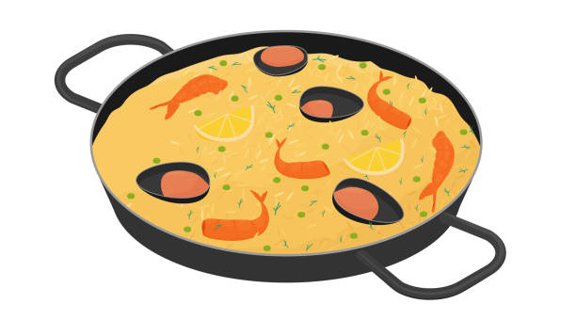
Talking about what skills Using the verb ‘saber’
gramática
Remember that the verb ‘saber’ means ‘to know’ or ‘to find out’. However, we use it with the infinitive to talk about skills.
The translation for ‘saber’ + infinitive is ‘can’, meaning ‘to know how to’ do something.
Sé cocinar platos españoles.
I can cook Spanish dishes
¿Sabes nadar?
Can you swim?
The structure ‘poder’ + infinitive can also be translated as ‘can’ + infinitive, but with the sense of ‘to be able to’.
I can sing / I know how to sing (meaning ‘I have the skill/I have learned’)
Sé cantar.
Puedo cantar.
I can sing / I am able to sing (meaning ‘I’m ready for it/I’m willing to do it’)
Notes:
Timing: 2 minutes
Aim: to recap the use of saber + infinitive and contrasting it with poder + infinitive
Procedure:
Go through the grammar explanation with students, revealing each new sentence on a mouse click.
Elicit the English for the Spanish examples.

Slide 20
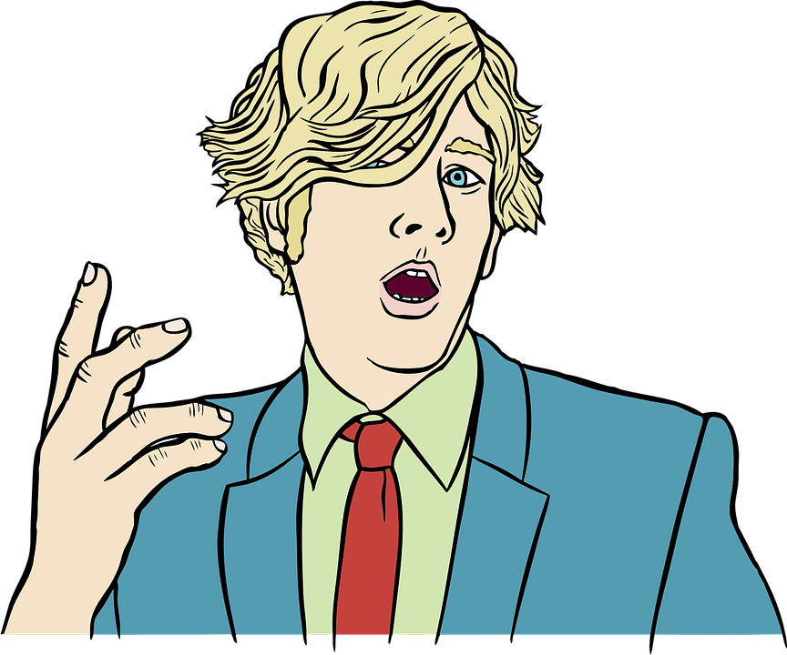
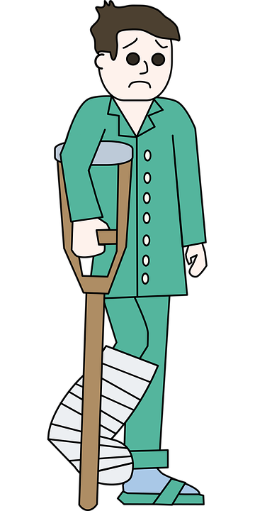
¿Saber o poder?
leer
Lee las siguientes frases. ¿Cuál es el significado de cada una?
Marca en la tabla.
Hallo!
1. Sé/puedo hablar alemán, lo aprendí en la escuela.
2. No sabe/puede nadar con la pierna rota.
3. Un profesor muy bueño le enseñó a tocar la guitarra. Puede/ Sabe tocar muy bien.
4. ¿Sabes/puedes conducir o bebiste demasido vino?
5. No puedes/ sabes usar la cámara de fotos durante el espectacúlo.
6. No sé/puedo dibujar gatos, es demasido difícil.
Notes:
Timing: 5 minutes
Aim: to learn how to make the distinction between ‘saber’ + infinitive and ‘poder’ + infinitive
Procedure:
Read each phrase and select the correct English meaning with a tick in the correct column.
Click to reveal the answers and elicit English translations from students.

Slide 21
En la fiesta
Lee algunos comentarios en la fiesta y completa la tabla:
leer
 | Modal verb / who? | action
1 |  | dance salsa
2 |  | hide the surprise
3 |  | thank my friends
4 |  | lower the volume
5 |  | put more food on the table
6 |  | switch on the karaoke
7 |  | try this dish
8 |  | bring the food
9 |  | drink a bit
¿Puedes traer la comida?
Tienes que probar este plato.
He knows how to
Debes colocar más comida en el salón.
He must
Debo esconder la sorpresa.
I want to
¿Sabes cantar? Puedo encender el karaoke.
I have to
Quiero agradecer a mis amigos.
You have to
I can
La música está muy alta. Tengo que bajar el volumen.
Quiere beber un poco.
You have to
Can you…?
¡Sabe bailar salsa!
He wants to
Notes:
Timing: 7 minutes
Aim: to practice recognising present tense modal verbs in their singular forms; to practise this week’s vocabulary in context
Procedure:
Read the speech bubbles.
Decide which line (1-9) from the table that this refers to.
Write in English the modal verb used in the same speech bubble in its correct form.
Click to reveal the answers.

Slide 22
Saying who or what receives the action Using direct object pronouns
gramática
Use ‘lo’ (for masculine objects) or ‘la’ (for feminine objects) to mean ‘it’.
Lo ofreces.
You offer it.
La comparte.
S/he shares it.
Use ‘los’ (for masculine objects) or ‘las’ (for feminine objects) to mean ‘them’. Remember that ‘los’ and ‘las’ also mean ‘the’, but only when they come before a noun.
Escondo los regalos. →
I hide the gifts.
Los escondo. →
I hide them.
Repartes las bebidas. →
You hand out the drinks.
Las repartes. →
You hand them out.
Notes:
Timing: 2 minutes
Aim: to recap the use of direct object pronouns
Procedure:
1. Go through the explanation with the students.
2. Elicit the English for the Spanish examples.

Slide 23
Saying who or what receives the action Using the pronouns ‘lo’, ‘la’, ‘los, ‘las’ in two verb constructions
gramática
In two verb constructions, object pronouns often go before the first verb. However, they can also go right after the infinitive, attached to it.
Debo traer los platos. →
I must bring the dishes.
Los debo traer. =
Debo traerlos. →
I must bring them.
Both options are correct!
Quiere organizar una actividad. →
S/he wants to organise an activity.
La quiere organizar.
= Quiere organizarla →
S/he wants to organise it.
Notes:
Timing: 1 minute
Aim: to introduce the use of singular and plural object pronouns in two verb constructions.
Procedure:
1. Go through the explanation with the students.
2. Elicit the English for the Spanish examples.

Slide 24
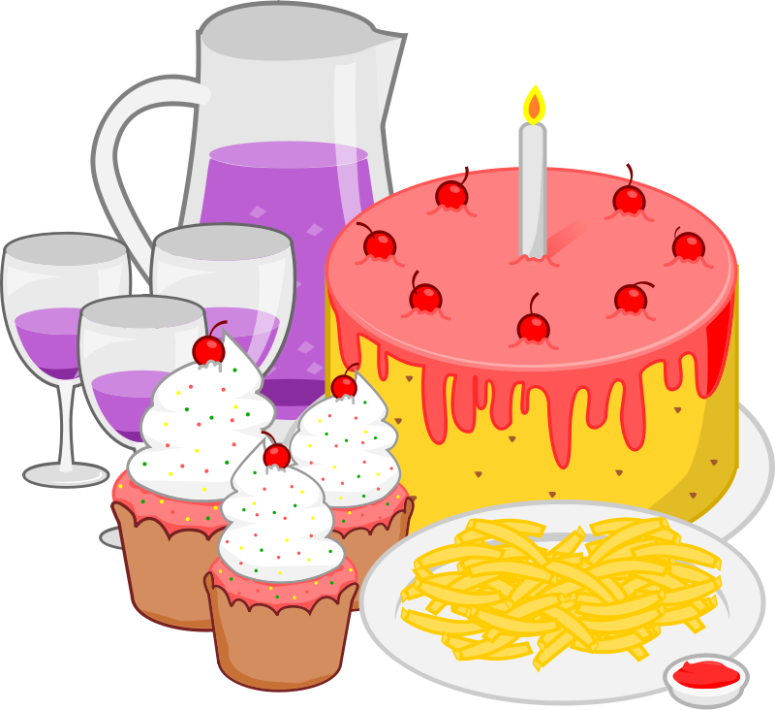
Lee las siguientes frases ¿Cuál es la opción correcta? ¿qué persona es? También debes decir cómo es en inglés.
leer
¿Qué?
¿Qué persona: ‘yo’, ‘tú’ o ‘él/ella’?
1. La sé cantar en inglés.
a) letra (f) b) cumpleaños feliz (m)
Yo
2. Debes invitarlas también.
a) amigos (m) b) amigas (f)
Tú
3. Quiere organizarlo ahora.
a) actividad (f) b) juego (m)
Él/ella
4. Lo tiene que arreglar después.
a) salón (m) b) habitación (f)
Él/ella
5. La debo esperar en el jardín.
a) abuela (f) b) abuelo (m)
Yo
6. Quiere ofrecerlos al final.
a) bebidas (f) b) helados (m)
Él/ella
7. Los tienes que colocar en el suelo.
a) cajas (f) b) regalos (m)
Tú
8. La puedo bajar.
a) música (f) b) volumen (m)
Yo
Notes:
Timing: 6 minutes
Aim: to distinguish between the use of different direct object pronouns according to gender and number; to recognise the subject of singular forms of modal verbs in the present tense
Procedure:
Read each sentence
Select which word is represented by the pronoun, according to the gender and number
For each phrase, write the subject in Spanish: ‘yo’, ‘tú’ o ‘él/ella’
Click to reveal the answers and elicit the English translations

Slide 25
Saying who or what receives the action Using the pronouns ‘lo’, ‘la’, ‘los, ‘las’ in two verb constructions
gramática
Remember that to use the verb in the negative form, the ‘no’ needs to go before the object pronoun:
¡No la puedo aguantar!
I can’t put up with it!
No quiero invitarlos.
I don’t what to invite them.
No la debo encender.
I mustn’t switch it on.
Notes:
Timing: 1 minute
Aim: to remind students of the word order when using verbs in the negative form with direct object pronouns
Procedure:
1. Go through the explanation with the students.
2. Elicit the English for the Spanish examples.

Slide 26
En la fiesta
Escucha algunas frases en la fiesta y marca en la tabla la persona correcta.
escuchar
Helen es una chica inglesa en la fiesta que no habla español. Escucha otra vez. ¿Puedes completar las frases en inglés para Helen?
 | Yo | Tú | Él / Ella
1
2
3
4
5
6
7
8
9
10
1
tidy
___ don’t want to ___________ it afterwards.
Can _____ _________ them now?
______ know how to __________ ____ !
____ must ______lose ____ .
______ _____ ____ take it out with the ________ .
___ _______ accompany _______ later.
_____ ________ record _____ with the phone.
____ ______ put _____ above the furniture.
_____ want to _____ _____ to chat for a while.
_____ ______ put it in the corner.
I
2
you
call
3
I
dance
it
4
S/he
not
it
5
You
have
to
drinks
6
I
can’t
them
7
You
must
it
8
S/he
can
it
9
I
call
them
10
You
can
Notes:
Note that there is a more challenging version of this activity on the following slide (where translations are not scaffolded).
Timing: 8 minutes
Aim: to practise aural recognition of singular forms of modal verbs in the present tense; direct object pronouns and this week’s vocabulary.
Procedure:
Listen to each phrase.
Select the subject of the verb according to the verb ending
Write the English translation.
Click to reveal the answers.
Notes:
1. Note that the last two include H vocabulary.
Transcript:
No lo quiero arreglar después.
¿Las puedes llamar ahora?
¡Sé bailarla!
No lo debe perder.
Tienes que sacarla con las bebidas.
No puedo acompañarlos más tarde.
¡Debes grabarlo con el móvil!
Lo puede poner encima del mueble.
Los quiero llamar para charlar un rato.
Puedes colocarla en la esquina.

Slide 27
En la fiesta
Escucha algunas frases en la fiesta y marca en la tabla la persona correcta.
escuchar
Helen es una chica inglesa en la fiesta que no habla español. Escucha otra vez. ¿Puedes completar las frases en inglés para Helen?
Higher
 | Yo | Tú | Él / Ella
1
2
3
4
5
6
7
8
9
10
1
1. I want to tidy it afterwards.
2
2. Can you call them now?
3
3. I know how to dance it!
4
4. S/he must not lose it.
5
5. You have to take it out with the drinks .
6
6. I can’t accompany them later.
7
7. You must record it with the phone.
8
8. S/he can put it above the furniture.
9
9. I want to call them to chat for a while.
10
10. You can put it in the corner.
Notes:
This is the more challenging version of the listening activity on the previous slide.
Timing: 7 minutes
Aim: to practise aural recognition of singular forms of modal verbs in the present tense; direct object pronouns and this week’s vocabulary.
Procedure:
Listen to each phrase.
Select the subject of the verb according to the verb ending
Complete the English translation for each phrase.
Click to reveal the answers.
Notes:
1. Note that the last two include H vocabulary.
Transcript:
No lo quiero arreglar después.
¿Las puedes llamar ahora?
¡Sé bailarla!
No lo debe perder.
Tienes que sacarla con las bebidas.
No puedo acompañarlos más tarde.
¡Debes grabarlo con el móvil!
Lo puede poner encima del mueble.
Los quiero llamar para charlar un rato
Puedes colocarla en la esquina.

Slide 28
Hablamos en la fiesta
escribir / hablar
El estudiante A y el estudiante B tienen una lista de 5 frases diferentes en inglés.
Cada estudiante escribe sus frases en español. Debe elegir una opción para cada frase.
Después, el estudiante A lee sus frases. El estudiante B debe escribir cada frase en inglés y decir qué opción es.
Remember pronouns can follow the infinitive.
Luego, hacemos un cambio.
Ejemplo:
Estudiante A :
Estudiante B :
Las debo ofrecer.
Debo ofrecerlas.
¿Las copas?
1. I must offer it/them.
1. I must offer it/them.
Sí.
Notes:
Timing: 10 minutes
Aim: to practise using direct object pronouns in two verb constructions in a spoken context.
Procedure:
Students are given 5 phrases each.
They choose an option from that board and translate their phrases into Spanish.
Students read their phrases to each other.
The person listening, notes down the phrase in English and says which of the pictures from the board they are talking about.
An answer slide follows this activity.

Slide 29
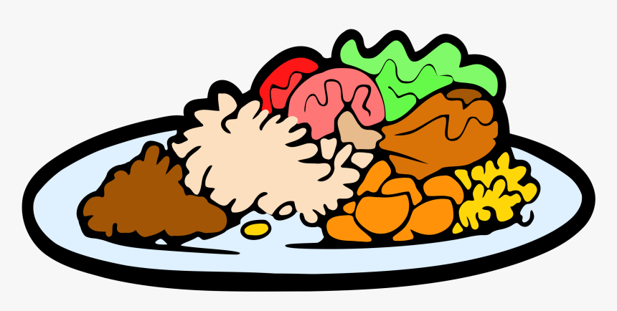
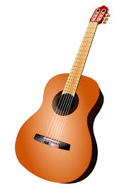
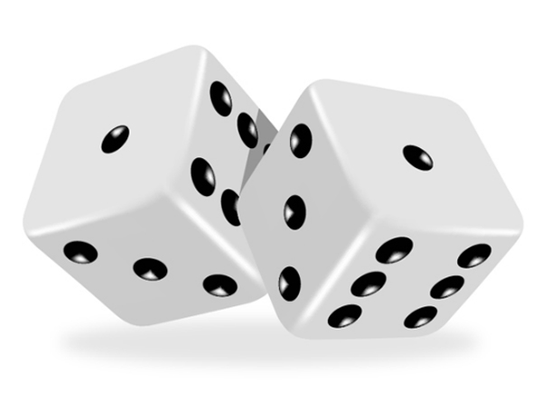
Elige una opción para cada frase
hablar
1
plato (m)
platos (m)
copa (f)
copas (f)
2
dulce (m)
dulces (m)
tarta (f)
tartas (f)
3
bebida (f)
bebidas (f)
café (m)
cafés (m)
4
regalo (m)
regalos (m)
guitarra (f)
guitarras (f)
5
fiesta (f)
fiestas (f)
juego (m)
juegos (m)
Notes:
TO DISPLAY ON THE BOARD DURING THE SPEAKING ACTIVITY

Slide 30
Tarjetas
Estudiante A
Estudiante B
A) Elige una opción.
B) Escribe las frases en español.
A) Elige una opción.
B) Escribe las frases en español.
1. You can offer it/them.
1. I have to wash it/them.
2. Do you want to put it/them on the table?
2. I want to eat it/them.
3. Can you share it/them out?
3. She must not drink it/them.
4. He has to bring it/them.
4. You have to buy it/them.
5. I must prepare it/them.
5. I can’t stand it/them.
Notes:
DO NOT DISPLAY DURING THE ACTIVITY

Slide 31
Tarjetas - RESPUESTAS
Estudiante A
1. You can offer it/them.
(Lo) puedes ofrecer(lo) – el plato (Los) puedes ofrecer(los) – los platos
(La) puedes ofrecer(la) – la copa (Las) puedes ofrecer(las) – las copas
2. I want to eat it/them.
(Lo) quiero comer(lo) – el dulce (Los) quiero comer(los) – los dulces (La) quiero comer(la) – la tarta (Las) quiero comer(las) – las tartas
3. Can you share it/them out?
¿(Lo) puedes compartir(lo)? – el café ¿(Los) puedes compartir(los)? – los cafés ¿(La) puedes compartir(la)? – la bebida ¿(Las) puedes compartir(las)? – las bebidas
4. He has to bring it/them.
(Lo) tiene que traer (lo) – el regalo (Los) tiene que traer(los) – los regalos (La) tiene que traer(la) – la guitarra (Las) tiene que traer(las) – las guitarras
5. I must prepare it/them.
(Lo) debo preparar(lo) – el juego (Los) debo preparar(los) – los juegos (La) debo preparar(la) – la fiesta (Las) debo preparar(las)? – las fiestas
Notes:
ANSWER SLIDE

Slide 32
Tarjetas - RESPUESTAS
Estudiante B
1. I have to wash it/them.
(Lo) tengo que lavar(lo) – el plato (Los) tengo que lavar(los) – los platos (La) tengo que lavar(la) – la copa (Las) tengo que lavar(las) – las copas
2. Do you want to put it/them on the table?
¿(Lo) quieres poner(lo) en la mesa? – el dulce ¿(La) quieres poner(la) en la mesa? – la tarta
¿(Los) quieres poner(los) en la mesa? – los dulces
¿(Las) quieres poner(las) en la mesa? – las tartas
3. She must not drink it/them.
No (lo) debe beber(lo) – el café No (los) debe beber(los) – los cafés No (la) debe beber(la) – la bebida No (las) debe beber(las) – las bebidas
4. You have to buy it/them.
(Lo) tienes que comprar (lo) – el regalo (Los) tienes que comprar (los) – los regalos (La) tiene que comprar(la) – la guitarra (Las) tienes que comprar(las) – las guitarras
5. I can’t stand it/them.
No (lo) puedo aguantar(lo) – el juego No (los) puedo aguantar(los) – los juegos No (la) puedo aguantar(la) – la fiesta. No (las) puedo aguantar(las)? – las fiestas
Notes:
ANSWER SLIDE

Slide 33
At a birthday party II
adjective and number agreement
position of adjectives / prenominal adjectives
position of adjectives and change of meaning
Year 10 Term 1.1 Week 3 – Lesson 3
Louise Caruso / Amanda Izquierdo
Artwork: Mark Davies
Date updated 22/01/23
Notes:
All words from this lesson’s vocabulary are on the three AO GCSE wordlists, with the following exception(s): AQA: caber, mueble, luna, colocar Edexcel: aguantar, caber, salón, ¡Enhorabuena! mueble, volume, diseñar, ingeniero, luna, piedra, controlar, engañar, charlar, encender, colocar
Artwork by Mark Davies. All additional pictures selected are available under a Creative Commons license, no attribution required.
With thanks to Rachel Hawkes for her input on the lesson material and Jo Cairns for teacher feedback.
New grammar features:
word order of direct object pronouns in two verb constructions (e.g. quiere llamarlo)
Revisited grammar features:
object-first word order only
direct object 'lo', 'la', 'los', 'las'
present tense -er/-ir verbs in 1st, 2nd, 3rd person singular (-o, -es, -e)
direct object pronouns in one verb constructions (e.g. los llama)
modals querer, poder, deber, tener que, sé + infinitive
definite articles 'el' and 'la'
definite articles 'los' and 'las'
verbs like conocer (c>zc) (1st person singular)
adjective agreement
number agreement
position of adjectives in relation to the nouns they refer to: mostly after nouns
prenominal adjectives (e.g. primer, segundo)
position of adjectives and change of meaning (e.g. único)
Phonics: [z] and [co]
Word frequency (1 is the most frequent word in Spanish):
New vocabulary: aguantar [1879]; arreglar¹ (to tidy) [1314]; caber [1187]; letra² (lyrics) [977]; montón [1736]; salón [1722]; sorpresa [1295]; alto² (loud volume) [231]; bajo² (as 'low') [452]; ¡Enhorabuena! [>5000] (10) / H Only: agradecer [1428]; esquina [1536]; mueble [2342]; el volumen [1568] (4)
Spaced repetition: diseñar [2010]; espacio [451]; ingeniero [1937]; luna [1240]; piedra [774]; faltar [524]; amor [283]; aire [401]; ese [35]; esa [35]; esos, esas [35](12) / H only: controlar [1169]; engañar [1981]; responsable [649]; mover [467] (5)
Thematic revisited vocabulary: ventana [725]; bajar [484]; música [340]; cumpleaños [3372]; celebrar [886]; mesa [525]; plato [1808]; comida [906]; gente [137]; alto [231]; jardín [1195]; familia [233]; familiar (relative) [1922]; organizar [1053]; ofrecer [351]; invitar [820]; llamar [122]; venir [118]; comer [347]; beber [1085]; charlar [2968]; bailar [1323]; bebida [2787]; cosa [69]; papá [365]; único [213]; puerta [274]; suelo [552]; arroz [2882]; ligero [1930]; gato [1728]; reloj [1684]; compra [1662]; temprano [1578]; encender [1431]; vecino [808]; colocar [801]; mamá [375] (39) Revisited function words: el [1]; la [1]; lo [18]; la [61]; los [18]; las [61]; querer [58]; poder [32]; deber [71]; tener que [n/a]; conocer [128]; para [16]; pedir [217] (13)
Source: Davies, M. & Davies, K. (2018). A frequency dictionary of Spanish: Core vocabulary for learners (2nd ed.). Routledge: London
The frequency rankings for words that occur in this PowerPoint which have been previously introduced in NCELP resources are given in the NCELP SOW and in the resources that first introduced and formally re-visited those words.
For any other words that occur incidentally in this PowerPoint, frequency rankings will be provided in the notes field wherever possible.

Slide 34
¡Encuentra el tesoro!
escribir
0
+5
+10
+15
+25
 | 1 | 2 | 3 | 4 | 5 | 6
A
B
C
D
E
un montón
arreglar
alto
engañar
bajo
floor
a lot of
to tidy
loud
to trick
low
suelo
aguantar
presentar
agradecer
bajar
amor
aire
to put up with
to introduce
to be grateful for
to lower
love
air
espacio
puerta
invitamos
responsable
piedra
space
door
moon
we invite
responsible
stone
luna
diseñan
esos ingenieros
¡Enhorabuena!
ese mueble
compra
esas cosas
they design
those engineers
congratulations!
that piece of furniture
shopping
those things
a light dish
she knows the lyric
un plato ligero
cabe en la esquina
mamá viene
mueve la mesa
me gusta esa falda
sabe la letra
it fits in the corner
mum is coming
he moves the table
I like that skirt
Notes:
Vocabulario Timing: 8 minutes Aim: This ‘treasure hunt’ activity revisits key vocabulary to consolidate knowledge (in the written modality). As well as meaning, the focus is on form and spelling. Procedure:
1. Work individually, in pairs or in small groups. Each row (A-E) represents one round. 2. Write 1-6 in exercise books or mini whiteboards, and write the Spanish for each number. 3. Click the red box to reveal and check answers. 4. Click the yellow box to reveal the points for each correct answer (these are randomly allocated for an element of chance) – tally the total.

Slide 35
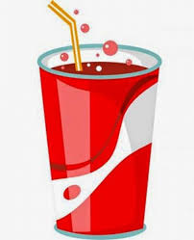
Tonguetwisters
hablar
Glossary
el refresco = soft drink
el frasco = jar
gigantesco = giant, gigantic
el marisco = seafood
británico = british
el almuerzo = lunch
Conozco al médico y le ofrezco un frasco* gigantesco* de marisco* fresco.
1
2
3
Desaparezco y conduzco a Cusco para tomar un refresco* con Francisco.
1
2
3
Crezco en Cuyocuyo y traduzco mucho para el chico británico* durante el almuerzo*.
1
2
3
Notes:
Tonguetwisters
Timing: 5 mins
Aim: to gain confidence in practising the SSCs [z] and [co] in sentences, particularly for verbs with ending –zco in first person singular.
Procedure:
The teacher first asks students to read each sentence and think about what they mean.
The teacher reads the sentences aloud in fragments, eliciting the meanings from students. Note that not all words have been previously taught.
Students then practise saying each sentence in pairs, at increasing speed.
The teacher can challenge students to listen to a native speaker read each sentence at three different speeds (1=slow; 3=very fast). Each time, students can be challenged to say it at the same speed.
Note:
Cusco and Cuyocuyo are both places in Peru.
Frequency of unknown/glossed words (1 is the most frequent word in Spanish):
el almuerzo [2887]; el frasco [4725]; el marisco [>5000]; el refresco [>5000]; británico [1227]; gigantesco [3250]

Slide 36
Describing people and objects Gender and number agreement
gramática
Remember that adjectives need to agree in gender and number with the noun that they describe.
la sorpresa divertida
las sorpresas divertidas
noun
adjective
noun
adjective
the fun surprise
the fun surprises
el chico alto
los chicos altos
noun
adjective
noun
adjective
the tall boy
the tall boys
Also, remember that in Spanish adjectives usually go after the noun.
Notes:
Timing: 1 minute
Aim: to recall the rule for using adjectives in Spanish
Procedure:
Click to reveal explanation and examples.
Elicit English and click to reveal the answers.

Slide 37
Una lista de objetos
escribir
Daniel tiene una lista de regalos de cumpleaños. ¿Puedes escribir los adjetivos en la forma correcta?
1. el reloj (red) =
rojo
6. la bolsa (light) =
ligera
2. los juegos (fun) =
divertidos
7. los pantalones (black) =
negros
3. el libro (new) =
nuevo
8. las camisas (white) =
blancas
4. la ropa (nice) =
bonita
9. la pelota (small) =
pequeña
5. la cámara (modern) =
moderna
10. el móvil (expensive) =
caro
Notes:
Timing: 4 minutes
Aim: to practise using adjectives with the correct ending, according to the gender and number of the noun
Procedure:
Read phrases 1-10.
Write the adjective in brackets in Spanish, using the correct ending according to the gender and number of the noun.
Click to reveal the answers.

Slide 38
Describing things Using prenominal adjectives
gramática
In Spanish, some adjectives can go before the noun.
el mismo regalo
the same gift
el primer plato
the first dish
la última bebida
the last drink
el segundo juego
the second game
su propio jardín
his/her own garden
el tercer premio
the third prize
Remember that some of these adjectives lose the –o ending before a singular masculine noun: primer, tercer, buen, mal.
Notes:
Timing: 1 minute
Aim: to recall prenominal adjectives
Procedure:
Click to reveal explanation and examples.
Elicit English and click to reveal the answers.

Slide 39
Describing things Change of meaning depending on position
gramática
The adjective ‘grande’ shortens to ‘gran’ before any singular noun.
el edificio grande
the big buiding
el gran edificio
the great building
Notice how the position changes the meaning of the adjective. This also happens with other adjectives.
the only food
the unique food
la única comida
la comida única
the poor people
(unfortunate)
la gente pobre
the poor (money)
la pobre gente
la casa vieja
the old (former) house
la vieja casa
the old (age) house
Notes:
Timing: 1 minute
Aim: to recall how the position of some adjectives can change their meaning.
Procedure:
Click to reveal explanation and examples.
Elicit English and click to reveal the answers.

Slide 40
Conversaciones en la fiesta
escuchar
Estas frases son parte de unas conversaciones. Escucha y marca en la tabla. ¿Cuál es la persona? ¿Cómo es en inglés?
 | Yo | Tú | Él/Ella | En inglés…
 |  |  |  | Brings the _______ game
 |  |  |  | Pick up the _______ _______.
 |  |  |  | Offer food to the _______ _______.
 |  |  |  | Gets the _______ chairs.
 |  |  |  | Give out the second _______.
 |  |  |  | Hide the _______ gift.
 |  |  |  | Shares his/her _______ _______.
 |  |  |  | _______ the same _______.
1
first
Remember, “dulce” can be used as a noun (m) or adjective.
Compare:
1. Me gustan los dulces.
I like sweets/sweet things.
2. Me gusta la comida dulce.
I like sweet food.
2
last
drinks
3
poor
cat
4
only
5
dish
6
third
7
own
sweets
8
Know
people
Notes:
Note that there is a Higher version of this activity on the following slide (where translations are not scaffolded).
Timing: 8 minutes
Aim: to practise recognition of –er/-ir endings and understanding the meaning of adjectives before and after the noun
Procedure:
Listen to the audio
Tick the subject of the verb according its ending
Complete the English translation
Click to reveal the answers. Subject ticks appear first then the gaps in the English translations, one at a time.
Finally, click to show a note about use of “dulce” as a noun or adj
Transcript:
Trae el primer juego.
Recoges las últimas bebidas.
Ofrezco comida al pobre gato.
Coge las únicas sillas.
Repartes el segundo plato.
Escondo el tercer regalo.
Comparte sus propios dulces.
Conozco a la misma gente.

Slide 41
Conversaciones en la fiesta
Higher
escuchar
Escucha estas frases. ¿Cuál es la persona? ¿Cómo es en inglés?
 | Yo | Tú | Él/Ella | En inglés…
1
Brings the first game.
Remember, “dulce” can be used as a noun (m) or adjective.
Compare:
1. Me gustan los dulces.
I like sweets/sweet things.
2. Me gusta la comida dulce.
I like sweet food.
2
Pick up the last drinks.
3
Offer food to the poor cat.
4
Gets the only chairs.
5
Give out the second dish.
6
Hide the third gift.
7
Shares his/her own sweets.
8
Know the same people.
Notes:
This is the Higher version of listening activity on the previous slide.
Timing: 8 minutes
Aim: to practise recognition of –er/-ir endings and understanding the meaning of adjectives before and after the noun
Procedure:
Listen to the audio
Tick the subject of the verb according its ending
Write the English translation
Click to reveal the answers. Subject ticks appear first then the gaps in the English translations, one at a time.
Finally, click to show a note about use of “dulce” as a noun or adj
Transcript:
Trae el primer juego.
Recoges las últimas bebidas.
Ofrezco comida al pobre gato.
Coge las únicas sillas.
Repartes el segundo plato.
Escondo el tercer regalo.
Comparte sus propios dulces.
Conozco a la misma gente.

Slide 42
Hablamos en la fiesta
*intercambiar = to exchange
escribir / hablar
¡Tienes 5 minutos para escribir frases sobre la imagen!
Un mínimo de dos frases debe tener un adjetivo.
Después trabajamos en parejas y los estudiantes intercambian* las frases.
Cada estudiante lee las frases de su compañero. ¿Es correcta? Entonces el estudiante gana un punto.
Ejemplo:
Estudiante A :
Estudiante B :
Daniel come un dulce rico.
El papá lleva una camisa blanca
1 punto
El papá lleva una camisa blanca.
Daniel come un dulce rico.
1 punto
Notes:
Timing: 10 minutes
Aim: to practise using adjectives and –ER/-IR verbs in the 3rd person singular present tense in a spoken context.
Procedure:
Students have to describe the image, mentioning what people are doing, and also describing objects. They have 5 minutes to write as many phrases as possible.
Then, students swap phrases with a partner. They have to read out and correct each other’s phrases.
Each correct sentence gets a point.
Frequency of unknown vocabulary:
intercambiar [3937]

Slide 43
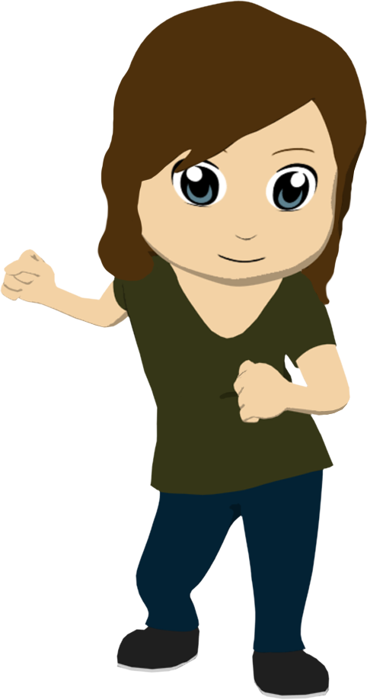
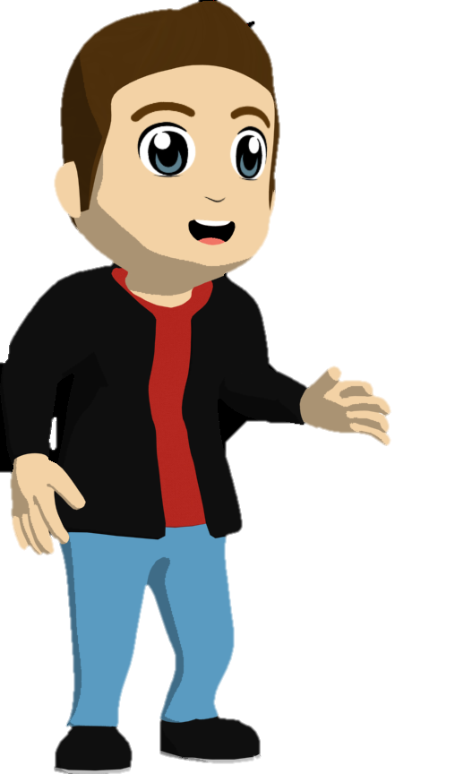
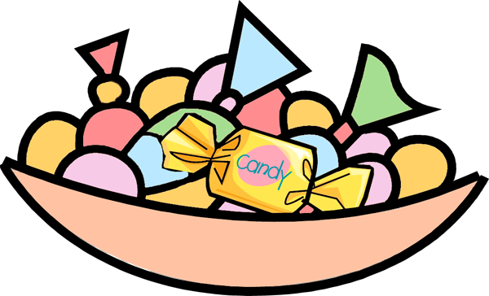
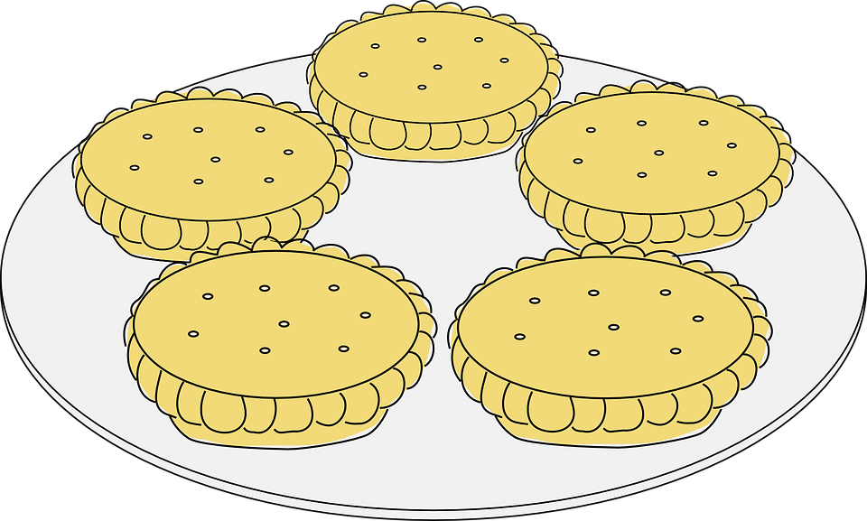
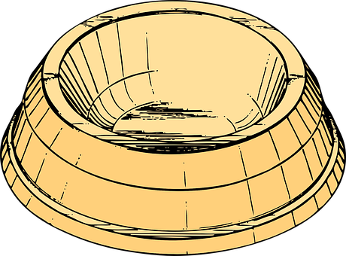
¿Cuántas frases sobre la imagen puedes escribir en 5 minutos?
escribir / hablar
¡Gracias!
Ana
Daniel
Lucía
Hugo
Nadia
grande | pequeño | primero | segundo | nuevo | blanco | negro | único | rico
español | moderno | hermoso | proprio | amarillo | limpio | ligero | pobre | último
Notes:
Timing: 12 minutes
Aim: to describe the image using verbs in the present tense and adjectives.
Procedure:
Students have to describe the image, mentioning what people are doing, and also describing objects. They have 5 minutes to write as many phrases as possible.
Then, students swap phrases with a partner. They have to read and correct each other’s phrases.
Each correct sentence gets a point.
Examples:
Daniel trae/lleva un regalo grande.
El volumen (H) de la música es muy alto.
Lucía abre su primer regalo.
Hugo le ofrece a Nadia un dulce.
Ana / la mamá (H) quiere bailar
Lucía es la única persona que lleva una falda
El gato pequeño come.
Ana tiene una bebida fresca/fría
Están celebrando el cumpleaños de Lucía
Es una fiesta en un salón grande
Hay un montón de regalos en el suelo
Nadia le responde a Hugo
El gato grande está cerca de la ventana/puerta
Hay dulces en la mesa
El mueble es moderno/viejo/antiguo/limpio
Lucía le agradece (H) a Daniel el regalo
El gato grande está en la esquina (H)
Lucía lleva una camisa amarilla
El gato grande es blanco y negro
La comida es rica
Hugo charla con Nadia (H)

Slide 44
Hablamos en la fiesta
escribir / hablar
Los estudiantes escriben cinco preguntas sobre las personas o los animales en la imagen.
Cada pregunta debe empezar con “¿Quién…?” y dos o más preguntas deben tener un adjetivo.
Después de cinco minutos, el estudiante B no puede mirar la imagen.
Entonces, el estudiante A hace las preguntas a estudiante B.
El estudiante B responde con una frase completa. Si es correcta, gana un punto.
Después de tres preguntas, hacen un cambio.
Ejemplo:
¿Quién come un dulce rico?
¿Quién lleva una camisa blanca?
Estudiante A :
Estudiante B :
¿Quién come un dulce rico?
¿Quién lleva una camisa blanca?
Lucía la lleva.
Daniel lo come.
1 punto
1 punto
Notes:
This is an alternative activity. It could also work well to follow on from the previous activity.
Timing: 10 minutes
Aim: to practise using adjectives, –ER/-IR verbs in the 3rd person singular present tense and direct object pronouns in a spoken context.
Procedure:
Students write 3 questions about the image, asking who is doing what. They have 5 minutes do so.
Then, the image disappears (teachers can return to this explanation slide to help students formulate their answers).
The students ask each other their questions and their partner answers in a full sentence, using a direct object pronoun where necessary.
Each correct sentence gets a point.

Slide 45
Describe la imagen
escribir / hablar
¡Gracias!
Ana
Daniel
Lucía
Hugo
Nadia
Notes:
Timing: 10 minutes
Aim: to practise using 3rd person singular present tense –ER verbs, adjectives and direct object pronouns.
Procedure:
Students have to describe the image, mentioning what people are doing, and also describing objects. They have 5 minutes to write as many phrases as possible.
Then, students swap phrases with a partner. They have to read and correct each other’s phrases.
Each correct sentence gets a point.
Examples:
¿Quién abre su primer regalo? Lucía la abre.
¿Quién trae un regalo grande? Daniel lo trae
¿Quién reparte los dulces? Hugo los reparte
¿Quién es la única persona que tiene la copa llena? Nadia es la única persona que tiene la copa llena.
¿Quién come? El gato pequeño come.
¿Quién recibe un regalo único? Lucía lo recibe.
¿Quién mira los dulces? Nadia los mira
¿Quién quiere ir en el jardín? El gato blanco y negro quiere ir en el jardín.
¿Quién responde a Hugo? Nadia responde a Hugo.
¿Quién bebe una bebida fresca? Ana la bebe.

Slide 46
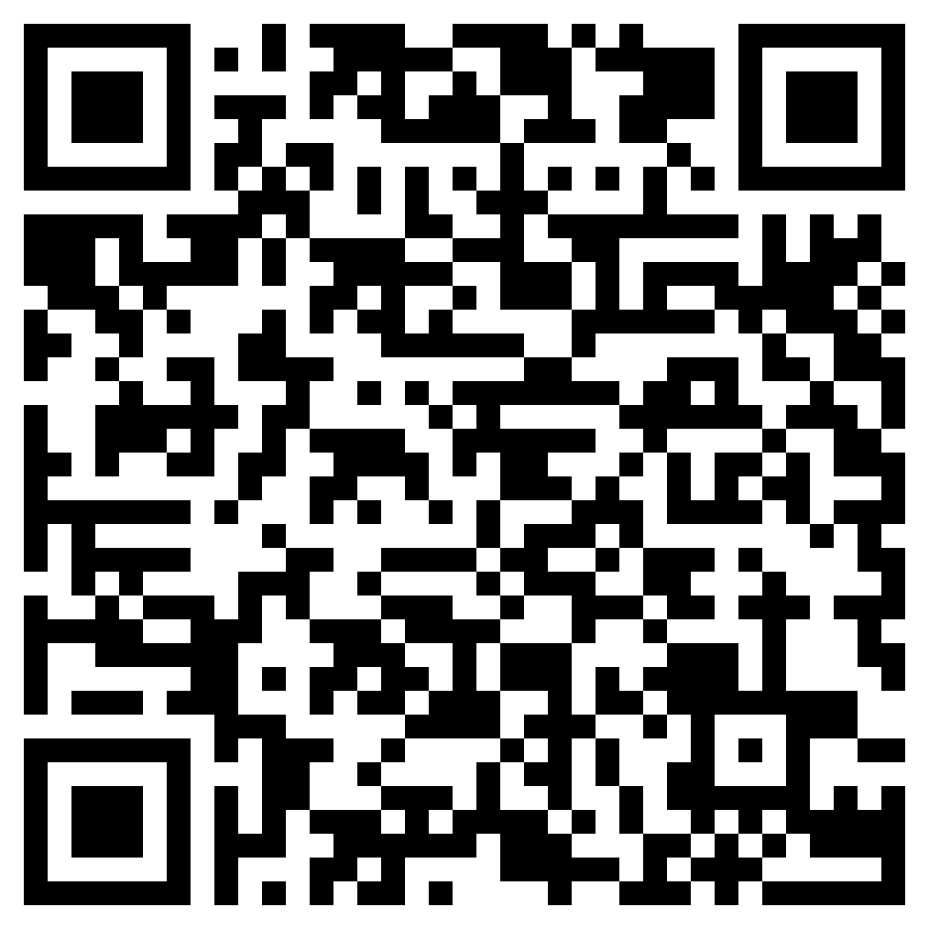
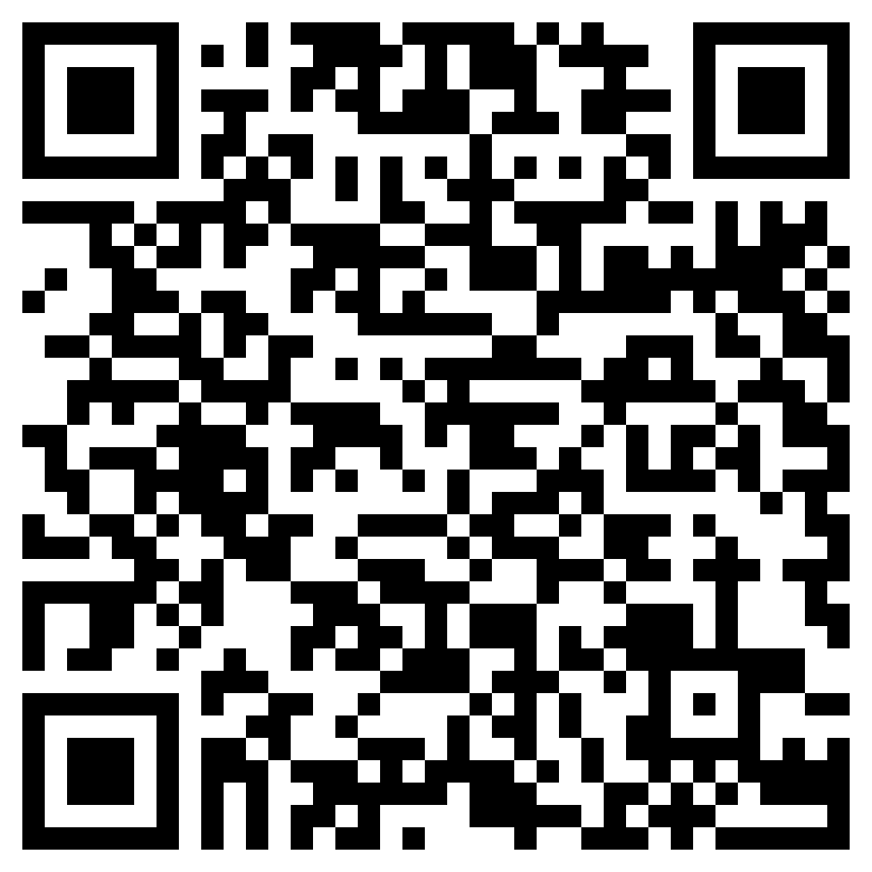
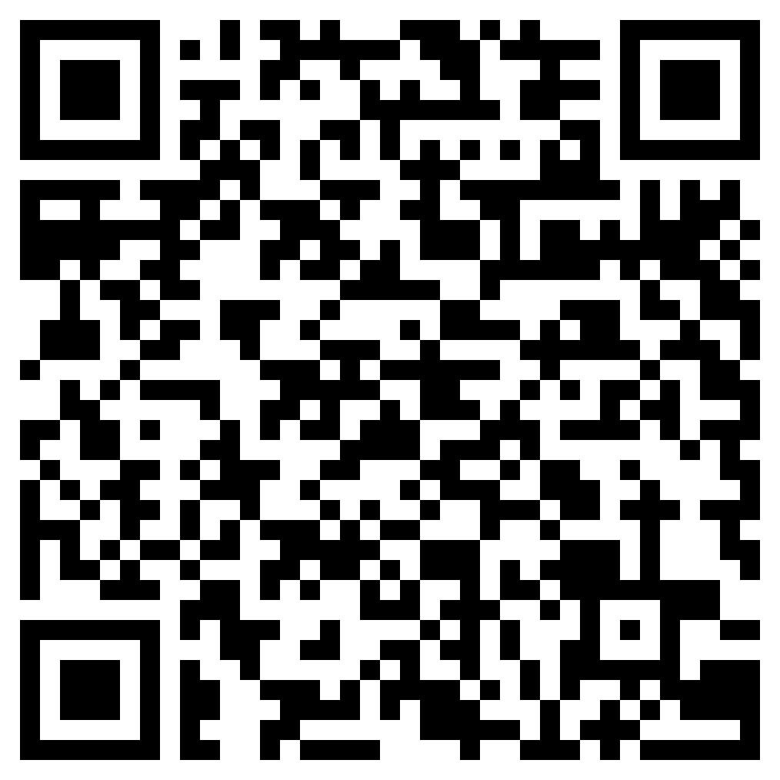
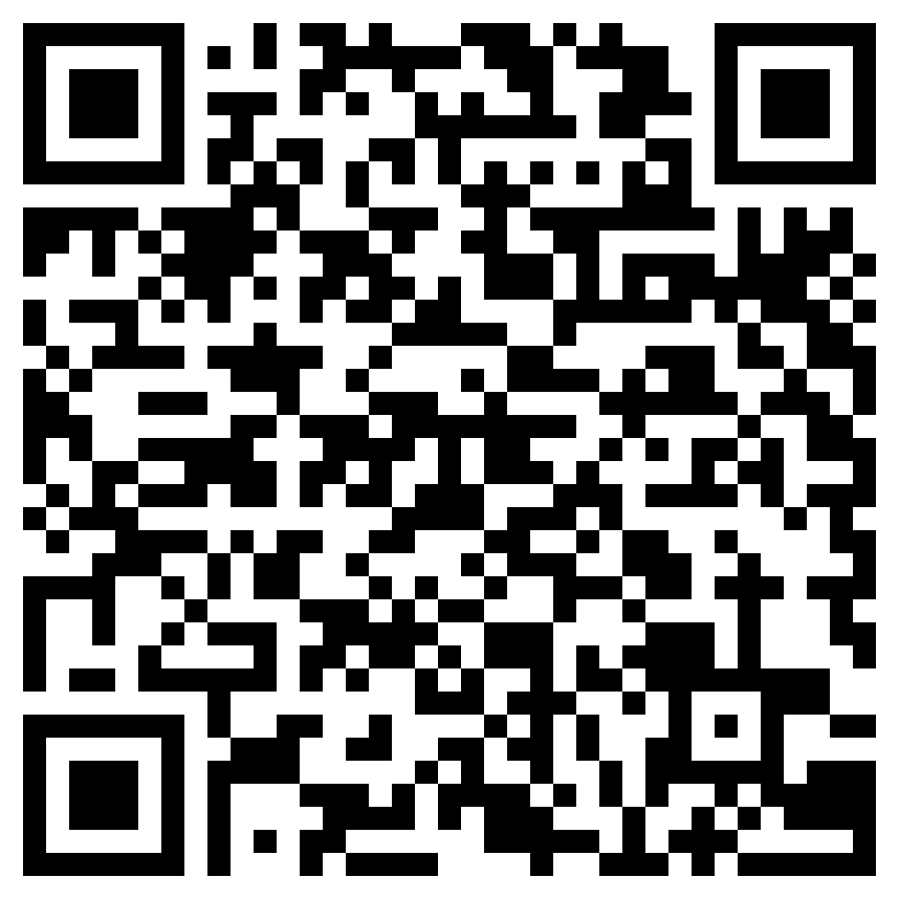
Deberes
deberes
Estudia este vocabulario:
Foundation
Higher
New
Revisit
Notes:
Homework slide
Students have 2 sets of vocabulary to study: a set of new vocabulary to be introduced in the next lesson and a set of revisited vocabulary from Year 9.

