Slide 1
Identität: Sprachen Wissen ist Macht!
Y10 Term 1.1 Week 4 Lesson 1
“Wer fremde Sprache nicht kennt, weiß nichts von seiner eigenen”. Johann Wolfgang von Goethe
Charlotte Moss / Rachel Hawkes
Artwork: Steve Clarke
Date updated: 31/03/24
Notes:
All words in this week’s lessons (new and revisited) appear on all three awarding organisation lists with the following exceptions: AQA list does not have: auffallen, betreffen, veröffentlichen, Engländer, Union, Heimat, Staaten, Vereinigte Staaten, Amerikaner, lesbisch, binär, schwul Edexcel list does not have: auffallen, betreffen, gelten, veröffentlichen, schade, schrecklich, wissenschaftlich, England, Engländer, Staaten, Vereinigte Staaten, französisch, spanisch, Amerikaner, Maschine, sterben, Wissenschaftler
Artwork by Steve Clarke. All additional pictures selected are available under a Creative Commons license, no attribution required.
Native-speaker teacher feedback provided by Stephanie Cross.
Learning outcomes: Introduce: Plural noun rules 7-9 (-se, (e)n, e+umlaut) Introduce: Irregular verb WISSEN (vs kennen vs können) Introduce: Adjectives that are identical as adverbs Revisit: Present tense strong verbs: e➜ i, e➜ ie Revisit: Present tense strong verbs: a➜ ä Revisit: WO1 vs WO3 (denn, weil, dass, wenn, falls (H), ob (H) Revisit: Nominalisation of infinitive verbs
Phonics: [ß] [ss] [-s] - [link to grammar: plural rule 9, present tense strong verbs]
long and short [e]|short [i][ie]|[a]|[ä]|[au]|[äu] [link to grammar: present tense strong verbs, plural rule 7]
Word frequency (1 is the most frequent word in German):
New vocabulary: stimmen; stimmen für + noun [490] weiß [78] weißt [78] Brille [n/a] Ergebnis [386] Ohr [1088] schade [2788] sogar [226] auffallen (H) [1160] aufgeben (H) [1371] betreffen (H) [416] gelten (H) [158] veröffentlichen (H) [1453] weiß (H) [78] weißt (H) [78] Inhalt (H) [1065] Kenntnis (H) [1536] Macht (H) [1098] Verständnis (H) [1578] schrecklich (H) [2200] wissenschaftlich (H) [909] entweder (H) [1100] falls (H) [1170]
Revisit 1: bedeuten [398] (der) Deutsche, (ein) Deutscher [499] (die, eine) Deutsche [499] England [1762] Engländer [3903] EU (Europäische Union) [726] Großbritannien [1640] Heimat [1305] Herr2 [154] Kunde [519] Mensch!2 Menschen1 [90] Name [255] Staaten [337] USA (Vereinigte Staaten von Amerika) [409] bi(sexuell) [n/a] englisch [662] europäisch [335] französisch [816] hetero(sexuell) [n/a] lesbisch [n/a] nicht binär [n/a] schwul [3961] spanisch [1919] besitzen (H) [586] stammen aus + noun (H) [908] Amerikaner (H) [1741] Maschine (H) [1237] eigentlich (H) [151] österreichisch (H) [1511] Schweizer (H) [1274]
Revisit 2: --
Thematic revisited vocabulary: anfangen [497] helfen [338] kennen [216] lassen [83] mitnehmen [1459] schlafen [679] sehen [79] sprechen [161] sterben (an^{dat.} + noun) [475] verbessern [1194] vergessen [584] versprechen [1056] verstehen; sich verstehen (mit) [211] (Natur)wissenschaft [4425] Angst (vor^{dat.} + noun) [392] Auge [222] Gefahr [841] Nacht [325] Wochenende [1243] arm [1475] ungefähr [1458] aber [31] dass [20] denn [93] obwohl [390] oder [35] und [2] weil [88] enthalten (H) [562] erhalten¹ (H) [287] Wissenschaftler (H) [1522] etwa (H) [181] ob (H) [127]
Revisited function words: wissen
Source: Jones, R.L & Tschirner, E. (2019). A frequency dictionary of German: Core vocabulary for learners. London: Routledge.
The frequency rankings for words that occur in this PowerPoint which have been previously introduced in NCELP resources are given in the NCELP SOW and in the resources that first introduced and formally re-visited those words.
For any other words that occur incidentally in this PowerPoint, frequency rankings will be provided in the notes field wherever possible.

Slide 2
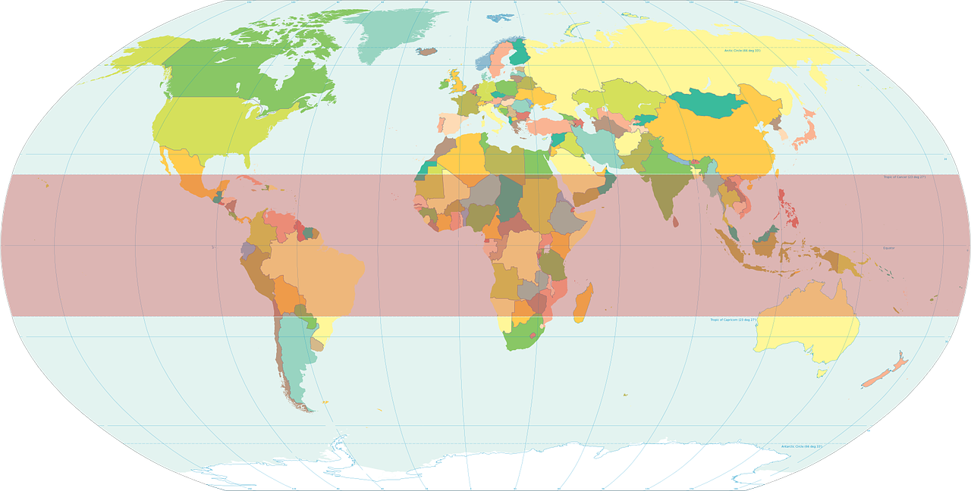
Weißt du das?
Auftakt
Ich arbeite für die Europäische Union. Wie viele von den 24 offiziellen Sprachen von der EU kannst du sprechen?
Ich bin Deutsche. Rund 130 Millionen Menschen sprechen Deutsch als Muttersprache.
___7___
_____5_____
Großbritannien
Ich wohne in Großbritannien. Ich bin Engländer. 1,5 Billionen Menschen können Englisch sprechen!
Deutsche
Name
_______1______
Spanisch
Heimat
____2____
Französisch
Ich stamme aus Spanien, aber kennst du Peru? Das ist meine Heimat. Weißt du, dass über 500 Millionen Menschen Spanisch sprechen?
Engländer
Und weißt du, dass es eigentlich über 200 verschiedene europäische Sprachen gibt?
europäische
____8____
Und Englisch ist eine offizielle Sprache in 67 Ländern, wie in den Vereinigten Staaten von Amerika. Ich wohne in den USA und ich bin Amerikaner.
Amerikaner
_____6_____
____9____
Europäische Union
____________
______3_____
Vereinigten Staaten von Amerika
Mein Name ist Knut. Ich bin Deutscher, aber ich wohne in Frankreich. Französisch ist eine offizielle Sprache in 29 Ländern!
________
_10_
____11____
____12____
_____4_____
Deutscher
Notes:
F/H – Note that stammen aus and Amerikaner are (H) only but students are unlikely to have difficulty with them in this task.
Auftakt (Upbeat) is a starter activity that students can do on arrival to the lesson, giving the teacher the opportunity to talk to individuals, as necessary. It will be useful for students to complete this activity as here we revisit vocabulary from Week 1.
Timing: 6 minutes Aim: to revisit previously taught vocabulary.
Procedure:
1. Students number 1-12. They look at the words on the right and decide which gap they best fit.
2. Students suggest answers chorally. Click to reveal answers.

Slide 3
ß | ss |-s
Phonetik
As you know, the SSC [-ss-] and [-ß-] sound the same.
Use [-ss-] if the vowel before it is short:
wissen
lassen
dass
Essen
Klasse
Ergebnis and Kenntnis are exceptions. The vowel is short but the words end in [-s].
Use [-ß-] when the vowel before it is long:
groß
Straße
Fußball
beschließen
weiß
Remember! At the end of words [-s] also sounds like [-ss-] and [-ß-].
The preceding vowel is usually long. You just have to learn whether to use [-s] or [-ß-]:
Reis
Glas
Spaß
Haus
harmlos
Notes:
F/H Timing: 2 minutes Aim: to revise the spelling rule for [-ss-] and [-ß-] and the SSC [-s]. Procedure: 1. Click through the animations.
2. Elicit the German pronunciation and English meanings for all the examples as these are known words.

Slide 4
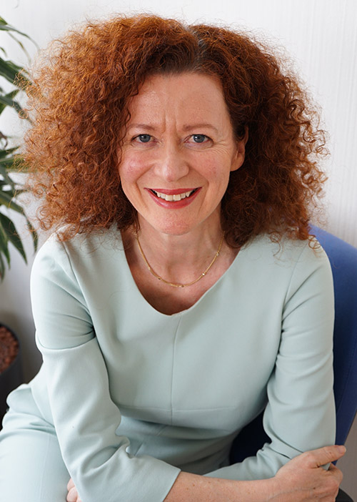
ß | ss |-s
Phonetik
Hör zu. Schreib ß oder ss. Dann lies den Text vor.
*Dolmetscher – interpreter
Grüße aus Brüssel! Ich heiße Susanne Alternbern und ich bin Dolmetscherin* bei der EU. Außer Deutsch spreche ich fünf Sprachen! Ich finde Sprachen interessant, und ich will meine Kenntnisse immer verbessern.
Grü__e
Brü__el!
hei__e
Au__er
*außer – apart from
intere__ant,
Kenntni__e
verbe__ern.
*die Kenntnis – knowledge
Notes:
F/H Timing: 4 minutes
Aim: to revisit knowledge about the spelling of words with the soft ‘s’ sound in German.
Procedure: 1. Click on the speech bubble to play the audio.
2. Students can either turn away from the board and write the whole text as a dictation exercise, or face the board and transcribe only the blanks (ß or ss)
3. Click to reveal the answers. Außer and Kenntisse were not glossed as they were part of the activity. Their meanings appear on click with the answers, as Kenntnis is Higher tier vocabulary only and this task has been envisaged for F and H students.
4. Students read the text aloud in pairs. Note: students can do this sentence by sentence initially. Further rounds of practice could involve playing 3-2-1: students take turn to read aloud, deciding each time whether to say three, two, or just one word each time. The student who says the final word in the text wins. The teacher may also want to hear all students say the text once through, chorally or circulate to listen in to students’ pronunciation and give feedback.
Text length: 31 words. Read aloud texts for the new GCSE will be a minimum of 35 words for Foundation, 50 words for Higher.
Attribution:
https://www.boeckler.de/de/magazin-mitbestimmung-2744-mein-arbeitsplatz-5526.htm https://www.universitas.org/wp-content/uploads/Universitas_411_web.pdf Picture - https://the-secretary-general.europarl.europa.eu/en/organisation/the-cabinet/head-of-cabinet

Slide 5
WISSEN | KENNEN – to know
Note that ‘ss’ changes to ‘ß’ in the I, you, s/he, it forms because the vowel ‘ei’ before it is long. However, the ‘s’ sound is the same.
Grammatik
The verb wissen (to know that) is irregular (strong):
Kennen (to know someone, be familiar with something) is regular (weak):
wissen
ich weiß | I know
du weißt | you know
er/sie/es weiß | he, she, it knows
wir wissen | we know
ihr wisst | you (all) know
Sie wissen | you (formal) know
sie wissen | they know
kennen
ich kenne | I know
du kennst | you know
er, sie, es kennt | he, she, it knows
wir kennen | we know
ihr kennt | you (all) know
Sie kennen | you (formal) know
sie kennen | they know
___ _____
___ _____
___ ______
___ ______
___ ______
___/___/__ ______
___/___/__ ______
___/___/__ ______
___ _______
___ _______
___ _______
___ _______
___ _______
___ _______
___ _______
___ _______
___ _______
___ _______
___ _______
___ _______
Notes:
F/H
Timing: 3 minutes
Aim: to present the present tense of the irregular verb wissen (students know ‘ich weiß’ and ‘wissen’ from KS3) and recap the pattern of endings for weak verbs in the present tense, with kennen.
Procedure: 1. Click to present the information step by step.
2. Elicit the English forms of wissen and German forms of kennen from students. As wissen is mostly new, teachers will reveal the German and elicit the English at this stage.

Slide 6
Wissen, kennen, können
Grammatik
Wissen and kennen both mean ‘to know’, but they are used differently.
Wissen means ‘know’ with facts:
Wissen is often followed by dass and a Word Order 3 verb clause, i.e., the verb is at the end.
Ich weiß, dass Katjas Mutter aus Polen kommt.
I know that Katja’s mum comes from Poland.
Kennen means to know someone or be familiar with something:
Ich kenne Katjas Mutter.
Where the meaning is clear, the 2nd verb can be left out. Katja kann gut Polnisch. Katja can speak good Polish.
Kennen is normally followed by a noun or pronoun.
I know Katja’s mum.
Können means ‘to be able to’:
Können is a modal verb and is normally used with a 2nd verb in the nfinitive, which comes at the end of the sentence.
Katjas Mutter kann sehr gut Polnisch sprechen.
Katja’s mum can speak very good Polish.
Notes:
F/H
Timing: 3 minutes Aim: to learn the differences between wissen, kennen, können.
Procedure: Click through the explanation of how to use these three verbs.

Slide 7
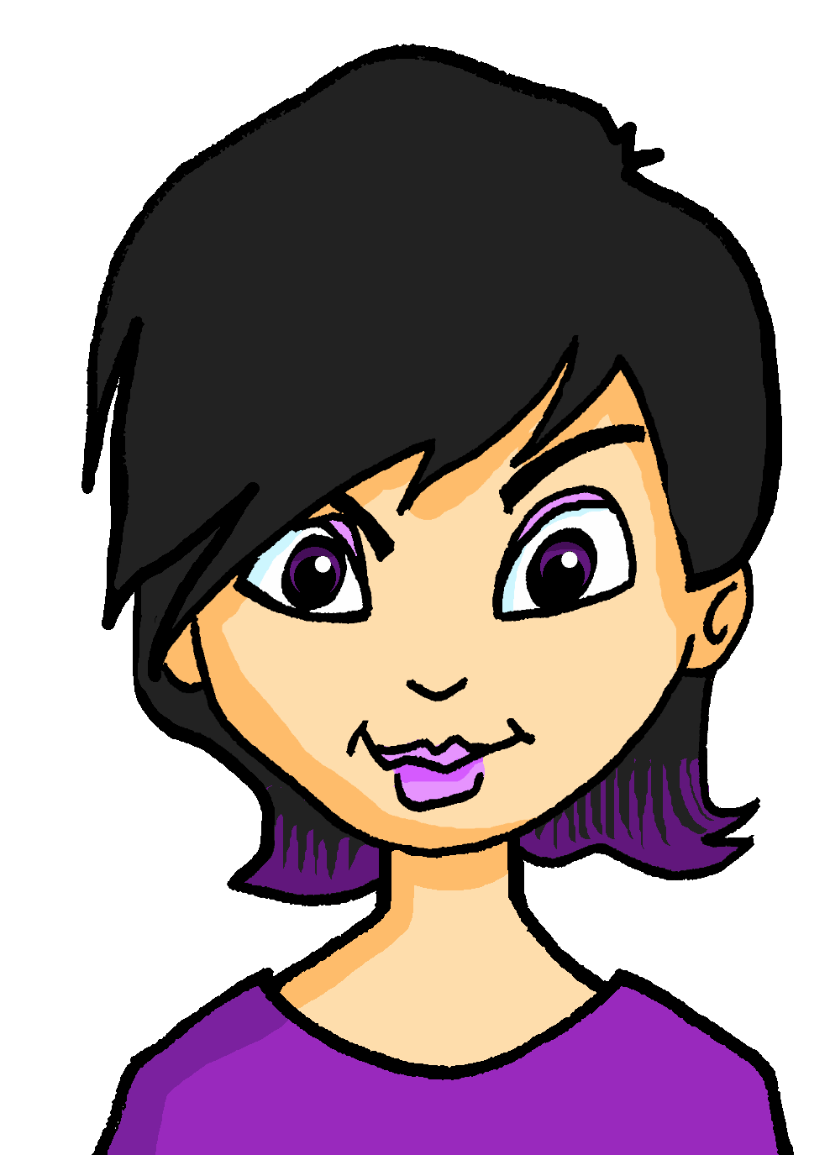
Piotr schreibt an Katja
lesen
Katjas Cousin schreibt ihr eine E-Mail. Sein Deutsch ist nicht perfekt. Sind die Lücken wissen oder kennen? Schreib 1-6 und die richtige Verbform.
*ändern – to change
Von: Piotr Nowak <piotr@nowak.pl>
An: Katja Nowak <katja@nowak.de>
Liebe Katja,
Ich weiß, dass du in Deutschland lebst, während ich in Polen lebe. Du kennst mich also nicht sehr gut, aber das will ich ändern*! Meine Eltern wollen dich auch besser kennenlernen*! Kennst du Warschau? Ich weiß, dass Warschau eine schöne Stadt ist. Vielleicht kannst du uns nächsten Sommer hier besuchen? Weißt du aber, dass meine Eltern kein Deutsch sprechen? Ich weiß, dass Polnisch* keine einfache Sprache ist, aber vielleicht kannst du es lernen?
Dein Cousin Piotr.
1
2
3
4
5
6
*kennenlernen – to meet, get to know *Polnisch – Polish
Notes:
F/H
Timing: 6 minutes Aim: to practise written differentiation between wissen and kennen; to practise correct identification of the sentence subject and written production of the appropriate verb form. Note that the activity includes only the ich and du forms of each verb. Procedure: 1. Explain the task. Katja’s cousin Piotr has written to her to invite her to Poland.
2. Using their knowledge of wissen and kennen, students fill the blanks.
3. Click to reveal answers.
Frequency of unknown words and cognates (1 is the most frequent word in German): ändern [448] Cousin [4837] kennenlernen [n/a] polnisch [3237] Source: Jones, R.L. & Tschirner, E. (2019). A frequency dictionary of German: core vocabulary for learners. Routledge

Slide 8
Katja lernt Polnisch
hören
Katja lernt Polnisch* bei einem Abendkurs. Hör zu. Ist das wissen, kennen oder können?
*Polnisch – Polish
*hart – hard
 |  | wissen | kennen | können
 | Ihr sollt wissen, dass dieser Kurs nicht einfach ist.
 | Hallo! Ich bin Stefan, und kennst du Tobias?
 | Ich kann diese Wörter gar nicht sagen!
 | Kannst du dieses Buch lesen?
 | Ich weiß, dass ich sehr hart arbeite.
 | Ich kenne viele polnische Sätze.
 | Kennst du deine polnische Familie?
 | Weißt du, wie ich mein Polnisch schnell verbessere?
1
2
3
4
5
6
7
8
Notes:
F/H
Timing: 8 minutes
Aim: to practise the distinction between wissen, kennen and können, based on the meaning of other words in the sentence. Procedure: 1. Explain the task. Katja is learning Polish in an evening course. It is the start of class and everyone is talking. Students decide whether the gap should be wissen, kennen or können, based on what they have learned.
2. Click on each audio button to hear a sentence.
3. Students decide whether the gap should be wissen, kennen or können, based on their understanding of the other words in the sentence.
4. Click to reveal answers and sentences.
Transcript: 1. Ihr sollt [wissen], dass dieser Kurs nicht einfach ist.
2. Hallo! Ich bin Stefan, und [kennst] du Tobias?
3. Ich [kann] diese Wörter gar nicht sagen!
4. [Kannst] du dieses Buch lesen?
5. Ich [weiß], dass ich sehr hart arbeite.
6. Ich [kenne] viele polnische Sätze.
7. [Kennst] du deine polnische Familie?
8. [Weißt] du, wie ich mein Polnisch schnell verbessere?
Frequency of unknown words and cognates (1 is the most frequent word in German): hart [728] Source: Jones, R.L. & Tschirner, E. (2019). A frequency dictionary of German: core vocabulary for learners. Routledge

Slide 9
Katja schreibt an Mia
Grammatik
*Polnisch – Polish
der Buchstabe – letter
Hallo Mia! Nächsten Sommer werde ich einen Monat bei meiner polnischen Familie in Polen verbringen. Sie können kein Deutsch sprechen...
Ich weiß, dass ich mein Polnisch* verbessere.
ich verbessere mein Polnisch.
Ich kenne
schon einige Wörter.
Ich kenne schon einige Wörter.
wie man „Guten Tag“ und „Danke“ sagt.
Ich weiß
Ich kann
Ich weiß, wie man „Guten Tag“ und „Danke“ sagt.
Ich weiß, dass das nicht genug ist.
das ist nicht genug.
alle polnischen Buchstabenkombinationen* nicht.
Ich kenne alle polnischen Buchstabenkombinationen* nicht.
Ich kann nicht alle Wörter gut sagen.
nicht alle Wörter gut sagen.
Ich weiß, dass Übung den Meister macht.
Übung macht den Meister.
Ich kenne Zuzanna. Sie kommt aus Polen und sie wird mir helfen.
Zuzanna. Sie kommt aus Polen und sie wird mir helfen.
Notes:
F/H
Timing: 8 minutes
Aim: to practise the difference between wissen, kennen, können. Procedure: 1. Explain the task. Katja is writing to Mia to tell her about her plans for next summer.
2. Students help her out by deciding whether each sentence should start with ich kenne, ich weiß or ich kann.
3. Remember that some sentence beginnings may change the word order of the sentence endings!
4. Click to reveal answers. Word order changes appear in italics.
Frequency of unknown words and cognates (1 is the most frequent word in German): Meister [1749] Note that Übung [1434] was introduced in Week 3 but is higher only. However, üben (F/H) is known from Y9 and Übung fits Word Pattern 5: Add suffix -ung to a verb stem to change into nouns with equivalent and transparent meaning (e.g., lösen --> die Lösung) Source: Jones, R.L. & Tschirner, E. (2019). A frequency dictionary of German: core vocabulary for learners. Routledge

Slide 10
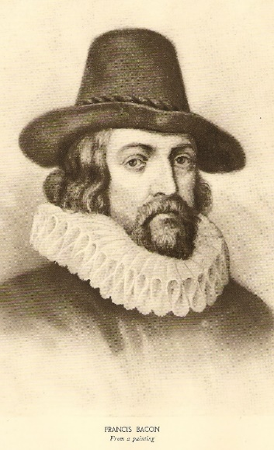
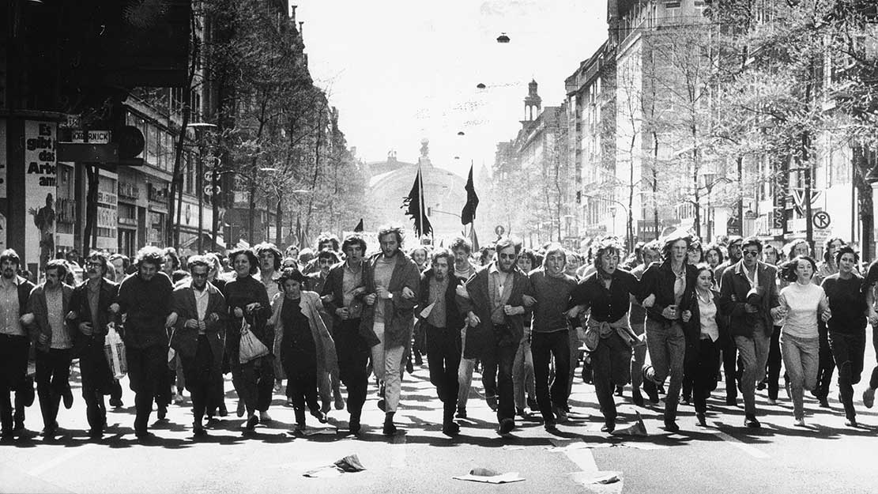
Wissen ist Macht!
Kultur
What do you think this means?
Wissen ist Macht!
In German, as in English, people use this phrase to highlight the importance of knowledge. However, when the term was first coined by Francis Bacon in 1597, he actually wanted to draw attention to the limitations of knowledge!
Knowing / Knowledge is power!
Language is dynamic. People constantly change it to express new ideas.
Wissen ist Macht, ich weiß nichts, macht nichts.
Can you guess what this could mean?
For example, this play on the original phrase was used by the left-wing Sponti movement in West Germany in the 1970s and 1980s.
It roughly translates to “knowledge is power, I know nothing, doesn’t matter”.
For the Spontis, it was actually better not to know everything. When you know everything, you are more likely to stick with convention and not think outside the box. Their phrase was a rallying call to question the status quo.
Notes:
F/H
Timing: 3 minutes
Aim: to learn about the origins and connotations of the phrase ‘Wissen ist Macht’; to awaken linguistic interest.
Procedure: Click through the animations to learn about the two phrases. When prompted, ask students what they think the phrases could mean, before revealing the answers.
Sources:
https://www.researchgate.net/publication/300069978_Wissen_und_Konnen_im_Kontext_inferentiellen_Denkens
https://www.deinlebenrockt.de/wissen-ist-macht/#:~:text=Manchmal%20ist%20es%20sogar%20von,und%20nicht%20in%20frage%20gestellt.
https://books.google.co.uk/books?id=4Yx9BwAAQBAJ&pg=PA183&lpg=PA183&dq=what+did+the+spontis+mean+by+%22Wissen+ist+Macht,+nichts+wissen,+macht+auch+nichts%22&source=bl&ots=5lQKTFMJcT&sig=ACfU3U1nM2uQ3If2fN-_Fii_0qhLM-M_YA&hl=en&sa=X&ved=2ahUKEwixpcr344f6AhXoTEEAHd9vD-AQ6AF6BAgREAM#v=onepage&q=what%20did%20the%20spontis%20mean%20by%20%22Wissen%20ist%20Macht%2C%20nichts%20wissen%2C%20macht%20auch%20nichts%22&f=false
https://en.wikipedia.org/wiki/Spontis
Image attribution: Francis Bacon By "Masters of Achievement", PD-US, https://en.wikipedia.org/w/index.php?curid=16027630 (in public domain)
Sponti picture: https://www.faz.net/aktuell/rhein-main/blockupy/frankfurt-am-main-stadt-der-demonstrationen-und-proteste-13487100.html

Slide 11
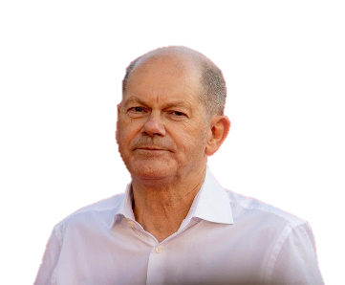
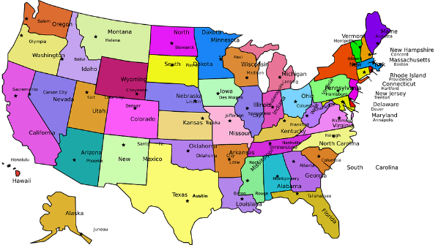
Weißt du das? Kennst du ihn/sie?
sprechen
Kennst du…
Weißt du…
Das weiß ich schon/ ja/ nicht
Ja / nein. Ich kenne ihn / sie / nicht.
eine Person, die eine Brille trägt?
dass man in Peru Spanisch spricht?
Olaf Scholz?
eine Deutsche?
Teenager sollen 8 bis 10 Stunden schlafen?
dass Großbritannien größer als England ist?
die USA haben 50 Staaten?
die USA?
Notes:
F/H
Timing: 5 minutes
Aim: to practise when to use wissen and kennen in a spoken context. Procedure: 1. Explain the task. Students work in pairs. They take it in turns to ask a question about one of the prompts. They select either the ‘Kennst du’ or ‘Weißt du’ starter depending on the prompt they have chosen.
2. Their partner responds using the appropriate wissen or kennen ending. They answer yes or no depending on whether they actually knew the answer or not.

Slide 12
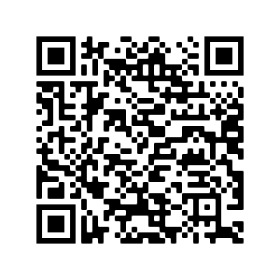
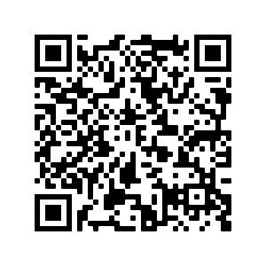
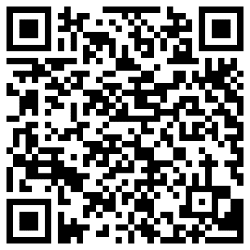
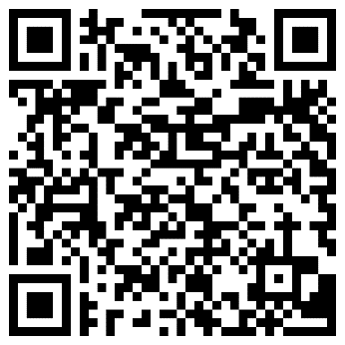
Hausaufgaben
10.1.1.4 new vocabulary
10.1.1.4 revisited vocabulary
Foundation
Higher
Foundation
Higher
Notes:
Timing: 2 minutes Aim: to remind students of the vocabulary they are learning and revisiting this week. Procedure: 1. Display the slide. Explain the tasks. 2. Post this slide or its information for students, using the usual school system for this.
Notes: A regular feature of the scheme of work (as for KS3) is that students spend time learning the vocabulary for the following week’s lessons. This can be done using any platform. We provide the words on Quizlet. Most lists are also available (free to all schools, not just subscribers) on LanguageNut. Teachers may of course create their own versions of vocabulary learning activities in any of the different platforms available. At KS4, there are several sets for learning/revisiting: 1. The new vocabulary for the following week. 2. The revisited thematic vocabulary (from KS3 SOW) assigned to the week. 3. The systematic revisiting (at +3 and +9 weekly intervals) of new vocabulary.
In the KS4 SOW every word from the GCSE vocabulary list has been tracked to ensure that: 1. New words are introduced, revisited twice at intervals during the course, and once again during the final 9-week revision phase. 2. KS3 revisited thematic vocabulary is revisited twice during the course, and once again during the final 9-week revision phase. 3. KS3 function words (listed as R(equired) on Annex E of the GCSE Subject Content are all revisited multiple times (Column D on the KS4 SOW) and the revisits are also tracked on the KS4 Vocabulary tracker.
We anticipate that students will spend on average 2 hours on homework per week at KS4. As a general rule, one hour would be assigned to vocabulary learning (and ideally this time will be spread across the week). The aim at KS3 was to establish a ‘little and often’ approach to vocabulary learning, using an app to facilitate this. This learning habit will hopefully continue into KS4. The 2nd hour will generally include additional reading, listening, speaking tasks. Teachers will be best placed to decide whether to include extended writing tasks for homework. However, given the availability of online translation tools and the strong temptation to use them, such tasks might best be undertaken in class, where teachers can replicate the conditions for written language production that will apply for students at GCSE.

Slide 13
Identität: Sprachen
Y10 Term 1.1 Week 4 Lesson 2
Janine Turner / Charlotte Moss / Rachel Hawkes Date updated: 10/1/23
Notes:
All words in this week’s lessons (new and revisited) appear on all three awarding organisation lists with the following exceptions: AQA list does not have: auffallen, betreffen, veröffentlichen, Engländer, Union, Heimat, Staaten, Vereinigte Staaten, Amerikaner, lesbisch, binär, schwul Edexcel list does not have: auffallen, betreffen, gelten, veröffentlichen, schade, schrecklich, wissenschaftlich, England, Engländer, Staaten, Vereinigte Staaten, französisch, spanisch, Amerikaner, Maschine, sterben, Wissenschaftler
Artwork by Steve Clarke. All additional pictures selected are available under a Creative Commons license, no attribution required.
Native-speaker teacher feedback provided by Stephanie Cross.
Learning outcomes: Introduce: Plural noun rules 7-9 (-se, (e)n, e+umlaut) Introduce: Irregular verb WISSEN (vs kennen vs können) Introduce: Adjectives that are identical as adverbs Revisit: Present tense strong verbs: e➜ i, e➜ ie Revisit: Present tense strong verbs: a➜ ä Revisit: WO1 vs WO3 (denn, weil, dass, wenn, falls (H), ob (H) Revisit: Nominalisation of infinitive verbs
Phonics: [ß] [ss] [-s] - [link to grammar: plural rule 9, present tense strong verbs]
long and short [e]|short [i][ie]|[a]|[ä]|[au]|[äu] [link to grammar: present tense strong verbs, plural rule 7] Word frequency (1 is the most frequent word in German):
New vocabulary: stimmen; stimmen für + noun [490] weiß [78] weißt [78] Brille [n/a] Ergebnis [386] Ohr [1088] schade [2788] sogar [226] auffallen (H) [1160] aufgeben (H) [1371] betreffen (H) [416] gelten (H) [158] veröffentlichen (H) [1453] weiß (H) [78] weißt (H) [78] Inhalt (H) [1065] Kenntnis (H) [1536] Macht (H) [1098] Verständnis (H) [1578] schrecklich (H) [2200] wissenschaftlich (H) [909] entweder (H) [1100] falls (H) [1170]
Revisit 1: bedeuten [398] (der) Deutsche, (ein) Deutscher [499] (die, eine) Deutsche [499] England [1762] Engländer [3903] EU (Europäische Union) [726] Großbritannien [1640] Heimat [1305] Herr2 [154] Kunde [519] Mensch!2 Menschen1 [90] Name [255] Staaten [337] USA (Vereinigte Staaten von Amerika) [409] bi(sexuell) [n/a] englisch [662] europäisch [335] französisch [816] hetero(sexuell) [n/a] lesbisch [n/a] nicht binär [n/a] schwul [3961] spanisch [1919] besitzen (H) [586] stammen aus + noun (H) [908] Amerikaner (H) [1741] Maschine (H) [1237] eigentlich (H) [151] österreichisch (H) [1511] Schweizer (H) [1274]
Revisit 2: --
Thematic revisited vocabulary: anfangen [497] helfen [338] kennen [216] lassen [83] mitnehmen [1459] schlafen [679] sehen [79] sprechen [161] sterben (an^{dat.} + noun) [475] verbessern [1194] vergessen [584] versprechen [1056] verstehen; sich verstehen (mit) [211] (Natur)wissenschaft [4425] Angst (vor^{dat.} + noun) [392] Auge [222] Gefahr [841] Nacht [325] Wochenende [1243] arm [1475] ungefähr [1458] aber [31] dass [20] denn [93] obwohl [390] oder [35] und [2] weil [88] enthalten (H) [562] erhalten¹ (H) [287] Wissenschaftler (H) [1522] etwa (H) [181] ob (H) [127]
Revisited function words: wissen
Source: Jones, R.L & Tschirner, E. (2019). A frequency dictionary of German: Core vocabulary for learners. London: Routledge.
The frequency rankings for words that occur in this PowerPoint which have been previously introduced in NCELP resources are given in the NCELP SOW and in the resources that first introduced and formally re-visited those words.
For any other words that occur incidentally in this PowerPoint, frequency rankings will be provided in the notes field wherever possible.

Slide 14
Wie sagt man das auf Englisch?
Vokabeln
bi(sexuell)
schwul
Spanish
bisexual
gay
spanisch
bedeuten
der Kunde
to mean, meaning
customer
Mensch!
Engländer
der Herr
Wow!
English person
gentleman
French
human beings, people
französisch
die Menschen
hetero (sexuell)
lesbian
states
heterosexual
lesbisch
die Staaten
Mr
non-binary
Herr
nicht binär
Schweizer
eigentlich
machine
Swiss
actual, real, actually, really
die Maschine
to own, have, having, owning
Austrian
besitzen
österreichisch
Notes:
F+H
Timing: 4 minutes
Note: The bottom row contains only Higher vocabulary. The teacher can direct students to do or ignore this row.
Aim: to practise oral recall of vocabulary.
Procedure:
1. Students sketch a 5x4 grid.
2. Working in pairs, they take turns to choose a word to translate orally into English.
3. Students should work as quickly as they can without repeating a word the other has already said. If their partner agrees the given translation is correct, the speaking student ‘claims’ the relevant square on the grid by putting their initials in it. If they cannot translate a word, or translate it incorrectly, they do not claim a square and the game moves on.
4. Click to reveal translations one by one.
5. Students count up the number of squares they have claimed. The student with the most squares wins.

Slide 15
Wie schreibt man das auf Deutsch?
Vokabeln
19) machine 20) to own, have
16) Swiss 17) actual, real 18) Austrian
12) Mr 13) non-binary 14) bisexual 15) French
9) states 10) human beings, people 11) to mean
6) customer 7) Wow! 8) heterosexual
3) lesbian 4) gay 5) Spanish
1) English person 2) gentleman
Notes:
F+H
Timing:
Aim: to practise written recall of vocabulary.
Note: The top five words are higher only. The teacher should direct students to translate them or not.
Procedure:
1. Students write 1-15 or 1-20.
2. They are challenged to translate all the words before they get covered by tetris blocks.
3. Click to the next slide to reveal the answers.

Slide 16
Wie schreibt man das auf Deutsch?
Vokabeln
1) Engländer
2) der Herr
3) lesbisch
4) schwul
5) spanisch
6) der Kunde
7) Mensch!
8) hetero(sexuell)
9) die Staaten
10) die Menschen
11) bedeuten
12) Herr
13) nicht binär
14) bi(sexuell)
15) französisch
16) Schweizer
17) eigentlich
18) österreichisch
19) die Maschine
20) besitzen
Notes:
ANSWERS

Slide 17
Word order 1 and 3
Grammatik
Remember that after the conjunction weil the verb goes to the end of the clause:
This is called Word Order 3.
Ich lerne Polnisch, weil meine Familie aus Polen kommt.
I learn Polish because my family comes from Poland.
Here are several WO3 conjunctions you may know:
Higher
dass
obwohl
wenn
ob
falls
that
although
if, when
whether, if
in case, if
Word Order 1 conjunctions do not change the word order:
und
aber
oder
denn
Higher
and
but
or
because
entweder
…oder
Er ist entweder Amerikaner oder Engländer.
either
… or
Notes:
F/H
Timing: 2 minutes Aim: to revisit Word Order 1 and 3 and to introduce two new Higher conjunctions ob and falls, which are on the vocabulary list for this week.
Procedure: 1. Click through to present the information.
2. Elicit English and/or German meanings as appropriate.

Slide 18
Katja spricht mit Piotr
Katja und Piotr sprechen zusammen. Hör zu, ist das WO1 oder WO3?
hören
Hallo Piotr! Wie geht es dir? Ich will Polnisch mit dir sprechen, weil ich jetzt Polnisch lerne.
denn weil
Toll! Ich denke, Polnisch ist keine einfache Sprache.
--- dass
Ja. Aber ich werde mein Polnisch schnell verbessern, wenn ich hart arbeite.
denn wenn
Und ich will dir helfen. Ich weiß, dass ich dieses Wochendende Zeit habe.
--- dass
Ich werde dieses Wochenende Zeit finden, denn ich will gute Ergebnisse.
denn wenn
Perfekt! Ich freue mich darauf, weil ich gern mit dir spreche.
denn weil
Notes:
There are two versions of this listening activity. If students are in a mixed class and unable to access the material on their own devices, this task could run in parallel with the reading on slide 9. The teacher oversees the Foundation listening whilst Higher students complete the reading independently and then vice versa. Alternatively, and depending on the level of the class, students could all complete the Foundation version in class, with Higher students completing the higher task for homework.
Foundation
Timing: 8 minutes
Aim: to practise WO1 and WO3 and the different conjunctions that lead to WO3. Procedure: 1. Explain the task. Katja and Piotr are discussing Katja learning Polish.
2. Click on each speech bubble to hear the audio.
3. The conjunction (or lack of conjunction) has been bleeped out, so students must use their knowledge of word order to decide which of the two options in the box to the right of the speech bubble would fill the gap.
4. Click to reveal the answers.
Transcript: 1. Hallo Piotr! Wie geht es dir? Ich will Polnisch mit dir sprechen, [weil] ich jetzt Polnisch lerne.
2. Toll! Ich denke,[ ] Polnisch ist keine einfache Sprache.
3. Ja. Aber ich werde mein Polnisch schnell verbessern, [wenn] ich hart arbeite.
4. Und ich will dir helfen. Ich weiß, [dass] ich dieses Wochenende Zeit habe.
5. Ich werde dieses Wochenende Zeit finden, [denn] ich will gute Ergebnisse.
6. Perfekt! Ich freue mich darauf, [weil] ich gern mit dir spreche.
Frequency of unknown words and cognates (1 is the most frequent word in German): hart [728] (will be introduced in 10.1.1.5) Source: Jones, R.L. & Tschirner, E. (2019). A frequency dictionary of German: core vocabulary for learners. Routledge

Slide 19
Katja spricht mit Piotr
Katja und Piotr sprechen zusammen. Hör zu, ist das WO1 oder WO3?
hören
Hallo Piotr! Wie geht es dir? Ich will Polnisch mit dir sprechen, weil ich jetzt Polnisch lerne.
denn weil
Toll! Ich denke, Polnisch ist keine einfache Sprache.
--- dass
Ja. Aber ich werde mein Polnisch schnell verbessern, wenn ich hart arbeite.
denn wenn
Und ich will dir helfen. Ich weiß nicht, ob du dieses Wochenende Zeit hast.
--- nicht, ob
Ja, ich habe Zeit. Können wir auch nächste Woche sprechen, falls der Kursinhalt nächste Woche schwierig ist?
. falls
Ja. Ich bin für dich da. Der Kurs enthält schwierige Wörter.
. falls
Notes:
Higher
Timing: 8 minutes
Aim: to practise WO1 and WO3 and the different conjunctions that lead to WO3. Procedure: 1. Explain the task. Katja and Piotr are discussing Katja learning Polish.
2. Click on each speech bubble to hear the audio.
3. The conjunction (or lack of conjunction) has been bleeped out, so students must use their knowledge of word order to decide which of the two options in the box to the right of the speech bubble would fill the gap.
4. Click to reveal the answers.
Transcript: 1. Hallo Piotr! Wie geht es dir? Ich will Polnisch mit dir sprechen, [weil] ich jetzt Polnisch lerne.
2. Toll! Ich denke,[-] Polnisch ist keine einfache Sprache.
3. Ja. Aber ich werde mein Polnisch schnell verbessern, [wenn] ich hart arbeite.
4. Und ich will dir helfen. Ich weiß [nicht, ob] du dieses Wochenende Zeit hast.
5. Ja, ich habe Zeit. Können wir auch nächste Woche sprechen, [falls] der Kursinhalt nächste Woche schwierig ist?
6. Ja. Ich bin für dich da[. -]Der Kurs enthält schwierige Wörter.
Frequency of unknown words and cognates (1 is the most frequent word in German): hart [728] Source: Jones, R.L. & Tschirner, E. (2019). A frequency dictionary of German: core vocabulary for learners. Routledge

Slide 20
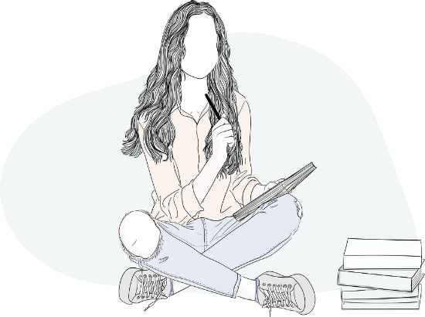
Adjectives that are identical as adverbs
Grammatik
As you know, most German adjectives can be used as adverbs, too:
Der Kurs ist praktisch.
The course is practical.
Im Kurs lernt man praktisch alles.
One learns practically everything in the course.
Sometimes the English translation is quite different:
Der Mann ist gut.
The man is good.
Der gute Mann spricht gut.
The good man speaks well.
Notes:
F+H
Timing: 2 minutes Aim: to recap the knowledge that German adjectives are often the same as adverbs, but that English has slightly or very different forms. Procedure: Click to present and elicit information.

Slide 21
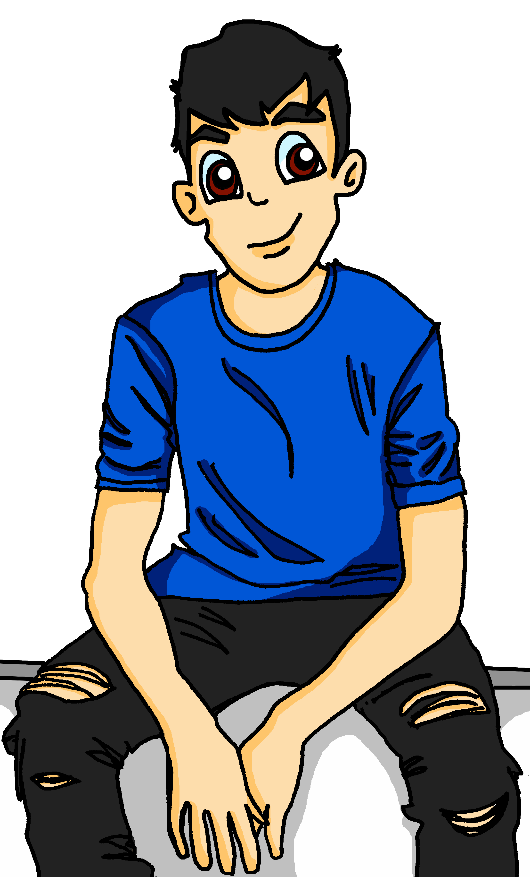
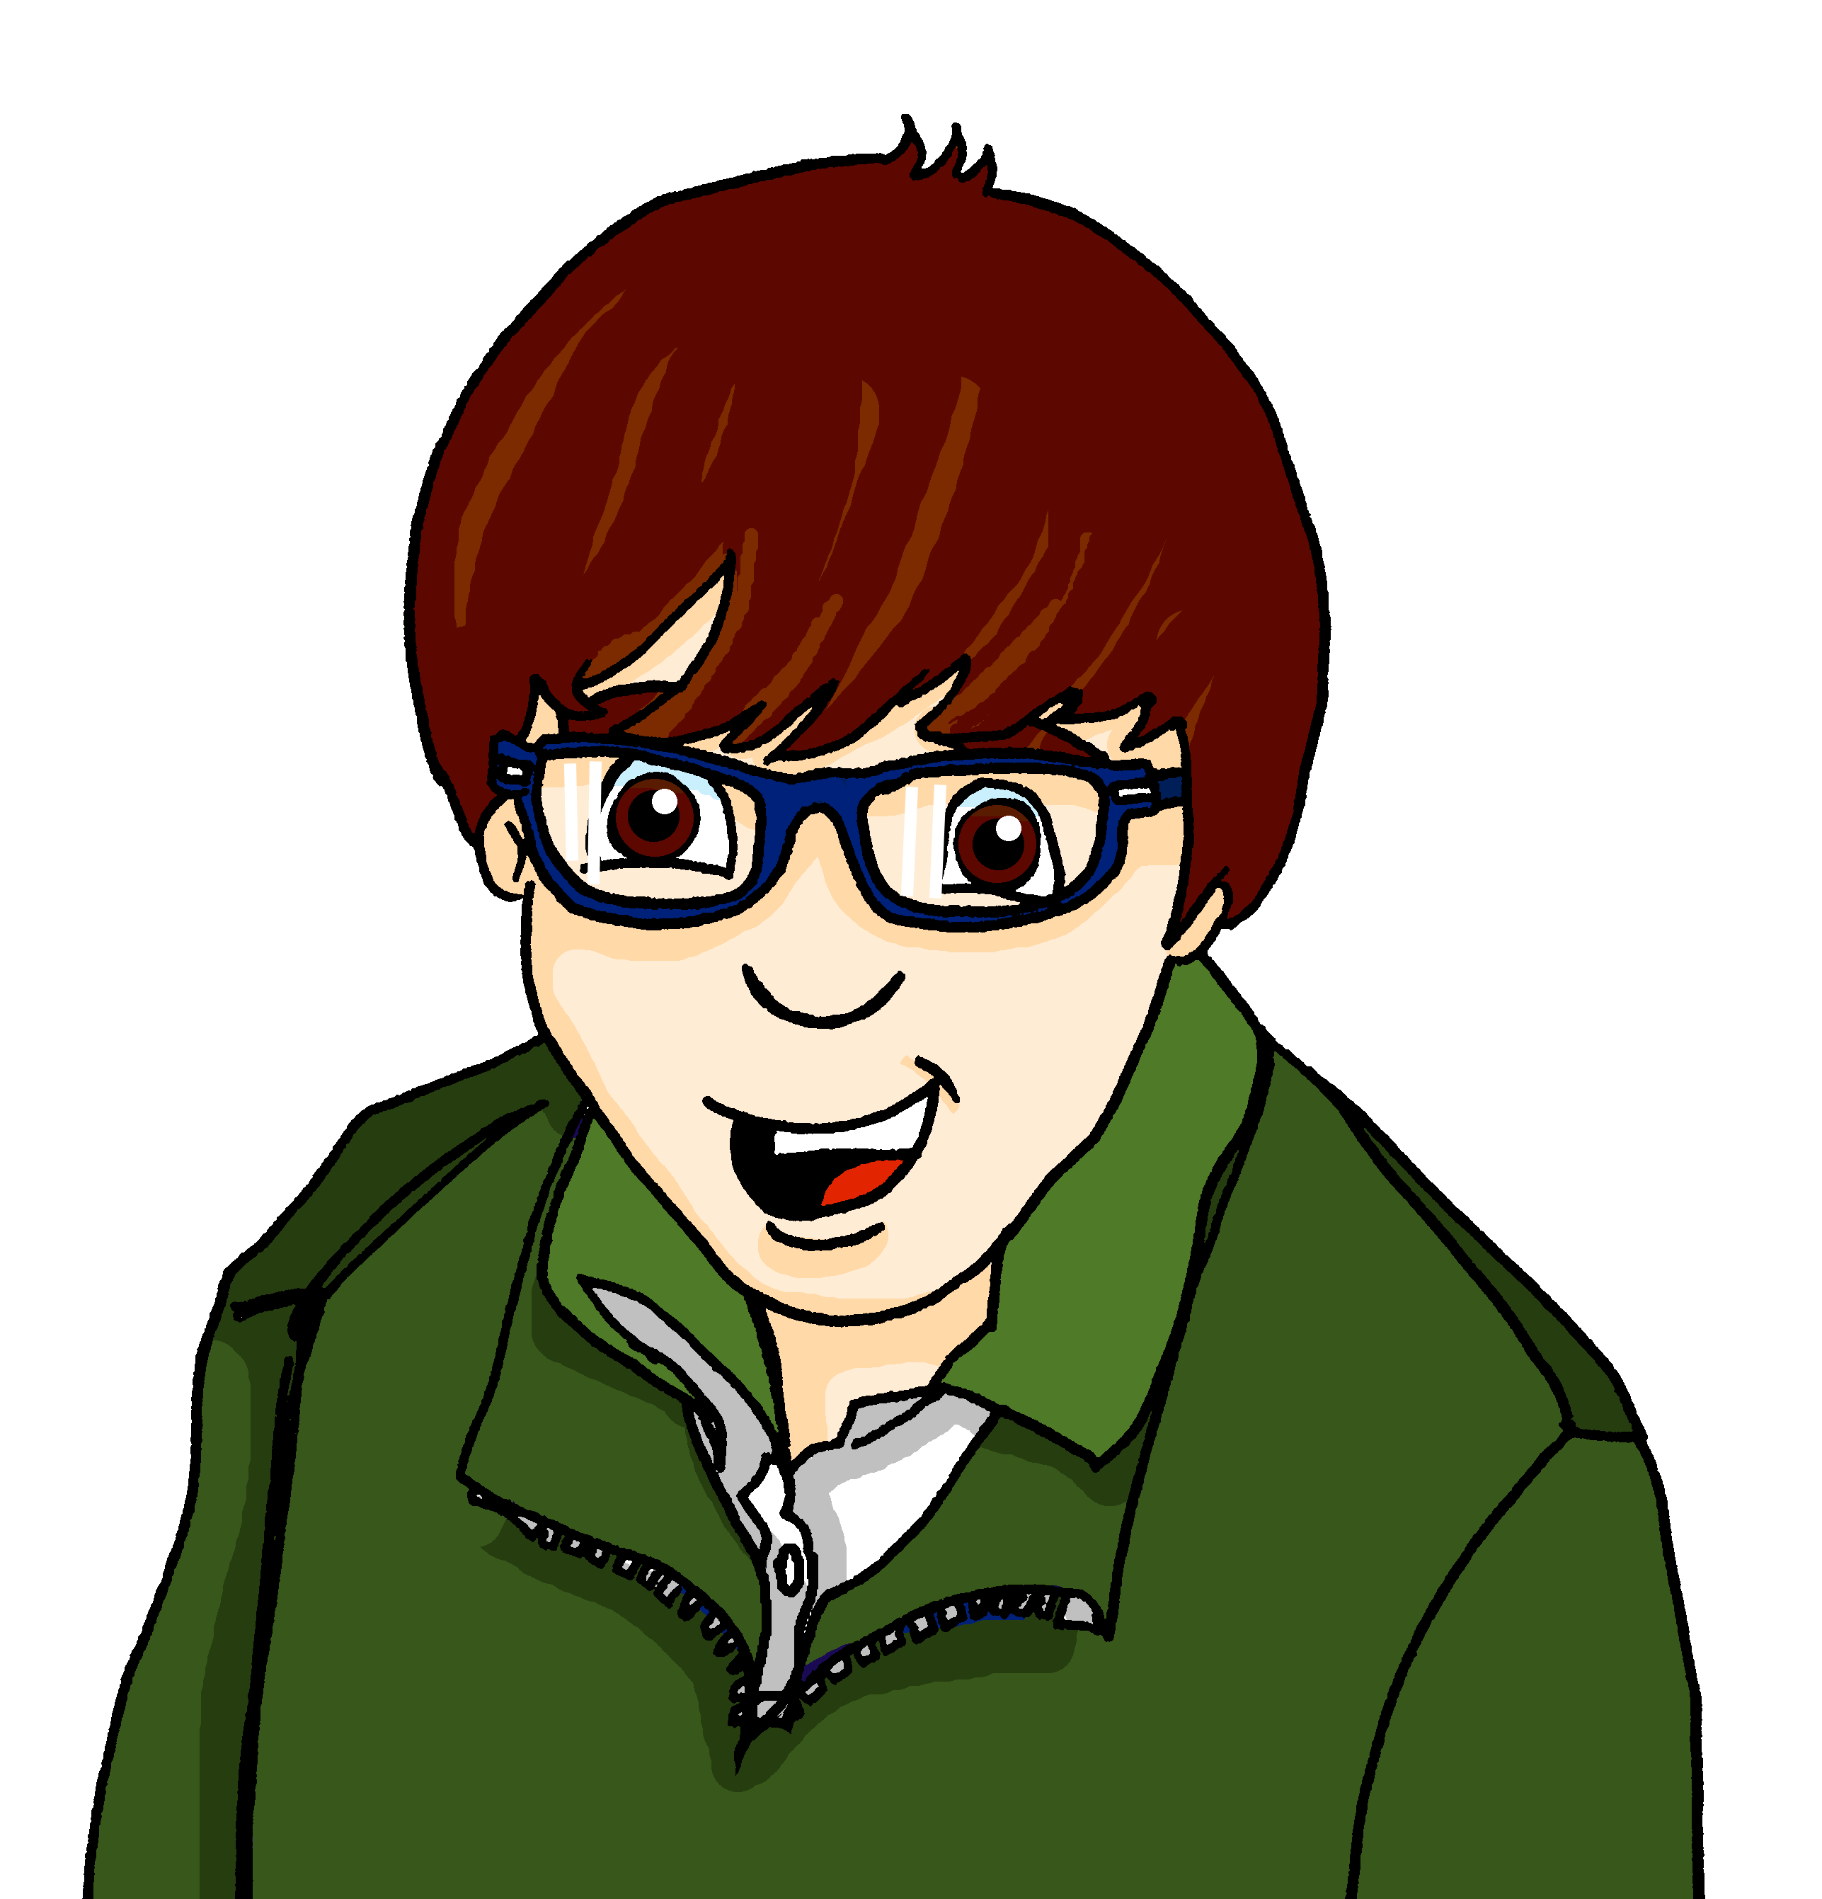
Matthias und Wolf sprechen über Fering [1/2]
lesen
Hallo Matthias! Wir lernen über kleine Sprachen in der Schule. Ich wollte dich natürlich fragen. Wie geht es mit Fering?
natural naturally
Fering ist relativ einfach. Es ist ähnlich wie Deutsch oder Englisch.
relative relatively
Das ist nicht so schlecht.
bad badly
quick quickly
Stimmt! Und ich kann mein Fering schnell verbessern, weil man im Radio häufig Fering spricht.
frequent frequently
Notes:
F/H Timing: 5 minutes
Aim: to practise the two different English translations for German adjectives that are identical as adverbs.
Procedure: 1. Explain the task. Wolfgang is asking his friend Matthias, who moved to the island of Föhr in KS3, about Fering, the language that is spoken there.
2. Students read each message, paying particular attention to the words in bold. They decide which English translation on the right better fits.
3. Click to reveal the answers.

Slide 22
Matthias und Wolf sprechen über Fering [2/2]
lesen
ändern – to change
Musiker – musicians
Es gibt nur ungefähr 3000 Personen, die Fering sprechen. Ist das richtig?
correct correctly
Ja, aber das will man ändern*. Jetzt lernen wir Fering in der Schule. Das finde ich gut.
good well
Und es gibt sogar Musiker* aus Föhr! Mattis Brodersen hat Ed Sheerans „Shape of You“ ins Feringe schön übersetzt!
beautiful beautifully
Toll! Kannst du mir einen Link zeigen? Ich will das Lied wirklich hören.
real really
Notes:
[2/2]

Slide 23
Strong verbs in the present tense
Grammatik
As you know, some verbs change their stems in the du and er/sie/es forms in the present tense:
Quiz! Here are other verbs that work the same way. Translate them into English.
Infinitive
Stem change
du; er/sie/ es
helfen
e ➜ i
du: hilfst
er/sie/es: hilft
sprechen
sterben
to speak
to die
aufgeben
betreffen
to give up
to affect
sehen
e ➜ ie
du: siehst
er/sie/es: sieht
lesen
to read
lassen
a ➜ ä
du: lässt
er/sie/es: lässt
schlafen
anfangen
to sleep
to start
auffallen
erhalten
to stand out
to receive
Notes:
F+H
Timing: 4 minutes
Aim: to revise e ➜ i, e ➜ ie, a ➜ ä strong verbs in the present tense.
Procedure: 1. Click to reveal the strong verbs conjugated in the 2nd and 3rd persons singular.
2. Click to reveal a quick quiz where students translate verbs that work the same way into English. Note: The quiz contains both higher and foundation verbs. Teachers should direct foundation students to translate the verbs in grey boxes and higher students to do both the grey and yellow boxes.
3. Click to reveal answers to the quiz.

Slide 24
Gibt es zu viel Englisch?
hören / lesen
Gibt es zu viel Englisch in der Wissenschaft? Wichtiges Wissen wird oft nicht bekannt, wenn es nicht auf Englisch ist. Das ist der Grund, warum man wissenschaftliche Artikel sehr oft auf Englisch schreibt. Aber wenn eine kleine Sprache stirbt, gibt es weniger Wissen auf der Welt! Das kann ein Problem sein.
Es ist gut, wenn man Diversität hat, und Artikel in anderen Sprachen als Englisch können helfen. Das stimmt für die Sprachen selbst, aber auch für das Wissen im Artikel: es ist schade und kann sogar auch schlecht sein, wenn man das Wissen nicht liest.
42% von den ungefähr 7000 Sprachen auf der Welt sind in Gefahr. Oft vergisst man die Sprachen von armen Nationen. Das darf nicht so sein, denn alle Personen und Sprachen sind gleich wichtig. Welche 'kleinen' Sprachen kennst du? Wo spricht man sie?
To get their findings known, people often write about………. in English.
But it can be a problem when……. because………
Articles written in different languages are positive for both the……. and the……..
42%..........
Languages from poor nations often……
This shouldn’t happen because……
1.__________
To get their findings known, people often write about science in English.
2.___
3._______
But it can be a problem when a small language dies because then there is less knowledge in the world.
4.__
Articles written in different languages are positive for both the languages and the knowledge in the article.
5.______
6.____
7.___
42% of around 7000 languages in the world are in danger.
8._____
9.____
10.___
Languages from poor nations often are forgotten.
11.___
This shouldn’t happen because all people and languages are equally important.
12._____
Notes:
Foundation Timing: 10 minutes
Aim: to practise transcription then written comprehension of new and revisited vocabulary in the context of a text about language.
Procedure:
Click on the audio button to hear the text. Students write 1-12 and transcribe the missing words.
Click to reveal answers. Students then have 1 minute to work out what the words mean.
Click to reveal an English summary of the text with gaps. Students complete the gaps in English. Click to reveal the answers.
Source:
https://learngerman.dw.com/de/wenn-zu-viel-englisch-wissen-bedroht/l-59546106/lm

Slide 25
Gibt es zu viel Englisch? [1/2]
1.__
Gibt es zu viel Englisch in der Wissenschaft? Wichtiges Wissen fällt kaum auf, wenn es nicht auf Englisch ist. Man veröffentlicht weniger wissenschaftliche Arbeiten, wenn sie nicht auf Englisch ist. Und das ist der Grund, warum so viel wissenschaflicher Inhalt auf Englisch ist. Eine schreckliche Wahrheit, kann man sagen!
Entweder benutzt man die kleinen Sprachen, oder sie sterben aus. Und dann stirbt die wissenschaftliche Kenntnis dieser kleinen Sprachen aus. Dann gibt es weniger Wissen auf der Welt!
Es ist gut, wenn man Diversität hat, und Artikel in anderen Sprachen als Englisch können helfen. Das gilt für die Sprachen selbst, aber auch für das Wissen im Artikel: es ist so schade, wenn man das Lesen eines Artikels aufgibt, nur weil er nicht auf Englisch ist.
42% von den ungefähr 7000 Sprachen auf der Welt sind in Gefahr. Das darf nicht so sein, denn alle Personen und Sprachen sind gleich wichtig. Diese Situation betrifft uns alle. Welche 'kleinen' Sprachen kennst du? Wo spricht man sie? Deine Verständnis der Welt verbessert sich sicher, falls du solche Sprachen lernst.
2._________
3._____________
4.__
5.________
6.______
7.______
8.__
9.____
10.__
11.______
12.__
Notes:
Higher Timing: 10 minutes
Aim: to practise transcription then written comprehension of new and revisited vocabulary in the context of a text about language.
Procedure:
Click on the audio button to hear the text. Students write 1-12 and transcribe the missing words.
Click to reveal answers. Students then have 1 minute to work out what the words mean.
Click to reveal the next slide and an English summary of the text with gaps. Students complete the gaps in English. Click to reveal the answers.
Source:
https://learngerman.dw.com/de/wenn-zu-viel-englisch-wissen-bedroht/l-59546106/lm (accessed 09/01/2023)

Slide 26
Gibt es zu viel Englisch? [2/2]
Important scientific knowledge doesn’t get noticed unless it’s in English.
Important ………. knowledge doesn’t get noticed unless it’s in English.
But it can be a problem for……. because………
Articles written in different languages are positive for both the……. and the……..
42%..........
This shouldn’t happen because……
Your understanding of the world will improve if……
But it can be a problem for smaller languages because then they die out.
Articles written in different languages are positive for both the languages and the knowledge in the article.
42% of around 7000 languages in the world are in danger.
This shouldn’t happen because all people and languages are equally important.
Your understanding of the world will improve if you learn smaller languages.
Notes:
Slide 2/2

Slide 27
More than 1 – rule 7
Grammatik
Add –e and an umlaut where possible to single syllable feminine nouns.
die Angst →
die Ängste
Remember: the word for ‘the’ is ‘die’ for all plural nouns.
die Stadt →
die Städte
Notes:
F/H
Timing: 1 minute
Aim: to present plural rule 7. Procedure: Click through the animations.

Slide 28
More than 1 – rule 7
hören
Hör zu. Wie viele? Schreib eins oder zwei
1
5
2
6
3
7
4
8
[power] [powers]
Notes:
F/H
Timing: 4 minutes Aim: to practise distinguishing between the plural and singular forms of rule 7 nouns (listening).
Procedure: 1. Click on the buttons to play the nouns.
2. Students determine whether they have heard a singular or plural noun. As these are feminine nouns, they will have to listen carefully to the noun itself rather than the article which will always be die.
3. Click to bring up the answers one by one.
Transcript
1. die Hände
2. die Städte 3. die Wand
4. die Luft
5. die Nächte
6. die Kunst
7. die Angst
8. die Mächte
Note: Macht is H only.

Slide 29
More than 1 – rule 8
*Ereignis – event
Grammatik
Nouns ending in –nis add –se.
das Ereignis* →
die Ereignisse
Remember: the word for ‘the’ is ‘die’ for all plural nouns.
das Ergebnis →
die Ergebnisse
Notes:
F/H
Timing: 1 minute Aim: to present plural rule 8. Procedure: Click through the animations.

Slide 30
More than 1 – rule 8
sprechen
20
Sag die Singular- und Pluralformen.
die Erkenntnis
das Verhältnis
die Kenntnis
(insight)
(relationship)
(knowledge)
das Verständnis
die Erlaubnis
das Zeugnis
(understanding)
(permission)
(certificate)
das Bedürfnis
das Gefängnis
0
das Ergebnis
(need)
Los!
(prison)
Notes:
F/H
Timing: 1 minute Aim: to practise the application of plural rule 8 in oral production.
Note: Although most of these words do not appear on the vocab list (9 for F and 7 for H), this is a useful exercise to practise applying plural rule 8 that students have just learned. It is also good phonics practise for students to pronounce unknown words and we do not rule out a role for incidental learning. Some students will pick up additional words useful to them along the way.
Procedure: 1. Students practise individually or in pairs, saying first the singular and then the plural form of each word, within the 20 seconds.
2. Remind them to change the article to ‘die’ every time.
3. After 2-3 rounds of practice, the teacher can complete the activity, with a choral round, setting the timer again and clicking to highlight the order of the words, so that all students are saying the same thing.
Word frequency of unknown words (1 is the most frequent word in German): Verhältnis [668] Kenntnis [H only] [1536] Erkenntnis [1328] Verständnis [H only] [1578] Erlaubnis [n/a] Zeugnis [4456] Bedürfnis [1824] Gefängnis [2523] Source: Jones, R.L. & Tschirner, E. (2019). A frequency dictionary of German: core vocabulary for learners. Routledge

Slide 31
Hausaufgaben
10.1.1.4 new vocabulary
10.1.1.4 revisited vocabulary
Foundation
Higher
Foundation
Higher
Notes:
Timing: 2 minutes Aim: to remind students of the vocabulary they are learning and revisiting this week. Procedure: 1. Display the slide. Explain the tasks. 2. Post this slide or its information for students, using the usual school system for this.
Notes: A regular feature of the scheme of work (as for KS3) is that students spend time learning the vocabulary for the following week’s lessons. This can be done using any platform. We provide the words on Quizlet. Most lists are also available (free to all schools, not just subscribers) on LanguageNut. Teachers may of course create their own versions of vocabulary learning activities in any of the different platforms available. At KS4, there are several sets for learning/revisiting: 1. The new vocabulary for the following week. 2. The revisited thematic vocabulary (from KS3 SOW) assigned to the week. 3. The systematic revisiting (at +3 and +9 weekly intervals) of new vocabulary.
In the KS4 SOW every word from the GCSE vocabulary list has been tracked to ensure that: 1. New words are introduced, revisited twice at intervals during the course, and once again during the final 9-week revision phase. 2. KS3 revisited thematic vocabulary is revisited twice during the course, and once again during the final 9-week revision phase. 3. KS3 function words (listed as R(equired) on Annex E of the GCSE Subject Content are all revisited multiple times (Column D on the KS4 SOW) and the revisits are also tracked on the KS4 Vocabulary tracker.
We anticipate that students will spend on average 2 hours on homework per week at KS4. As a general rule, one hour would be assigned to vocabulary learning (and ideally this time will be spread across the week). The aim at KS3 was to establish a ‘little and often’ approach to vocabulary learning, using an app to facilitate this. This learning habit will hopefully continue into KS4. The 2nd hour will generally include additional reading, listening, speaking tasks. Teachers will be best placed to decide whether to include extended writing tasks for homework. However, given the availability of online translation tools and the strong temptation to use them, such tasks might best be undertaken in class, where teachers can replicate the conditions for written language production that will apply for students at GCSE.

Slide 32
Identität: Christine Thürmer
Y10 Term 1.1 Week 4 Lesson 3
Janine Turner / Hilary Potter / Rachel Hawkes
Date updated: 31/03/24
Notes:
All words in this week’s lessons (new and revisited) appear on all three awarding organisation lists with the following exceptions: AQA list does not have: auffallen, betreffen, veröffentlichen, Engländer, Union, Heimat, Staaten, Vereinigte Staaten, Amerikaner, lesbisch, binär, schwul Edexcel list does not have: auffallen, betreffen, gelten, veröffentlichen, schade, schrecklich, wissenschaftlich, England, Engländer, Staaten, Vereinigte Staaten, französisch, spanisch, Amerikaner, Maschine, sterben, Wissenschaftler
Artwork by Steve Clarke. All additional pictures selected are available under a Creative Commons license, no attribution required.
Native-speaker teacher feedback provided by Stephanie Cross.
Learning outcomes:
Introduce plural noun rules 7-9 (-se, (e)n, e+umlaut) Introduce irregular verb WISSEN (vs kennen vs können) Introduce adjectives that are identical as adverbs Revisit strong verbs in the present tense
Revisit nominalisation of infinitive verbs
Phonics: long and short [e]|short [i][ie]|[a]|[ä]|[au]|[äu] - [link to grammar: present tense strong verbs, plural rule 7]
[ß] [ss] [-s] - [link to grammar: plural rule 9, present tense strong verbs]
Word frequency (1 is the most frequent word in German):
New vocabulary: stimmen; stimmen für + noun [490] weiß [78] weißt [78] Brille [n/a] Ergebnis [386] Ohr [1088] schade [2788] sogar [226] auffallen (H) [1160] aufgeben (H) [1371] betreffen (H) [416] gelten (H) [158] veröffentlichen (H) [1453] Inhalt (H) [1065] Kenntnis (H) [1536] Macht (H) [1098] Verständnis (H) [1578] schrecklich (H) [2200] wissenschaftlich (H) [909] entweder (H) [1100] falls (H) [1170]
Revisit 1: bedeuten [398] (der) Deutsche, (ein) Deutscher [499] (die, eine) Deutsche [499] England [1762] Engländer [3903] EU (Europäische Union) [726] Großbritannien [1640] Heimat [1305] Herr2 [154] Kunde [519] Mensch!2 Menschen1 [90] Name [255] Staaten [337] USA (Vereinigte Staaten von Amerika) [409] bi(sexuell) [n/a] englisch [662] europäisch [335] französisch [816] hetero(sexuell) [n/a] lesbisch [n/a] nicht binär [n/a] schwul [3961] spanisch [1919] besitzen (H) [586] stammen aus + noun (H) [908] Amerikaner (H) [1741] Maschine (H) [1237] eigentlich (H) [151] österreichisch (H) [1511] Schweizer (H) [1274]
Revisit 2: --
Thematic revisited vocabulary: anfangen [497] helfen [338] kennen [216] lassen [83] mitnehmen [1459] schlafen [679] sehen [79] sprechen [161] sterben (an^{dat.} + noun) [475] verbessern [1194] vergessen [584] versprechen [1056] verstehen; sich verstehen (mit) [211] (Natur)wissenschaft [4425] Angst (vor^{dat.} + noun) [392] Auge [222] Gefahr [841] Nacht [325] Wochenende [1243] arm [1475] ungefähr [1458] aber [31] dass [20] denn [93] obwohl [390] oder [35] und [2] weil [88] enthalten (H) [562] erhalten¹ (H) [287] Wissenschaftler (H) [1522] etwa (H) [181] ob (H) [127]
Revisited function words: wissen
Source: Jones, R.L & Tschirner, E. (2019). A frequency dictionary of German: Core vocabulary for learners. London: Routledge.
The frequency rankings for words that occur in this PowerPoint which have been previously introduced in NCELP resources are given in the NCELP SOW and in the resources that first introduced and formally re-visited those words.
For any other words that occur incidentally in this PowerPoint, frequency rankings will be provided in the notes field wherever possible.

Slide 33
Vokabeln
Schreib 1-16 und die Wörter auf Englisch.
Auftakt
leer
1. stimmen | 2. stimmen für + noun | 3. weiβ | 4. weiβt | 5. Brille | 6. Ergebnis | 7. Ohr | 8. schade | 9. sogar | 10. Naturwissenschaft | 11. Gefahr | 12. arm | 13. ungefähr | 14. anfangen | 15. lassen | 16. versprechen
auf Englisch
Artikel ‘the’
auf Englisch
Artikel ‘the’
---
9
10
11
12
13
14
15
16
1
2
3
4
5
6
7
8
to be correct
even, in fact
---
to vote for
---
natural science
die
I know, s/he,it knows
---
danger, risk
die
---
you know
---
poor
glasses
---
approximately
---
result
to start
---
das
ear
das
to let, allow
---
pity
---
to promise
---
Notes:
F/H
Auftakt (Upbeat) is a starter activity that students can do on arrival to the lesson, giving the teacher the opportunity to talk to individuals, as necessary. It will be useful for students to complete this activity as here we revisit vocabulary from Week 1.
Timing: 5 minutes
Aim: to practise written comprehension of new vocabulary and its correct association with the appropriate definite article (word for ‘der’).
Procedure:
Students are to write down the English meanings of the words (in order as they appear from the left on the ‘tickertape’).
Note: the tickertape is set to repeat until the next mouse click. Pupils may need to see as many as 3 – 4 repetitions to get all of the words.
2. Students also write the definite articles for the nouns.
3. Pupils can volunteer the answers orally. Written answers appear on clicks.

Slide 34
Vokabeln
Was passt zusammen? [1/2]
lesen
etwa
about, approximately
content, plot
gelten
to be valid, true
power, strength
betreffen
to affect, concern
understanding
Inhalt (der)
content, plot
scholar, scientist
Verständnis (das)
understanding
to affect, concern
Wissenschaftler (der)
scholar, scientist
knowledge
Kenntnis (die)
knowledge
to be valid, true
Macht (die)
power, strength
about, approximately
Notes:
Higher only. See following slides for an alternative activity for Foundation vocabulary, which could be done simultaneously. Timing: 5 minutes (two slides)
Aim: to practise written recognition of this week’s new (and three items of revisited) vocabulary.
Procedure:
In pairs, students read aloud and match the English meanings, taking it in turns to say the German and English.
They can tally their points. If one student responds incorrectly and the other student knows, s/he gains an additional point. If neither student is sure, they move on.
Teacher elicits answers orally from the whole class and clicks to reveal. Students note any words they were unsure of.
Move to the next slide and repeat steps 1-3.

Slide 35
Vokabeln
Was passt zusammen? [2/2]
lesen
falls
in case, if
either
schrecklich
terrible, terribly
in case, if
erhalten
to receive
to give up
entweder
either
to stand out, notice
auffallen
to stand out, notice
terrible, terribly
aufgeben
to give up
to publish
wissenschaftlich
scientific, scholarly
to receive
veröffentlichen
to publish
scientific, scholarly
Notes:
2/2

Slide 36
Vokabeln
60
 | Word | English meaning
1 | stimmen | to be correct
2 | stimmen (für) | to vote (for)
3 | (ich, er, sie, es, man) weiß | (I, he, she, it, one) know(s)
4 | (du) weißt | (you) know
5 | die Brille | glasses
6 | das Ergebnis | result
7 | das Ohr | ear
8 | schade | (it’s/that’s a) pity
9 | sogar | even, in fact
0
Los!
Notes:
Foundation only. See previous slides for an alternative activity for Higher vocabulary, which could be done simultaneously.
Timing: 1-4 minutes Aim: to reactivate and strengthen vocabulary knowledge. Note: Students in Y10 pre-learn their vocabulary on Quizlet, additionally completing several tasks to build their knowledge. This task assists recall of the new vocabulary. Procedure: Round 1: Look at the German, recall the English meanings, saying them aloud. [1 minute] Round 2: Look at the English, recall the German meanings, saying them aloud. [1 minute] Repeat for two further minutes, to speed up recall.

Slide 37
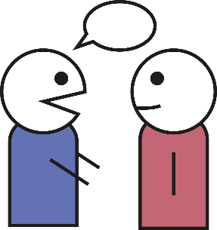
Vokabeln
sprechen / hören
Person A
Person B
(I, s/he, it) knows
even, in fact
it’s/that’s a pity
result
ear
ear
even, in fact
(you) know
it’s/that’s a pity
glasses
glasses
result
to be correct
to vote for
to vote for
to be correct
(you) know
(I, s/he, it) knows
Notes:
Foundation only. Optional additional vocabulary activity.
Timing: 5 minutes
Aim: to practise spoken production and aural recognition of the nine new words for this week.
Procedure:
Person A and Person B sketch a quick 3 x 3 grid. They write the English meanings into it, without conferring with each other.
Then Person A starts and says one of the words in German. Both students cross it on their grids.
Person B says a 2nd word. They are trying to make a line of three (as in noughts and crosses). Again, both students cross off. (The element of chance arises because the students don’t know where each other’s words are so in trying to create their own line of words, students may inadvertently help their partner to win).
Students continue until one has a row of three (vertical, diagonal, horizontal).
Then they play on for a 2nd row, column until all the words are used.
If a student cannot say any more words, the play passes to the other student, who gets to choose the next word and has more chance of controlling the game.
Students can do multiple rounds of the activity.

Slide 38
Verbs into nouns
Grammatik
Use any German infinitive as a noun by capitalising it:
wandern
Wandern
to hike, (go on a) walk
das
hiking, going walking
➜
All such nouns are neuter, so take the article das.
You can use these nouns with or without das:
Ich mag das Wandern.
Ich mag Wandern.
➜
I like hiking, going walking.
You may choose to add das for emphasis or with specific examples:
Das Wandern hier ist so schön.
➜
The hiking here is so nice.
Noun-verb phrases become compound nouns:
Karten spielen
➜
(das) Kartenspielen
playing cards, card playing
to play cards
Notes:
Timing: 2 minutes Aim: to revisit the concept of nominalisation of verbs, and to present new information about the use or omission of the article das.
Procedure: 1. Click through to present the information.
2. Elicit English and/or German meanings as appropriate.

Slide 39
Welche Form ist richtig?
hören
Hör zu. Schreib 1- 8 und V (verb) oder NV (nominalised verb).
 |  | Verb | Nominalised verb
 | Ich werde wandern. | wandern | Wandern
 | Das ist ein Versprechen. | versprechen | Versprechen
 | Für mich ist Schlafen wichtig. | schlafen | Schlafen
 | Hausaufgaben nicht vergessen. | vergessen | Vergessen
 | Wir wissen viel über das Thema. | wissen | Wissen
 | Ich mag es zu Helfen. | helfen | Helfen
 | Das Kartenspielen ist nicht erlaubt. | Karten spielen | Kartenspielen
 | Man darf kein Essen mitnehmen. | mitnehmen | Mitnehmen
1
I will hike/go hiking.
2
That’s a promise.
3
For me sleep(ing) is important.
4
Don’t forget your homework.
5
We know a lot about the topic.
6
I like helping.
7
Playing cards is not allowed.
8
You’re not allowed to take food.
Notes:
Timing: 5 minutes Aim: to practise the recognition of and written distinction between infinitive verbs and their noun forms, depending on their function and meaning in the sentence.
Procedure: 1. Explain the task. Students will listen to full sentences and choose the infinitive verb or nominalised verb, depending on the sentence.
2. Do number 1 with students as an example. Click to listen. Prompt students to consider the other words in the sentence. ‘Ich werde’ (I will/am going to) – what must follow? What does the whole sentence mean? Click to confirm the answers and reveal the English sentence meaning.
3. Continue with items 2 – 7. We suggest giving feedback item by item with this task and have set the animations accordingly.
Transcript: 1. Ich werde wandern.
2. Das ist ein Versprechen.
3. Für mich ist Schlafen wichtig.
4. Hausaufgaben nicht vergessen.
5. Wir wissen viel über das Thema.
6. Ich mag es zu Helfen.
7. Das Kartenspielen ist nicht erlaubt.
8. Man darf kein Essen mitnehmen.

Slide 40
More than 1 – rule 9
*das Herz – heart
Grammatik
Remember: the word for ‘the’ is ‘die’ for all plural nouns.
Some neuter nouns add –(e)n.
➜
die Augen
das Auge
das Herz*
➜
die Herzen
Notes:
F/H
Timing: 1 minute Aim: to present plural rule 9. Procedure: Click through the animations.

Slide 41
Welche Kategorie ist das?
hören
Hör zu. Schreib 1-14 und NV oder R9.
1
2
3
4
5
6
7
8
9
10
11
12
13
14
Nominalised verbs
Schlafen
Vergessen
Sterben
Sehen
Mitnehmen
Helfen
Verbessern
Rule 9 Plurals
Ohren
Betten
Interessen
Herzen
Hemden
Wochenenden
Augen
Notes:
F/H Timing: 2 minutes
Aim: to practise word knowledge by differentiating between nominalised verbs and Rule 9 plural forms, both of which end in (e)n. Note: these are all revisited words (except for Herzen, just encountered on the previous slide), though the plural noun forms are not yet known.
Procedure:
Students divide their page in half and title each side: Verb nouns | Rule 9 plurals.
Click to listen.
Students transcribe the whole words into the correct ‘box’.
Elicit the answers in German and the word meanings and click to reveal the answers.
Transcript:
Ohren
Betten
Schlafen
Vergessen
Interessen
Herzen
Sterben
Hemden
Sehen
Mitnehmen
Helfen
Wochenenden
Verbessern
Augen

Slide 42
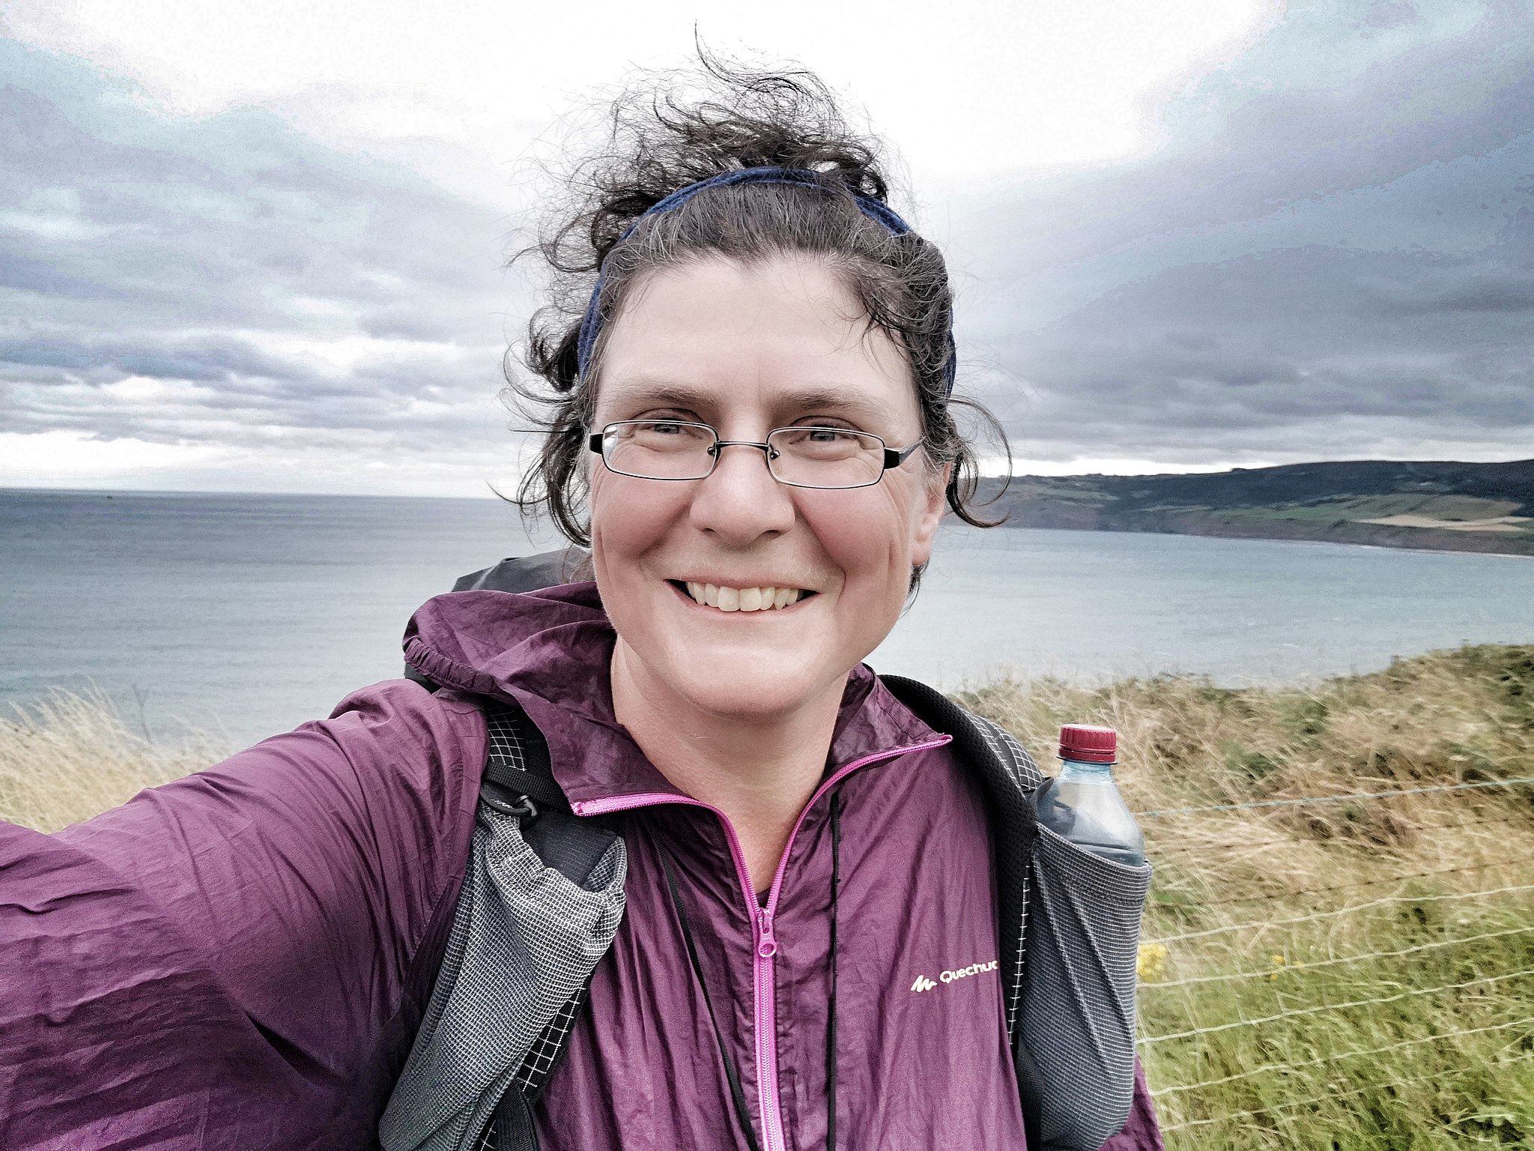
Christine Thürmer [1/2]
Hör zu. Beantworte die Fragen auf Englisch.
hören
What is Christine Thürmer’s first book called?
How does she know about these activities? (two details)
Name three ways that Christine travels. (three details)
How does the speaker know this?
1
Run(nin)/Walk(ing), Eat(ing), Sleep(ing).
2
She does them every day |all over the world.
3
on foot | by bike | by boat
4
Reads it on Christine’s blog
überall – everywhere
Notes:
Foundation – there is a Higher version of the activity on the next slide. Timing: 8 minutes
Aim: to practise aural comprehension of vocabulary and structures from this week’s learning.
Procedure: 1. Explain the task.
2. Students listen to the passage and answer the questions in English.
Note: the audio has been inserted both as individual items and as one complete passage. Teachers can use either or both, to suit the needs of their students. 3. Elicit responses and click to provide the answers.
Transcript: Laufen, Essen, Schlafen.
Das ist das erste Buch von Christine Thürmer. Sie hat drei Bücher geschrieben.
Diese drei Dinge macht Christine jeden Tag.
Sie läuft, sie isst, sie schläft. Gerne!
Diese drei Dinge macht sie überall auf der Welt.
Heute, am 25. August 2022 lese ich auf Christines Blogseite, dass sie 60.000 Kilometer zu Fuß gelaufen ist, dass sie 30.000 Kilometer mit dem Rad und 6.500 Kilometer mit dem Boot gefahren ist.
Differentiation: to increase the level of challenge, teachers could remove the questions and set the activity as a dictagloss. Students listen to the whole passage and write notes in English. They then have time to work in pairs or small groups to reconstruct the passage. A word-for-word reconstruction is not the aim, rather a written version that contains and successfully communicates all of the main information from the original passage.
Source:
https://de.wikipedia.org/wiki/Christine_Th%C3%BCrmer
Image attribution: Christine Thürmer, CC BY-SA 4.0 via Wikimedia Commons https://commons.wikimedia.org/wiki/File:Christine_Th%C3%BCrmer1.jpg

Slide 43
Christine Thürmer [1/2]
Hör zu. Beantworte die Fragen auf Englisch.
hören
What is Christine Thürmer’s first book called?
How does she know about these activities? (two details)
Name three ways that Christine travels. (three details)
How does the speaker know this?
1
Run(nin)/Walk(ing), Eat(ing), Sleep(ing).
2
She does them every day |all over the world.
3
on foot | by bike | by boat
4
Reads it on Christine’s blog
Notes:
Higher – there is a Foundation version of the activity on the previous slide. Timing: 8 minutes
Aim: to practise aural comprehension of vocabulary and structures from this week’s learning.
Procedure: 1. Explain the task.
2. Students listen to the passage and answer the questions in English.
Note: the audio has been inserted both as individual items and as one complete passage. Teachers can use either or both, to suit the needs of their students. 3. Elicit responses and click to provide the answers.
Transcript: Laufen, Essen, Schlafen.
Das ist das erste Buch von Christine Thürmer. Sie hat drei geschrieben.
Diese drei Dinge sind das, was Christine macht. Jeden Tag.
Sie läuft, sie isst, sie schläft. Gerne!
Diese drei Dinge macht sie in allen Ecken der Welt.
Christine ist die meist gewanderte Frau der Welt.
Heute, am 25. August 2022 lese ich auf Christines Blogseite, dass sie 60.000 Kilometer zu Fuß gelaufen ist, dass sie 30.000 Kilometer mit dem Rad gefahren ist, dass sie 6.500 Kilometer mit dem Boot gefahren ist.
Differentiation: to increase the level of challenge, teachers could remove the questions and set the activity as a dictagloss. Students listen to the whole passage and write notes in English. They then have time to work in pairs or small groups to reconstruct the passage. A word-for-word reconstruction is not the aim, rather a written version that contains and successfully communicates all of the main information from the original passage.
Source:
https://de.wikipedia.org/wiki/Christine_Th%C3%BCrmer
Image attribution: Christine Thürmer, CC BY-SA 4.0 via Wikimedia Commons

Slide 44
Christine Thürmer [2/2]
lesen
5. Why did Christine not do PE at school?
Christine wurde 1967 in Forchheim geboren. Sporttreiben in der Schule? Nein, das gibt's nicht! Also arbeitet Christine als Managerin. Mit 37 Jahren fängt sie mit dem Wandern an, weil sie ihren Job verliert und weil ein Freund stirbt.
There wasn’t any.
6. Why did she start hiking? (2 details)
She lost her job| A friend died.
Sie wandert durch Australien, Neuseeland, Japan, die USA, Singapur, Großbritannien, Europa. Sie hat keine Angst – das Wandern macht sie glücklich!
Christine nimmt sehr wenig mit – Zahnbürste*, Nivea-Crème, Wasser, Zahnseide*. Sie wandert mit nur ungefähr 5 Kilogramm. Unterwegs trägt sie auch keine Unterhose. Sie sind einfach nicht praktisch. ‚Going Commando’ heißt das. Sie navigiert mit einem GPS-Gerät, benutzt manchmal ihr Handy.
Gar nicht schlecht für einen Sportmuffel*.
7. How does she feel about hiking? (2 details)
She is not afraid |
It makes her happy
8. Apart from toothbrush, floss and cream, name two things Christine travels with.
water | phone
Zahnbürste – toothbrush; Zahnseide – floss Sportmuffel – couch potato
Notes:
Foundation – there is a Higher version of the activity on the next slide. Timing: 8 minutes
Aim: to practise written comprehension of vocabulary and structures from this week’s learning.
Procedure: 1. Explain the task.
2. Students read the text about Christine Thürmer and answer the questions in English.
3. Elicit responses and click to provide the answers.
Answers:
5. Why did Christine not do sport at school? There wasn’t any 6. Why did she start hiking (two details) ? She lost her job | A friend died. 7. How does she feel about it? (two details) She is not not afraid | It makes her happy 8. Apart from toothbrush, floss and cream, name two things Christine has with her on her travels. Water | phone

Slide 45
Christine Thürmer [2/2]
lesen
5. Why did Christine not do PE at school?
Christine wurde 1967 in Forchheim geboren. Sporttreiben in der Schule? Das gibt's nicht! Also arbeitet Christine als Managerin. Mit 37 Jahren fängt sie mit dem Wandern an, weil sie ihren Job verliert und weil ein Freund stirbt.
There wasn’t any.
6. Why did she start hiking? (2 details)
She lost her job| A friend died.
Sie macht sich auf den Weg durch Australien, Neuseeland, Japan, die USA, Singapur, Großbritannien, Europa. Sie hat keine Angst – das Wandern macht sie glücklich!
Christine nimmt so wenig wie möglich mit. Ihr Rucksack enthält Zahnbürste*, Nivea-Crème, Wasser, Zahnseide*. Sie wandert mit nur ungefähr 5 Kilogramm. Unterwegs trägt sie auch keine Unterhose. Sie sind einfach nicht praktisch. ‚Going Commando’ heißt das.
Sie navigiert mit einem GPS-Gerät, benutzt manchmal ihr Handy.
Gar nicht schlecht für einen Sportmuffel*.
7. How does she feel about hiking? (2 details)
She is not afraid |
It makes her happy
8. Apart from toothbrush, floss and cream, name two things Christine travels with.
water | phone
Zahnbürste – toothbrush; Zahnseide – floss Sportmuffel – couch potato
Notes:
Higher – there is a Foundation version of the activity on the previous slide. Timing: 8 minutes
Aim: to practise written comprehension of vocabulary and structures from this week’s learning.
Procedure: 1. Explain the task.
2. Students read the text about Christine Thürmer and answer the questions in English.
3. Elicit responses and click to provide the answers.
Answers:
5. Why did Christine not do sport at school? There wasn’t any 6. Why did she start hiking (two details) ? She lost her job | A friend died. 7. How does she feel about it? (two details) She is not not afraid | It makes her happy 8. Apart from toothbrush, floss and cream, name two things Christine has with her on her travels. Water | phone

Slide 46
Wie viele Sprachen?
schreiben
WO1 or WO3 after dass?
Schreib die Sätze auf Deutsch.
1. We know that many people only speak one language.
2. Why? They have many fears.
3. Do you know Natalie Portman or Novak Đoković?
4. She speaks five languages and he speaks seven.
5. So you can have more interests – e.g. sport and languages.
6. You see the results quickly, if you practise often.
Which ‘know’ ?
Plural rule 7
Which ‘know’ ?
Plural rule 9
Plural rule 8
Wenn + WO3
Stem change verb!
Some adjectives and adverbs are identical.
Notes:
Note: this is a Foundation version of the task. The animated callouts are presented as static tip boxes on the handouts. Aim: to practise written production of language and structures from this week and prior learning. Procedure: 1. Students translate the six sentences from English into German. 2. Students can peer or self assess this task (at the start of next lesson, perhaps). Note: this task deliberately targets words and grammar from this week, whilst including other previously taught language, which is not credited in the mark scheme. Students should attempt full sentences, but they should also be clear which words are targeted. Each underlined section is worth 2 points, giving a total of 20 for the task. Mark scheme: 2 points – message communicated accurately 1 point – message communicated 0 – message not communicated Teachers may consider it useful to include summary tasks like this (either weekly or fortnightly), recording the scores and sharing them with students and parents (e.g., on the school's online data system). The tasks provide a very useful regular snapshot of student effort and progress over time. In our department, we have teacher-marked every 1/3 of these tasks, with peer marking for the rest. We have generally considered that 14+/20 is a benchmark for good progress, whilst regular scores of >12 are of concern.
Image attribution: https://commons.wikimedia.org/wiki/File:Multilingual_support_symbol.svg
Source: European Day of Languages > Facts > Celebrities speaking languages (ecml.at) [Date accessed 16.10.22]

Slide 47
Wie viele Sprachen?
schreiben
WO1 or WO3 after dass?
Schreib die Sätze auf Deutsch.
1. We know that many people can only speak one language.
2. Why? They have many fears. They think that they will make mistakes.
3. But do you know that many famous people speak either one other language or more?
4. Do you know Natalie Portman or Novak Đoković? She speaks 5 languages and he speaks 7.
5. So you can have more interests – for example, sport and languages.
6. If you practise a new language regularly, you see the results relatively quickly.
7. If you know more than one language it helps you to make more friends.
Which ‘know’ ?
Plural rule 7
either …or
Here you could make ‘berühmt’ into a noun ‘famous people’.
Which ‘know’ ?
Plural rule 8
Plural rule 9
Wenn + WO3
Stem change verb!
Some adjectives and adverbs are identical.
In German you ‘find’ friends not ‘make’ them.
Notes:
Note: this is a Higher version of the task. The animated callouts are presented as static tip boxes on the handouts.
Timing: 15 minutes Aim: to practise written production of language and structures from this week and prior learning. Procedure: 1. Students translate the seven sentences from English into German. 2. Students can peer mark this task (at the start of next lesson, perhaps). Note: this task deliberately targets words and grammar from this week, whilst including other previously taught language, which is not credited in the mark scheme. Students should attempt full sentences, but they should also be clear which words are targeted. Each underlined section is worth 2 points, giving a total of 20 for the task. Mark scheme: 2 points – message communicated accurately 1 point – message communicated 0 – message not communicated Note that item 4 repeats the same target structure as item 1. This is a 2nd chance for students to get the 2 points for this structure. If they get it right in both items, they still receive two points (i.e., they do not score 22/20).
Teachers may consider it useful to include summary tasks like this (either weekly or fortnightly), recording the scores and sharing them with students and parents (e.g., on the school's online data system). The tasks provide a very useful regular snapshot of student effort and progress over time. In our department, we have teacher-marked every 1/3 of these tasks, with peer marking for the rest. We have generally considered that 14+/20 is a benchmark for good progress, whilst regular scores of >12 are of concern.
Image attribution: https://commons.wikimedia.org/wiki/File:Multilingual_support_symbol.svg
Source: European Day of Languages > Facts > Celebrities speaking languages (ecml.at) [Date accessed 16.10.22]

Slide 48
Wie viele Sprachen?
schreiben
WO1 or WO3 after dass?
Schreib die Sätze auf Deutsch.
1. We know that many people only speak one language.
2. Why? They have many fears.
3. Do you know Natalie Portman or Novak Đoković?
4. She speaks five languages and he speaks seven.
5. So you can have more interests – for example, sport and languages.
6. You see the results quickly, if you practise often.
Wir wissen, dass viele Leute nur eine Sprache sprechen.
Which ‘know’ ?
Plural rule 7
Warum? Sie haben viele Ängste.
Kennst du Natalie Portman oder Novak Đoković?
Which ‘know’ ?
Sie spricht fünf Sprachen und er spricht sieben.
Also kann man mehr Interessen haben – zum Beispiel Sport und Sprachen.
Plural rule 8
Wenn + WO3
Man sieht die Ergebnisse schnell, wenn man oft übt.
Stem change verb!
Plural rule 9
Some adjectives and adverbs are identical.
Notes:
ANSWERS
Procedure:
Click to remove each tip and then elicit answers from students. Alternatively, click more quickly through all animations and ask students to peer mark or mark their own work.
Image attribution: https://commons.wikimedia.org/wiki/File:Multilingual_support_symbol.svg
Source: European Day of Languages > Facts > Celebrities speaking languages (ecml.at) [Date accessed 16.10.22]

Slide 49
Wie viele Sprachen?
schreiben
WO1 or WO3 after dass?
Schreib die Sätze auf Deutsch.
1. We know that many people can only speak one language.
2. Why? They have many fears. They think that they will make mistakes.
3. But do you know that many famous people speak either one other language or more?
4. Do you know Natalie Portman or Novak Đoković? She speaks 5 languages and he speaks 7.
5. So you can have more interests – for example, sport and languages.
6. If you practise a new language regularly, you see the results relatively quickly.
7. If you know more than one language it helps, for example, to make more friends.
Wir wissen, dass viele Leute nur eine Sprache sprechen können.
Which ‘know’ ?
Warum? Sie haben viele Ängste. Sie denken, dass sie Fehler machen warden.
Plural rule 7.
Aber weißt du, dass viele Berühmte entweder eine andere Sprache oder mehr sprechen?
either …or
Here you could make ‘berühmt’ into a noun ‘famous people’.
Kennst du Natalie Portman oder Novak Đoković? Sie spricht 5 Sprachen und er spricht 7.
Which ‘know’ ?
Also kann man mehr Interessen haben – zum Beispiel Sport und Sprachen.
Plural rule 9
Plural rule 8
Wenn man eine neue Sprache häufig übt, sieht man die Ergebnisse relativ schnell.
Wenn + WO3
Stem change verb!
Some adjectives and adverbs are identical.
Wenn man mehr als eine Sprache kennt, hilft es, zum Beispiel, mehr Freunde zu finden.
In German you ‘find’ friends not ‘make’ them.
Notes:
ANSWERS
Procedure:
Click to remove each tip and then elicit answers from students. Alternatively, click more quickly through all animations and ask students to peer mark or mark their own work.
Image attribution: https://commons.wikimedia.org/wiki/File:Multilingual_support_symbol.svg
Source: European Day of Languages > Facts > Celebrities speaking languages (ecml.at) [Date accessed 16.10.22]

Slide 50
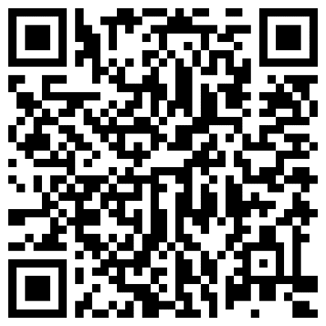
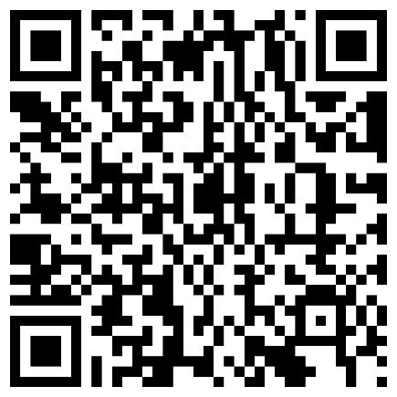
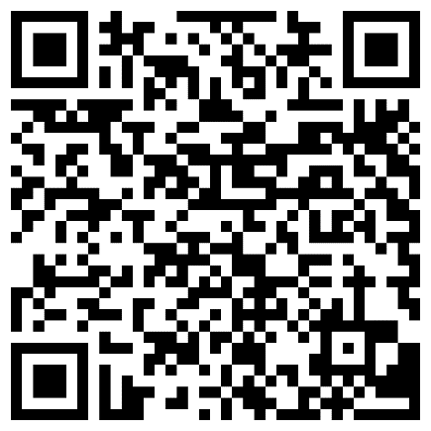
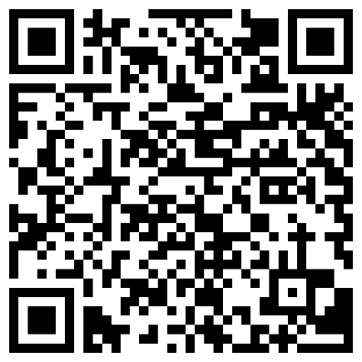
Hausaufgaben
10.1.1.5 new vocabulary
10.1.1.5 revisited vocabulary
Hausaufgabenblatt 10.1.1.4
Foundation
Higher
Foundation
Higher
Notes:
Timing: 2 minutes Aim: to remind students of the vocabulary they will be learning and revisiting for next week.
Procedure: 1. Display the slide. Explain the tasks. 2. Post this slide or its information for students, using the usual school system for this.
Notes: A regular feature of the scheme of work (as for KS3) is that students spend time learning the vocabulary for the following week’s lessons. This can be done using any platform. We provide the words on Quizlet. Most lists are also available (free to all schools, not just subscribers) on LanguageNut. Teachers may of course create their own versions of vocabulary learning activities in any of the different platforms available. At KS4, there are several sets for learning/revisiting: 1. The new vocabulary for the following week. 2. The revisited thematic vocabulary (from KS3 SOW) assigned to the week. 3. The systematic revisiting (at +3 and +9 weekly intervals) of new vocabulary.
In the KS4 SOW every word from the GCSE vocabulary list has been tracked to ensure that: 1. New words are introduced, revisited twice at intervals during the course, and once again during the final 9-week revision phase. 2. KS3 revisited thematic vocabulary is revisited twice during the course, and once again during the final 9-week revision phase. 3. KS3 function words (listed as R(equired) on Annex E of the GCSE Subject Content are all revisited multiple times (Column D on the KS4 SOW) and the revisits are also tracked on the KS4 Vocabulary tracker.
We anticipate that students will spend on average 2 hours on homework per week at KS4. As a general rule, one hour would be assigned to vocabulary learning (and ideally this time will be spread across the week). The aim at KS3 was to establish a ‘little and often’ approach to vocabulary learning, using an app to facilitate this. This learning habit will hopefully continue into KS4. The 2nd hour will generally include additional reading, listening, speaking tasks. Teachers will be best placed to decide whether to include extended writing tasks for homework. However, given the availability of online translation tools and the strong temptation to use them, such tasks might best be undertaken in class, where teachers can replicate the conditions for written language production that will apply for students at GCSE.

Slide 51
Eine interessante Person
schreiben
Prepare to write about an interesting plurilingual person. To do this:
1) read the task bullets (1 minute) 2) note key grammar features to include (2 minutes) 3) do some research to identify a person and find information about them (15 minutes) 4) complete the plan with some key words and phrases (25-30 minutes).
Schreib ungefähr 100 Wörter über eine interessante Person, die zwei oder mehr Sprachen spricht.
die Person und die Sprachen, die diese Person kennt
die Gründe, warum diese Person andere Sprachen kann
die Vorteile für diese Person
deine Meinung (z.B. über diese Person oder über Sprachen im Allgemeinen)
e ➜ i
helfen mitnehmen sprechen vergessen versprechen
andere Verben
bedeuten lernen verbessern verstehen
andere Ideen: WO1, WO2, WO3, Verbs as nouns Pluralformen (R7, 8, 9)
a ➜ ä
anfangen lassen schlafen
e ➜ ie
lesen sehen
wissen kennen können
Notes:
HOMEWORK Foundation version
Timing: 45 minutes
Aim: to plan a short piece of semi-structured writing about a plurilingual person you find interesting to write in class next week. This could be someone you know or a celebrity. There are some suggested sources of information below.
Procedure:
Students complete the template provided (separate word document). They complete some fact-finding, note main ideas against each bullet and write down key words/language they want to include in their answer, which they will write in class time.
The template is designed to help preparation so that students can focus on language in the task, but also to support cognition and comprehension by making writing a two-stage process of planning and implementing that planning.
Sources of information: Who Are The Most Multilingual Celebrities In The World? (babbel.com)
European Day of Languages > Facts > Celebrities speaking languages (ecml.at)
The Most Famous Multilingual People in History – BeTranslated

Slide 52
Eine interessante Person
When you use können, remember the 2-verb rule.
schreiben
Schreib ungefähr 100 Wörter über eine interessante Person, die zwei oder mehr Sprachen spricht.
Which word order do you need after deshalb?
Dan Stevens ist berühmt für seine Rolle als Matthew Crawley in Downton Abbey. Dan spricht nicht nur Englisch. Er kann auch Deutsch und Französisch sprechen.
Dan hat Deutsch in der Schule gelernt. Seine Familie hatte gute Freunde in Bielefeld, deshalb hat Dan oft Deutschland besucht und als er 17 Jahre alt war, hat er ein Praktikum* dort gemacht.
Sein erster Kinofilm war Hilde. Er war der englische Mann von Hildegard Knef im Film und musste Deutsch sprechen. Dan denkt, dass er bessere Chancen in der Filmwelt hat, weil er andere Sprachen kann.
Er hat den Film Ich bin dein Mensch in Berlin gemacht. Hier hat er sich in Deutschland verliebt*. Deutschsprechen ist einfach ganz toll!
als is a WO3 conjunction.
Which word order follows dass?
das Praktikum – work placement
sich verlieben – to fall in love
Nouns from verb phrases become compound nouns. Deutsch sprechen ➜ (das) Deutschsprechen
Notes:
HOMEWORK Foundation version – Sample answer
Notes: This sample answer could be used in a variety of ways:
use an audio version of the text in class as a dictagloss task before students write their own answer, whereby students listen, make notes in English, then work in pairs or small groups to try to produce a written version of the text containing all of the key information. After this, this slide could be displayed, with the callouts to focus in on key language features from this week.
as for i) but do this after students have written their own versions, but before submission, giving them the opportunity to check and/or edit their own work (but without leaving the written model in view).
use this written version with callouts before students prepare to write to draw attention to key features that they may want to include, but ensure that students don’t have access to this written version for their preparation homework as they may be too tempted to stick too closely to its content/language.
use this written version with callouts after students have had their own work marked to draw attention to key features.
Written feedback: Some useful principles to guide teacher practice in written feedback are:
give immediate feedback when possible; if students write their answers in class the teacher can circulate to prompt attention to errors, highlight successful examples etc.
target specific (previously highlighted) features for error correction, rather than correcting every mistake
give direct feedback (i.e., rather than codes) though some learners may benefit from a prompt style feedback (i.e., underlining errors for them to correct)
use a model writing answer to go through whole class as a stimulus to students improving their answers (this could be post teacher correction, or prior to handing in)
Image: https://commons.wikimedia.org/wiki/File:Dan_Stevens_at_Premiere_of_Beauty_and_the_Beast_(cropped).jpg https://www.flickr.com/photos/minglemediatv/, CC BY-SA 2.0 <https://creativecommons.org/licenses/by-sa/2.0>, via Wikimedia Commons

Slide 53
Eine interessante Person
schreiben
Prepare to write about an interesting plurilingual person. To do this:
1) read the task bullets (1 minute) 2) note key grammar features to include (2 minutes) 3) do some research to identify a person and find information about them (15 minutes) 4) complete the plan with some key words and phrases (25-30 minutes).
Schreib 100-120 Wörter über eine interessante Person, die zwei oder mehr Sprachen spricht.
die Person und die Sprachen, die diese Person kennt
die Gründe, warum diese Person andere Sprachen kann
die Vorteile für diese Person
deine Meinung (z.B. über diese Person oder über Sprachen im Allgemeinen)
a ➜ ä
anfangen lassen schlafen
auffallen
erhalten
e ➜ i
helfen mitnehmen sprechen vergessen versprechen
betreffen
gelten
andere Verben
aufgeben
bedeuten lernen verbessern verstehen
Stimmen
veröffentlichen
andere Ideen: WO1, WO2, WO3, Verbs as nouns Pluralformen (R7, 8, 9)
e ➜ ie
lesen sehen
wissen kennen können
Notes:
Higher version
Timing: 45 minutes
Aim: to plan a short piece of semi-structured writing about a plurilingual person you find interesting to write in class next week. This could be someone you know or a celebrity. There are some suggested sources of information below.
Procedure:
Students complete the template provided (separate word document). They complete some fact-finding, note main ideas against each bullet and write down key words/language they want to include in their answer, which they will write in class time.
The template is designed to help preparation so that students can focus on language in the task, but also to support cognition and comprehension by making writing a two-stage process of planning and implementing that planning.
Sources of information: Who Are The Most Multilingual Celebrities In The World? (babbel.com)
European Day of Languages > Facts > Celebrities speaking languages (ecml.at)
The Most Famous Multilingual People in History – BeTranslated

Slide 54
Eine interessante Person
When you use können, remember the 2-verb rule.
schreiben
Schreib 100 – 120 Wörter über eine interessante Person, die zwei oder mehr Sprachen spricht.
Which word order do you need after deshalb?
Dan Stevens ist berühmt für seine Rolle als Matthew Crawley in Downton Abbey. Dan spricht nicht nur Englisch. Er kann auch Deutsch und Französisch sprechen. Er schreibt auch gern und veröffentlicht seine Arbeiten.
Dan hat Deutsch in der Schule gelernt. Seine Familie hatte gute Freunde in Bielefeld, deshalb hat Dan oft Deutschland besucht und als er 17 Jahre alt war, hat er ein Praktikum* dort gemacht.
Sein erster Kinofilm war Hilde. Er war der englische Mann von Hildegard Knef im Film und musste Deutsch sprechen. Also kann er entweder Deutsche oder Engländer spielen. Dan denkt, dass er bessere Chancen in der Filmwelt hat, weil er andere Sprachen kann.
Er hat den Film Ich bin dein Mensch in Berlin gemacht. Hier hat er sich in Deutschland verliebt*. Deutschsprechen ist einfach ganz toll!
als is a WO3 conjunction
das Praktikum – work placement
Which word order follows dass?
new conjunction!
sich verlieben – to fall in love
Nouns from verb phrases become compound nouns. Deutsch sprechen ➜ (das) Deutschsprechen
Notes:
HOMEWORK Foundation version – Sample answer
Notes: This sample answer could be used in a variety of ways:
use an audio version of the text in class as a dictagloss task before students write their own answer, whereby students listen, make notes in English, then work in pairs or small groups to try to produce a written version of the text containing all of the key information. After this, this slide could be displayed, with the callouts to focus in on key language features from this week.
as for i) but do this after students have written their own versions, but before submission, giving them the opportunity to check and/or edit their own work (but without leaving the written model in view).
use this written version with callouts before students prepare to write to draw attention to key features that they may want to include, but ensure that students don’t have access to this written version for their preparation homework as they may be too tempted to stick too closely to its content/language.
use this written version with callouts after students have had their own work marked to draw attention to key features.
Written feedback: Some useful principles to guide teacher practice in written feedback are:
give immediate feedback when possible; if students write their answers in class the teacher can circulate to prompt attention to errors, highlight successful examples etc.
target specific (previously highlighted) features for error correction, rather than correcting every mistake
give direct feedback (i.e., rather than codes) though some learners may benefit from a prompt style feedback (i.e., underlining errors for them to correct)
use a model writing answer to go through whole class as a stimulus to students improving their answers (this could be post teacher correction, or prior to handing in)
Image attribution: https://www.flickr.com/photos/minglemediatv/, CC BY-SA 2.0 via Wikimedia Commons

