Slide 1
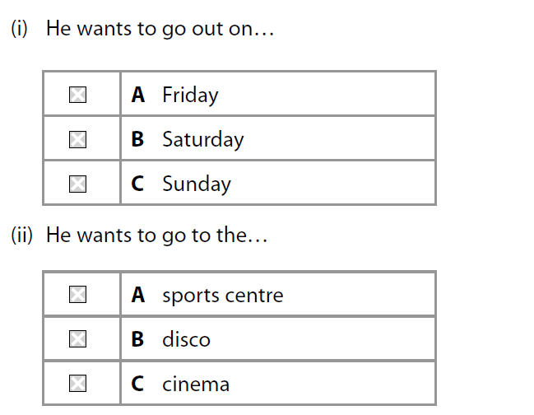
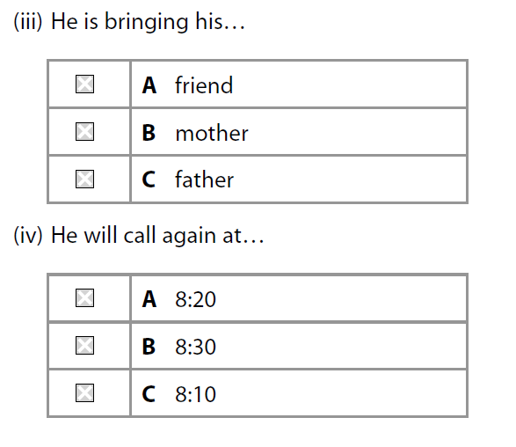
3 Going out Jorge has left a message on Andrea’s mobile. Put a cross X in the correct box.
/ 4
Notes:
2011 Edexcel Foundation Q9
Answers (i) – B (ii) – C (iii) – A (iv) - C

Slide 2
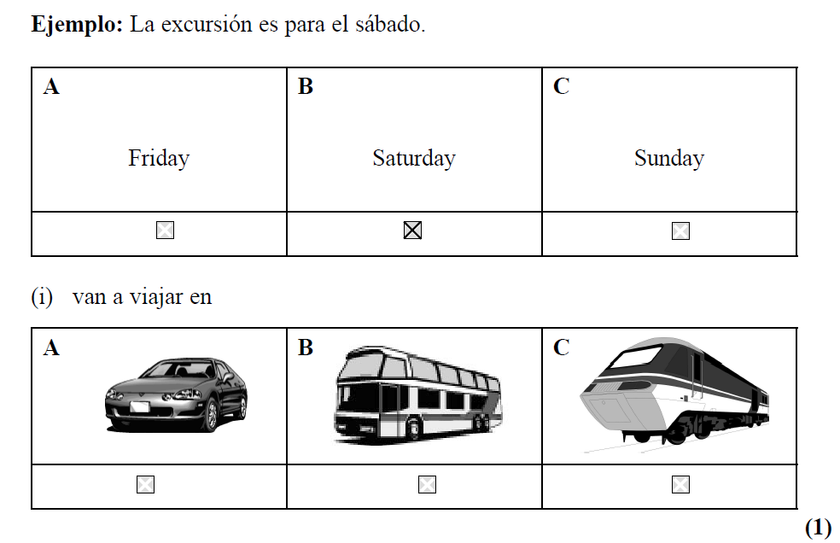
4 Una excursión Juan habla de sus planes para un día. Put a cross X in the correct boxes.
Notes:
2010 legacy Edexcel Foundation 23 a & b Answers (i) – A (ii) – C (iii) – A (iv) – C (v) – B
Total points = 18 16/18 = Level 5 12/18 = Level 4

Slide 3
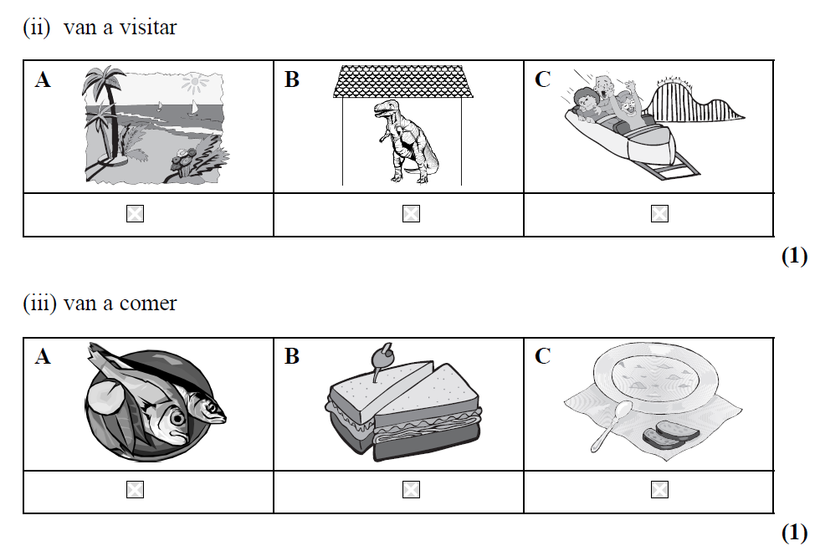

Slide 4
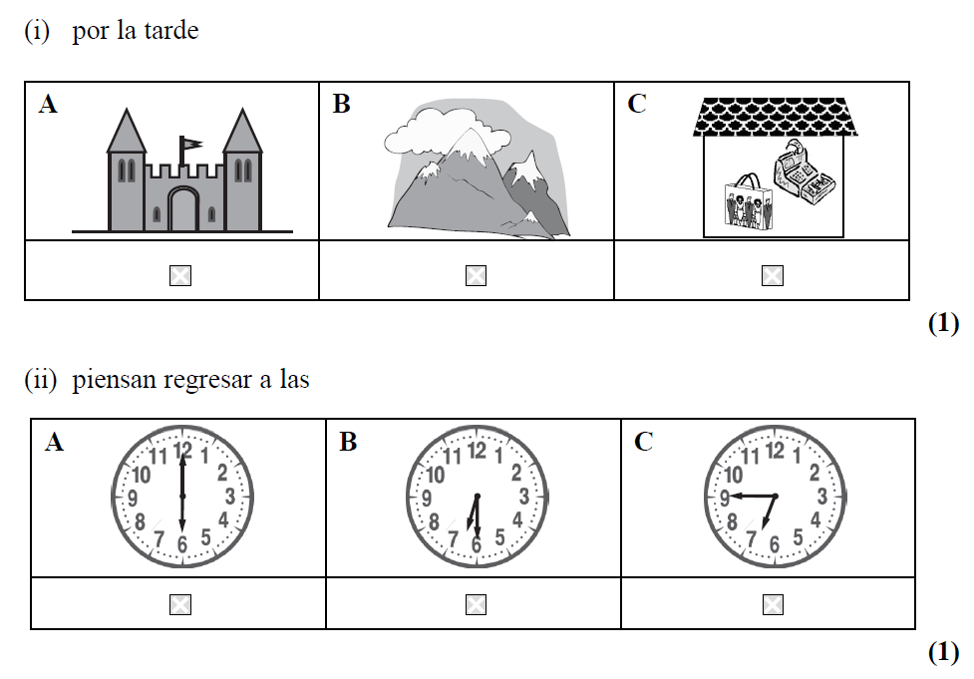
/ 5

