Slide 1

Repaso
preguntas
presentación
respuestas
Hoy vamos a repasar:
cómo hacer preguntas
cómo conversar sobre el tiempo libre

Slide 2
1 | ¿Cuál es tu d_____________ p___________? (What is your favourite sport?)
2 | ¿C____________ lo empezaste? (When did you start it?)
3 | ¿A____________ a alguien? (Do you admire anyone?)
4 | ¿Tienes una __________ preferida? (Do you have a favourite shop?)
5 | ¿Hay o_______ c____________ que te gustan hacer? (Are they other things you like doing?)
6 | ¿Qué h____________ el fin de semana p____________? (What did you do last weekend?
7 | ¿A____________ fuiste? (Where did you go?)
8 | ¿Qué p__________ tienes para el p__________ f__ de s________? (What are you planning to do next weekend?)
9 | Y tu programa favorito, ¿d__________ tiene l_________? (Your favourite programme, where is it set?)
10 | ¿De qué t___________? (What’s it about?)
11 | ¿Te g_____________ los medios s___________? (Do you like social media?)
12 | ¿Te gustaría p___________ algún deporte o_____________? (Would you like to try an olympic sport?)
Notes:
It’s really important that students recognise questions and can answer them spontaneously, even if not perfectly. In this lesson they need to get the message that they will be able to prepare something but also that they will be asked follow up questions and that understanding the questions and making a confident response is what counts here. Elicit the missing words from the class. Then blank the screen and ask the questions in Spanish at random - first see if they can understand the question at speed (translating it into English) then get them to practise just giving a short response, even if not in a full sentence.

Slide 3
asatiempo
referido
1 | ¿Cuál es tu p_____________ p___________? (What is your favourite hobby?)
2 | ¿C____________ lo empezaste? (When did you start it?)
3 | ¿A____________ a alguien? (Do you admire anyone?)
4 | ¿Tienes una __________ preferida? (Do you have a favourite shop?)
5 | ¿Hay o_______ c____________ que te gustan hacer? (Are they other things you like doing?)
6 | ¿Qué h____________ el fin de semana p____________? (What did you do last weekend?
7 | ¿A____________ fuiste? (Where did you go?)
8 | ¿Qué p__________ tienes para el p__________ f__ de s________? (What are you planning to do next weekend?)
9 | Y tu programa favorito, ¿d__________ tiene l_________? (Your favourite programme, where is it set?)
10 | ¿De qué t___________? (What’s it about?)
11 | ¿Te g_____________ los medios s___________? (Do you like social media?)
12 | ¿Te gustaría p___________ algún deporte o_____________? (Would you like to try an olympic sport?)
uándo
dmiras
tienda
tras
osas
iciste
asado
dónde
lanes
róximo
in
emana
ónde
ugar
rata
ustan
ociales
robar
límpico

Slide 4
Write a 30-second mini-presentation about sports using this as a framework. Then do a prompt sheet with 10 words maximum and practise until you can deliver the presentation with only the prompts.
One or two sports you like and why
los deportes
Your plans for next weekend + extra details
What you did last weekend (+extra detail + opinion)
Where? When? With whom?
Say a sport that someone else you know likes.
Notes:
This is going to be the remainder of the lesson and then homework. Starting it in class will help them to get the idea.

Slide 5
Write a 30-second mini-presentation about sports using this as a framework. Then do a prompt sheet with 10 words maximum and practise until you can deliver the presentation with only the prompts.
One or two sports you like and why
los deportes
Your plans for next weekend + extra details
What you did last weekend (+extra detail + opinion)
Where? When? With whom?
Say a sport that someone else you know likes.

Slide 6
Do your 10 word prompt sheet here. Use colours to remind you about the different tenses and pictures too.
los deportes
Notes:
Explain the homework. I will record and mark this as a mini practice exam next Monday and Tuesday. There will be an open book writing assessment too with questions on free time, leisure and sport on Tuesday.

Slide 7

How do we need to improve our speaking?
Speed of recognising the questions
Speed of response
Being and sounding ‘real’ – tone of voice
Being sure about present, past, future (is it juego, jugué or voy a jugar?)
Making ‘porque es/son’ more interesting (other words apart from aburrido/divertido)
Singular or plural? Is or are? ¿Es o son? I like it or I like them? ¿Me gusta o me gustan?

Slide 8
Starting off a letter |  | Por la tarde | In the evening
Dear… | Querido/a | Normalmente | usually
I’m going to talk about | Voy a hablar sobre | In the past (PAST TENSE VERBS!)
Linking ideas |  | last weekend | el fin de semana pasado
My favourite sport | mi deporte favorito | last Saturday | el sábado pasado
My favourite hobby | mi pasatiempo preferido | Future plans
Another activity I like is | Otra actividad que me gusta es.. | next weekend | el próximo fin de semana
I also like | También me gusta | I am going to | voy a…
but I don’t like | pero no me gusta… | I would like to | me gustaría…
and I hate | y odio… | I am thinking of.. | tengo pensado…
Saying what you generally do (PRESENT TENSE) |  | More links (see board)
At weekends.. | los fines de semana | although | aunque

Slide 9
Modals – (plus infinitive)
1. Quiero/no quiero – I want/ I don’t want
2. Puedo/no puedo – I can/ I can’t
3. Tengo que/ No tengo que – I have to/I don’t have to
Conditional
1. Me gustaría – I would like to
Past tense
1. imperfect – Cuando era joven, jugaba al = When I was young, I used to play
2. preterit - El sábado pasado, fui a ……. = last Saturday, I went to 3. preterite – Decidí + infinitive = I decided to
Future 1. Voy a….. = I’m going to
2. Tengo pensado – I’m planning to/thinking of 3. Tengo la intención de – I’m intending to…….
Subjunctive
1. Cuando sea mayor – when I’m older
Additional extras
1. Intento + infinitive = I try to........
2. Suelo + infinitive = I usually ……….. 3. Antes de + infinitive……Before doing……. 4. Después de + infinitive …..After doing…….

Slide 10
Research & reference A. When you are preparing for your speaking, you need to:
Use your exercise book
Use your Y9 Spanish vocabulary guide
If you still find there are words you need then use: 1. www.wordreference.com Online dictionary – use this and not an online translator
If what you want to say needs a VERB, you will need to look up the correct form of the verb. You cannot just put the infinitive ‘mirar’ (to watch) when you want to say ‘I watched’. For this use www.verbix.com
http://spanish.typeit.org/)
Saves you having to ask how to type accents or leaving them out on homework completely!

Slide 11
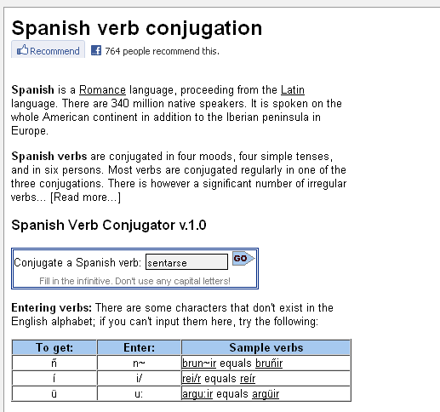
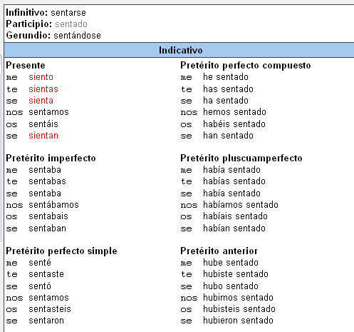
http://www.verbix.com/languages/spanish.shtml
Type the Spanish verb in here.
el presente
el pretérito
Notes:
http://www.verbix.com/languages/spanish.shtml

Slide 12
Practising A. When you have prepared what you want to say, you need to practise to get more fluent and more confident. First you might want to hear how it is pronounced. You can use online text-tp-speech tools. For example: 1. www.voki.com Follow the instructions. First you should copy/paste text in and choose a Spanish voice to say it . Then you can record yourself saying it and listen back to yourself.
2. http://text-to-speech.imtranslator.net/ This is another similar website. 3. In class, work in pairs. Do these activities: a. 3 -2 – 1 game with your answers b. Read your partner’s text out loud and pause to see if s/he can remember the next word c. Ask each other questions from the topic (prompt if needed. d. Listen to each other’s presentations and then ask questions.

Slide 13
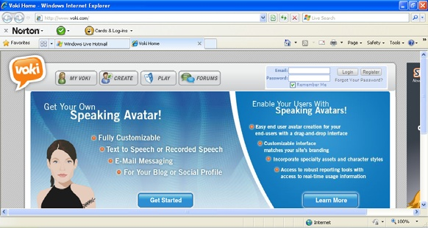
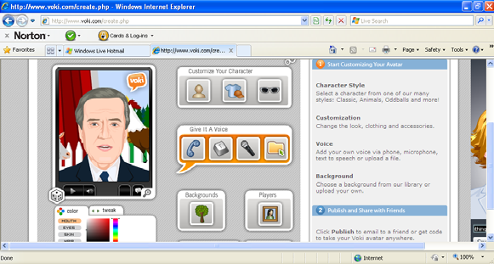
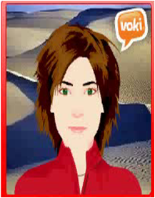
www.voki.com
http://text-to-speech.imtranslator.net/
Notes:
Vokis are talking avatars. Using this free website you can either record and upload the mp3 audio file OR you can copy/paste corrected TL script and choose a voice to say your words.

