Slide 1

Repaso
deportes
pasado (pretérito)
Hoy vamos a repasar:
vocabulario asociado con los deportes
cómo describir acciones en el pasado

Slide 2
Connect-4
I want (to) | I have to | I can | It’s hot | It’s cold | It’s sunny
usually | often | from time to time | once a week | every day | once a month
My brother loves | My dog likes | My mum likes | My gran loves | My dad likes | My sister doesn’t like
to download music | to play tennis | to go to the cinema | to swim | to read books | to go shopping
to go out with friends | to play football | to watch tv | action films | to listen to music | comedies
I like (1 thing) | I don’t like (things plural) | I love | I like (things plural) | I hate | I prefer
Notes:
A repetition of the activity from last lesson. Two teams, volunteers take turns to pick a square and give the appropriate Spanish word/phrase to claim that square. Must build up from bottom of grid – aim is to get four in a row before the other team.

Slide 3

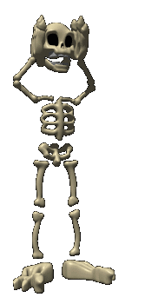
Los deportes
A 1 minuto ¡De memoria! Todas las palabras que tratan de los deportes.
B Cambia el papel con tu compañero/a. Añade a su lista. C En tu propio papel, escribe más palabras. D En un papel nuevo, escribe tu lista de memoria.
Empty your head!
Notes:
There are 4 stages to this activity. make sure you prepare for the lesson in presentation mode as B, C, D are hidden and appear on successive clicks.

Slide 4
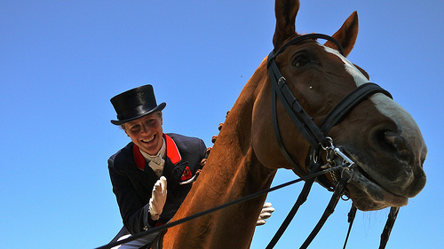
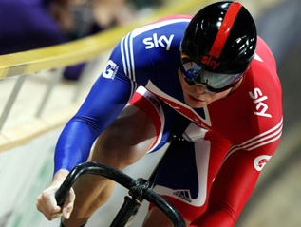
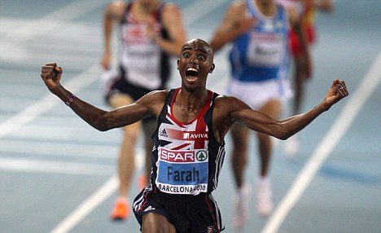
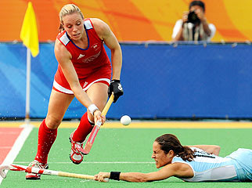
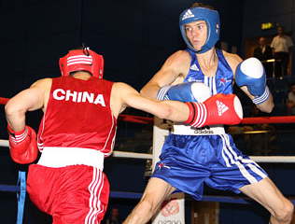
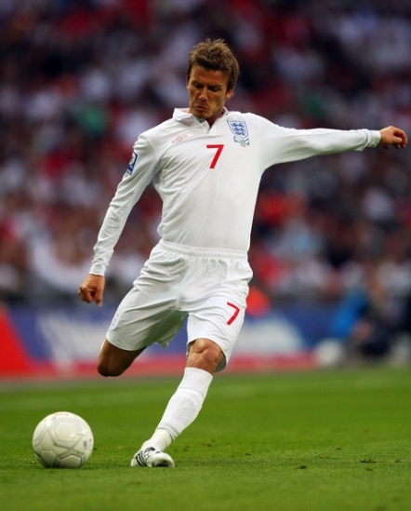
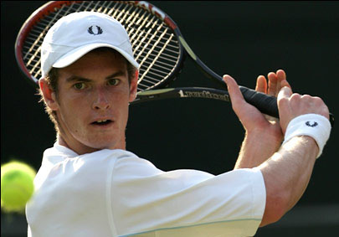
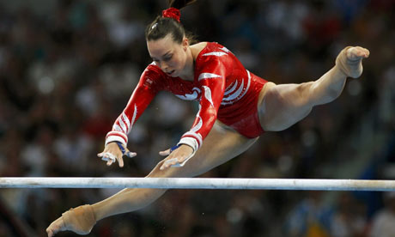
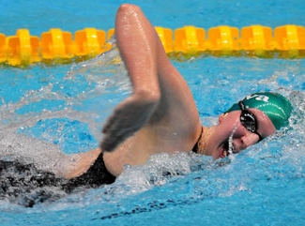
Laura Bechtolsheimer
Chris Hoy
Mo Farah
Katie Walsh
Luke Campbell
David Beckham
Andy Murray
Beth Tweddle
Rebecca Adlington
Notes:
We have seen these sports personalities before and will use them to revise – jugué and hice

Slide 5
¿Practicaste algún deporte el fin de semana pasado?
Sí, jugué al fútbol.
Sí, hice el boxeo.
Sí, hice el ciclismo.
Sí, monté al caballo.
Sí, hice la gimnasia.
Sí, hice el atletismo.
Sí, hice la natación.
Sí, jugué al hockey.
Sí, jugué al tenis.
Notes:
Chance to see the preterite forms – students only have to name the sportsperson that said this. Although this is very basic and we have done these verbs before many times – we now need students to make sure they are completely confident with these forms – in particular, how they sound and how they’re written.

Slide 6
¿Practicaste algún deporte el fin de semana pasado?
Notes:
Model language responding as each of the sportspeople and teams gain a point by correctly naming the sportsperson. This time they only listen to the correct preterite phrase rather than reading it.
9 x point available

Slide 7
¿Practicaste algún deporte el fin de semana pasado?
Notes:
This time students get 2 points if they can correctly answer as the sportsperson.
18 points available

Slide 8
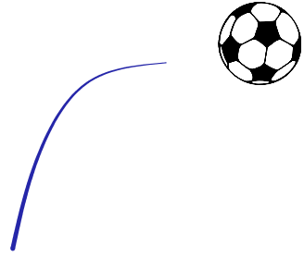
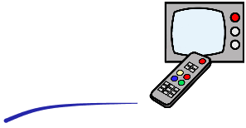
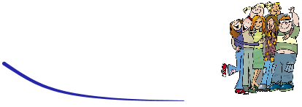
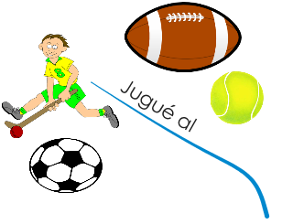
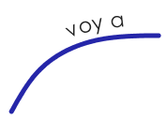
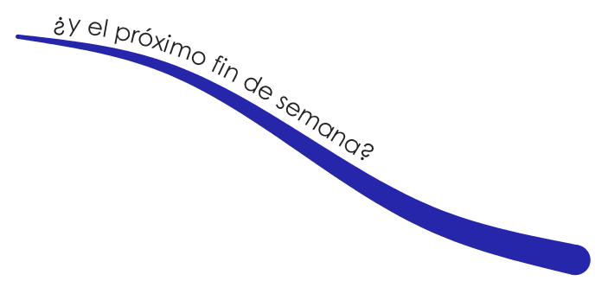
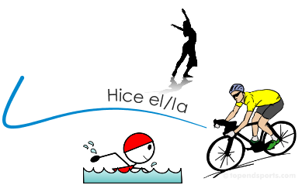




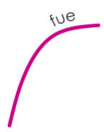

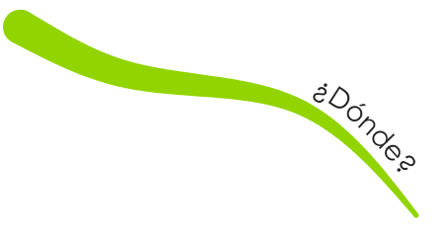








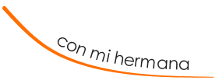

Slide 9
/4 each question
1st
2nd
2 | Answers with full sentence inc.verb / extra detail
1 | Answers with 1 or 2 words
0 | Not able to answer
1 ¿Practicaste algún deporte el fin de semana pasado?
2 ¿Dónde?
3 ¿Con quién?
4 ¿Qué tal fue?
5 ¿Y qué planes tienes para el próximo fin de semana?
2 | Answers confidently, interacts well
1 | Answers but a little hesitant
0 | Very hesitant
Total points / 20
1st attempt
2nd attempt
Ideas for extra details! ¡Sí, me encanta el deporte! ¡Sí, por supuesto! Lo jugué – I played it…. Lo hice – I did it… que se llaman … - who are called… Es siempre así – it’s always like that No lo sé exactamente – I don’t exactly know Pienso que – I think that
Bueno… - Well…
Feedback comment
What went well……..
Even better if………

