Slide 1
Repaso
expresiones de frecuencia
opiniones
Hoy vamos a:
repasar cómo dar opiniones
repasar cómo usar unos verbos esenciales
verbos esenciales

Slide 2
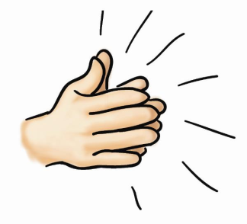
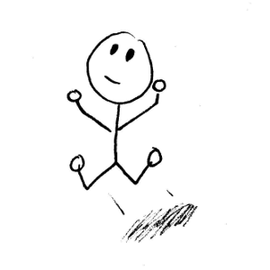
Para empezar…
Persona 1: Uno Persona 2: Dos Persona 1: Tres
1. En vez de decir la palabra ‘dos’, da una palmada.
1. En vez de decir la palabra ‘tres’, salta.
Notes:
This is a fun activity to start the revision process. If they have never done this one before, use the Uno – Dos – Tres to get them into the swing of it. The next slide should be something they can memorise quickly (like lines from a play) and have fun delivering with different tones of voice/ mood etc..

Slide 3
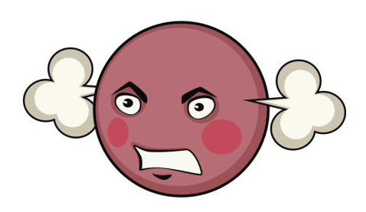
¡Un poco de teatro!
Persona 1: ¿Qué deportes te gustan? Persona 2: Pues, me gustan mucho los deportes individuales. Persona 1: ¡Los deportes individuales! ¡Yo prefiero los deportes de equipo!

Slide 4
Opiniones, expresiones de frecuencia, verbos esenciales
Repaso: Write the English next to the Spanish words.
Me gusta
Me gustan
No me gustan
Me encanta
Odio
Prefiero
often
usually
once a week
once a month
every day
from time to time
A mi madre le gusta
A mi padre le gusta
A mi abuela le gusta
A mi perro le gusta
A mi hermano le encanta
A mi hermana no le gusta

Slide 5
to read books
to go shopping
to swim
to play football
to play tennis
to go to the cinema
to download music
to watch tv
to listen to music
to go out with friends
Choose from these for the table above
I can | Puedo
I want to | Quiero
I have to | Tengo que
it’s hot | Hace calor
it’s cold | Hace frío
it’s sunny | Hace sol
escuchar música | nadar
descargar música | ir de compras
ir al cine | leer libros
jugar al tenis | salir con amigos
jugar al fútbol | ver la tele

Slide 6
En parejas
Test each other orally
Tick off the items your partner can do
Keep returning to the ones s/he finds difficult
Highlight the ones s/he still needs to practise more at home

Slide 7
Connect-4
I want (to) | I have to | I can | It’s hot | It’s cold | It’s sunny
usually | often | from time to time | once a week | every day | once a month
My brother loves | My dog likes | My mum likes | My gran loves | My dad likes | My sister doesn’t like
to download music | to play tennis | to go to the cinema | to swim | to read books | to go shopping
to go out with friends | to play football | to watch tv | action films | to listen to music | comedies
I like (1 thing) | I don’t like (things plural) | I love | I like (things plural) | I hate | I prefer
Notes:
Two teams, volunteers take turns to pick a square and give the appropriate Spanish word/phrase to claim that square. Must build up from bottom of grid – aim is to get four in a row before the other team.

Slide 8
Deberes
Make sure you know all of this language off by heart. Test yourself by completing a new copy of today’s worksheet without referring to your book OR go online to revise:
http://quizlet.com/6985581/gcse-spanish-free-time-1-flash-cards/
http://quizlet.com/6985620/gcse-free-time-2-flash-cards/

Slide 9
Repaso: Write the English next to the Spanish words. Then learn them. If you want to learn them online, use the 2 links at the bottom of this sheet.
Me gusta
Me gustan
No me gustan
Me encanta
Odio
Prefiero
often
usually
once a week
once a month
every day
from time to time
A mi madre le gusta
A mi padre le gusta
A mi abuela le gusta
A mi perro le gusta
A mi hermano le encanta
A mi hermana no le gusta
http://quizlet.com/6985581/gcse-spanish-free-time-1-flash-cards/
http://quizlet.com/6985620/gcse-free-time-2-flash-cards/

Slide 10
to read books
to go shopping
to swim
to play football
to play tennis
to go to the cinema
to download music
to watch tv
to listen to music
to go out with friends
Choose from these for the table above
I can | Puedo
I want to | Quiero
I have to | Tengo que
it’s hot | Hace calor
it’s cold | Hace frío
it’s sunny | Hace sol
escuchar música | nadar
descargar música | ir de compras
ir al cine | leer libros
jugar al tenis | salir con amigos
jugar al fútbol | ver la tele

