Slide 1
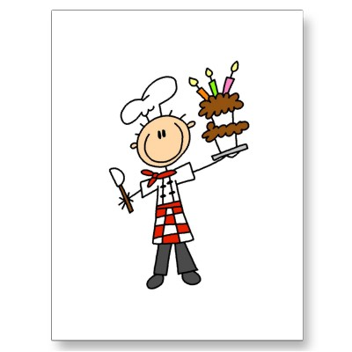

Recetas
Objetivo:
Hablar sobre la comida y las recetas
5
Notes:
http://rlv.zcache.com/pastry_chef_tshirts_and_gifts_postcard-p239845564030806144trdg_400.jpg http://tujs.files.wordpress.com/2011/03/chefs_hat_tujs.png

Slide 2

Notes:
The majority of this lesson is to practise speaking in a speaking line. Part of the lesson could also be used to see any of the project work on recipes that might have already come in, or additional to do any other revision activities.

Slide 3
Un repaso
¿Qué te gusta comer? ¿Qué no te gusta?
¿Conoces un plato típico de los país hispánicos? (por ejemplo, las empanadas)
¿Qué es?
¿Qué ingredientes lleva(n)?
¿Cuál es tu snack preferido?
¿Cómo se prepara?
¿Qué comiste y bebiste esta mañana para el desayuno?
Notes:
Students will practise these questions in a speaking line this lesson to revise what they have covered in this unit. For higher level students, encourage (time permitting) them to research other typical Spanish dishes – There is a proforma/worksheet for them to do this and then they could include something other than empanadas in this conversation. Encourage them that if they use some language they have researched themselves and use it successfully in their spontaneous speaking, this indicates a higher level (potentially level 7 depending on output clearly).
They will do a peer speaking assessment in the final week of the Christmas term but the emphasis needs to be NOT on preparing and memorising so much as understanding and responding readily to the questions. There will be more opportunities next term for practising their prepared speaking/presenting skills in the media module.

