Slide 1
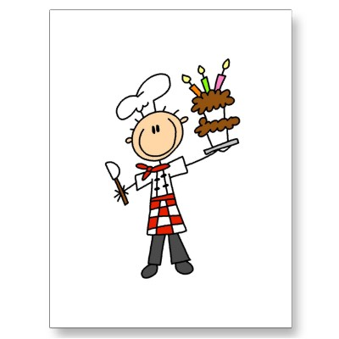

Recetas
Objetivo:
Hablar sobre la comida y las recetas
6
Notes:
http://rlv.zcache.com/pastry_chef_tshirts_and_gifts_postcard-p239845564030806144trdg_400.jpg
http://tujs.files.wordpress.com/2011/03/chefs_hat_tujs.png

Slide 2

Un repaso
¿Qué te gusta comer? ¿Qué no te gusta?
¿Conoces un plato típico de los país hispánicos? (por ejemplo, las empanadas)
¿Qué es?
¿Qué ingredientes lleva(n)?
¿Cuál es tu snack preferido?
¿Cómo se prepara?
¿Qué comiste y bebiste esta mañana para el desayuno?
Notes:
Students will practise these questions in a speaking line this lesson to revise what they have covered in this unit.
For higher level students, encourage (time permitting) them to research other typical Spanish dishes – There is a proforma/worksheet for them to do this and then they could include something other than empanadas in this conversation. Encourage them that if they use some language they have researched themselves and use it successfully in their spontaneous speaking, this indicates a higher level (potentially level 7 depending on output clearly).
They will do a peer speaking assessment in the final week of the Christmas term.

Slide 3

Notes:
The majority of this lesson is to practise speaking in a speaking line. Part of the lesson could also be used to see any of the project work on recipes that might have already come in, or additional to do any other revision activities.

Slide 4
Y9 Speaking: Peer Assessment Sheet
You are going to assess the speaking of others in your class today. You are going to assess at least 3 different students in your class in a speaking line. Ask your partner all of the 8 questions listed below and then s/he will ask you 2 spontaneous questions. For each answer or question give him/her either 2,1 or 0. At least 3 students will also assess your speaking.
 | Questions
1 | ¿Qué te gusta comer? (¿Qué no te gusta?)
2 | ¿Conoces un plato típico de los país hispánicos? (por ejemplo, las empanadas)
3 | ¿Qué es?
4 | ¿Qué ingredientes lleva(n)?
5 | ¿Cuál es tu snack preferido?
6 | ¿Cómo se prepara?
7 | ¿Qué comiste esta mañana para el desayuno?
8 | ¿Qué bebiste esta mañana para el desayuno?

Slide 5
 | Name | Name | Name | Marksheme. Give 2, 1 or 0 for each answer
1 |  |  |  | 2 = full sentence answer (or question), ready response, not much hesitation, significant effort to sound Spanish 1 = answer that does communicate BUT might not be complete sentence, some attempt to sound Spanish 0 = cannot answer OR does not recognise the question so gives a different answer
2
3
4
5
6
7
8
?
?
Total | /20 | /20 | /20

