Slide 1
Recetas
Objetivo:
Entender instrucciones en una receta
Describir el proceso /las acciones en el pasado
2
Notes:
http://rlv.zcache.com/pastry_chef_tshirts_and_gifts_postcard-p239845564030806144trdg_400.jpg http://tujs.files.wordpress.com/2011/03/chefs_hat_tujs.png

Slide 2
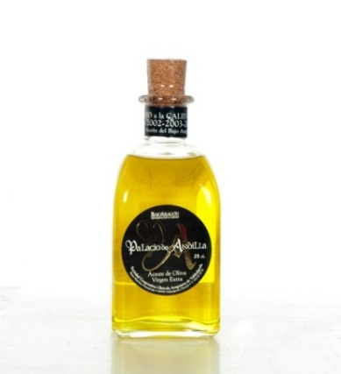
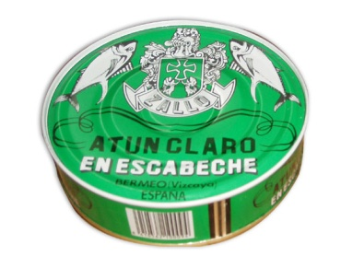
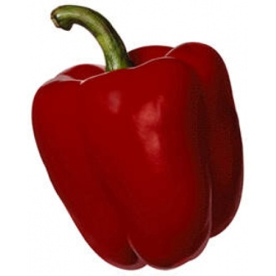
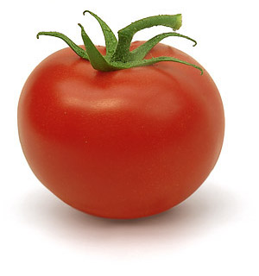
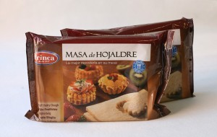
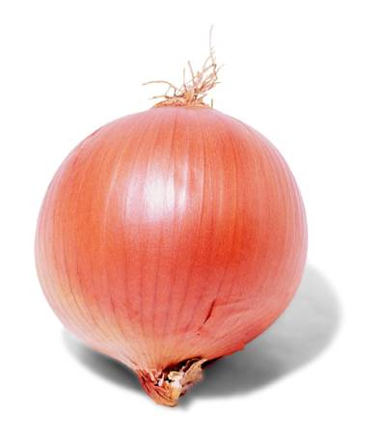
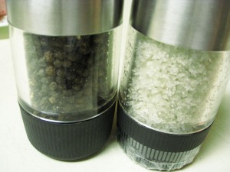
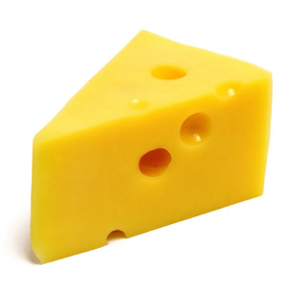
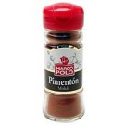
Fui al mercado y compré………
Una lata de = a tin of Una botella de = a bottle of medio kilo de = ½ kilo of
Notes:
Group memory game – picture prompts are empanada ingredients from previous lesson but any additional food items can be included.
http://www.zallo.com/modulos/usuariosFtp/conexion/imagenes571A.jpg http://www.sabor-artesano.com/imagen/aceite-oliva/aceite-oliva-virgen.jpg
http://delhuertoamicasa.es/images/pimiento%20rojo%20asar.jpg
http://2.bp.blogspot.com/-0t-ie-0rx-s/TfsjfYE_G3I/AAAAAAAABIw/0BvaSKPDie0/s1600/tomate.jpg
http://2.bp.blogspot.com/_lU7LZC-yq4g/S6pPHQ5wbnI/AAAAAAAAB58/rDSq7r0DQ7U/s1600/alii.h3.jpg
http://www.togetheragency.co.uk/blog/wp-content/uploads/2011/05/cheese.jpg
http://bisayanqueen.files.wordpress.com/2011/02/salt-and-black-pepper2.jpg?w=300&h=225
http://www.dechilealmundo.com/media/catalog/product/cache/1/small_image/135x/9df78eab33525d08d6e5fb8d27136e95/9/2/9231.jpg
http://congeladosmarin.com/img/p/37-129-large.jpg

Slide 3
2
Notes:
http://www.youtube.com/watch?v=ejeOqZzVd9Y I have cut this video clip so that I only include the 3rd recipe, which is the clearest to understand, has the most useful verbs and ingredients and is a good model for the language activities in this lesson!

Slide 4
A
B
C
Untar el pan con un poquito de tomate. | Poner un huevo en medio de todo. | Cortar dos salchichas.
Meter el plato al microondas. | Poner dos rebanadas de pan encima del plato. | Sacar el plato y ¡listo!
Poner unos champiñones encima. | Poner cuatro rebanadas de queso encima del tomate. | Colocar los trocitos de salchicha encima del queso.
D
E
F
G
H
I
Notes:
As students watch and listen the video clip they need to put the instructions in the right order. They will probably need to watch it 2 or 3 times.
Most student enjoy working with text much more if they physically get to move the pieces but of course this activity could be done just by matching the letters to number they write down in their books. This slide has letters for easy reference.

Slide 5
E
H
Poner dos rebanadas de pan encima del plato. | Untar el pan con un poquito de tomate. | Poner cuatro rebanadas de queso encima del tomate.
Cortar dos salchichas. | Colocar los trocitos de salchicha encima del queso. | Poner unos champiñones encima.
Poner un huevo en medio de todo. | Meter el plato al microondas. | Sacar el plato y ¡listo!
A
C
I
G
B
D
F
Notes:
As students watch and listen the video clip they need to put the instructions in the right order. They will probably need to watch it 2 or 3 times.
Most student enjoy working with text much more if they physically get to move the pieces but of course this activity could be done just by matching the letters to number they write down in their books. This slide has letters for easy reference.

Slide 6
Una receta: unos detalles más…
A ¿Cómo se dice en inglés…?
una rebanada | colocar | meter | el plato
encima de | en medio de | el microondas | ¡listo!
a slice
to place/put
to place/put
the plate
on top of
In the middle of
a microwave
ready!
B Two of the words above are verbs. Which two? Can you think of another verb you already know that means the same?
poner
C At the end of the video the presenter says this:
“Si tardas más en cocinarlo que en comértelo, no merece la pena.”
What do you think this might mean?
Notes:
If it takes longer to cook it than to eat it then it’s not worth the effort!

Slide 7
Y finalmente…
D Write a summary of what the presenter did to make this dish. Are these completed actions in the past or descriptive scene-setting? Which tense will you need to use?
Infinitivo | Pretérito | Resto de la frase
poner* | puso | dos rebanadas de pan encima del plato.
untar
cortar
colocar
meter
sacar
untó
cortó
colocó
metió
sacó
NB: 1 Poner is an irregular verb. Remember to check your verbs using either an online conjugator (www.verbix.com ) or the verb tables in your dictionary. 2 Colocar and sacar need checking too – something strange happens to the spelling! 3 Did you notice that meter is an –ER verb?

Slide 8
Los deberes
To produce instructions in Spanish for making a snack. You can choose the format you want to use for this homework. Here are some ideas!
Video clip with spoken instructions
Video clip with written instructions
Poster (hand-drawn or using ICT app)
Audio recording
PowerPoint presentation with text, pictures, audio
Word/Publisher with text and pictures
Video using www.animoto.com (30 second limit) – photos and text.
If you can, try to include two times frames. You could do this by explaining how to make something as you demonstrate and then providing a summary at the end of what you did.
You have a week to produce your work and we will display/show the results in class.
Notes:
http://www.youtube.com/watch?v=f_8t9OMCG_M This is a link to a video clip showing students how to use animoto – the project is a different one but it’s a useful run through for teachers and/or students as to how to use the site. They can essentially use it to make a nice video montage using still photos which they upload, entering some text (160 character limit each time) and backing music. I’ve made one to show them what it looks like from some stills of my son in Y2 with a teddy he had to bring home to stay!

