Slide 1
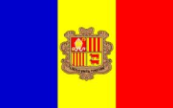
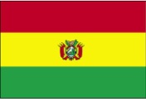
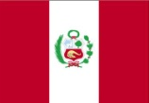
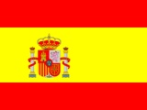
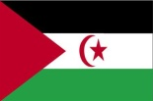
Información sobre países
Notes:
Use this slide to elicit prior knowledge in Spanish.
See which countries they can recognise. See if they can tell you the continents. Ask what languages they speak there.

Slide 2
Objetivos:
Aprender información sobre 6 países
Poner y contestar preguntas

Slide 3
Vamos a comparar 6 países
País | Continente | Capital | Población | Expectativa de vida Hombres / Mujeres |  | Idiomas | Moneda
Andorra
Bolivia
Perú
España
República Árabe Saharaui Democrática
Reino Unido
Notes:
Don’t dwell too much on this slide. Just explain the objective is to 1) know more information about 6 countries 2) use the information to compare countries with each other Use the table headings to make sure students know what each one means.

Slide 4
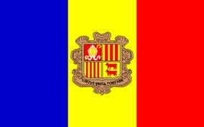
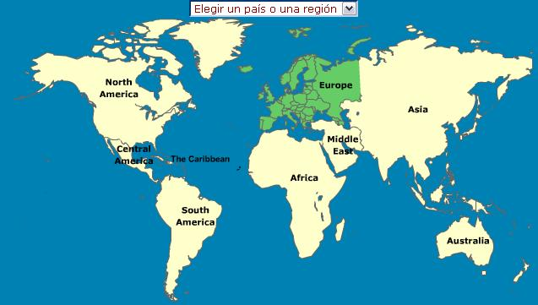
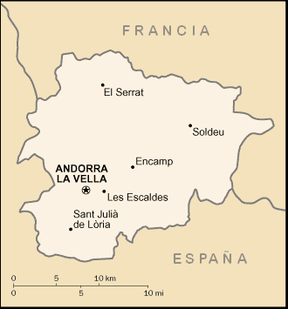
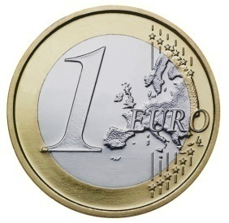
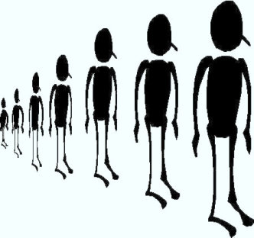
Bandera
Continente
87 años / 81 años
Idiomas
Catalán Español Francés
Expectativa de vida
Capital
Moneda
Población
82,000 (ochenta y dos mil habitantes)
Notes:
This is the example of 1 x country’s profile slide. Display this slide. Students have a copy of the questions on slide 4 already. Elicit answers from them – modelling whole sentences yourself but accepting all TL responses form them.
A focus with higher sets is to get them asking as well as answering as soon as possible. They won’t do this naturally if we are always asking the questions, so ask them to turn over their set of questions (slide 5) and take them back through this slide, getting them to see how many of the questions they can ask.
Allow them to have 5 secs to look at their sheet if and when they get stuck.
http://www.google.co.uk/imgres?imgurl=http://www.worldflags.es/ampliaciones/448aANDORRA.jpg&imgrefurl=http://www.worldflags.es/en/cart.php%3Faction%3Ddetalle%26idp%3D448%26idSEC%3D1%26categoria%3D3%26subcategoria%3D19%26inicio%3D0&h=250&w=400&sz=25&tbnid=6Nj4-wAy_zzuLM:&tbnh=78&tbnw=124&prev=/images%3Fq%3DAndorra%2Bbandera&zoom=1&q=Andorra+bandera&hl=en&usg=__IjD0kEkZst5YXSs8PscPxKYxXKE=&sa=X&ei=PyZiTZPcNNC48gP2v4jyCA&ved=0CD8Q9QEwBw
http://www.google.co.uk/imgres?imgurl=http://upload.wikimedia.org/wikipedia/commons/9/94/Andorra_mapa.png&imgrefurl=http://commons.wikimedia.org/wiki/File:Andorra_mapa.png&h=355&w=330&sz=7&tbnid=5AkzwUPln68KgM:&tbnh=121&tbnw=112&prev=/images%3Fq%3Dandorra%2Bmapa&zoom=1&q=andorra+mapa&hl=en&usg=__ibqus6tACA-bytnE5S4oeg9YEoY=&sa=X&ei=7iZiTbOlKYmPswaslaS2CA&sqi=2&ved=0CCQQ9QEwBQ
http://www.google.co.uk/imgres?imgurl=http://gregor.us/wp-content/uploads/2009/07/population-graphic.jpg&imgrefurl=http://gregor.us/coal/its-a-planet-of-slums/&usg=__ckh6OImTjmdyfPckNscJDnXFaeE=&h=422&w=449&sz=29&hl=en&start=10&zoom=1&tbnid=UZVbXId4sgk-uM:&tbnh=135&tbnw=149&ei=VipiTZzgOJLe4gap_anGCQ&prev=/images%3Fq%3Dpopulation%26um%3D1%26hl%3Den%26client%3Dfirefox-a%26sa%3DN%26rls%3Dorg.mozilla:en-US:official%26biw%3D667%26bih%3D578%26tbs%3Disch:10%2C477&um=1&itbs=1&iact=hc&vpx=135&vpy=234&dur=418&hovh=140&hovw=149&tx=166&ty=105&oei=TSpiTfH9Csz44AbC_-zVCQ&page=2&ndsp=9&ved=1t:429,r:3,s:10&biw=667&bih=578

Slide 5
¿Qué colores tiene la bandera?
¿En qué continente está?
¿Con qué países limita?
¿Cuántos habitantes hay/tiene?
¿Cuál es la capital?
¿Qué idiomas hablan?
¿Cuál es la expectativa de vida para los hombres/ para las mujeres?
¿Cómo se llama la moneda de este país?
Notes:
Show this slide. Sort them into groups (6 x groups for the 6 countries). Once they are sorted into their groups, give out copies of the country information for each.
Each group is going to write a short presentation giving the information in response to these 8 questions. They can divide up the questions in their groups but all need to have a copy of all of the presentation by the end. They should practise during the remainder of the lesson in pairs, asking and answering the 8 questions Homework is going to be to write up a neat version (if this is necessary – some groups may have worked neatly from the beginning) and to practise the presentation. They should be able to talk about their country either as a continuous presentation or in response to the 8 questions.
Top sets should be able to cope with being able to answer all questions. Sets 3 or 4 – teacher will need to decide what is a reasonable expectation.

Slide 6
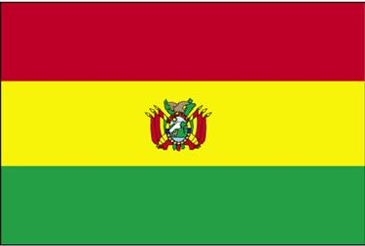
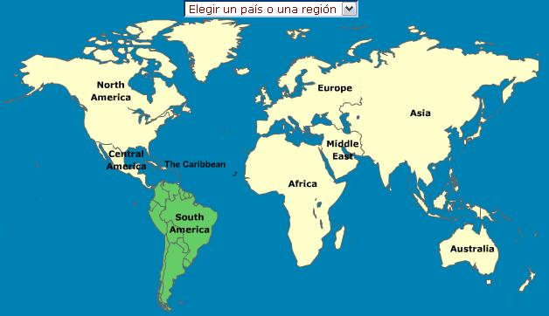
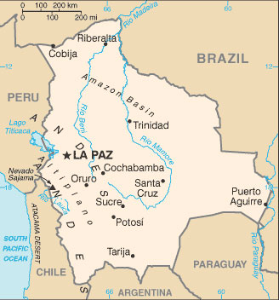
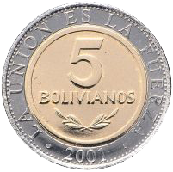
Bandera
Continente
69 años / 64 años
Idiomas
Español Quechua Aymara
Expectativa de vida
Capital
Moneda
Población
9,248,000 (nueve millones doscientos cuarenta y ocho mil habitantes)
Notes:
Images from www.countryreports.org Boliviano from wikipedia man/woman from open clip art

Slide 7
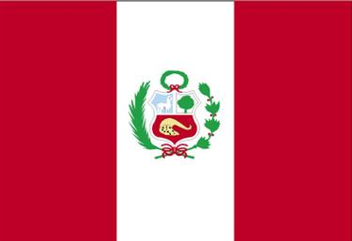
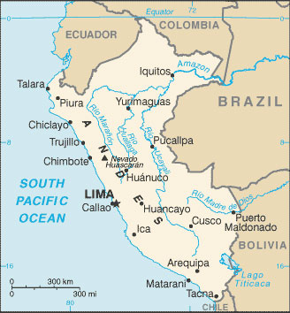
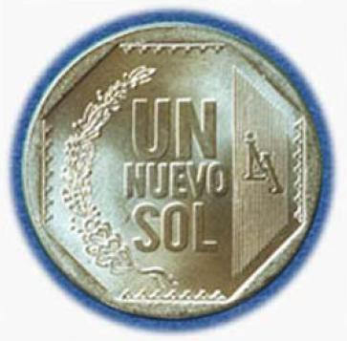
Bandera
Continente
72 años / 69 años
Idiomas
Español Quechua Aymara
Expectativa de vida
Capital
Moneda
Población
29,181,000 (veintinueve millones ciento ochenta y un mil habitantes)
Notes:
Images from www.countryreports.org Currency from wikipedia man/woman from open clip art

Slide 8
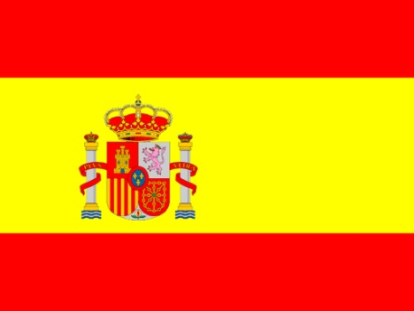
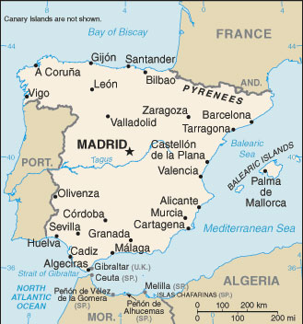
Bandera
Continente
85 años / 79 años
Idiomas
Expectativa de vida
Español (Castellano), Catalán, Valenciano, Gallego, Euskera
Capital
Moneda
Población
45,000,000 (cuarenta y cinco millones de habitantes)
Notes:
Images from www.countryreports.org Currency from wikipedia man/woman from open clip art

Slide 9
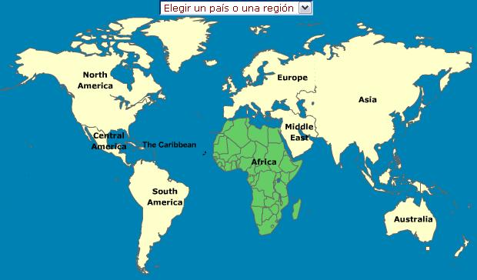
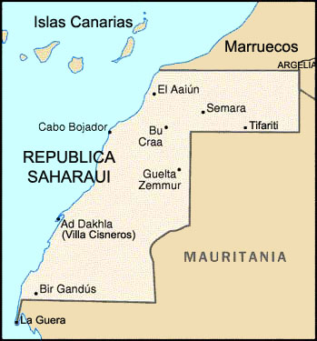
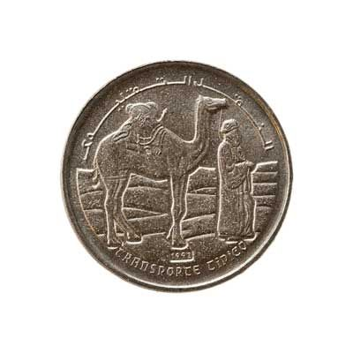
Bandera
Continente
56 años / 52 años
Idiomas
Expectativa de vida
Árabe Español
Capital ? El Aaiún
Moneda
Población
394,000 (trescientos noventa y cuatro mil habitantes)
Notes:
Images from www.countryreports.org Currency from wikipedia man/woman from open clip art

Slide 10
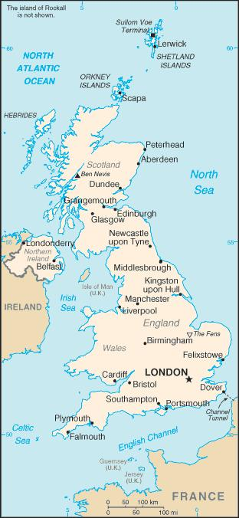
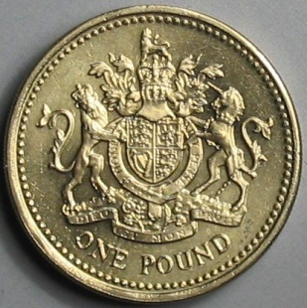
Bandera
Continente
81 años / 76 años
Idiomas
Expectativa de vida
Inglés
Capital
Moneda
Población
61,000,000 (sesenta y un millones de habitantes)
Notes:
Images from www.countryreports.org Currency from wikipedia man/woman from open clip art

Slide 11
Vamos a comparar 6 países
País | Continente | Capital | Población | Expectativa de vida Hombres / Mujeres |  | Idiomas | Moneda
Andorra | Europa | Andorra La Vella | 82,000 | 81 | 87 | catalán, español, francés | Euro
Bolivia | Sudamérica | La Paz | 9,248,000 | 64 | 69 | español quechua aymara | Boliviano
Perú | Sudamérica | Lima | 29,181,000 | 69 | 72 | español quechua aymara | Nuevo sol
España | Europa | Madrid | 45,000,000 | 79 | 85 | español (castellano), catalán, valenciano, gallego, euskera | Euro
República Árabe Saharaui Democrática | África | El Aaiún | 394,000 | 52 | 56 | árabe, español | Peseta Saharawi
Reino Unido | Europa | Londres | 61,000,000 | 76 | 81 | inglés | Libra esterlina
Notes:
Complete set of answers

