Slide 1

Morph – Lección 4
Hoy vamos a:
Escribir la historia de otro episodio de Morph
Observar y practicar cómo se cambian los verbos del presente al pasado

Slide 2

Notes:
Most people will want to download these to use them in class. Here are the links to each one:
Red = episode 3 - http://www.youtube.com/watch?v=8i9juY3ezrg&feature=related
Yellow = episode 6 - http://www.youtube.com/watch?v=w0cpY4lrevY&feature=related
Green = episode 13 - http://www.youtube.com/watch?v=UxjYJZC4j0c&feature=fvsr
Blue = episode 14 - http://www.youtube.com/watch?v=11HZt2JCj7g&feature=related
It will be helpful to provide some useful verbs for each one, plus a reminder of some key narrative links. These are on the next slide.

Slide 3
sentarse – to sit down
pulsar – to press
desaparecer – to disappear
aparecer – to appear
reírse – to laugh
leer – to read
explotar – to explode
(el control remoto, el botón, el periódico)
cruzar – to cross
pagar – to pay
decir – to say
decidir – to decide
rodear – to go around
desaparecer – to disappear
transformarse en – to turn into
(el puente, un peaje, un monstruo acuático)
jugar a las cartas
apostar (bollos) – to bet (buns)
descubrir – to discover
hacer trampas – to cheat
comer – to eat
estar lleno – to be full
pesar (mucho) – to weigh ( a lot)
romperse – to break
caerse – to fall
estar orgulloso de – to be proud of
ponerse en marcha – to start up
entrar (en) – to go (into)
salir (de) – to come out (of)
ser una broma – to be a joke
fingir – to pretend
(una máquina del tiempo, muy viejo, un bébé)

Slide 4
Morph – episodio ?
1.
2.
3.
4.
5.
6.
7.
8.
9.
Notes:
They should write their narration in the preterite (+ imperfect) and use a maximum of 9 stages as with episode 4. If on computers they should be encouraged to use an online verb conjugator to check the preterite forms. The next slide shows a screen shot of an example of this to model to students.

Slide 5
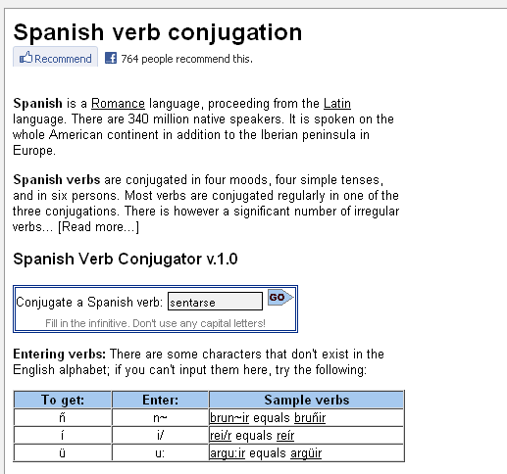
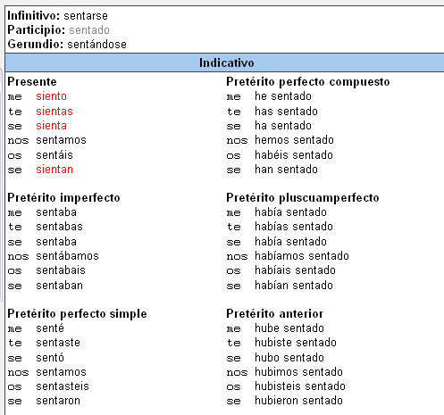
http://www.verbix.com/languages/spanish.shtml
Escribe el infinitivo en español aquí
el presente
el pretérito
Notes:
http://www.verbix.com/languages/spanish.shtml

