Slide 1
Los Juegos Olímpicos
Hoy vamos a:
entender textos escritos y ejercicios auditivos
escribir unas frases de memoria
Notes:
I think that the first listening/reading/writing milestone assessment tasks of this term should be done during this week at some point, but it is up to individuals if they want to do them in one lesson like this or spread them out and intersperse them with other lesson activities.

Slide 2
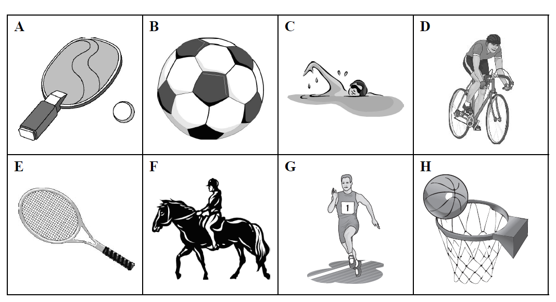
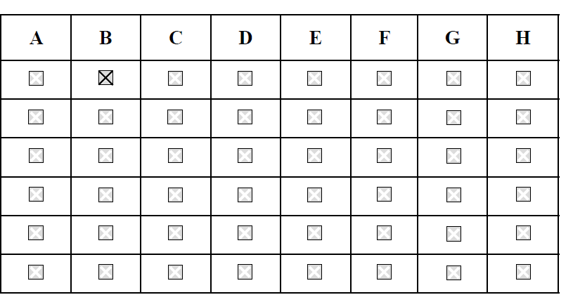
1 El deporte ¿Qué hacen?
Pon una equis (X) en la casilla adecuada.
Notes:
2010 Legacy Edexcel Foundation Q17 – 21 Straightforward task. Level 3/4
Answers:
1. C 2. D 3. A 4. G 5. F

Slide 3
2 El deporte en la televisión Three friends are talking about sport on TV. Answer the questions in English.
Give 3 reasons why one of the friends thinks that football is the best sport to watch on TV. (3)
________________________________________________________
________________________________________________________
2. What is the problem with watching tennis on TV? (2)
_______________________________________________________
3. What is the disadvantage about watching athletics? (1)
________________________________________________________
Which sport do all 3 friends agree is the best one to watch? (1)
________________________________________________________
Notes:
2009 Edexcel Higher Q8 Level 5/6 Answers: 1. available all year / games last less than 2 hours / very exciting 2. very slow / is boring (it bores him / he gets bored) 3. only available in the summer 4. football
Total / 7 6/7 = Level 6 (+ 5 from previous activity) = 11/12 4/7 = Level 5 (+ 5 from previous activity) = 9/12
2/7 = level 4 (+ 5 from previous activity) = 7/12

Slide 4
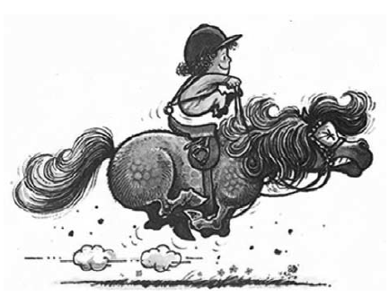
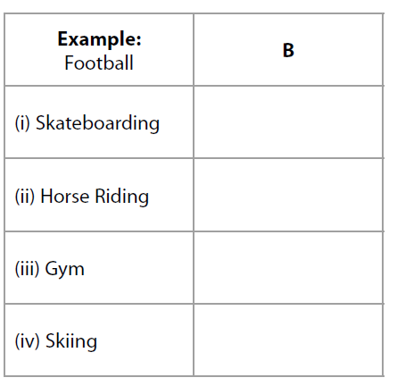
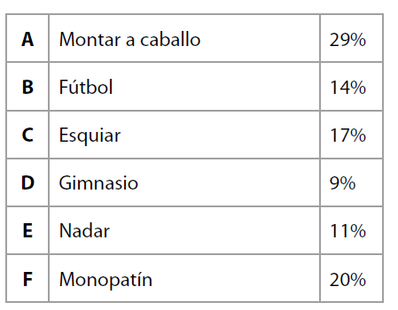
/4
1 Free time What leisure activities do young people like best?
Put the correct letter in each box.
Notes:
SAM Foundation Q5

Slide 5
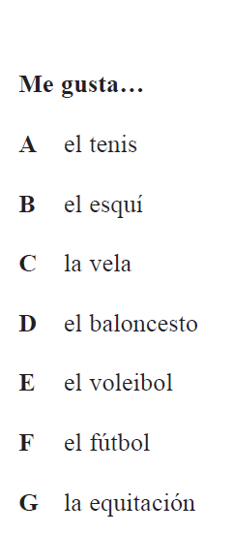
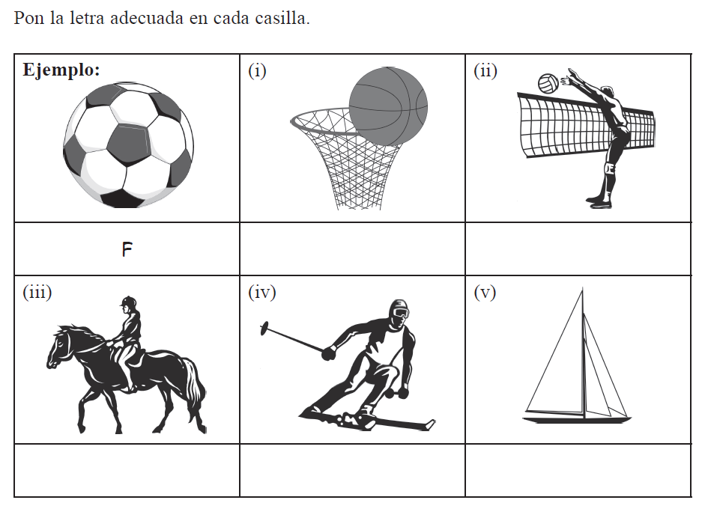
2 Los deportes ¿Qué deporte es?
/5
Notes:
Edexcel Foundation 2008 Q1

Slide 6
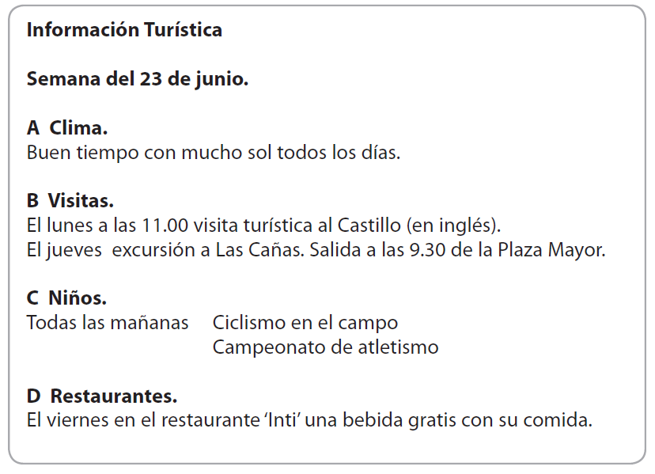
3 Activities for the week Information sheet
Notes:
Edexcel 2010 Foundation Q9

Slide 7
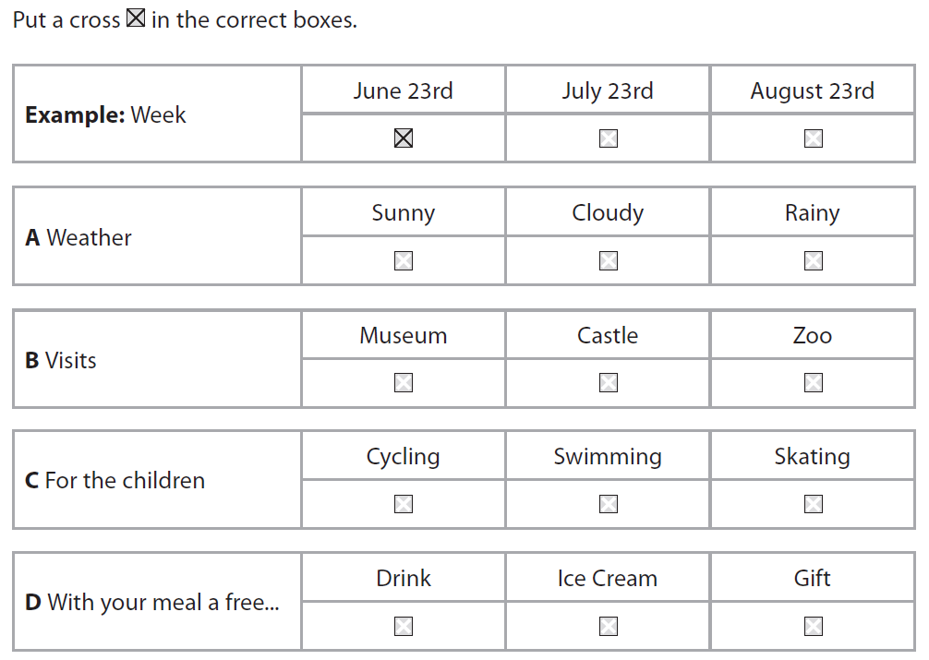
/4

Slide 8
NAME: ___________________________________________
Fill in the missing words to translate into Spanish the following phrases:
1 I like playing volleyball.
Me gusta ____________ al voleibol.
2 Basketball is a team sport.
El ___________________ es un deporte ___ _____________.
3 I love water sports.
Me _______________ los deportes ___________________.
4 I like swimming a lot but I don’t often go the pool because it’s expensive.
____ ______________ mucho _____________ pero ___ _________ a menudo a la piscina _____________ es ____________.
5 My mum likes cycling because it’s fun.
A ____ ___________ ___ gusta el ciclismo porque ___ __________.
Notes:
NB: The more challenging version of this task is in the folder of milestone assessments.

Slide 9
6 I prefer football because it’s more exciting.
____________ el _____________ porque ___ _____ __________.
7 Skiing is a winter sport.
El ___________________ es un deporte ___ _____________.
8 Tennis is less fun than basketball.
El tenis ____ _________ divertido ________ _____ baloncesto.
9 I don’t like rowing but I like sailing.
No _______ _____________ el _________ pero me gusta ____ ___________.
10 My dog likes playing football in the park.
____ mi ___________ ___ gusta __________ _____ fútbol ___ el parque.

