Slide 1
Los Juegos Olímpicos
Hoy vamos a:
repasar los verbos para los deportes
usar ‘gustar’ para describir las opiniones de otras personas (e.g. She likes… – He loves…)

Slide 2
¿Qué deportes te gustan?
Your answer must contain EXACTLY 7 words!
¿Qué deportes no te gustan?
Your answer must contain more than 9 words!
Notes:
The conditions or ‘targets’ can be many and varied. It ALMOST doesn’t matter as the point of putting a condition there is to cause students to think their sentences through carefully as they build them. It makes them much more aware of what they’re saying. After a week of lessons focusing on imperfect/present comparisons based on the ancient and modern olympics, this sequence of lessons is going to focus on questions, use of gustar with 3rd person singular, practising dictionary skills, memory and sentence-building skills, all based on sport.
2

Slide 3
¿En casa o fuera?
Notes:
Home or away?
Home questions are easier – away questions more challenging.

Slide 4
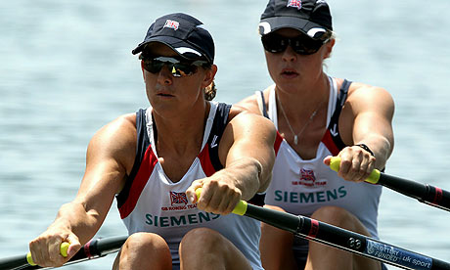
(el) remo = 1 punto
hacer el remo OR remar = 2 puntos
Katherine Grainger/Anna Watkins = 2 puntos+
Notes:
Demo slide for the scoring

Slide 5
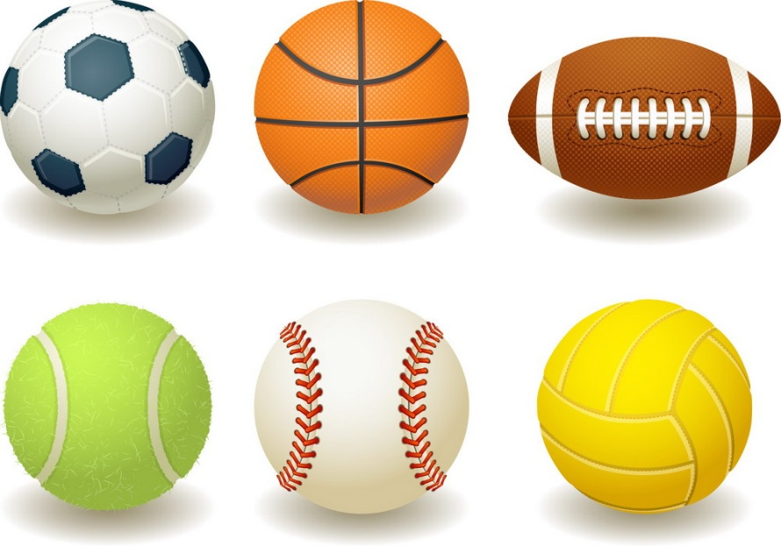
NB: practicar can be used for both but sounds a bit more formal. It can also literally mean to practise.
hacer (el/la)
jugar (al)
Notes:
Reminder of the rule re sports & correct verbs.

Slide 6
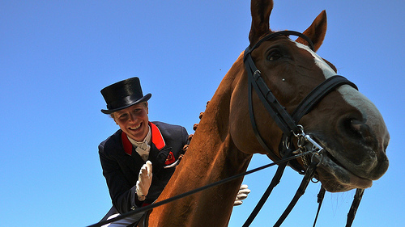
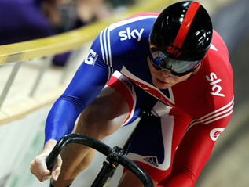
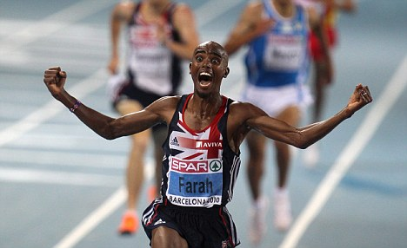
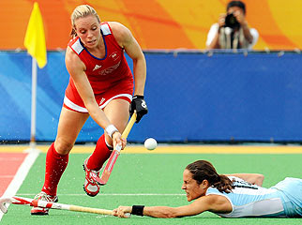
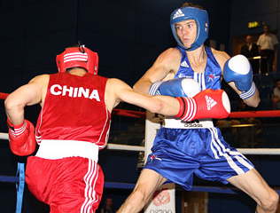
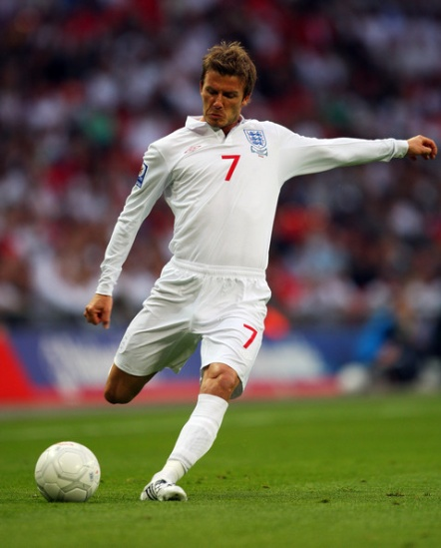
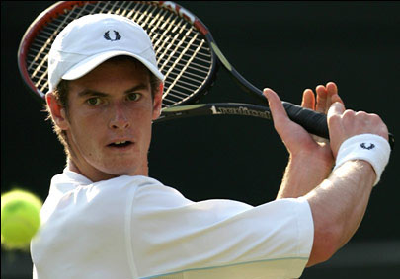
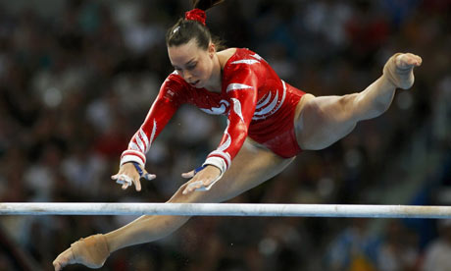
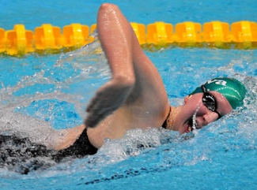
Notes:
Hay que nombrar el deporte (1 or 2 puntos) – 1 x punto para el sustantivo, 2 x puntos para el verbo correcto y el sustantivo, y para ganar 2 puntos extra hay que nombrar al deportista.
36 points available in total.

Slide 7
Laura Bechtolsheimer
Chris Hoy
Mo Farah
Katie Walsh
Luke Campbell
David Beckham
Andy Murray
Beth Tweddle
Rebecca Adlington
Notes:
Opportunity to win more points for team by naming each sportsperson left to right.
9 x points available

Slide 8
¿Qué deportes les gustan a ellos?
¿Qué deporte le gusta a Chris Hoy?
A Chris Hoy le gusta ………………
Notes:
Teacher to use the slide to model and elicit language – stress ‘le’

Slide 9
¿Qué medalla vas a ganar?
Notes:
Extend the use of ‘le’ to family members. This and the next slide to be printed as one worksheet. Students to be challenged to get a Gold, Silver or Bronze medal in their groups or pairs. Score each sentence with 3,2,1
3 = no mistakes, 2 = 1 or 2 errors, 1 = 3+ errors. Everything wrong is an error including accents! Gold medal = 12 – 15 points Silver = 8 – 11 points Bronze = 4 – 7 points

Slide 10
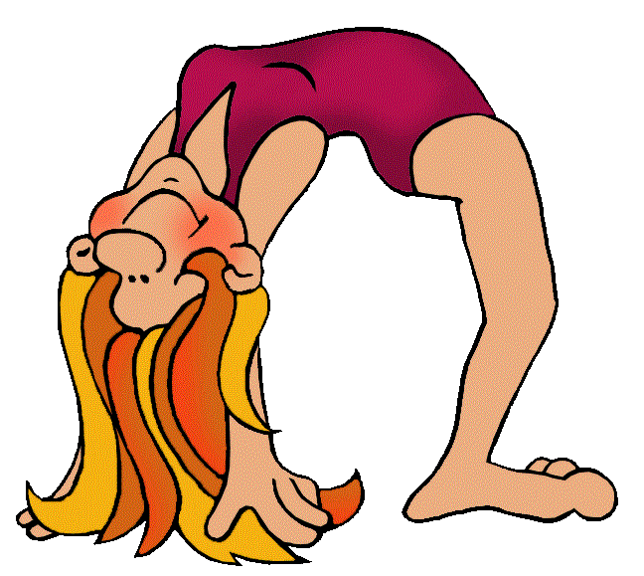
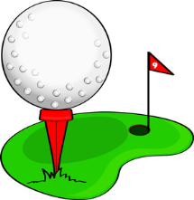
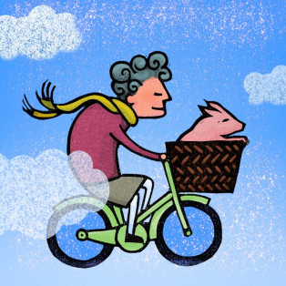
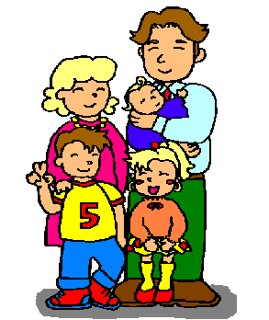
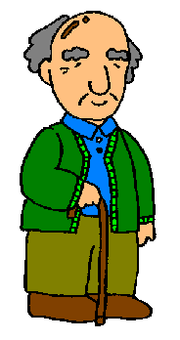
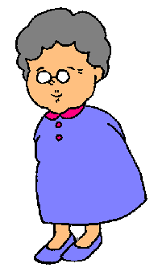
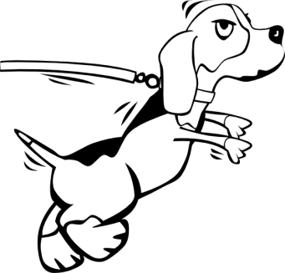
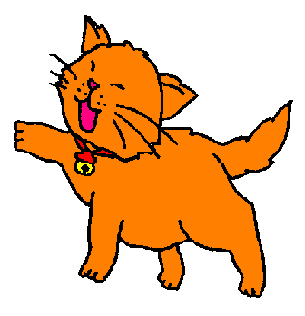
¿Qué deportes le gustan a tu familia?
A mi padre le gusta el golf.
A mi hermana menor le encanta la gimnasia.
Vocabulario: varied = variado to run = correr
A mi abuelo le gusta ver el fútbol en la tele.

Slide 11
1. My granddad likes Match of the Day because he loves football.
2. My younger sister loves gymnastics because it’s exciting.
3. My mum likes athletics because it’s varied.
4. My granny loves cycling because it’s fun.
5. My dog loves athletics because he loves running.

Slide 12
1. My granddad likes Match of the Day because he loves football.
2. My younger sister loves gymnastics because it’s exciting.
3. My mum likes athletics because it’s varied.
4. My granny loves cycling because it’s fun.
5. My dog loves athletics because he loves running.
A mi abuelo le gusta MOTD porque le encanta el fútbol.
A mi hermana menor le encanta la gimnasia porque es emocionante.
A mi madre le gusta el atletismo porque es variado.
A mi abuela le encanta el ciclismo porque es divertido.
A mi perro le encanta el atletismo porque le encanta correr.

