Slide 1
Voces Inocentes
dirigido por Luís Mandoka (2004) Study guide written by Rachel Hawkes

Slide 2
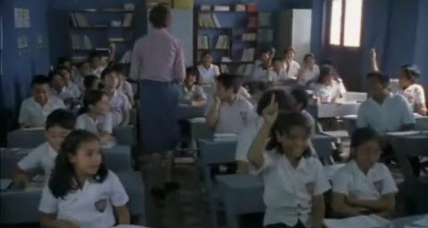
¿Cómo era el aula?
El aula …………………… cuatro paredes. ………….. bastante tradicional.
Adentro …………………… muchas mesas y sillas.
Los niños …………………. sentados.
……………. una pantalla y un mapa en la pared. Los alumnos …………………….. contentos.
Notes:
Students should watch the first clip of the film, entitled: Adrian’s scenes from Voces Inocentes part 1
The link to YouTube is:
http://www.youtube.com/watch?v=WqIVaVREoJw&playnext=1&list=PLCCC7AF2318529BA9 The clip is 8 minutes long. It opens in the school, shows some normal lesson time, lunchtime where the boys go down to the river to play – their fun is cut short when they see two soldiers. On return to school lessons resume. Cristina Maria passes Chava a note. One student asks to go to the toilet. Whilst out of the class, she sees rebel guerillas entering the school and gunfire breaks out. The school is caught up in the middle of a fierce battle between the army and rebel soldiers. Following this incident the school is closed and Chava and his family move to a safer village where his grandma lives.
After watching the clip, students should do the activities. No. 2 is a simple activity to describe the scene in the classroom, using the imperfect tense. Answers: tenía / Era / había / estaban / Había / estaban
2

Slide 3
¿Cómo era el aula?
tenía
El aula …………………… cuatro paredes. ………….. bastante tradicional.
Adentro …………………… muchas mesas y sillas.
Era
había
estaban
Los niños …………………. sentados.
……………. una pantalla y un mapa en la pared. Los alumnos …………………….. contentos.
Había
estaban
Notes:
Of course this activity could be done in the present tense too. Or the words could be added at the bottom for students to select from.
3

Slide 4
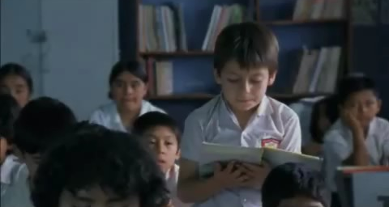
El poema de un alumno
Ningún niño de mi escuela quiere ir a pelear No les gusta la guerra porque prefieren jugar Los soldados nos buscan porque nos quieren reclutar pero a mí y a mis amigos nunca nos van a encontrar
Notes:
This poem is read out by a pupil in the class, during the same 8 minute clip. It shows very clearly how much of an influence the war had on their everyday lives (just like the earlier scene at the river, when their lunchtime games are halted by the appearance of the soldiers). A poem written for homework speaks of their fear at being found and recruited by the army.
4

Slide 5
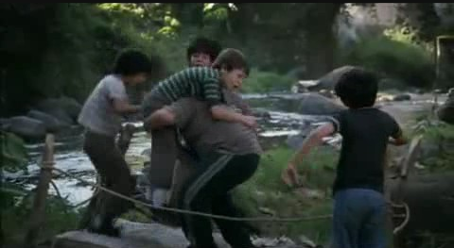
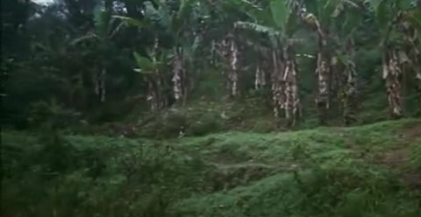
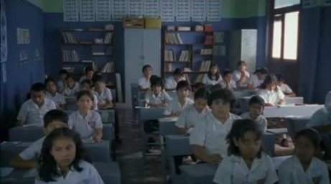
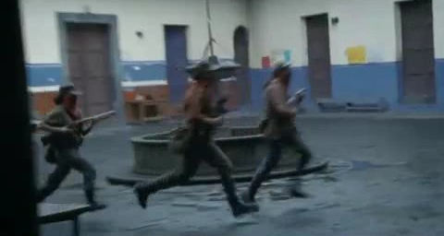
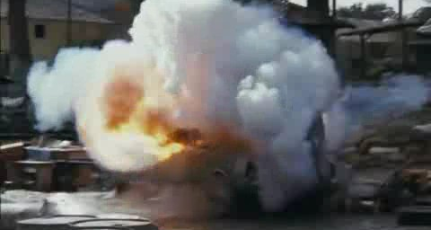
La guerra llegó a la escuela
Los niños jugaban junto al río cuando pasaron 2 soldados.
Los niños estudiaban cuando llegaron los guerillas.
Los niños tenían miedo cuando estallaron las bombas.
descripción = imperfecto / acción terminada = pretérito
Notes:
The film sets up very striking contrasts between normal childhood activities and life in a war zone, none more effective that in these scenes when war breaks out in their school. I have used this scene also to show the imperfect and preterit combine to give description and action. There could be other foci, but towards the end of year 9, this is an important linguistic focus in our Y9 SOW.
The texts are animated to appear because the students in their study guide first have to match them to the correct pictures.
5

