Slide 1
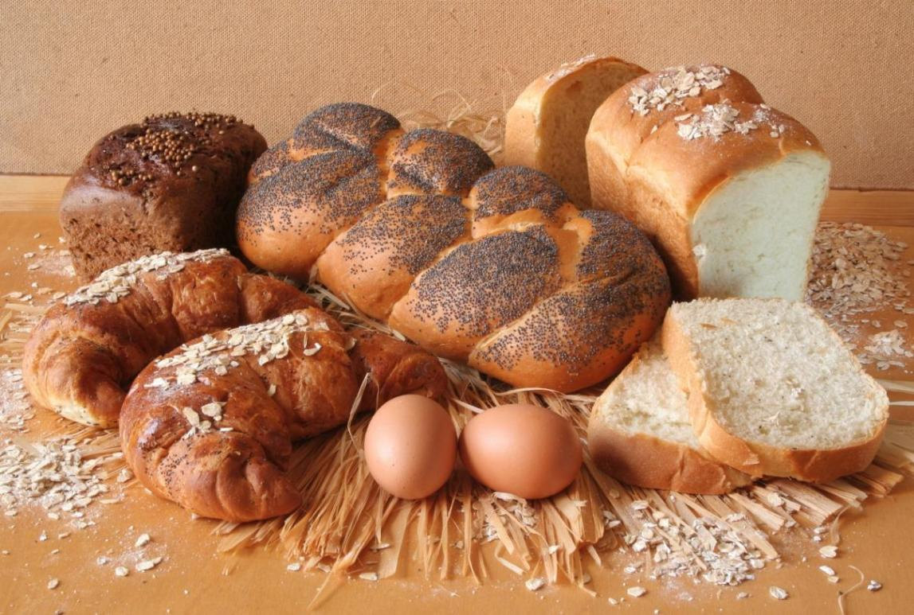
el pan

Slide 2
Objetivos:
Repasar vocabulario para comida
Considerar ingredientes típicos para bocadillos en Inglaterra y España

Slide 3
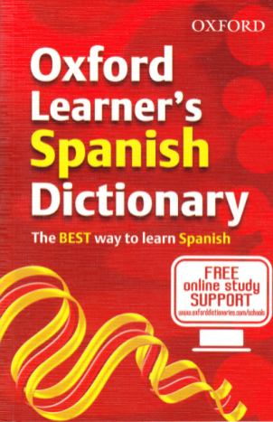
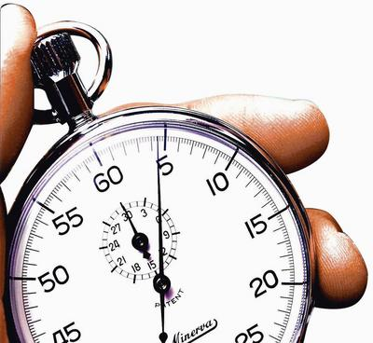
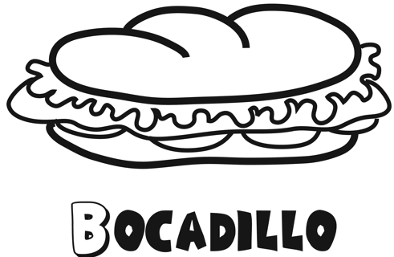
Tienes dos minutos para escribir una lista de todos los ingredientes posibles de un bocadillo.
2:00
1:59
1:58
1:57
1:56
1:55
1:54
1:53
1:52
1:51
1:50
1:49
1:48
1:47
1:46
1:45
1:44
1:43
1:42
1:41
1:40
1:39
1:38
1:37
1:36
1:35
1:34
1:33
1:32
1:31
1:30
1:29
1:28
1:27
1:26
1:25
1:24
1:23
1:22
1:21
1:20
1:19
1:18
1:17
1:16
1:15
1:14
1:13
1:12
1:11
1:10
1:09
1:08
1:07
1:06
1:05
1:04
1:03
1:02
1:01
1:00
0:59
0:58
0:57
0:56
0:55
0:54
0:53
0:52
0:51
0:50
0:49
0:48
0:47
0:46
0:45
0:44
0:43
0:42
0:41
0:40
0:39
0:38
0:37
0:36
0:35
0:34
0:33
0:32
0:31
0:30
0:29
0:28
0:27
0:26
0:25
0:24
0:23
0:22
0:21
0:20
0:19
0:18
0:17
0:16
0:15
0:14
0:13
0:12
0:11
0:10
0:09
0:08
0:07
0:06
0:05
0:04
0:03
0:02
0:01
FIN
Notes:
Give students 2 minutes + access to a dictionary. Then give them a further minute to share with a partner and add new words to their list.

Slide 4
Ingredientes de un bocadillo
tomate
queso
lechuga
patatas fritas
pepino
salchicha
cebolla
salami
bacon
mermelada
pechuga (de pollo)
mantequilla
sano | malsano
Notes:
In their books students can draw a quick table for sano/malsano categories and after revising the words quickly orally they can categorise them by completing the table.

Slide 5
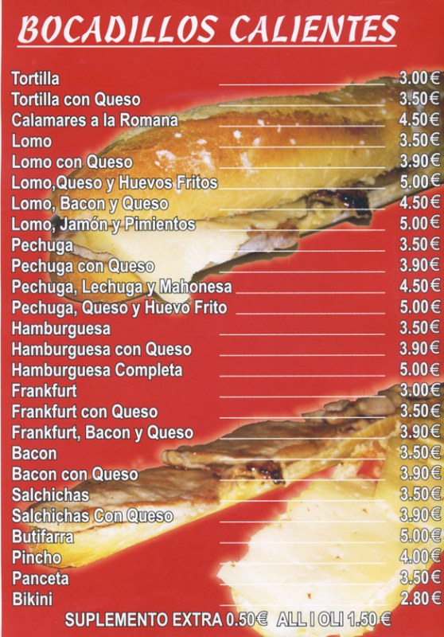
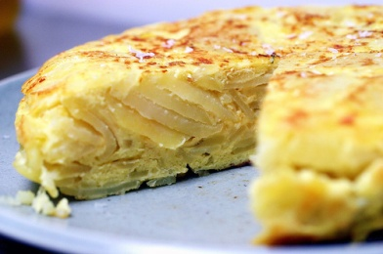
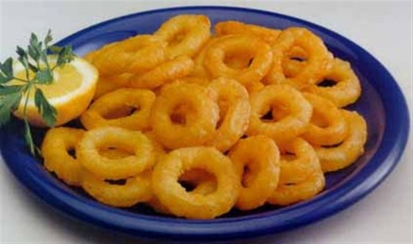
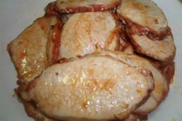
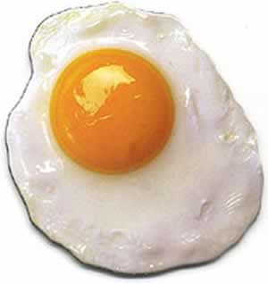
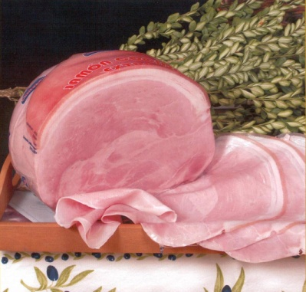
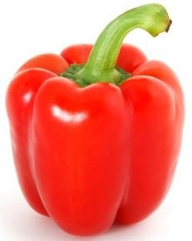
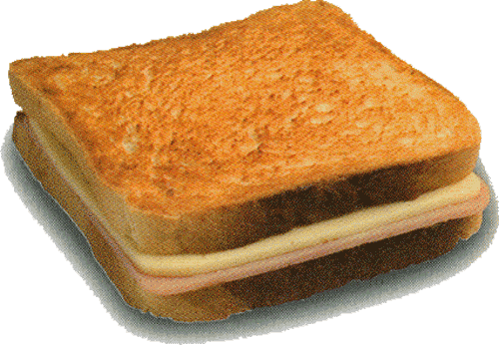
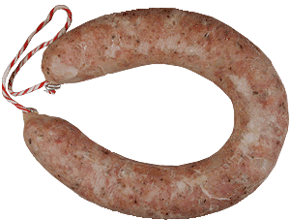
A
B
C
D
E
F
G
H
Notes:
There are several items that overlap on this menu from the previous slide. First question would be to ask students to identify them from the menu. Then there are 8 or so items that are different. Some they will know from year 8, some will be new. I’ve added pictures of the main 8 items in order of the menu. I’ve left out hamburguesa, frankfurt for obvious reasons, pincho because that is presumably just a ‘pincho’ stuffed into a roll and there are lots of varieties of this, and also panceta because it’s really another word for bacon. Here is the Spanish for each letter in case it’s not clear:
A = tortilla B = calamares C = lomo (pork loin/back) D = huevo frito E = jamón F = pimiento G = butifarra H = bikini (un sandwich de pan molde con jamón y queso – like a croque monsieur) The students could then be asked to add these words to the correct column from their previous categorising activity.

Slide 6
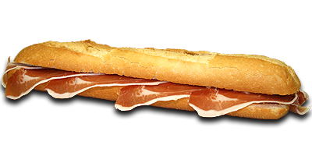
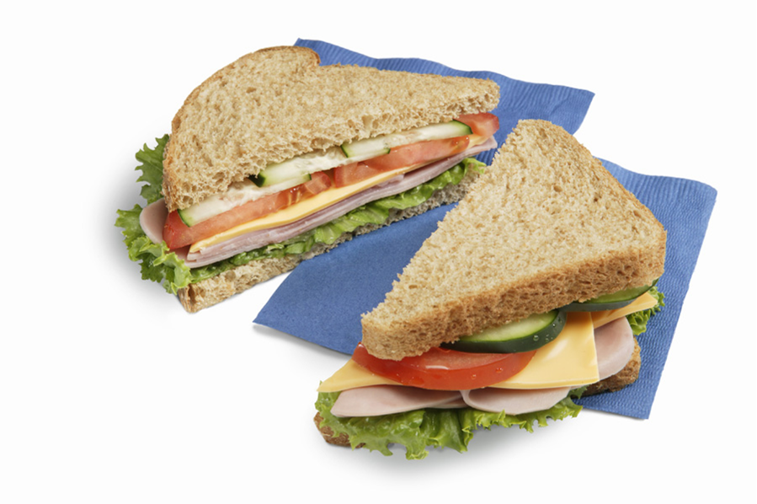
LOS BOCADILLOS
un bocadillo en España
un bocadillo en Inglaterra
¿Hay mucha diferencia?

Slide 7
* Datos del estudio ‘Tu bocadillo preferido’. Pan Cada Día. 2009
Notes:
This activity would work in a variety of ways but one way would be to do it like a game of Family Fortunes where 1 representative from each half of the class would come up to the front and would have to answer a quick quiz question to get (or lose) control of the game. Then the team in charge would choose whether to play or pass to the other team. The team would then have to come up with the 4 answers of most popular sandwiches. The next round of the game could then be play with the data on the following slide.

Slide 8
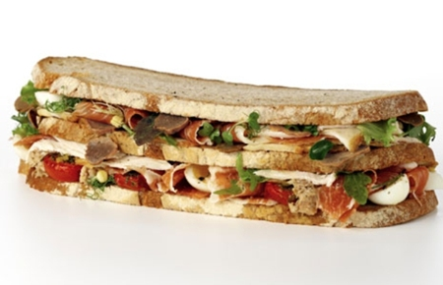
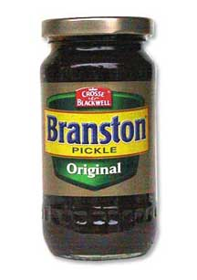
El bocadillo preferido de los ingleses
Notes:
Source of information: http://www.mirror.co.uk/news/health-news/2009/05/14/lick-your-lips-at-this-lot-what-is-your-favourite-sandwich-115875-21357330/

Slide 9
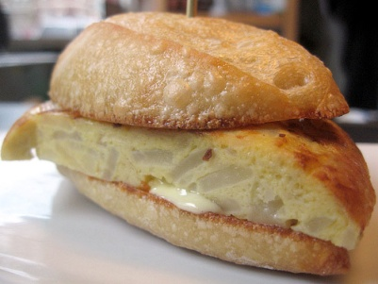
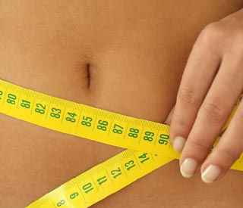
Los bocadillos son buenos – España
Según la encuesta ‘Tu Bocadillo Preferido’ realizada por la campaña Pan cada día, los bocadillos de jamón con tomate (29 por ciento) y de tortilla de patatas (16 por ciento) son los preferidos por los madrileños.
El 68 por ciento de los madrileños consume bocadillos durante sus jornadas de playa, piscina, excursiones por el campo o visitas turísticas. Los jóvenes de entre 25 y 34 años son los que más los consumen (80 por ciento). Los bocadillos favoritos son el de jamón serrano con tomate y el de tortilla de patatas, seguido del de lomo con queso (11 por ciento). Mucho menos populares son los de calamares, jamón serrano, atún con pimientos y los de anchoas, ternera, queso, chorizo y otros. Carmen Gómez Candela, jefe de la Unidad de Nutrición Clínica y Dietética en Madrid, dice: "la importancia del bocadillo es no sólo por ser fuente de hidratos de carbono, (que son importantes para el organismo, sobre todo para el cerebro),sino por sus cantidades en fibra, vitaminas del grupo B, especialmente la B1, o minerales como el fósforo y el calcio, encargados de la formación de huesos y dientes, entre otros.”
¡No engordan!
La campaña Pan Cada Día intenta combatir también el mito de que los bocadillos engordan, algo que, según ellos, "no tiene ningún fundamento científico". Un bocadillo de jamón con tomate aporta unas 495 kilocalorías, una cuarta parte de la energía diaria de una dieta normal.
Notes:
This is the simplified version of the text but it is still a challenging piece. Depending on the ability level of your students you may want to differentiate by:
Reading it out loud slowly to the group as they follow along 2) Do as for 1) but stress in addition key words 3) Bold key words in the text or highlight them as you read through. 4. Give a glossary of some important key words 5. Allow students to work in groups 6. Divide the task up and have short plenaries after each task is complete.

Slide 10
1. Read the text quite quickly. Don’t stop when there are words you don’t understand. You are just trying to pick up on the gist (main message) of the text this time around. Now see if you can assign an appropriate heading to each paragraph. There are more headings than you need! Put numbers 1,2,3,4 and 5 under the most appropriate headings.
Not fattening | Preferences | Places eaten | The survey | Nutritional value
2. Read the text again. Highlight every sentence where you are pretty sure you can guess the overall meaning, even when you don’t know the meaning of each word. How many sentences have you highlighted? Write that number here ________ (total number of sentences = 8)
3. Read the text again. This time, see if you can interpret the likely meanings of the following words (that you have never met before!) They appear in order in the text to help you find them.
people from Madrid | young people | bones and teeth
survey | percent | myth
campaign | carbohydrate | to make (you) fat
beach | brain | normal diet
4. Circle the word that best describes your understanding of this text now: I understand all / most / about half / less than half / none of this text.

Slide 11
¿Cuáles son las preguntas?
7. Sí, pero es un poco aburrido.
1. Sí, me encantan.
2. No, no me gustan nada.
6. Sí, por supuesto. ¿Y tú?
3. Mi bocadillo preferido es de queso y tomate.
5. Detesto las cebollas.
4. No, porque soy vegetariano/a.
Notes:
11
Students are used to this activity now and should not need lots of prompting. But in case they do, examples could be: 1. Te gustan los bocadillos de jamon? 2. Te gustan los bocadillos de tortilla? 3. Cual es tu bocadillo favorito? 4. Te gustan bocadillos de salchicha? 5. Que no te gusta comer? 6. Te gusta el queso? 7. Te gusta el tomate?

