Slide 1
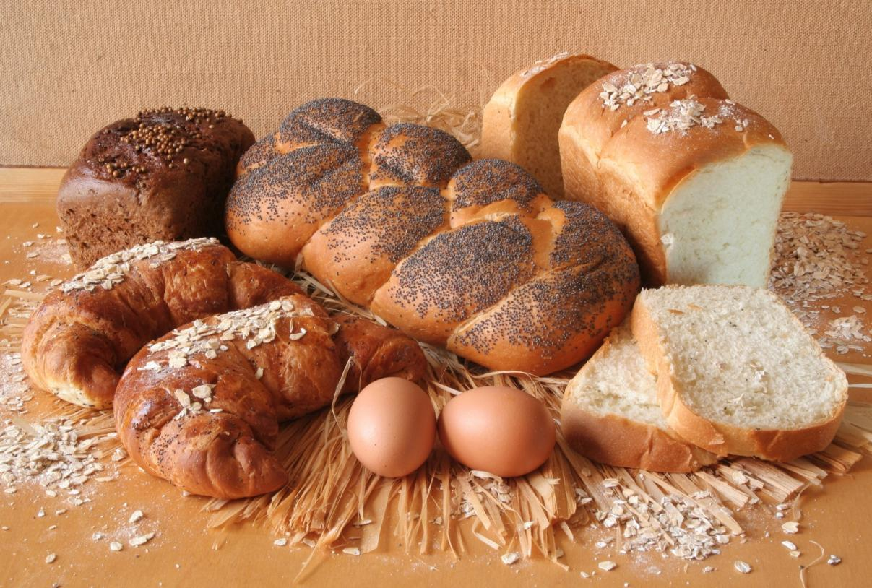
el pan

Slide 2
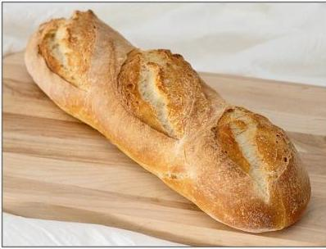
Objetivos:
Considerar varios tipos de pan, su forma y su origen
Conversar sobre mis gustos y preferencias

Slide 3

pain
Brot
pa
pane
t’anta
brood
pan
mkate
bread
español | inglés | alemán
catalán | francés | holandés
quechua | italiano | swahili
Notes:
All are words for bread in different languages. Teacher can introduce this by using ‘bread’ and ‘inglés’ as an example and then eliciting the languages of the remaining words. Depending on the group a few further comments about those that ‘se parecen’ and those that ‘se diferencian’ or ‘son únicos’ could extend this simple starter.
In case not known, mkate = swahili and t’anta = quechua

Slide 4
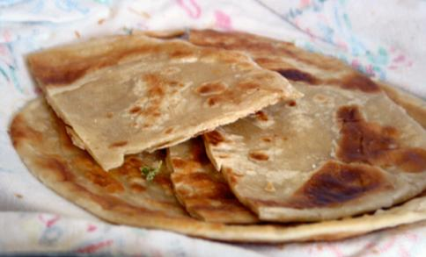
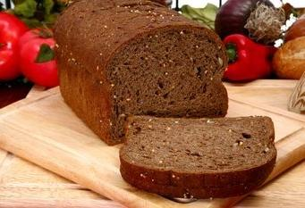
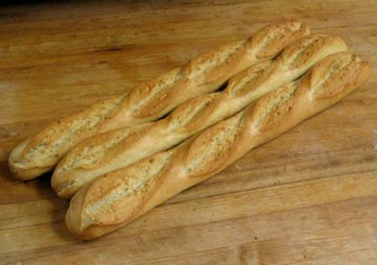
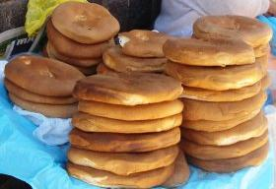
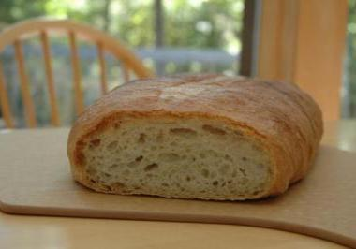


¿De dónde son estos panes?
Notes:
From left to right, the answers are: Chapatis – Africa/India, - Alemania, Baguete – Francia, Pan Chuta – Perú, Una barra de pan – España, Ciabatta – Italia. We are going to look at most of these in the next few slides so there is no need to correct the suggestions given at this stage. Perhaps only the Peru example as this does not re-appear.
http://images.all-free-download.com/images/graphiclarge/figure_talking_callout_clip_art_22956.jpg

Slide 5
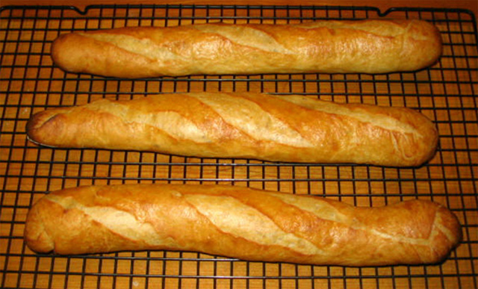
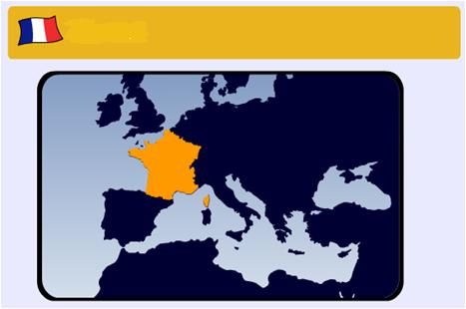
Francia
baguete

Slide 6
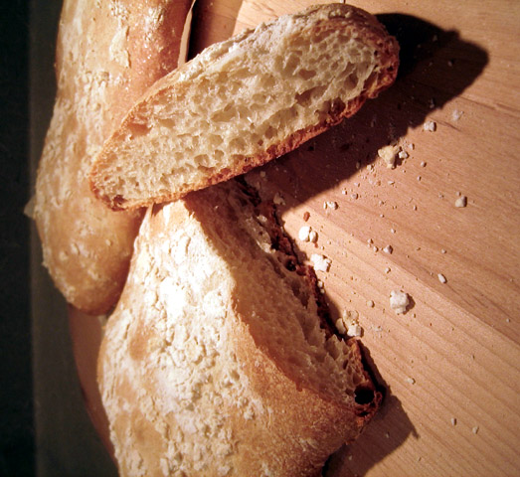
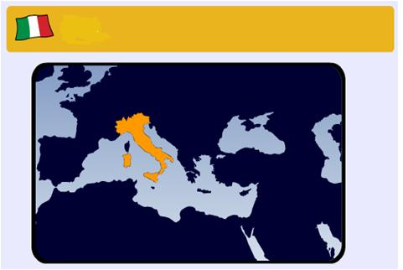
Italia
ciabatta

Slide 7
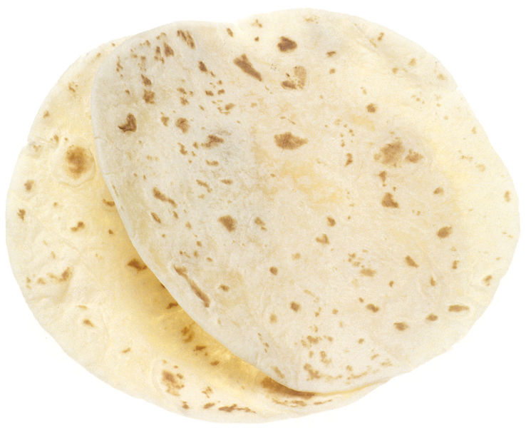
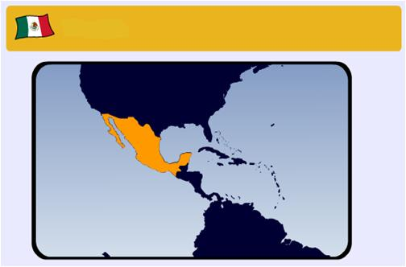
México
tortilla

Slide 8
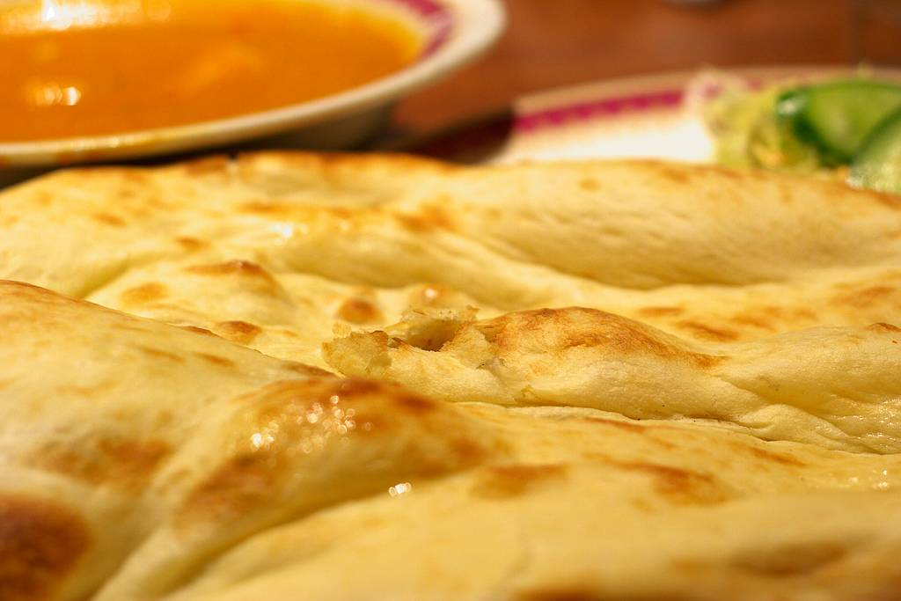
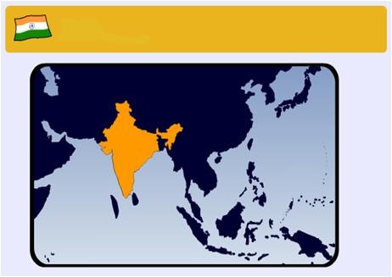
India
naan

Slide 9
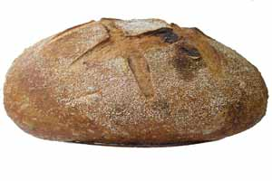
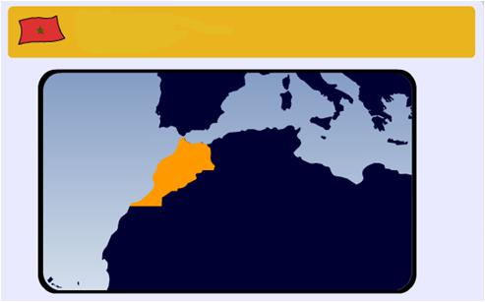
Marruecos
pan casero

Slide 10
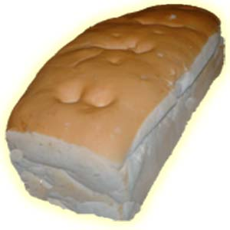
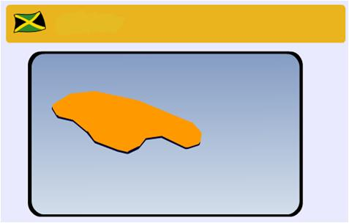
Jamaica
pan duro

Slide 11
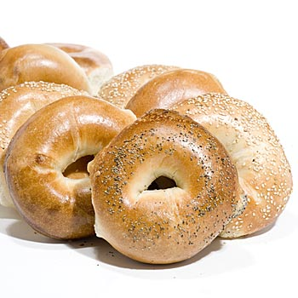
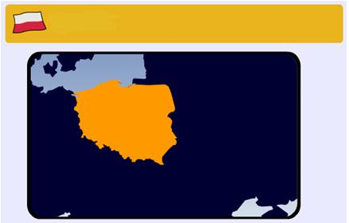
Polonia
beigal
Notes:
I’ve been guided in my choice of word and spelling here by the following discussion thread in wordreference.com – it’s makes phonetic sense to me to have this spelling of the word too.
http://forum.wordreference.com/showthread.php?t=120762

Slide 12
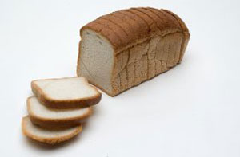
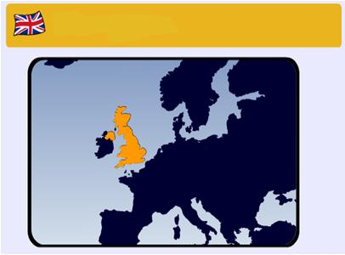
Reino Unido
pan de molde

Slide 13
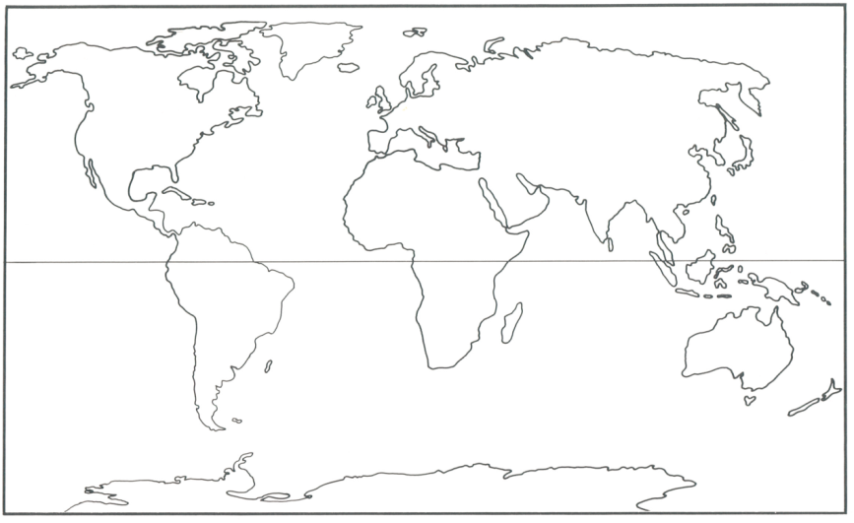
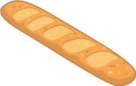
¿De dónde vienen los diferentes tipos de pan? Escribe ejemplos y señala su origen en el mapa.
Los baguetes vienen de Francia

Slide 14
comer
pelar
prensar
cortar
beber
cocinar
coger
preparar
comprar
robar
tirar
dar
Notes:
In the agua modules students have done a lot with infinitive phrases. This activity should work well orally, asking students (whilst miming the verb) ‘se puede………………. una manzana’? When you change the noun it makes students consider the verb meanings to tell you whether they are still possible with the new noun. This is just oral revision of the se puede construction. Many of these verbs are known or are cognates and they will return in the following lessons.

Slide 15
dulce | sweet
salado | salty
duro | hard (or chewy)
blando | soft
sabroso | tasty
delicioso | delicious
rico | delicious
sano | healthy
malsano | unhealthy
bueno para la salud | good for your health
malo para la salud | bad for your health
muy - very
demasiado = too
Notes:
Most of these words appeared in Y8 when students were doing the food theme, so this is really just revision plus (duro/blando). Give students a couple of minutes to pronounce these in pairs and then ask for volunteers. It is good for pupils to get used to reading and pronouncing words accurately independently. Pick up on any issues or room for improvement.

Slide 17



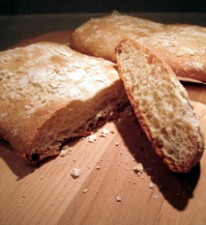


¿Qué opinas de estos panes?
Creo que… es … Pienso que… es … Me parece … | Me gusta /Prefiero…porque….
delicioso / sabroso sano / malsano dulce / salado duro / blando
¡Qué va! ¡Hombre! ¡Vaya! ¿Estás loco/a? | ¿Qué opinas tú? ¿Qué piensas tú? ¿Qué te parece? Pues, yo creo que …..
Notes:
Group talk activity

Slide 18
During your conversation with each other, you should aim to try to do the following:
Use a time filler
Ask someone in the group a question
Express agreement or disagreement
Express your own preferences and give reason why
Listen to someone’s point of view and then respond to what they say

