Slide 1
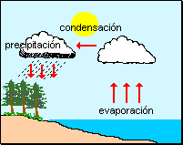
El ciclo del agua

Slide 2
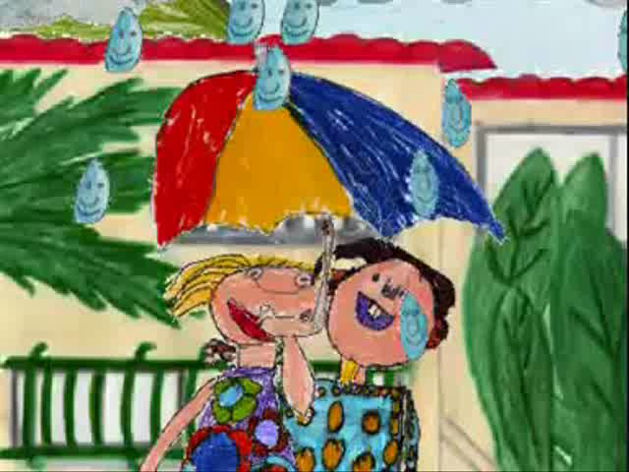
Notes:
If students need more inspiration, here is one YouTube example. There is no audio added but the text is written out on each slide.

