Slide 1


Slide 2

Día mundial del agua
El día es el 22 de marzo
Llama la atención sobre lo importante que es el agua para todos
Hay siempre publicidad para presentar los hechos importantes
Las funciones importantes del agua (¿para qué sirve el agua?)
Los problemas de la escasez de agua y sus causas
Las soluciones – cómo podemos ahorrar agua individualmente
You are going to prepare some publicity material for the next World Water Day on 22 March 2012. It could be a poster, a PowerPoint, a short video sequence with voice over. The format is up to you. You will have 4 lessons and homework time to complete it.
You can either concentrate on 1 of the 3 aspects of water use listed or all of them.

Slide 3


Slide 4


Slide 5
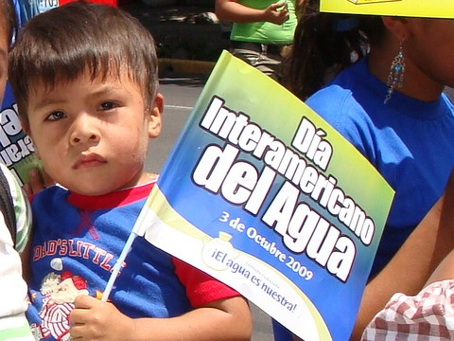


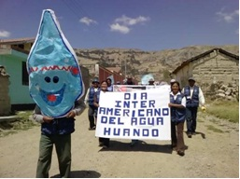

Slide 6
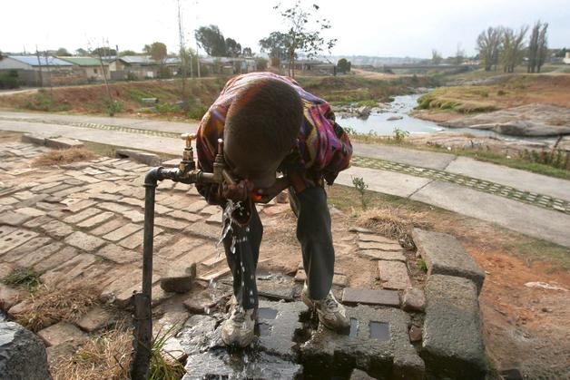
 | ☺ | ☹
presente
presente (otras personas)
pasado (pretérito)
pasado (imperfecto)
futuro
verbo + infinitivo
enlaces
‘que’ (pronombre relativo)
opiniones
razones
negativos
comparativos
spelling errors
Las funciones importantes de agua (¿para qué sirve el agua?)
Los problemas de la escasez de agua y sus causas
Las soluciones – cómo podemos ahorrar agua individualmente
Notes:
This slide is to guide students towards using the full range of language they have for this topic. They will need reminding, particularly about how to include verb + infinitive (poder, deber, soler, sirve para) and links, que, opinions, comparatives. They can find a way to include the past and the future – remind them about the water wars that they can refer to.
As always with their writing they should be aiming for 80:20 ratio approx, so 80% should be language they have used in the lessons on this topics and previously, 20% could be looked up. That means, if they write 200 words, only 40 can be looked up online/in dictionary.
This work can be started this lesson, is homework for this week, and then will be completed in the next lesson and handed it.
The final lesson of this term will be general revision of everything to do with water topic this half term – to be chosen by the teacher, or could be a Xmas lesson if preferred.

