Slide 1
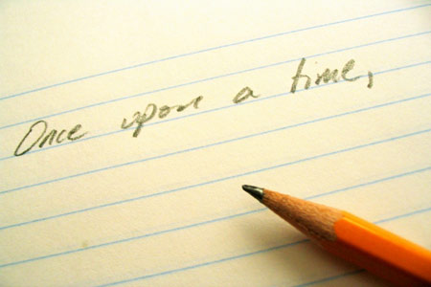

Cuentos
Érase una vez
entender y responder a una historia en español
escribir un texto para narrar una histora
5

Slide 2

Expresiones para narrar
Érase una vez
Un día
Entonces
Pronto
Luego
Más allá en el camino
De repente
Después de un rato
Once upon a time
One day
Then, so
Soon
Then
Further along the road
Suddenly
After a while

Slide 3
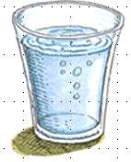
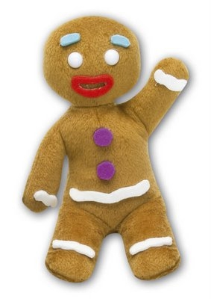
comer
pelar
prensar
cortar
beber
cocinar
coger
preparar
comprar
robar
tirar
dar
Notes:
Se puede o no se puede

Slide 4

Notes:
This video clip is Frau Holle (Madre Nieve in Spanish Version) from BBC clips online. http://www.bbc.co.uk/learningzone/clips/frau-holle-spanish/5766.html

Slide 5
¡Vamos a mirar algo!
Título del programa/de la película: ………………………………….
1. ¿Qué tipo de programa es?
3. ¿Dónde tiene lugar?
5. ¡Añade tu opinión!
 | película
 | dibujos animados
 | telenovela
 | noticias
 | programa de deporte
 | telecomedia
 | concurso
 | programa de música
 | afuera
 | me gustó
 | no me gustó
 | en la ciudad
 | en el campo
 | adentro
Escribe en español lo que ves en el programa.
 | en el estudio
 | en un edificio
________________________________________________________________________________________________________________________________________________________________________________________________________________________________________________________________________________________________________________________
4. ¿Cómo es?
2. ¿Para quién es?
 | divertido
 | cómico
 | triste
 | informativo
 | serio
 | interesante
 | emocionante
 | aburrido
 | adultos
 | niños
 | todos
Notes:
Student fill in the sheet. Then they ask each other the questions (or could do whole class Q&A) See which words they have managed to hear. (They may need to watch the story again to do this part) Below is a list of words they may have picked up.
Words that they might understand for section 6: cretina, perfecto, zapatos, desayuno, niña, bonita, madrastra, hermanastra, perdona, mamá, los dedos, ahora mismo, adiós, , hola, me llamo Clara, Yo soy madre nieve, Sí, triste, ahora, increíble, oro, la historia, fea, mucho, menos, que es esto, mama, todos los días

Slide 6
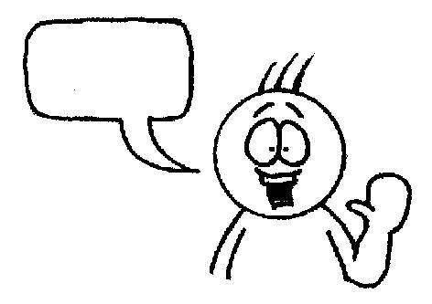
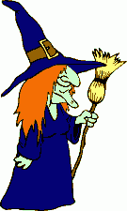
Érase una vez
una niña fea
una princesa
una niña bonita
que vivía con
su madrastra
su madre
Madre Nieve
su hermana malvada
su hermano malvado
su hermanastra malvada
y con
Angelina.
Agnes.
Dolores.
que se llamaba
Un día Clara tuvo que
en un castillo.
en la casa.
en el pozo.
una bruja.
una anciana.
un dragón.
entrar
Se encontró con
Notes:
This is a trapdoor activity to practise scene-setting language. It’s brilliant for a) memory and b) speaking (repetition with a reason!) It’s a competitive game in pairs. Each chooses and option for each sentence in their head. One starts reading out loud, trying to anticipate the other’s choices. Each time they make a choice, the partner either nods or shakes his/her head. If the choice is wrong, play passes to the partner who starts the same process. If it is the right choice, the student gets to continue. The aim is to get to the end first. Answers don’t change, so this is also a great memory developer.

Slide 7
lavó
limpió
fue de compras
Clara se quedó con Madre Nieve y
y/e
jugó.
hizo las camas.
cocinó.
Cuando volvió a casa, Madre Nieve le regaló
una gallina de oro.
un vestido de oro.
un plato de oro.
una idea.
un problema.
un plan retorcido.
La madrastra tuvo
Agnes también entró
oro.
alquitrán negro.
plata.
en el pozo pero no
cayó
trabajó
comió
bien y su recompensa fue
Notes:
This is a trapdoor activity to practise scene-setting language. It’s brilliant for a) memory and b) speaking (repetition with a reason!) It’s a competitive game in pairs. Each chooses and option for each sentence in their head. One starts reading out loud, trying to anticipate the other’s choices. Each time they make a choice, the partner either nods or shakes his/her head. If the choice is wrong, play passes to the partner who starts the same process. If it is the right choice, the student gets to continue. The aim is to get to the end first. Answers don’t change, so this is also a great memory developer.

Slide 8
Vamos a narrar un cuento en español.
Escribe una versión corta en inglés
Piensa en los verbos – usa el 80% de los verbos ya conocidos
Utiliza frases temporales para narrar bien y formar enlaces
Escribe tu versión en español
Leela en voz alta– fíjate en la pronunciación
Notes:
In the remaining half of this lesson, present the story task to students. They are going to write the story of either The Gingerbread Man or Mother Snow in 10 short sections or less. OR They can write their own story. What they must do though is write a structure first in English, but thinking all the time about the Spanish they can do. This is a progression from the simple adaptation they did of the Sleeping Beauty story.
The story must be simple enough for them to write confidently in Spanish, using 80% verbs they know and using a conjugator for extra 20% new verbs. The same goes for vocabulary. Section 1 (and perhaps 2) should be setting the scene using the imperfect. Then they can use the preterite. They need to think about the verb forms and the linking phrases (see slide 2 this lesson) – those are the priorities.

Slide 9
Madre Nieve
1
2
3
4
5
6
7
8
9
10
Notes:
Perhaps use this one to generate the English version all together if students need a lot of support. Challenge them to keep it to verbs they know as much as possible (80% rule) and keep asking them the Spanish for what they suggest in English.

Slide 10
El hombrecito del pan de jengibre
1 | Once upon a time there was an old lady who lived with her husband in a little house in a wood. They were very happy.
2 | One day she decided to cook something special, a gingerbread man.
3 | She put it into the oven, but then heard a voice. She decided to open the oven door.
4 | The gingerbread man jumped out and ran away.
5 | The old women followed him, saying ‘stop, I want to eat you!’ But he said: ‘Run, run as fast as you can, you can’t catch me, I’m the gingerbread man!’
6 | The old woman’s husband followed too.
7 | Soon the gingerbread man met a cow, who said: ‘Stop, I want to eat you!’ But he said: ‘Run, run as fast as you can, you can’t catch me, I’m the gingerbread man!’
8 | Then the gingerbread man met a horse, who said: ‘Stop, I want to eat you!’ But he said: ‘Run, run as fast as you can, you can’t catch me, I’m the gingerbread man!’
9 | The gingerbread man arrived at a river and did not know how to cross it. A fox offered to help him.
10 | In the middle of the river, the fox threw the gingerbread man into the air, opened his mouth and ate him. And that was the end of the little gingerbread man…
Notes:
This is a possible suggestion for the Gingerbread Man English version. Students will continue writing and then rehearsing their stories next lesson. If there is time they should record themselves doing a voice over for their chosen story. If they have written their own story, encourage them to draw illustrations (or make a powerpoint with images) for homework. For some of them, the narration of this story will be their contribution to the radio programme next term.

