Slide 1
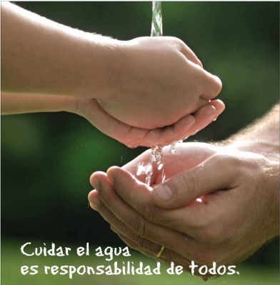

El consumo de agua
Objetivo:
Saber más información sobre el uso del agua en España e Inglaterra
Repasar verbos para los usos del agua
Repasar los números más grandes

Slide 2
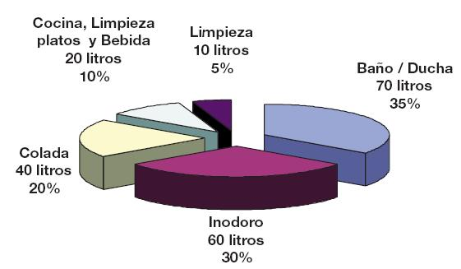
¿Cómo usamos el agua?
limpiar
limpiarse los dientes
beber
lavar la ropa
usar el servicio
lavarse
bañarse
ducharse
lavar los platos
Notes:
A useful slide to start with. These data are from Spain and show the proportion in % of the various uses of water in the home, and also the number of litres. The labels may not be completely obvious and therefore I’ve provided infinitive verbs that students have seen before to link to the nouns shown on the diagram. This can be done as whole class oral work and it highlights the link between noun and verb forms.
Also, in the sequence of lessons ‘introduccion al agua’ students learnt how to use the construction ‘sirve para’ so this is revision for them.
They should be able to tell you answers to your question ‘para que sirve el agua’?

Slide 3
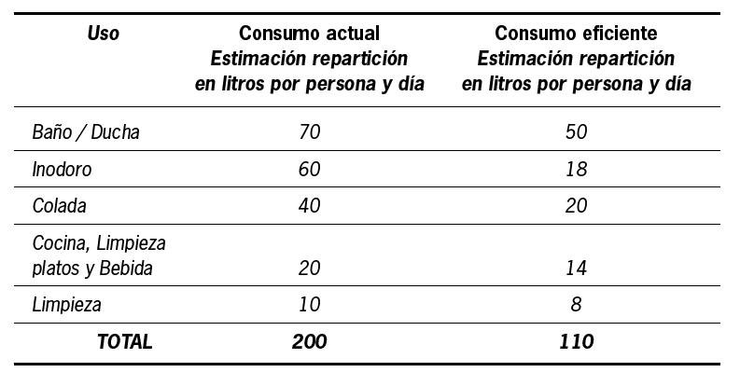

El consumo medio actual de una familia de 4 personas en España es de 800 litros/día, o sea, de 200 litros por persona por día. Con unos hábitos eficientes sería de 440 litros/día (o 110 por persona por día).
Notes:
This slide shows the current position in Spain for average water use in the first column and also what would be ideal – i.e what it should be reduced to.

Slide 4
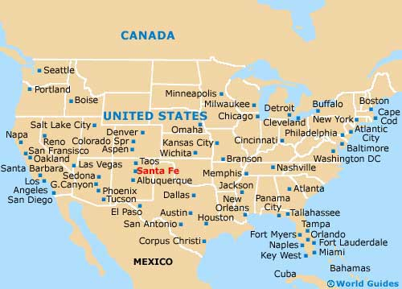
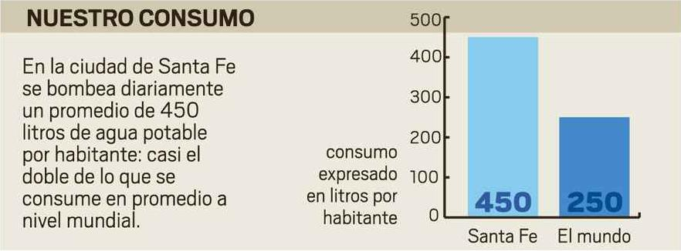

Slide 5
Cuánta agua se usa para…
lavarse las manos | 5 litros
limpiarse los dientes durante 2 minutos | 10 litros
cocinar | 60 litros
una ducha de 5 minutos | 60 litros
un baño | 350 litros
la lavadora (por ciclo) | 200 litros
lavar los platos de 4 personas | 100 litros
lavar el coche con manguera | 500 litros
lavar el coche con balde | 50 litros
descargar la cisterna de inodoro | 20 litros
Notes:
Useful slide to practise higher numbers. We will come back to this one in lesson 4 as the source of data for a homework task.

Slide 6
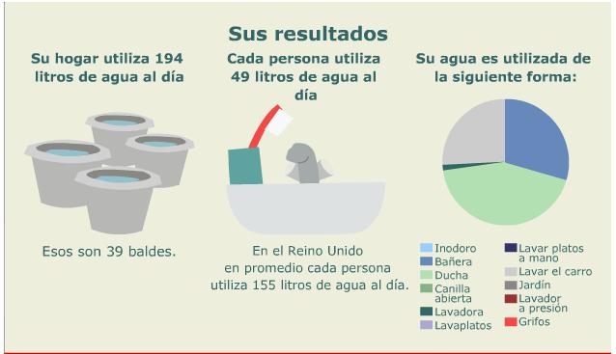
Vamos a calcular nuestro consumo de agua
http://news.bbc.co.uk/hi/spanish/specials/ancho/newsid_6544000/6544761.stm
Notes:
This is the graphic showing the water use for me and for my family – follow the link and go through the questions with the class. Give them the link to do this activity at home for homework. Tell them to print screen the results and to save as a jpeg and email to you – you will be able to display them then for the class. You can take an average of your class’s results to represent a UK average figure for water consumption.

