Slide 1
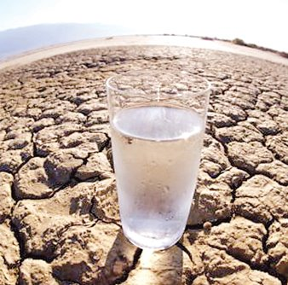

El consumo de agua
Objetivo:
Saber más información sobre el uso del agua en España e Inglaterra
Informarnos sobre la situación en América del Sur y comparar
La escasez de agua

Slide 2
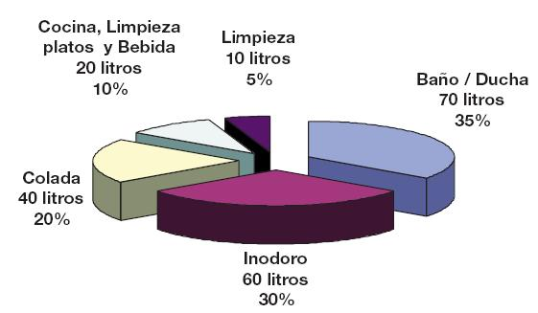
¿Cómo usamos el agua?
limpiar
limpiarse los dientes
beber
lavar la ropa
usar el servicio
lavarse
bañarse
ducharse
lavar los platos
Notes:
A useful slide to start with. These data are from Spain and show the proportion in % of the various uses of water in the home, and also the number of litres. The labels may not be completely obvious and therefore I’ve provided infinitive verbs that students have seen before to link to the nouns shown on the diagram. This can be done as whole class oral work and it highlights the link between noun and verb forms. Also, in the sequence of lessons ‘introduccion al agua’ students learnt how to use the construction ‘sirve para’ so this is revision for them. They should be able to tell you answers to your question ‘para que sirve el agua’?

Slide 3
El agua sirve para limpiarse los dientes, ducharse, lavarse y rogar las plantas en el jardín.
Personalmente, no uso mucha agua para limpiarme los dientes, pero uso más para ducharme .
A nosotros nos gusta trabajar en el jardín y usamos mucha agua para rogar la plantas. También la usamos para lavarnos después.
Notes:
This activity extends from the previous slide to look at how reflexive infinitives change when referring to different people. Failing to recognise these changes can lead to lack of comprehension in reading texts, so this is more about recognition than active use at the moment. Higher ability pupils may latch onto this, however, and begin to incorporate this into their written work.
The main things that they need to realise is that these are the same pronouns that they use for reflexive verbs generally, (which they met in Year 8) just that they are tacked on to the end of the infinitive. They have a page on this in their vocabulary booklets.

Slide 4
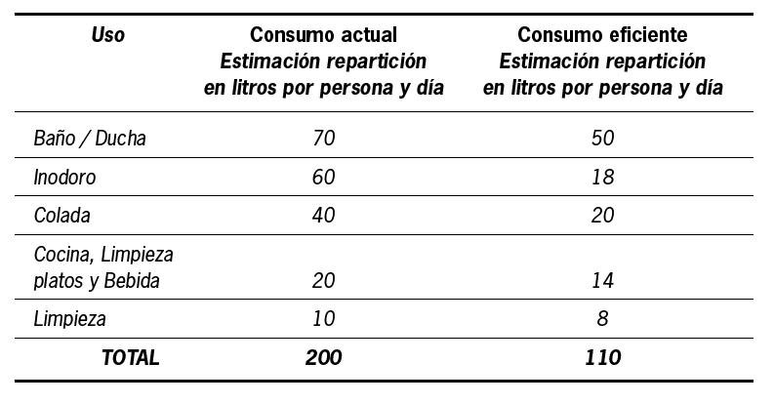

El consumo medio actual de una familia de 4 personas en España es de 800 litros/día, o sea, de 200 litros por persona por día. Con unos hábitos eficientes sería de 440 litros/día (o 110 por persona por día).
Notes:
This slide shows the current position in Spain for average water use in the first column and also what would be ideal – i.e what it should be reduced to.
The main idea here is that in most of western Europe we use too much water without thinking too much about it.

Slide 5
Cuánta agua se usa para…
lavarse las manos | 5 litros
limpiarse los dientes durante 2 minutos | 10 litros
cocinar | 60 litros
una ducha de 5 minutos | 60 litros
un baño de imersión | 350 litros
la lavadora (por ciclo) | 200 litros
lavar los platos de 4 personas | 100 litros
lavar el coche con manguera | 500 litros
lavar el coche con balde | 50 litros
descargar la cisterna de inodoro | 20 litros
Notes:
Useful slide to practise higher numbers. Get them to guess how many litres of water are used in each task. Each one is triggered. This will introduce them to new pieces of vocabulary too, which you can pick out with them e.g. manguera, balde, tanque de inodoro, lavarropas

Slide 6
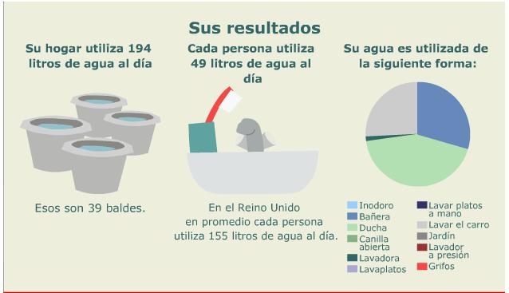
Vamos a calcular nuestro consumo de agua
http://news.bbc.co.uk/hi/spanish/specials/ancho/newsid_6544000/6544761.stm
Notes:
This is the graphic showing the water use for me and for my family – follow the link and go through the questions with the class. Give them the link to do this activity at home for homework. Tell them to print screen the results and to save as a jpeg and email to you – you will be able to display them then for the class. You can take an average of your class’s results to represent a UK average figure for water consumption.

Slide 7
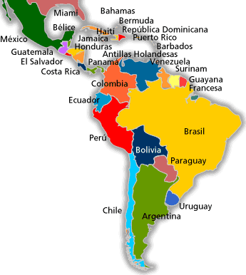

Objetivo:
Saber más información sobre el uso del agua en España e Inglaterra
Informarnos sobre la situación en América del Sur y comparar
Notes:
We now turn to look at the situation in Latin America. Remind them perhaps of the 2 x lesson objectives. Compare water situations in Europe (UK/Spain) and Latin America.
Read the text once through out loud and ask students to circle the numbers they hear during the reading – they are not reading the text during this first reading.

Slide 8

 | Indica la opción correcta
1 | 0.5% | 50%
2 | 75 millones | 65 millones
3 | 106 millones | 116 millones
4 | 14% | 15%
5 | 64% | 74%
6 | 34/1.000000 | 34/1000
Notes:
This slide can be printed at ¼ a4 size for students to write on OR they can number 1-6 in books and write the correct option down.

Slide 9
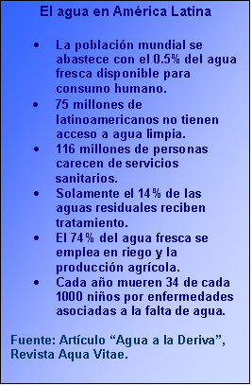
Notes:
This is the text you read to them. Now go through the answers on slide 10.

Slide 10
 | Indica la opción correcta
1 | 0.5% | 50%
2 | 75 millones | 65 millones
3 | 106 millones | 116 millones
4 | 14% | 15%
5 | 64% | 74%
6 | 34/1.000000 | 34/1000
Notes:
Here are the answers.

Slide 11
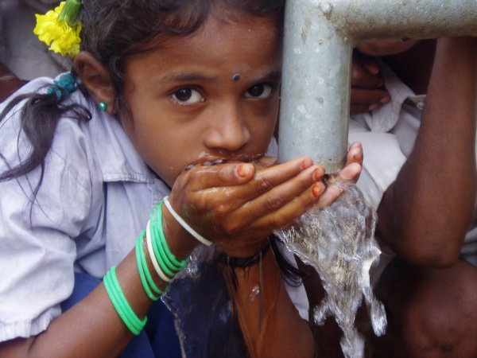
Actualmente, uno de cada cinco habitantes de América Latina no tiene acceso al agua potable.
1/5
Notes:
These next slides reinforce the messages again but illustrated this time and broken down into individual facts. They are illustrated with real pictures from Latin America countries as shown.
Depending on the time available, students could be encouraged to describe, respond orally to these pictures or the teacher may simply use them as a source of information/input and read the prompts aloud to the students.

Slide 12
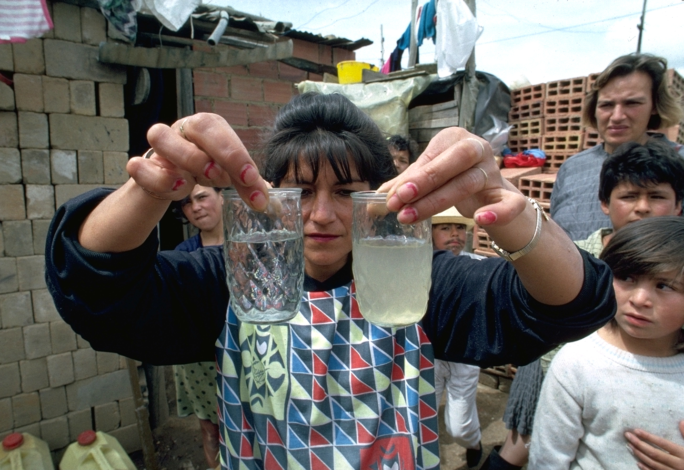
75 millones de latinoamericanos no tienen acceso a agua limpia.
Colombia

Slide 13
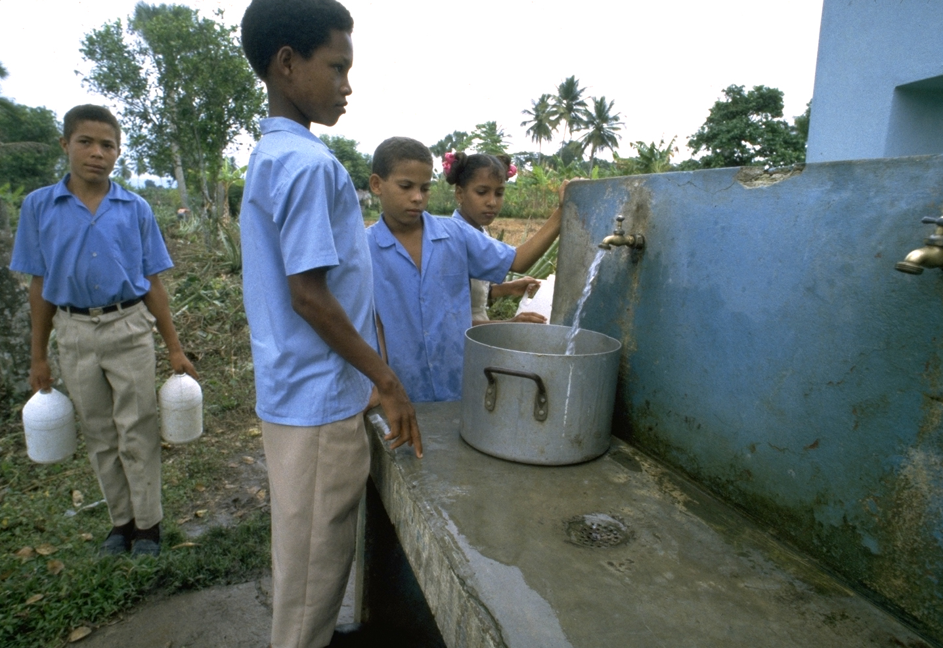
116 de millones carecen de servicios sanitarios.
Pozo público, La República Dominica

Slide 14
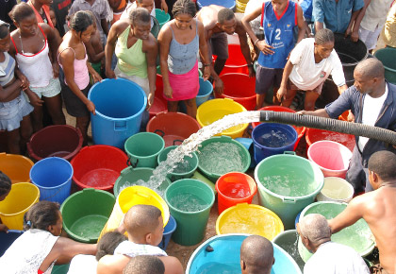
Solo 14% de las aguas reciben tratamiento.
Colombia

Slide 15
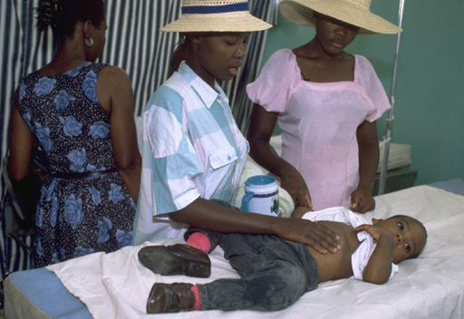
Cada año mueren 34 de cada 1000 niños …………
por enfermedades asociadas con la falta de agua.
Un hospital, Leogane, Haiti

Slide 16
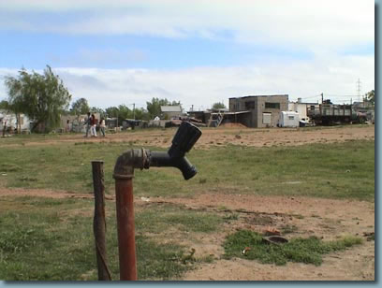
Una canilla en Maldonado, Uruguay. Se abastecen de esta canilla 300 personas.
Maldonado, Uruguay
Notes:
http://www.somosamigosdelatierra.org/06_contaminacion/agua/agua.html

Slide 17

¿Por qué hay una escasez de agua en el mundo?
2
Notes:
http://www.alekmorillo.com/blog/uploaded_images/UrgenteSalvemoselPlaneta_900E/shutterstock_9744109.jpg
Give students a couple of minutes to brainstorm (in English) all the reasons for a shortage of water in the world. Take responses (writing up perhaps on white board) and then present these reasons and ask students to match them to the English they have written down already.
http://www.booksaboutthefuture.com/pop_hst1.gif
http://2.bp.blogspot.com/_7N0xPVn6IL8/S_mJ0NYqgmI/AAAAAAAAACs/KSRhPv9OLgY/s320/overpopulation.jpg
http://www.conciudadanos.com.ar/wp-content/uploads/2010/03/glifosato-cea.jpg
http://1.bp.blogspot.com/-oPQeRD47m50/TVhaInJ1qJI/AAAAAAAABEg/3NFpgKpTL00/s1600/20070418klpcnaecl_375.Ies.SCO.jpg
http://i42.tinypic.com/foeo8j.jpg
http://www.definicionabc.com/wp-content/uploads/Evaporaci%C3%B3n.jpg
http://es.sott.net/image/image/s3/67146/medium/agua_3.jpg

Slide 18
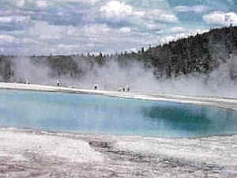
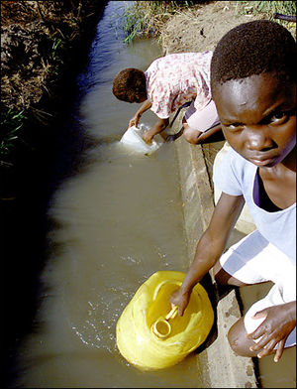

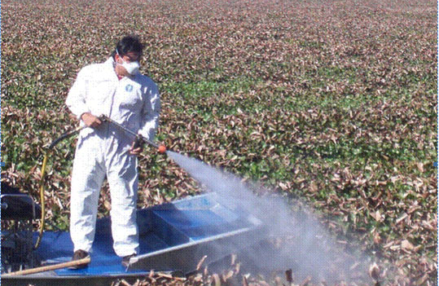
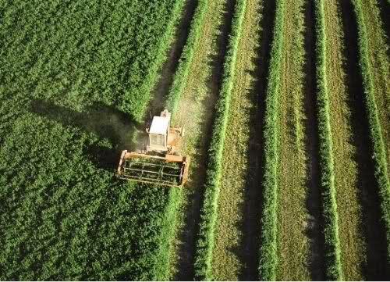
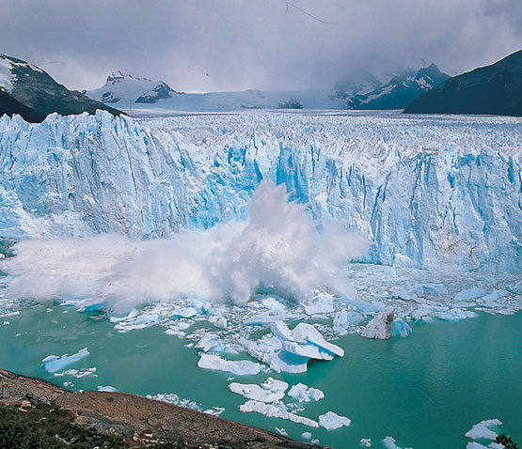
¿Por qué hay una escasez de agua en el mundo?
A
1
2
el crecimiento de la población
B
el derretimiento de los glaciares
C
la agricultura intensiva
3
4
D
la falta de saneamiento
E
la evaporación
6
5
F
la contaminación con agroquímicos
Notes:
Give students a couple of minutes to brainstorm (in English) all the reasons for a shortage of water in the world. Take responses (writing up perhaps on white board) and then present these reasons and ask students to match them to the English they have written down already.
http://www.booksaboutthefuture.com/pop_hst1.gif
http://2.bp.blogspot.com/_7N0xPVn6IL8/S_mJ0NYqgmI/AAAAAAAAACs/KSRhPv9OLgY/s320/overpopulation.jpg
http://www.conciudadanos.com.ar/wp-content/uploads/2010/03/glifosato-cea.jpg
http://1.bp.blogspot.com/-oPQeRD47m50/TVhaInJ1qJI/AAAAAAAABEg/3NFpgKpTL00/s1600/20070418klpcnaecl_375.Ies.SCO.jpg
http://i42.tinypic.com/foeo8j.jpg
http://www.definicionabc.com/wp-content/uploads/Evaporaci%C3%B3n.jpg
http://es.sott.net/image/image/s3/67146/medium/agua_3.jpg

Slide 19
Rellena los huecos en español.
era
es
será
El agua ____, ____y ____ para siempre esencial para los seres humanos.
es
Hoy en día el agua ____ un recurso escaso en el mundo.
Actualmente, por ejemplo, uno de cada cinco habitantes de América Latina no ______ acceso al agua potable.
tiene
son
Las causas _____: el crecimiento de la población
la contaminación con agroquímicos el uso de grandes cantidades de agua en la agricultura intensiva
el derretimiento de los glaciares
la falta de saneamiento
la evaporación (el calentamiento global)
va a superar
En 2025 la demanda de agua _____________ en un 56 % al suministro.
tiene | era | son | va a superar | es | es | será
has | was | are | is going to exceed | is | is | will be
Notes:
This is a useful summary. Students will want to use this language for their work the following week, so it would be useful to make sure it is completely.

