Slide 1
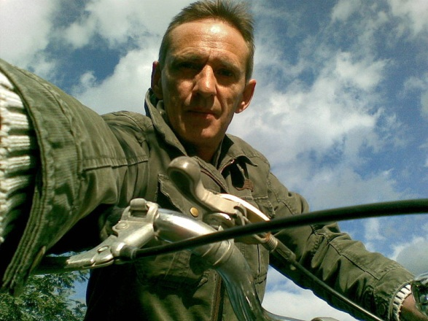
Comment s’appelle-t-il?
Quel âge a-t-il?
Comment est-il physiquement? physiquemen (físicamente)?
Comment est son caractère?
¿Qué tiene como familia?
A-t-il des animaux à la maison maison ?
Où habite- il ?
Où travaille-t-il?
Qu’est-ce qu’il aime ?
Qu’est-ce qu’il n’aime pas?
Qu’est-ce qu’il aime manger et boire?
Qu’est-ce qu’il tient à la main
Avec qui parle-t-il?
Notes:
This lesson is a reading images lesson. It aims to pull together a lot of language from year 7 in a new context. The teacher encourages the pupils to generate/imagine an identity for this person. If the class is strong this first photo can be done as a whole class, perhaps if possible all sitting close to the screen all together, with pupils contributing their ideas orally and a pupil acting as scribe taking notes. This first stage of the lesson can take 15 – 20 minutes and then further photos can be provided for pupils to write their own profile using their vocabulary books and dictionaries for further ideas. Useful points to draw out in the initial stage are adjective endings. Ask them what the word would be if there were describing a woman etc..to reinforce the rules on adjective endings. Also the use of aimer plus infinitive verb – refer pupils to the relevant pages of their vocabulary book and do a couple of examples perhaps with them. At all times encourage pupils to be imaginative within the structures they know, at all times to focus on all the French they do know and not to ask the teacher for whole sentences they don’t know. The focus is on their independence. With a slightly weaker class, this first photo is often enough. After the initial brainstorming as a whole class, pupils can return to their desks to write up a full profile and they can refer back to the questions as prompts for their writing. Encourage the pupils to think in terms of an audience for their work and plan to display the best 8 pieces of work from the group in the classroom? The relevant pages of the vocabulary booklet are pages 2 – 8.

Slide 2
Notes:
http://commons.wikimedia.org/wiki/File:Marco_017.jpg

Slide 3
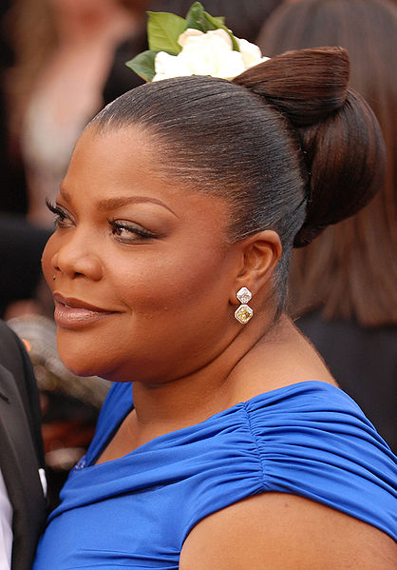
Notes:
http://commons.wikimedia.org/wiki/File:Mo%27Nique_attenting_the_82nd_Academy_Awards_2010.jpg

Slide 4
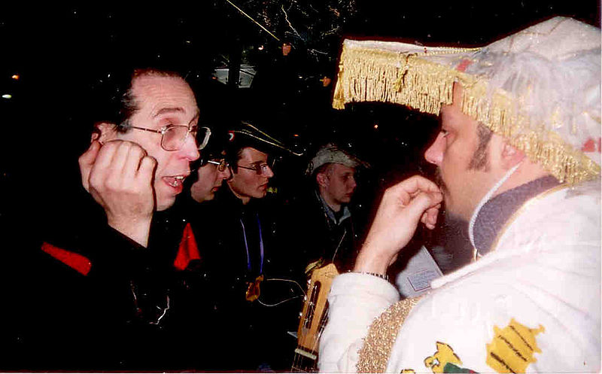
Notes:
http://commons.wikimedia.org/wiki/File:Le_Grand_Pontife_de_la_Goliardia_de_Turin_au_Carnaval_de_Paris_2005.jpg

Slide 5
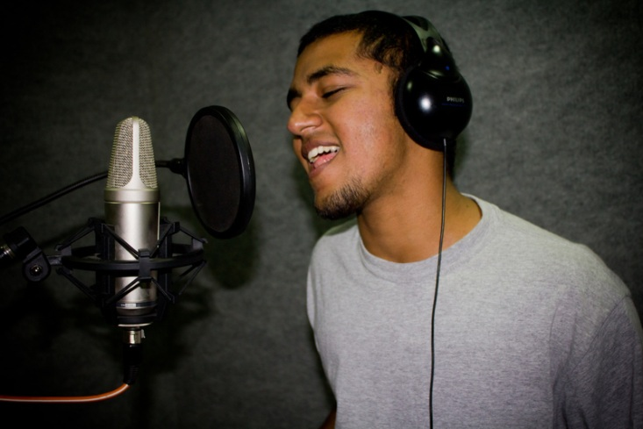
Notes:
http://commons.wikimedia.org/wiki/File:Rapper_Karnage.jpg

Slide 6
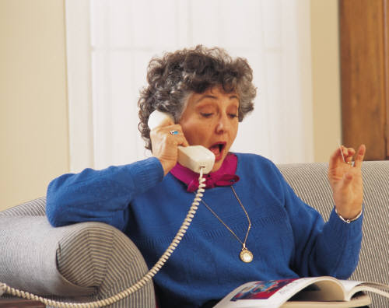

Slide 7
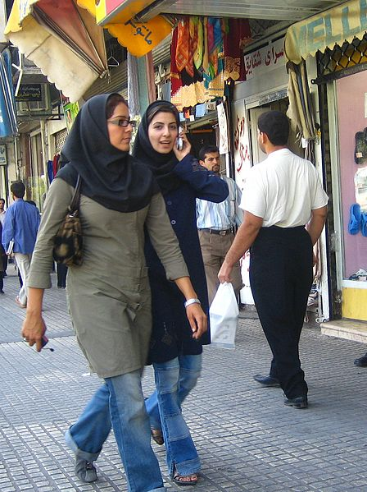
Notes:
http://commons.wikimedia.org/wiki/File:Iranian_women_walking_and_talking.jpg

