Slide 1
Hoy vamos a……..
entender un texto en el pasado
describir una cena en el pasado
Notes:
Aim of the lesson is to increase confidence and fluency with language from this topic. Pupils are going to produce a dialogue in groups of 3 and practise to perform from memory. These could be recorded or videoed. For a way to add interest/motivation and detract from embarassment, consider giving pupils simple ‘roles/characterisations’ i.e. la persona mas timida del mundo.

Slide 2
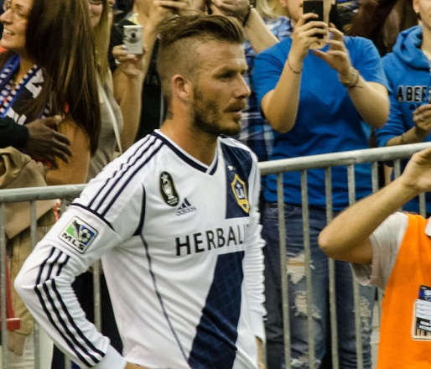
Concurso de los Juegos Olímpicos
Cena con los Beckham
Mi cena con los Beckham El fin de semana pasado salí con David y Victoria Beckham. Fui a los Angeles en avión y fui a un restaurante español muy guay con ellos. De primer plato comí una ensalada y David comió sopa. Victoria no comió nada. De segundo plato compartimos una gran paella pero Victoria solo bebió agua. De postre comí un helado y David comió un flan. Bebimos café. Victoria bebió más agua. Hablamos de fútbol y de los Juegos Olímpicos. ¡Fue fantástico!
de Josh Jones
Notes:
http://commons.wikimedia.org/wiki/File:David_Beckham_2012.jpg
http://commons.wikimedia.org/wiki/File:Victoria_Beckham_%28Headshot%29.jpg

Slide 3
1. Where did Josh have dinner with the Beckhams? (1)
2. When did he have dinner with them? (1 point)
3. What did Josh eat? (3 points)
4. What did David eat? (3 points)
5. What did Victoria eat? (1 point)
6. What did they talk about? (1 point)
In Los Angeles
Last weekend
Salad, paella, ice cream
soup, paella, flan
nothing
football
Preterite | English | Infinitive | English
salí | I went out | salir | to go out
 |  | ir
 | It was |  | to be
 |  | comer
 | we shared | compartir
 | s/he ate
bebimos |  |  | to drink
 |  | beber | to drink
hablamos
fui (x2)
I went
to go
fue (x3)
ser
comí (x2)
I ate
to eat
compartimos
to share
comió
comer
to eat
we drank
beber
bebió
she drank
we talked
hablar
to talk
Reading = 10 points (9 or 10 = level 5)
Grammar = 20 points

Slide 4
Durante la cena, hablamos de…
La semana pasada, salí con…
De postre, comí…. y bebí…..
Mi cena especial
Fui(mos) a un restaurante en….
De primer plato, comí….y de segundo plato, comí..
Fui(mos) en…. (coche, avión..)
Speaking = Level 5 (whole sentences from picture prompts only)

Slide 5
Mi cena con…
El fin de semana pasado salí con…
Fui a…
Fue…
De primer plato…y mi compañero/a …
De postre…
Bebimos…
Hablamos de…
Fue…
Writing = level 5 if short paragraph produced from memory, full sentences, most verb forms correct

Slide 6
Hoy hemos……..
entendido el texto
descrito una cena en el pasado
p
p

Slide 7
1. Where did Josh have dinner with the Beckhams? (1)
2. When did he have dinner with them? (1 point)
3. What did Josh eat? (3 points)
4. What did David eat? (3 points)
5. What did Victoria eat? (1 point)
6. What did they talk about? (1 point)
Preterite | English | Infinitive | English
salí | I went out | salir | to go out
 |  | ir
 | It was |  | to be
 |  | comer
 | we shared | compartir
 | s/he ate
bebimos |  |  | to drink
 |  | beber | to drink
hablamos
Reading = 10 points (9 or 10 = level 5)
Grammar = 20 points

