Slide 1
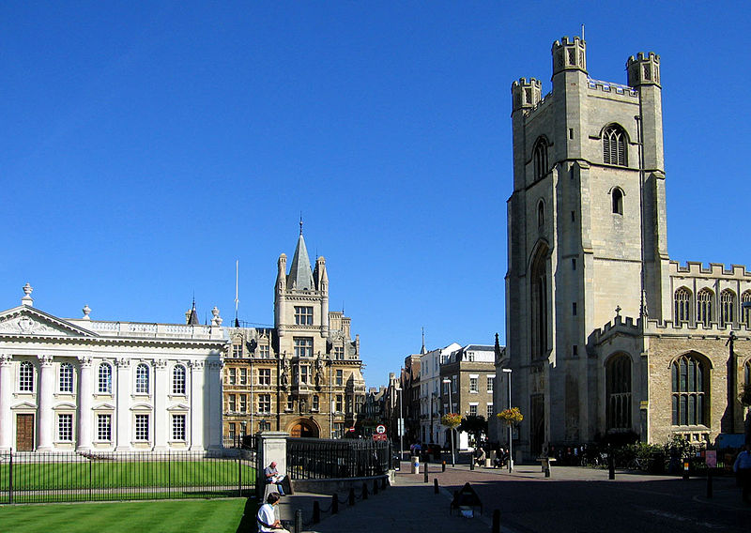
Mi ciudad

Slide 2
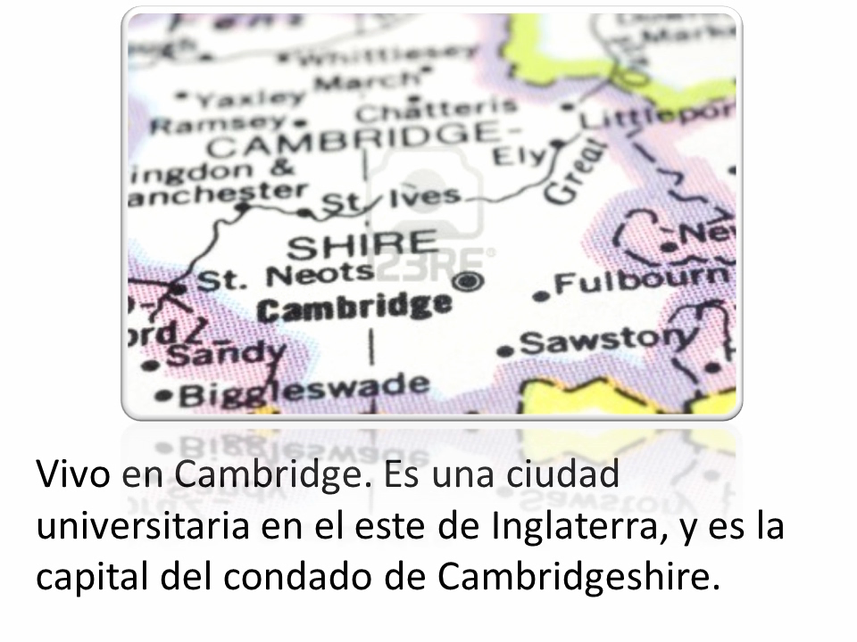
Mi ciudad
Notes:
Introduction to the theme. Click to play audio for the text. You can return to this later, too when students are practising their own responses to the question ‘¿Dónde vives?’ (where do you live?)
Pupils need to recognise ‘vivo en’ ‘ciudad’ ‘condado’ from the context.
Vivo en = I live in ciudad = town / city condado = county

Slide 3
Hoy vamos a…
decir dónde vivimos
decir dónde está

Slide 4

una ciudad
Notes:
opportunity for them to practise the pronunciation.

Slide 5
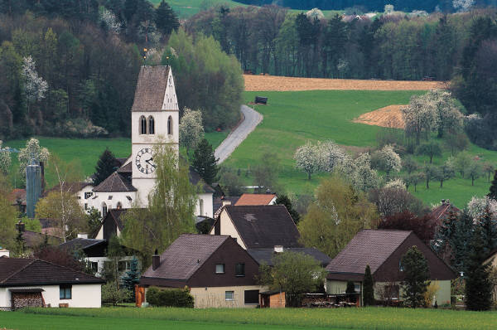
un pueblo

Slide 6
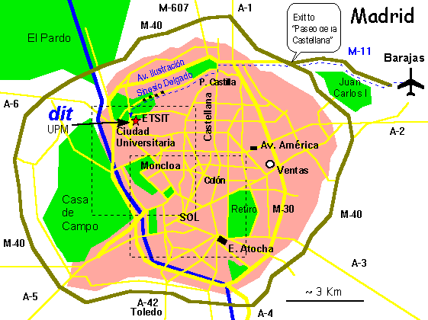
¿Dónde vives?
Vivo en…

Slide 7
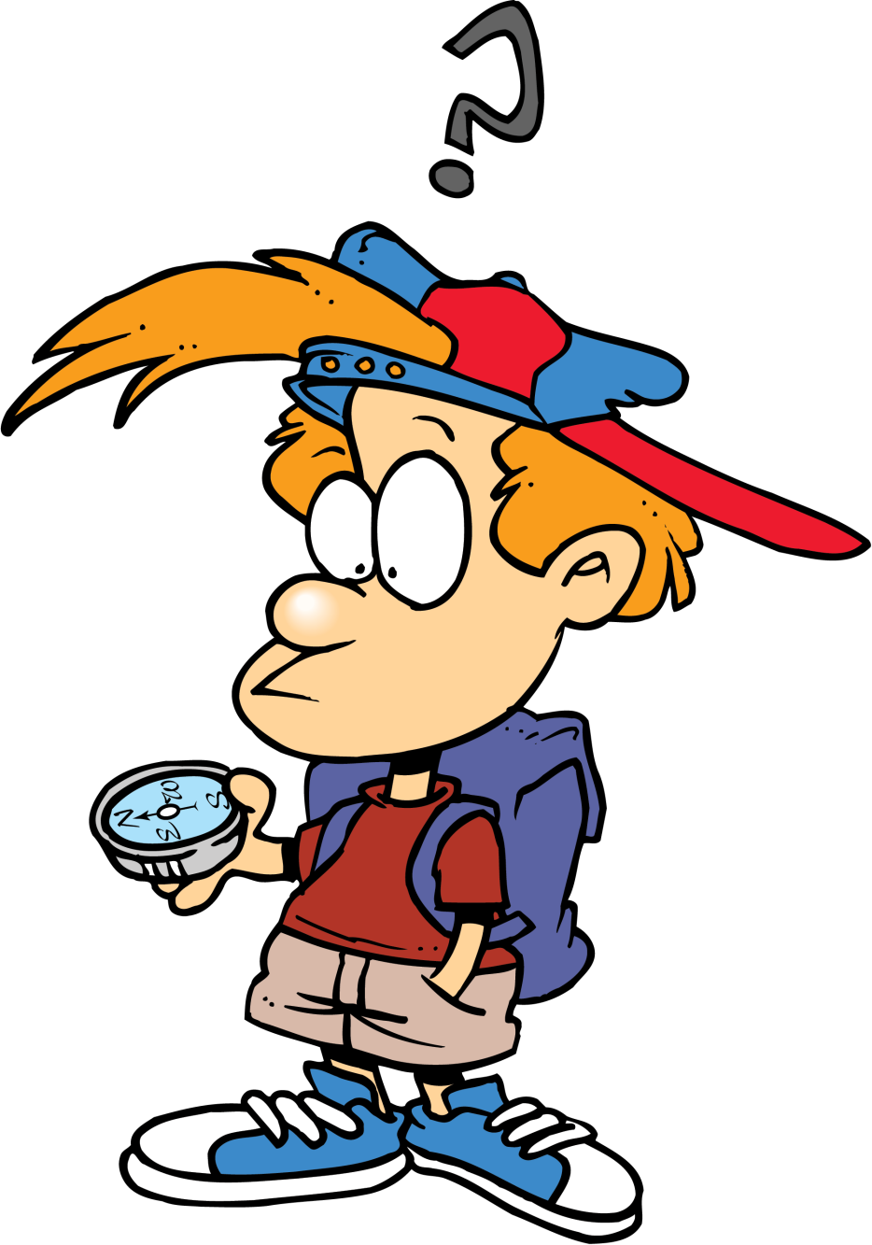
¿Dónde está exactamente?
Notes:
http://www.staceyreid.com/news/wp-content/uploads/2011/08/Compass.png

Slide 8
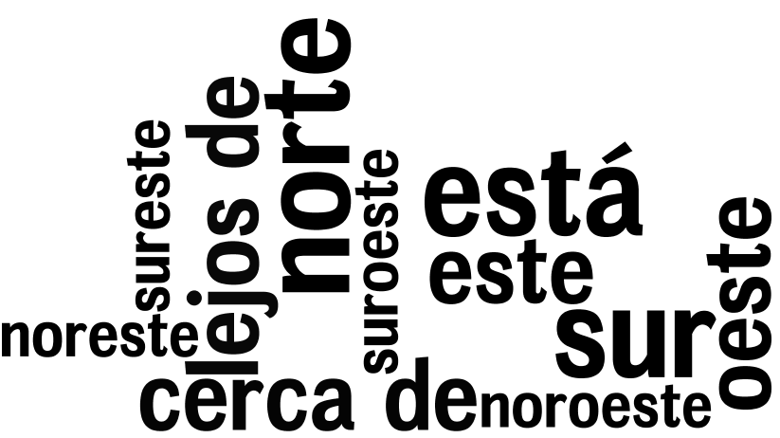
Está en el ….
Notes:
Learners know the cardinal points, so this is just revision.
The teacher can use the compass icon in the right corner to elicit the points from the class in Spanish.
Then the teacher asks students to spot what is left: está, which they know means ‘it is’ relating to physical position or moods.
And… There are two new phrases in here: cerca de = near to, lejos de = far from

Slide 9
¿Dónde vives?
I live in _____, which is _____ in the _____ of England, near to _____.
Notes:
Students use this frame to translate orally in their own answer into Spanish. Collect responses orally from the class.

Slide 10
¿Dónde vives?
Vivo en _____, que es _____ en el _____ de Inglaterra, cerca de _____.
Notes:
Give them 2 mins to write up an answer in their books. Then ask them to use the Look, Cover, Say, Check memory strategy to get to the point where they can say their whole answer in response to the question.
This will take some extended practising time.

Slide 11

V… e… …
¿D_____ v____?
Notes:
Students practise, and at the end of the lesson, a few display their learning to the class.

