Slide 1
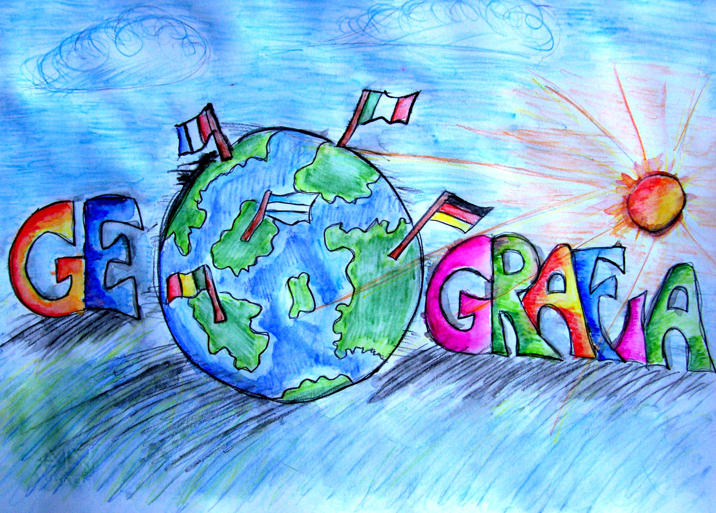
española
Notes:
Geografía española: Spanish geography
In this lesson pupils will learn to understand and describe the locations of some of the key towns/cities in Spain, how to ask where something is.and what something is called.

Slide 2
Hoy vamos a…
usar ‘mucho’ para describir España
leer y comprender un texto sobre España

Slide 3
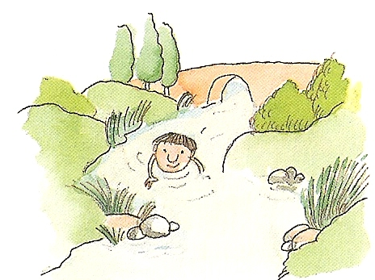
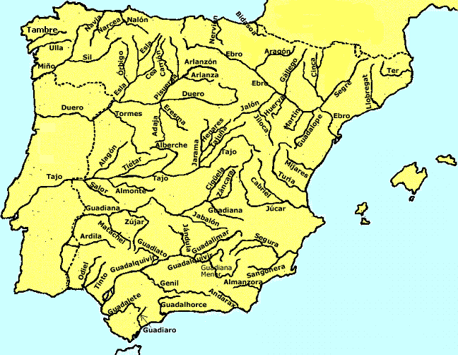
un río
muchos ríos
¿Qué hay en España?
En España hay muchos ríos.
Notes:
un río = a river, muchos ríos = lots of rivers,
En España hay muchos ríos = In Spain there are lots of rivers. (Shown on map)
This format is to show pupils that they can begin with a piece of vocabulary, convert it (using the rules they know) into the plural form, and then use a verb and another short phrase to form a full sentence with ease. Pupils have already met ‘hay’ (there is/are) in Year 3.

Slide 4
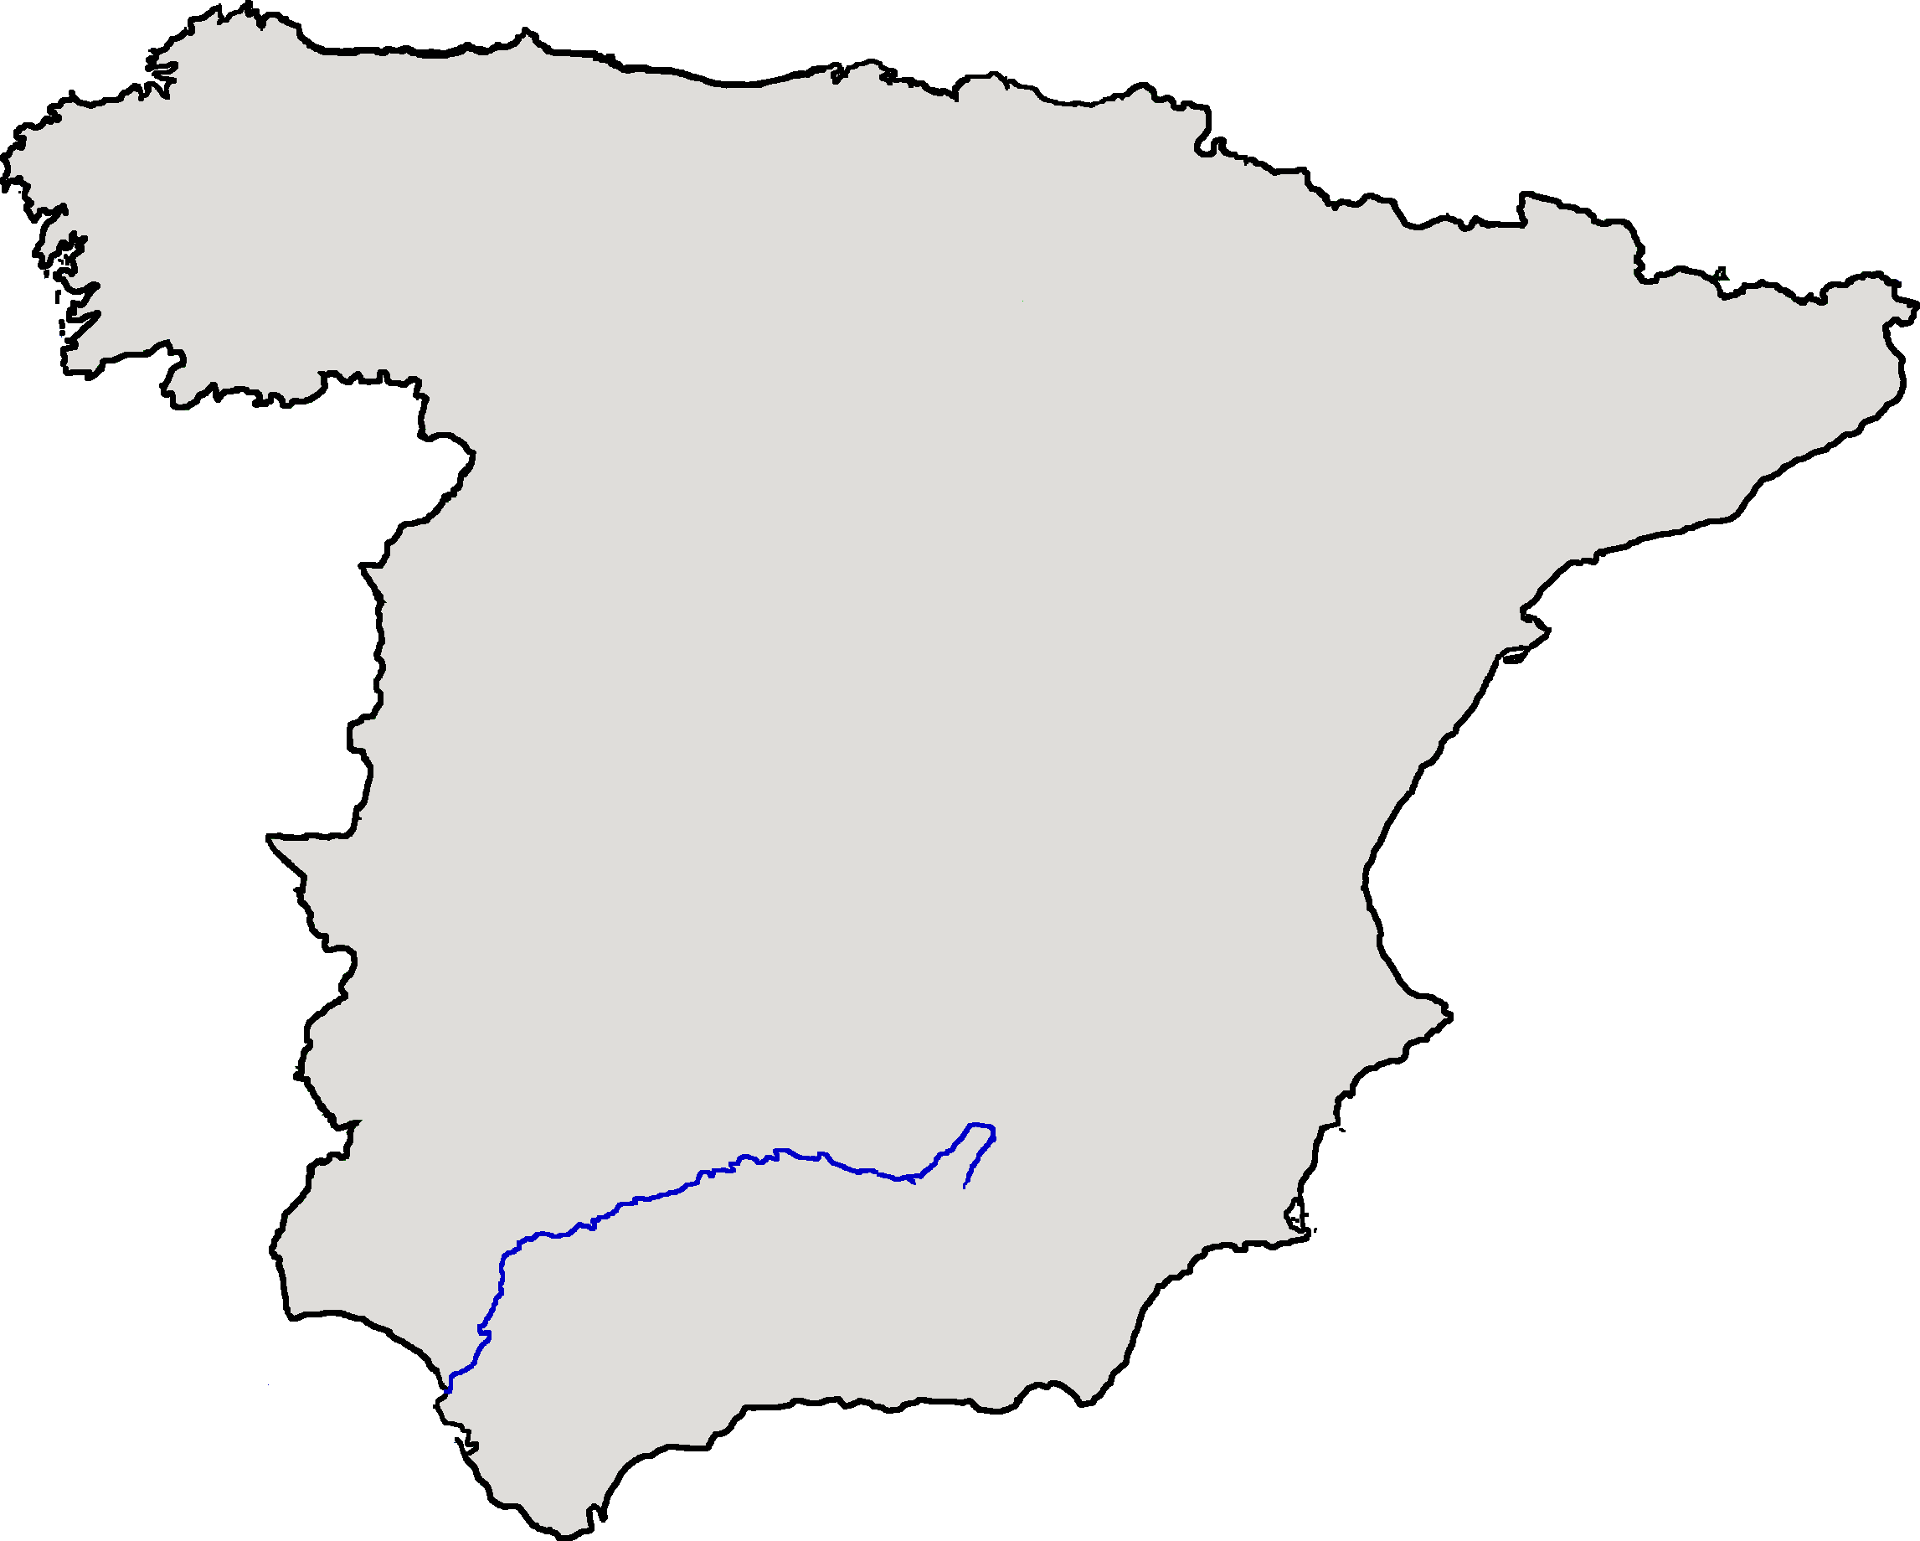
En España hay un río famoso que se llama Guadalquivir.
Notes:
Spanish geography:
En España hay un río famoso que se llama Guadalquivir: In Spain there’s a famous river called the Guadalquivir. (shown on map)

Slide 5
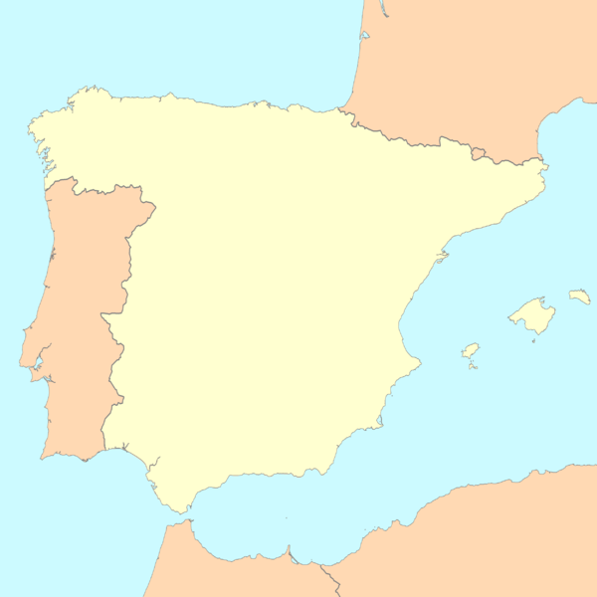
Francia
1
Bilbao
España
2
Pamplona
3
Barcelona
Portugal
4
Madrid
5
Valencia
Guadalquivir
6
Granada
7
Cádiz
Notes:
You may want to ask the pupils to turn their sheets over for a moment. They will now be asked to recall the names of the cities they earlier marked on the map. This is because we are going to be focusing on some of these particular cities for later work on festivals – Madrid and Madrid will not be focused on but it’s of course very important to know the location of the capital.
¿Cómo se llama la ciudad número …?: What’s city number … called?
Encourage pupils to answer using ‘Se llama …’ It’s called …

Slide 6
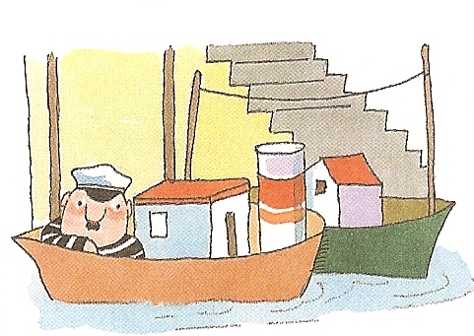
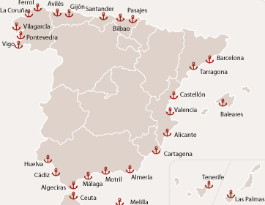
un puerto
muchos puertos
¿Qué hay en España?
En España hay muchos puertos.
Notes:
un puerto = a port, muchos puertos = lots of ports
En España hay muchos puertos = In Spain there are lots of ports. (Shown on map)

Slide 7
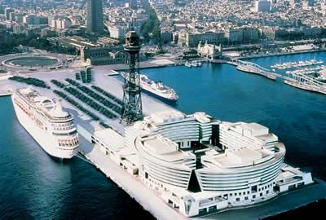
En Barcelona hay un puerto famoso que se llama Puerto Olímpico.
Notes:
Spanish geography:
En Barcelona hay un puerto famoso que se llama Puerto Olímpico: In Barcelona there’s a famous port which is called Port Olympic.

Slide 8

Francia
1
Bilbao
Puerto Olímpico
España
2
Pamplona
3
Barcelona
Portugal
4
Madrid
5
Valencia
Guadalquivir
6
Granada
7
Cádiz
Notes:
You may want to ask the pupils to turn their sheets over for a moment. They will now be asked to recall the names of the cities they earlier marked on the map. This is because we are going to be focusing on some of these particular cities for later work on festivals – Madrid and Madrid will not be focused on but it’s of course very important to know the location of the capital.
¿Cómo se llama la ciudad número …?: What’s city number … called?
Encourage pupils to answer using ‘Se llama …’ It’s called …

Slide 9
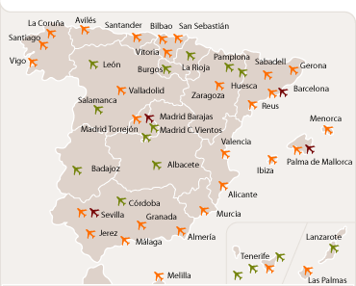
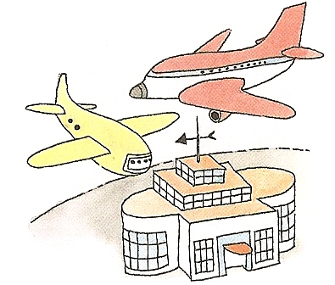
un aeropuerto
muchos aeropuertos
¿Qué hay en España?
En España hay muchos aeropuertos.
Notes:
un aeropuerto = an airport, muchos aeropuertos = lots of airports
En España hay muchos aeropuertos = In Spain there are lots of airports. (Shown on map)

Slide 10
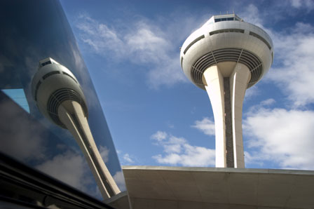
En Madrid hay un aeropuerto famoso que se llama Barajas.
Notes:
Spanish geography:
En Madrid hay un aeropuerto famoso que se llama Barajas: In Madrid there’s a famous airport which is called Barajas.

Slide 11

Francia
1
Bilbao
Puerto Olímpico
España
2
Pamplona
Aeropuerto Barajas
Barcelona
3
Portugal
4
Madrid
5
Valencia
Guadalquivir
6
Granada
7
Cádiz
Notes:
You may want to ask the pupils to turn their sheets over for a moment. They will now be asked to recall the names of the cities they earlier marked on the map. This is because we are going to be focusing on some of these particular cities for later work on festivals – Madrid and Madrid will not be focused on but it’s of course very important to know the location of the capital.
¿Cómo se llama la ciudad número …?: What’s city number … called?
Encourage pupils to answer using ‘Se llama …’ It’s called …

Slide 12
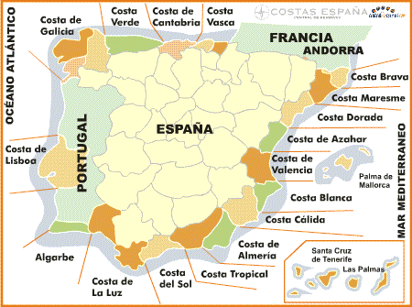
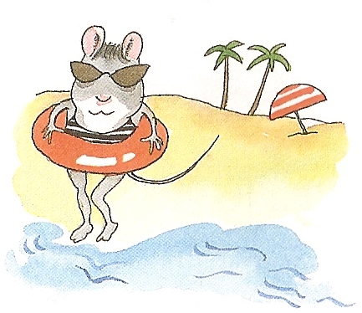
una playa
muchas playas
¿Qué hay en España?
En España hay muchas playas.
Notes:
una playa = a beach, muchas playas = lots of beaches
En España hay muchas playas = In Spain there are lots of beaches. (Costal areas shown on map)

Slide 13
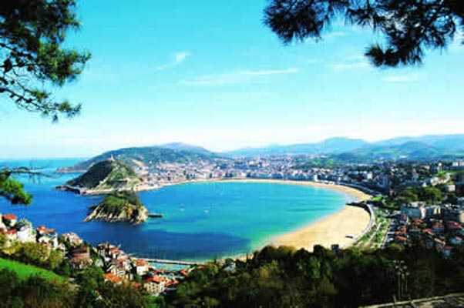
En San Sebastián hay una playa famosa que se llama La Concha.
Notes:
Spanish geography:
En San Sebastián hay una playa famosa que se llama La Concha: In San Sebastian there’s a famous beach called La Concha (The Shell).

Slide 14

Playa – la Concha
Francia
1
Bilbao
Puerto Olímpico
España
2
Pamplona
Aeropuerto Barajas
Barcelona
3
Portugal
4
Madrid
5
Valencia
Guadalquivir
6
Granada
7
Cádiz
Notes:
You may want to ask the pupils to turn their sheets over for a moment. They will now be asked to recall the names of the cities they earlier marked on the map. This is because we are going to be focusing on some of these particular cities for later work on festivals – Madrid and Madrid will not be focused on but it’s of course very important to know the location of the capital.
¿Cómo se llama la ciudad número …?: What’s city number … called?
Encourage pupils to answer using ‘Se llama …’ It’s called …

Slide 15
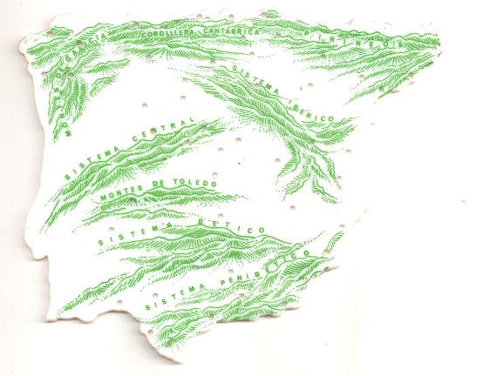
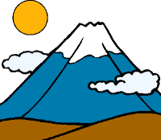
una montaña
muchas montañas
¿Qué hay en España?
En España hay muchas montañas.
Notes:
una montaña = a mountain, muchas montañas = lots of mountains
En España hay muchas montañas = In Spain there are lots of mountains.

Slide 16
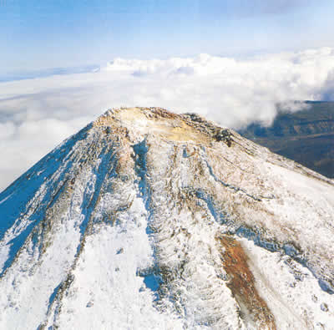
En Tenerife hay una montaña famosa que se llama Teide.
Notes:
Spanish geography:
En Tenerife hay una montaña famosa que se llama Teide: In Tenerife there’s a famous mountain called Mount Teide.

Slide 17
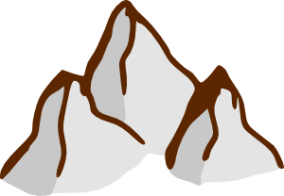
Playa – la Concha
Francia
1
Bilbao
Puerto Olímpico
España
2
Pamplona
Aeropuerto Barajas
Barcelona
3
Portugal
4
Madrid
5
Valencia
Guadalquivir
6
Granada
7
Cádiz
Montaña - Teide
Notes:
You may want to ask the pupils to turn their sheets over for a moment. They will now be asked to recall the names of the cities they earlier marked on the map. This is because we are going to be focusing on some of these particular cities for later work on festivals – Madrid and Madrid will not be focused on but it’s of course very important to know the location of the capital.
¿Cómo se llama la ciudad número …?: What’s city number … called?
Encourage pupils to answer using ‘Se llama …’ It’s called …

Slide 18
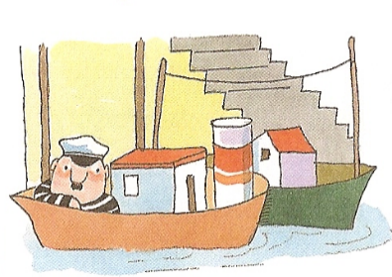


¿Qué hay en España?
En España hay…

Slide 19
España
En España ________ habla normalmente español. Hay ______ gente - 47 millones de habitantes. (En __________ hay 51 millones de habitantes.) España es _______ - 500 000 km². (Inglaterra es ______ grande - 245 000 km².) La capital de España se llama _______. La ________ de España es roja y amarilla. El país es famoso por el ____, el flamenco y por las _______. En España hay _______ puertos y _______ montañas.
mucha
la gente
grande
menos
muchos
sol
playas
Madrid
muchas
bandera
Inglaterra
Notes:
Translations & answers on next slide.

Slide 20
España
En España ________ habla normalmente español. Hay ______ gente – 47 millones de habitantes. (En __________ hay 51 millones de habitantes.) España es _______ – 500 000 km². (Inglaterra es ______ grande - 245 000 km².) La capital de España se llama _______. La ________ de España es roja y amarilla. El país es famoso por el ____, el flamenco y por las _______. En España hay _______ puertos y _______ montañas.
mucha
la gente
grande
menos
muchos
sol
playas
Madrid
muchas
bandera
Inglaterra
Notes:
Spanish geography and culture gap-fill exercise based on the previous work in the lesson.
Answers will fly from the bottom box on mouse-clicks.
En España ________ habla normalmente español. In Spain _____ normally speak Spanish. Hay ______ gente – 47 millones de habitantes. There are ____ people = 47 million inhabitants.
(En __________ hay 51 millones de habitantes.) In ____ there are 52 million inhabitants.
España es _______ – 500 000 km². Spain is ____ - 500 000 square km.
Inglaterra es ______ grande - 245 000 km².) England is ____ big – 245 000 square km.
La capital de España se llama _______. The capital of Spain is called _____.
La ________ de España es roja y amarilla. The ____ of Spain is red and yellow.
El país es famoso por el ____, el flamenco y por las _______. The country is famous for the ____, the flamenco and the ____. (plural)
En España hay _______ puertos y _______ montañas. In Spain there are _____ ports (masc. plural) and ______ mountains. (fem. plural)

