Slide 1
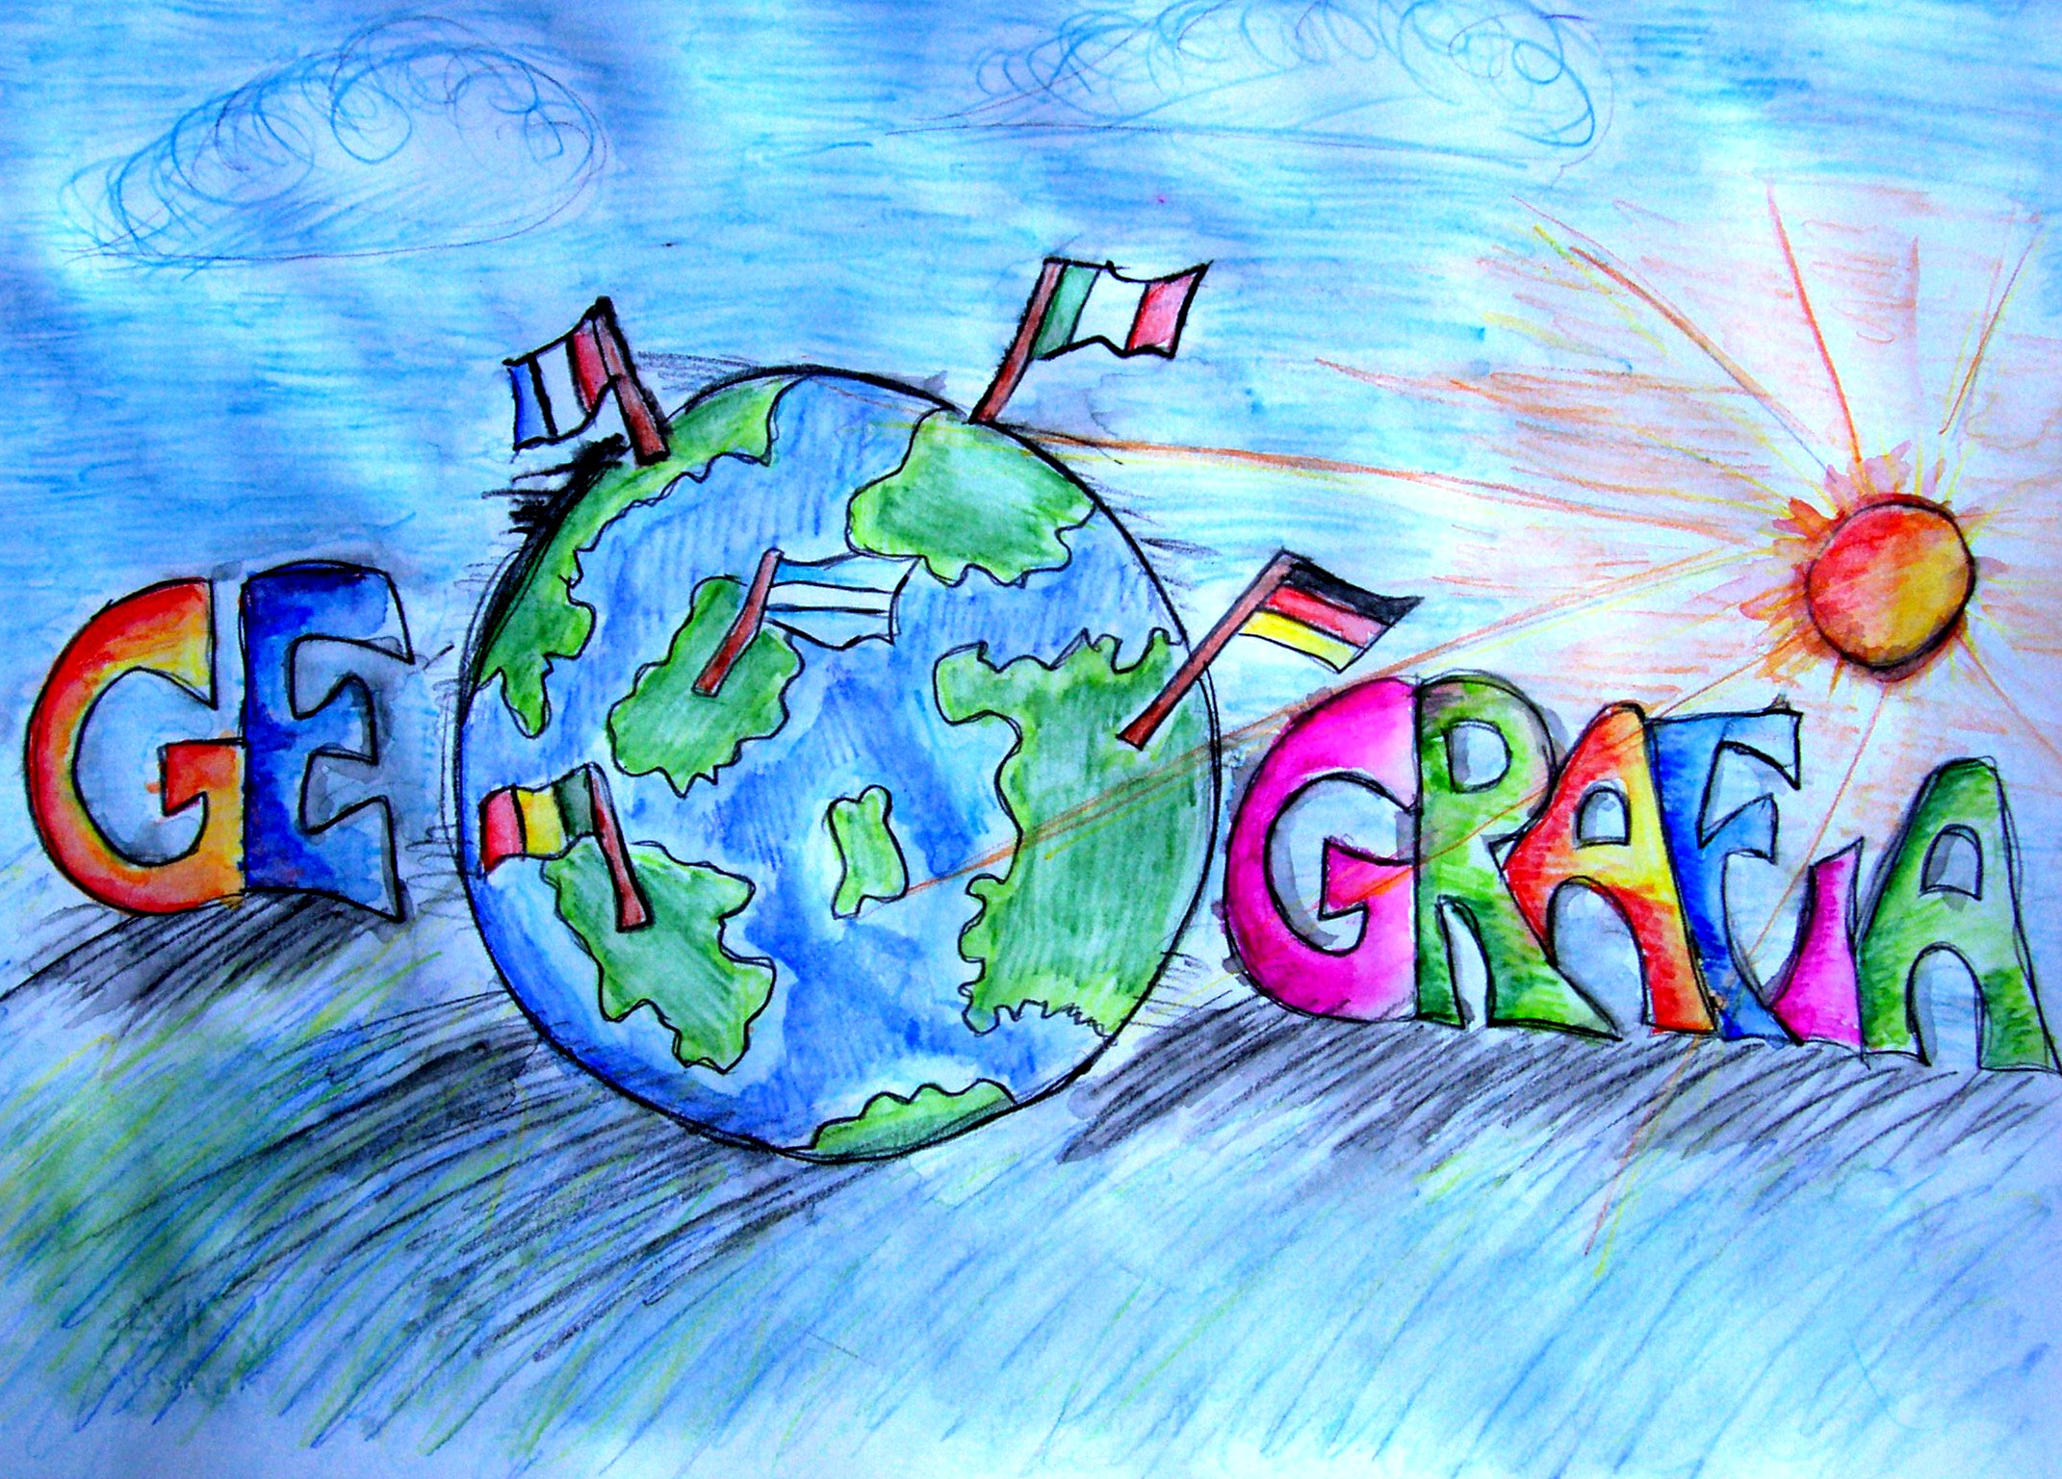
española
Notes:
Geografía española: Spanish geography
In this lesson pupils will learn to understand and describe the locations of some of the key towns/cities in Spain, how to ask where something is.and what something is called.

Slide 2
Hoy vamos a…
describir España
aprender cómo decir ‘a lot’

Slide 3
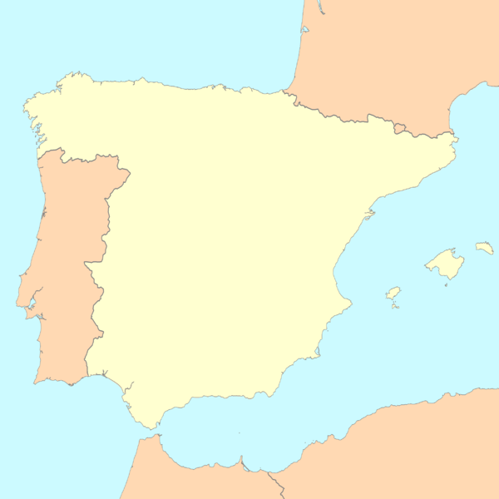
Francia
1
Bilbao
España
2
Pamplona
3
Barcelona
Portugal
4
Madrid
5
Valencia
6
Granada
7
Cádiz
¿Cómo se llama la ciudad número cuatro?
¿Cómo se llama la ciudad número siete?
¿Cómo se llama la ciudad número cinco?
¿Cómo se llama la ciudad número seis?
¿Cómo se llama la ciudad número uno?
¿Cómo se llama la ciudad número dos?
¿Cómo se llama la ciudad número tres?
Notes:
You may want to ask the pupils to turn their sheets over for a moment. They will now be asked to recall the names of the cities they earlier marked on the map. This is because we are going to be focusing on some of these particular cities for later work on festivals – Madrid and Madrid will not be focused on but it’s of course very important to know the location of the capital.
¿Cómo se llama la ciudad número …?: What’s city number … called?
Encourage pupils to answer using ‘Se llama …’ It’s called …

Slide 4

España
Notes:
Pupils are going to learn how to understand and talk about a few features of Spain, using the key vocabulary ‘river, port, airport, beach, river, mountain’ to practise masculine & feminine singular and plural forms of nouns, and the word ‘mucho’ (lots of) in its various forms – mucho, mucha, muchos, muchas.

Slide 5
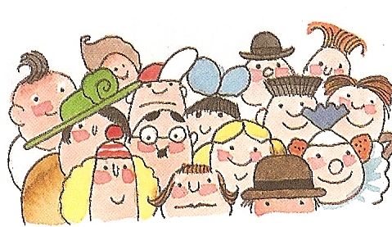
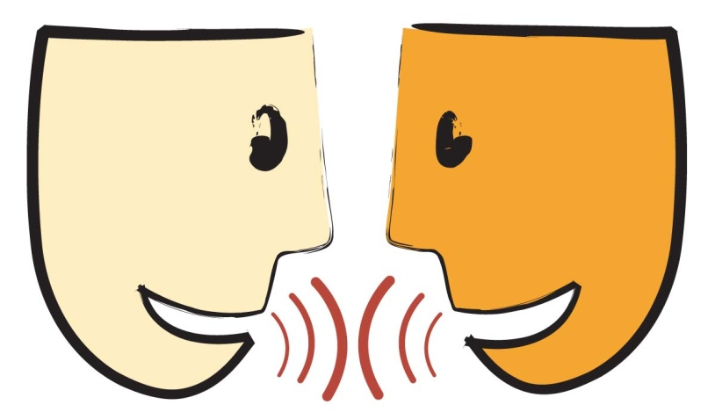
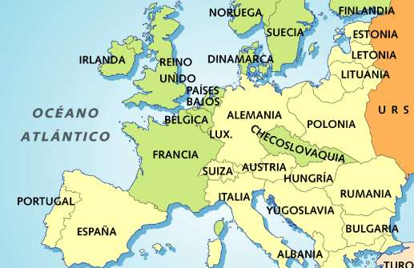
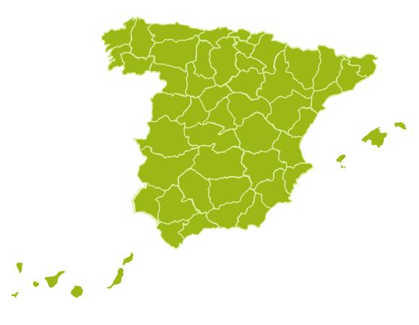
Vocabulario importante: ¡Repite y memoriza!
la gente = personas
hablar
España
un país
muchos países
Notes:
Important vocabulary: Repeat and memorise!

Slide 6


¿Cómo se dice en español?
la gente
hablar
España
un país
muchos países
Notes:
¿Cómo se dice en español? = How do you say it in Spanish?
Ask pupils to recall the Spanish and reveal answers by clicking on each question mark (make sure that you see the hand symbol before clicking or else the presentation will simply continue on to the next slide – if this happens just press the back arrow to go back and continue as normal ☺ ). This words are useful in working out what the sentence in the next slide means and all apart from ‘hablar’ will be important in this lesson and the next.

Slide 7
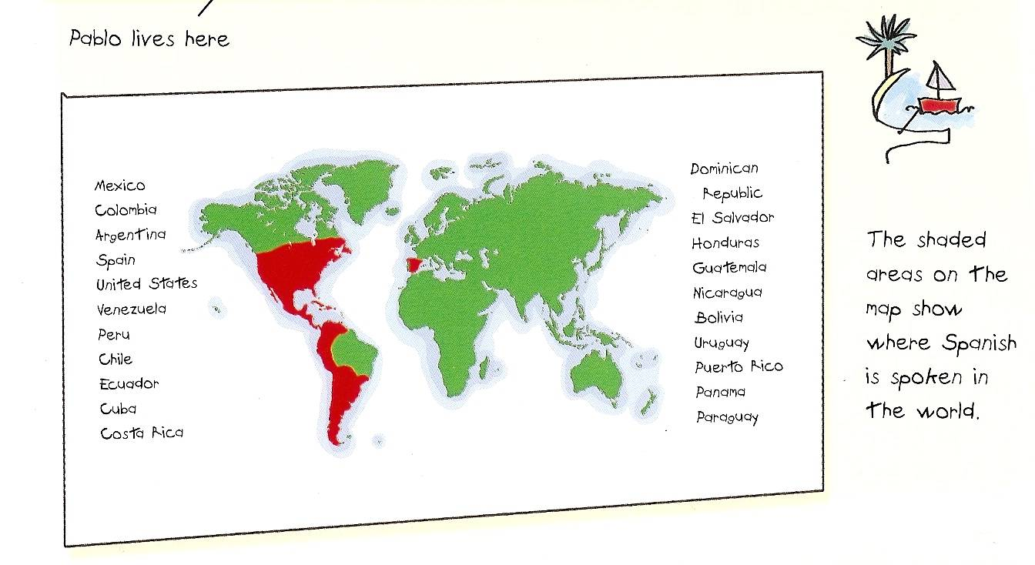
Mucha gente en los países rojos hablan español.
Notes:
Mucha gente en los países rojos hablan español. = Lots of people in the red countries speak Spanish.
The red countries are listed in English. Some of these will come up again in future lessons on Spanish speaking countries & nationalities.

Slide 8
¿Qué hay en España?
España
Notes:
¿Qué hay en España? = What is there is Spain?

Slide 9
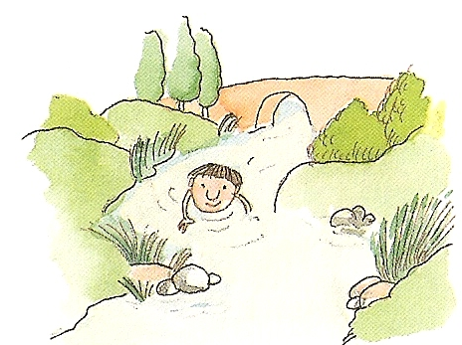
Hay un río.
Hay dos ríos.
Hay muchos ríos.
Notes:
(Masculine/blue noun) Hay un río = There’s a river. Hay dos ríos = There are two rivers. Hay muchos ríos = There are lots of rivers.

Slide 10
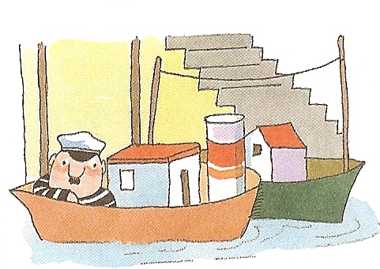
Hay un puerto.
Hay dos puertos.
Hay muchos puertos.
Notes:
(Masculine/blue noun) Hay un puerto = There’s a port. Hay dos puertos = There are two ports. Hay muchos puertos = There are lots of ports.

Slide 11
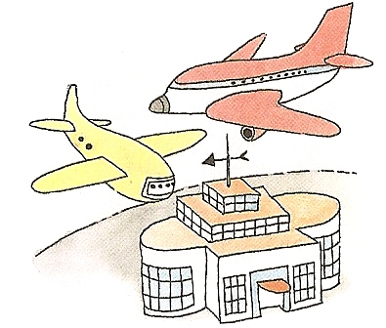
Hay un aeropuerto.
Hay dos aeropuertos.
Hay muchos aeropuertos.
Notes:
(Masculine/blue noun) Hay un aeropuerto = There’s an airport. Hay dos aeropuertos = There are two airports. Hay muchos aeropuertos = There are lots of airports.

Slide 12
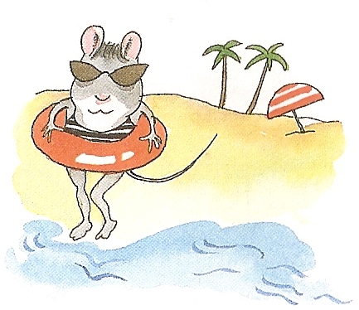
Hay una playa.
Hay dos playas.
Hay muchas playas.
Notes:
(Feminine/red noun) Hay una playa = There’s a beach. Hay dos playas = There are two beaches. Hay muchas playas = There are lots of beaches.

Slide 13

Hay una montaña.
Hay dos montañas.
Hay muchas montañas.
Notes:
(Feminine/red noun) Hay una montaña = There’s a mountain. Hay dos montañas = There are two mountains. Hay muchas montañas = There are lots of mountains.

Slide 14

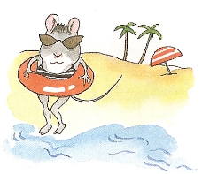




1 | 2 | 3
4 | 5 | 6
7 | 8 | 9
Notes:
Slide to practise recall of vocabulary

Slide 15

1
Notes:
Listening slide 1 NB: Don’t display this slide. Call the items from left to right in 3 x rows at a slow, steady pace. Pupils will try to place their cards in the same formation (3 x 3) on their desks. I usually do this activity in pairs so they have more room to work.

Slide 16
2
Notes:
Round 2 of the listening activity. Do the items a little faster this time.

Slide 17
3
Notes:
3rd time. A little faster still…

Slide 18
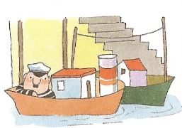
4
Notes:
Fastest round of all!

Slide 19
1 | 2 | 3
4 | 5 | 6
7 | 8 | 9
Notes:
Oral recall slide.

Slide 20
Deberes
Find the name and location in Spain of a famous example of each of these:
Beach
River
Mountain
Port
Airport
Come prepared to write the name of it and where it is in Spain.

