Slide 1
española
Notes:
Geografía española: Spanish geography
In this lesson pupils will learn to understand and describe the locations of some of the key towns/cities in Spain, how to ask where something is.and what something is called.

Slide 2
Hoy vamos a…
describir países
aprender cómo decir ‘is famous for’
dar opiniones

Slide 3
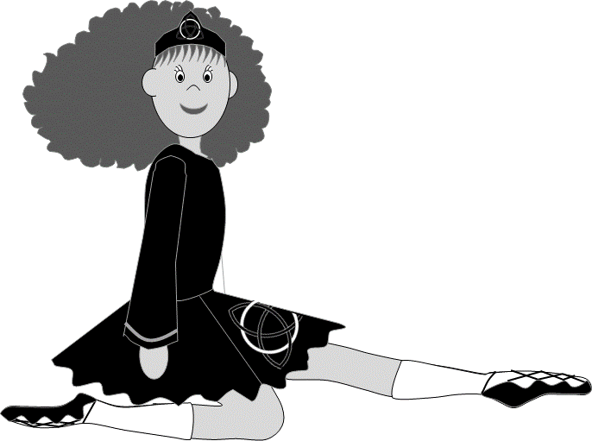
¿Por qué es Irlanda famosa?
3
a. las patatas
1
b. el baile irlandés
Irlanda es famosa por …
2
c. la lluvia
Escribe los números correctos.
2
3
1
Notes:
¿Por qué es Irlanda famosa? = What’s Ireland famous for? Irlanda es famosa por … = Ireland is famous for … Escribe los números correctos = Write the correct numbers. I have used some cognates that pupils haven’t seen before, e.g. patatas = potatoes and used some other clues to help pupils work out the correct answers. For example, for el baile irlandés I hope that pupils might work out that irlandés means irish from the context of already knowing Irlanda = Ireland and seeing the picture of irish dancing. (I don’t think there’s such a thing as irish rain!) This exercise is to help pupils use logic and develop independent ‘working out’ skills & perseverance rather than just admitting defeat and saying that they don’t know the words in question. The words are revealed on mouse clicks so you can reveal one at a time or all three before starting to match up. Pupils should pronounce all the new words and repeat them several times. Encourage pupils to put full sentences together orally when they have matched up the words and the pictures, e.g. Irlanda es famosa por las patatas, el baile irlandés y la lluvia. They could also write these sentences down.

Slide 4
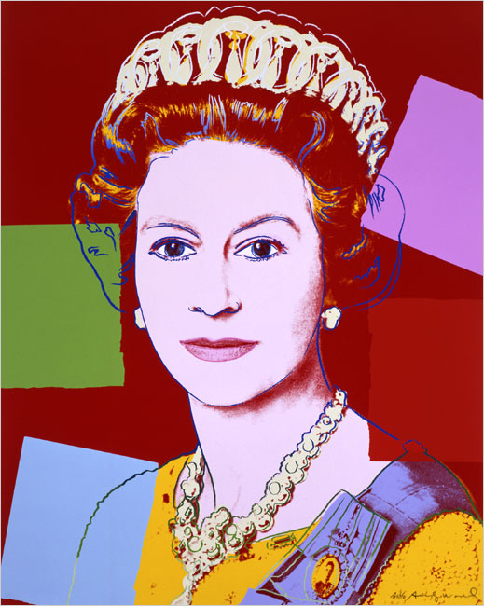
¿Por qué es Inglaterra famosa?
3
a. pescado y patatas fritas
1
b. el té
Inglaterra es famosa por …
2
c. la familia real
Escribe los números correctos.
2
1
3
Notes:
As per previous slide. England is famous for … a. pescado y patatas fritas = fish & chips, b. el té = tea, c. la familia real = the royal family.

Slide 5
¿Por qué es Alemania famosa?
1
a. las salchichas
3
b. los coches
Alemania es famosa por …
2
c. la cerveza
Escribe los números correctos.
2
3
1
Notes:
As per previous slide. Germany is famous for … a. las salchichas = sausages, b. los coches = cars (pupils have come across this word in the singular form before in the phonic hooks lesson in Yr3), c. la cerveza = beer.

Slide 6
¿Por qué es Francia famosa?
2
a. el queso
3
b. el pan
Francia es famosa por …
1
c. el vino
Escribe los números correctos.
3
1
2
Notes:
As per previous slide. France is famous for … a. el queso = cheese (again, pupils have come across this word in the phonic hooks lesson), b. el pan = bread, c. el vino = wine.

Slide 7
¿Por qué es España famosa?
3
a. el sol
1
b. el flamenco
España es famosa por …
2
c. la playa
Escribe los números correctos.
1
3
2
Notes:
As per previous slide. Spain is famous for …a. el sol = sun, b. el flamenco = flamenco dancing, c. la playa = beach.

Slide 8
¡Busca la excepción!
Ahora ¡escribe la frase correcta!
1. Alemania es famosa por la cerveza, la lluvia y los coches.
1. Alemania es famosa por la cerveza, las salchichas y los coches.
2. Francia es famosa por la familia real, el vino y el pan.
2. Francia es famosa por el queso, el vino y el pan.
3. Irlanda es famosa por las patatas, la playa y el baile irlandés.
3. Irlanda es famosa por las patatas, la lluvia y el baile irlandés.
4. España es famosa por el flamenco, el sol y el queso.
4. España es famosa por el flamenco, el sol y la playa.
5. Inglaterra es famosa por el té, pescado y patatas fritas y las salchichas.
5. Inglaterra es famosa por el té, pescado y patatas fritas y la familia real.
Notes:
Busca la excepción = Look for the odd-one-out. One of the three things each country is famous for is incorrect. The incorrect words are underlined on mouse clicks. Click again for the instruction Ahora ¡escribe la frase correcta! = Now write the correct sentence! Again, the answers are revealed on mouse clicks so that pupils can check their work when they have finished. Remember that the pupils just need to swap around the underlined words to get the correct answers.

Slide 9
¿Te gusta …? ¿Por qué?
Me gusta…
No me gusta…
Me encanta…
Odio…
porque me parece …
porque creo que es …
divertido/a
aburrido/a
impresionante
emocionante
interesante
delicioso/a
horrible
Notes:
¿Te gusta? ¿Por qué? : Do you like …? Why?
Click on the individual pictures to hear the question if necessary.
Pairwork for pupils to ask each other questions and give answers. I’ve listed the ways to start giving opinions and added a few adjectives at the bottom (from previous lesson & another couple of cognates) of the slide which they may want to use:
divertido: fun, aburrido: boring, impresionante: impressive, emocionante: exciting, interesante: interesting, delicioso: delicious, horrible: horrible
Encourage pupils to construct full sentences using the support provide. Pupils will need to remember that the feminine nouns with have feminine adjectives: la playa, la lluvia.

Slide 10
¿Te gusta…? ¿Por qué?
Me gusta…
No me gusta…
Me encanta…
Odio…
porque me parece …
porque creo que es …
divertido/a
aburrido/a
impresionante
emocionante
interesante
delicioso/a
horrible
Notes:
¿Te gusta? ¿Por qué? : Do you like …? Why?
Click on the individual pictures to hear the question if necessary.
Pairwork for pupils to ask each other questions and give answers – or, if preferable pupils could write this set of questions and opinions down. I’ve listed the ways to start giving opinions and added a few adjectives at the bottom (from previous lesson & another couple of cognates) of the slide which they may want to use:
divertido: fun, aburrido: boring, impresionante: impressive, emocionante: exciting, interesante: interesting, delicioso: delicious, horrible: horrible
Encourage pupils to construct full sentences using the support provide. Pupils will need to remember that the feminine nouns with have feminine adjectives: la familia real.

