Slide 1

española
Notes:
Geografía española: Spanish geography
In this lesson pupils will learn to understand and describe the locations of some of the key towns/cities in Spain, how to ask where something is.and what something is called.

Slide 2
Hoy vamos a…
aprender 5 países
repasar los colores
describir banderas

Slide 3
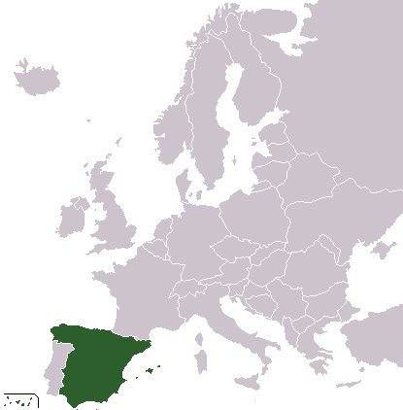





¿Qué número es el país?
Inglaterra es número …
2
Inglaterra
3
Alemania
4
Francia
1
2
3
5
España
4
1
Irlanda
5
Notes:
¿Qué número es el país? = Which number is the country? Inglaterra = England, Alemania = Germany, Francia = France, España = Spain, Irlanda = Ireland
Teachers should ask the question and give pupils time in pairs to look at the flags and the spelling (pronouncing the countries aloud) to work out which numbers matches each country. Inglaterra es número … = England is number … The answers are revealed on mouse clicks starting with England and working down to Ireland. Pupils should be able to answer with the Spanish numbers, and hopefully full sentences ‘Inglaterra es número dos’ etc.

Slide 4
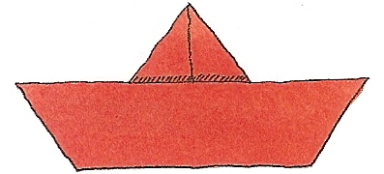
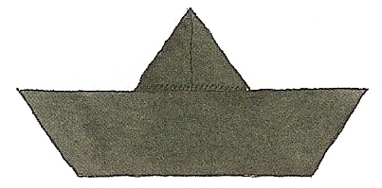
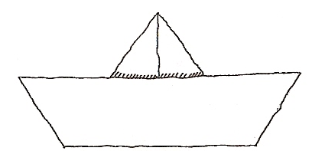
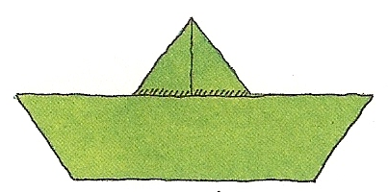
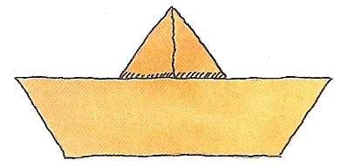
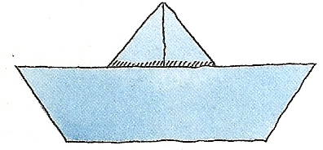
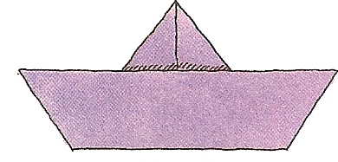
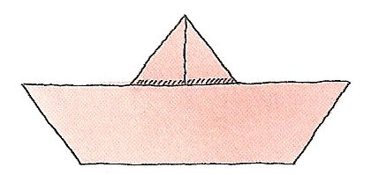
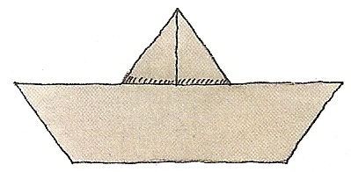
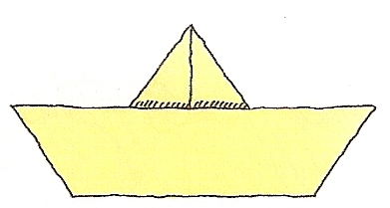
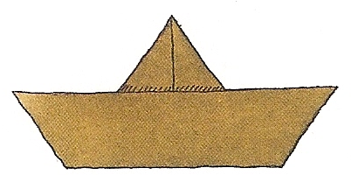
Un repaso de los colores…
Es rojo.
¿De qué color es el barquito?
Es negro.
Es blanco.
Es verde.
Es naranja.
Es azul.
Es morado.
Es rosa.
Es gris.
Es marrón.
Es amarillo.
Notes:
Un repaso de los colores = a revision of the colours; ¿De qué color es el barquito? = What colour is the little boat?
Boats will sail across the screen from left to right and pupils must volunteer in Spanish what colour each one is. The answer then appears on a mouse clock in written Spanish on the right hand side of the screen. We are using the masculine singular form of the adjective here but we will soon be using the feminine singular form and plural forms in later PowerPoints.

Slide 5


El barquito …
La mariposa …
es rojo.
es roja.
es negro.
es negra.
es blanco.
es blanca.
es verde.
es verde.
es naranja.
es naranja.
es azul.
es azul.
es morado.
es morada.
es rosa.
es rosa.
es gris.
es gris.
es marrón.
es marrón.
es amarillo.
es amarilla.
Notes:
The boat is … The butterfly is … Here pupils are encouraged to think about what the feminine singular form of the adjective will be, and how it would change, if at all, from the masculine to the feminine form when you are describing different objects which may vary in gender in Spanish. The answers appear one-by-one in red to the right hand side of the blue column. The rule (that they have seen before) is that if the masculine form ended in an –o it will change to an –a in the feminine. If it ended in anything else there is usually no change to the spelling or pronunciation.

Slide 6

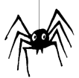
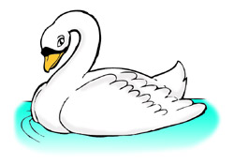
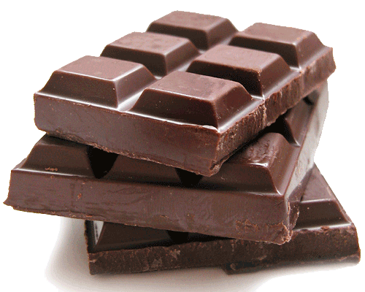


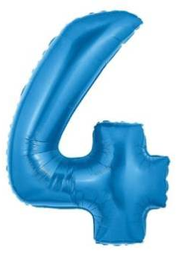

¿De qué color es…?
1.
2.
3.
4.
el cisne
la araña
el chocolate
el juguete
5.
6.
7.
8.
la vaca
el cuatro
el gigante
la hoja
Notes:
¿De qué color es…? What colour is …?
Pupils get a chance to choose the colour and make it agree with the gender of the noun in question.
e.g. 1. El cisne es blanco. 3. La araña es negra. 3. El chocolate es marrón 4. El juguete (toy) es naranja. 5. La vaca es blanca y negra. 6. El cuatro es azul. 7. El gigante es verde. 8. La hoja es roja.

Slide 7
¿De qué color son las banderas de estos países?
La bandera de Inglaterra es …
roja y blanca.
La bandera de Alemania es …
negra, roja y amarilla.
La bandera de Francia es …
azul, blanca y roja.
La bandera de España es …
roja y amarilla.
La bandera de Irlanda es …
verde, blanca y naranja.
Notes:
¿De qué color son las banderas de estos países? = What colour are the flags of these countries? In pairs pupils can speak or write their answers, ensuring that they choose the feminine singular forms of the colours as they are describing a flag which is a feminine word in Spanish (la bandera). Encourage the pupils to speak/write in full sentences so they can get used to verb forms etc.

