Slide 1
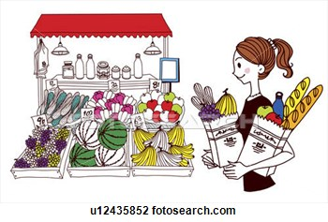
¿Qué hay en tu ciudad?

Slide 2
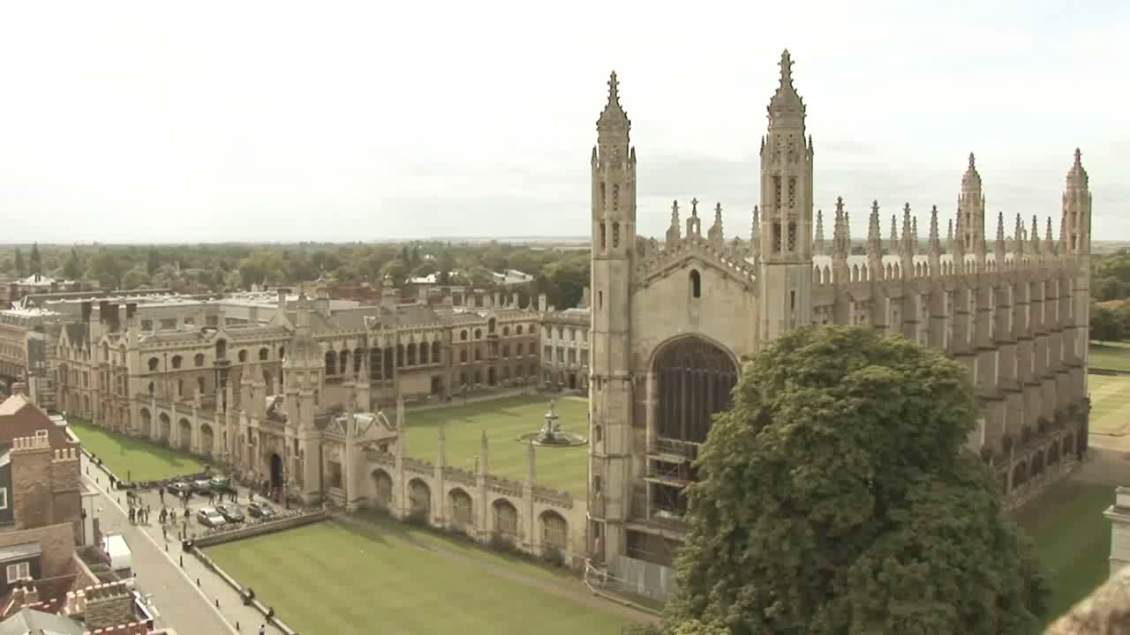
Notes:
https://www.youtube.com/watch?v=NEI-52a3YTo
Play students either or both of these video clips (very different views of Cambridge) and giving them a post-it note, ask them to note down words for places in the town.
Then ask them to spend one more minute thinking about any places in Cambridge that they know but did not see in the videos.
This video = 1min Next slide’s video = 2 min (parcour video – some teachers might not be ask keen to show this but I think students will be interested!) They will note the words in English. Take some whole class feedback and make a list of the words on a flipchart at the front.

Slide 3

Notes:
https://www.youtube.com/watch?v=55GnWh4TqY4

Slide 4
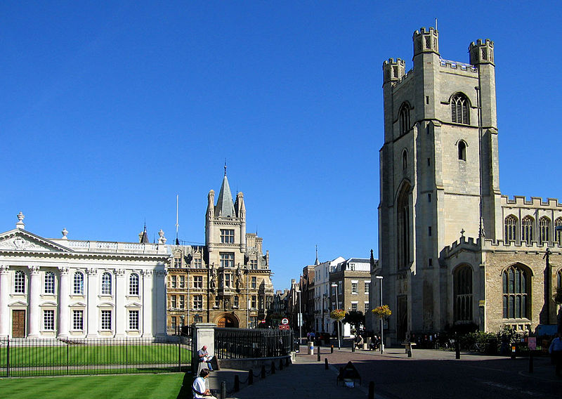
Hoy vamos a…
aprender vocabulario para describir la ciudad
decir lo que hay en Cambridge

Slide 5
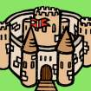

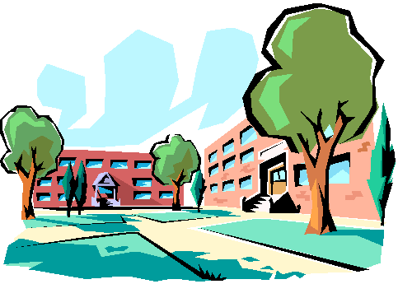

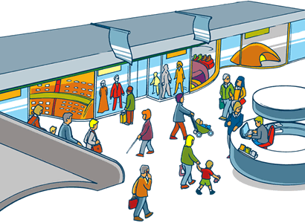
1 | 2 | 3 | 4
5 | 6 | 7 | 8
9 | 10 | 11 | 12
Notes:
Teachers may find it easier to introduce each place in the singular, BUT as our aim is to describe Cambridge AND students already know mucho and unos/unas it does make sense to ask them which applies to Cambridge. E.g. Un cine En Cambridge hay un cine? No, hay uno, dos, tres (naming them helps e.g. Cineworld, Vue, Arts cinema) entonces → unos cines.
un cine (a cinema) or unos cines (some cinemas)
muchos parques (lots of parks) muchos museos (lots of museums)
un castillo (a castle) muchos restaurantes (lots of restaurants un polideportivo (a sports centre) un estadio (a stadium)
un mercado (a market)
un centro comercial (a shopping centre)
una universidad (a university)
muchas tiendas (lots of shops)
una piscina (a swimming pool) or unas piscinas (some swimming pools)

Slide 6

1 | 2 | 3 | 4
5 | 6 | 7 | 8
9 | 10 | 11 | 12
Notes:
Pictures are re-ordered here. Elicit through usual routines, then animate the splats to take items away one by one, seeing if students can produce the words themselves.
un cine (a cinema) or unos cines (some cinemas)
muchos parques (lots of parks) muchos museos (lots of museums)
un castillo (a castle) muchos restaurantes (lots of restaurants un polideportivo (a sports centre) un estadio (a stadium)
un mercado (a market)
un centro comercial (a shopping centre)
una universidad (a university)
muchas tiendas (lots of shops)
una piscina (a swimming pool) or unas piscinas (some swimming pools)

Slide 7
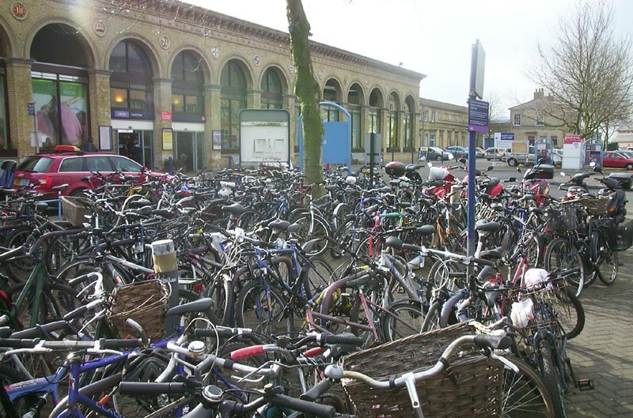
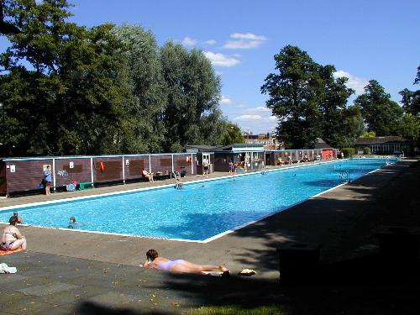
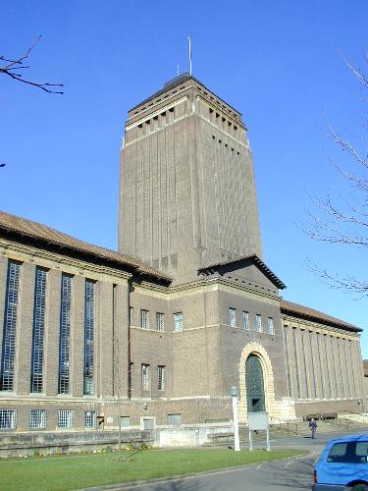
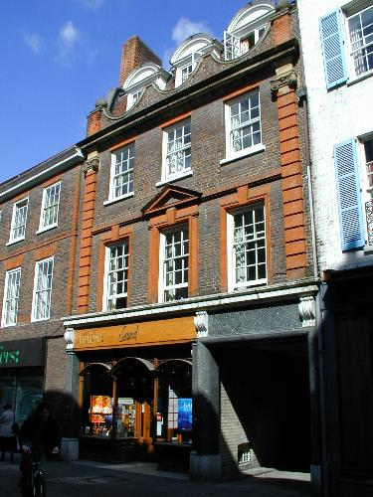
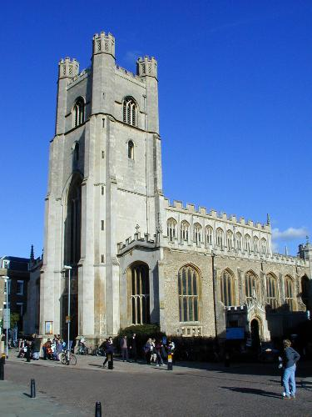
¿Qué hay en Cambridge?

Slide 8
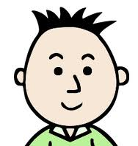
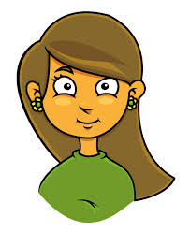
¿Q__ h__ e_ C_______?
H__ y
p___ n_ h__
Notes:
¿Qué hay en Cambridge? Hay un estadio y muchos parques pero no hay un castillo.

Slide 9


Hay un centro comercial.

Slide 10
Hay unas tiendas.

Slide 11


No hay una playa.

Slide 12


Hay una universidad y un mercado pero no hay un castillo.

Slide 13
Hay muchos restaurantes, unas piscinas y un polideportivo.

Slide 14

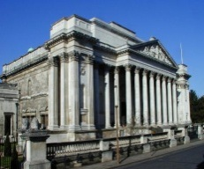

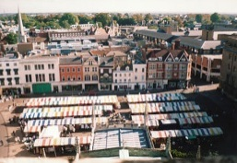
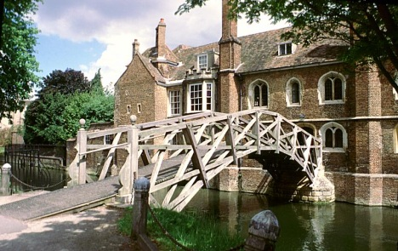
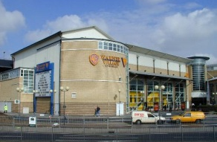
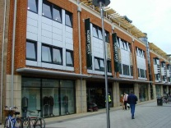
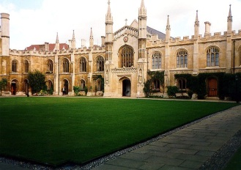
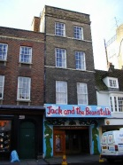

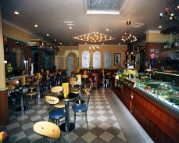
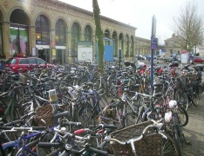
Notes:
This slide has pictures of Cambridge. Some words are known and others are not e.g. un puente, un teatreo, una estación de trenes, una oficina de turismo, una iglesia. Explain that students need to use their general knowledge of Cambridge as well as the words that they do know to complete the challenge of naming these well-known places in Cambridge. They will have the sheet of text, which is jumbled up, and need to write the correct descriptor next to each place. They can use dictionaries only if they have used their knowledge and the knowledge of their group.

Slide 15
¿Qué hay en tu ciudad?
lugar / monumento / atracción | español | lugar / monumento / atracción | español
Notes:
Print this slide, display slide 16.

Slide 16
la piscina | de Grafton
el museo | de Cambridge
la oficina | mayor
la universidad | de trenes
el puente | de los artes
la plaza | de Fitzwilliam
el centro comercial | Vue
la iglesia | para todos los bolsillos
la estación | matemático
muchos restaurantes | de Jesus Green
el cine | de Santa María
el teatro | de turismo

