Slide 1
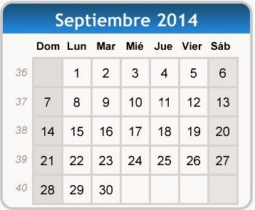
¿Qué día es hoy?
¿Qué fecha es hoy?
martes,
treinta de septiembre
mes = ?
día = ?
mes = month
día = day
hoy = ?
fecha = ?
hoy = today
fecha = date
Notes:
Pupils were introduced to this routine in the summer term of Y3 and in Y4 but may need reminding.
This will help remind them of the days of the week, keep working the numbers and help them remember some essential vocabulary e.g. day / month etc. This slide can be adapted obviously to fit the day of the week / month.

Slide 2
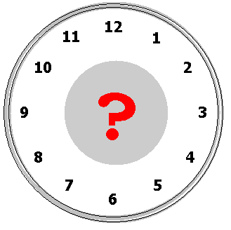
¿Qué hora es?
¿Q_____ h______ e__?
Notes:
Elicit the question: Qué hora es?

Slide 3
Notes:
Catchy song to listen to and join in with. https://www.youtube.com/watch?v=2YhtvRPRNCs

Slide 4
Son las doce y cinco.
Son las doce y diez.
Son las doce y veinte.
Son las doce y veinticinco.
Notes:
It’s five past twelve. It’s ten past twelve.
It’s twenty past twelve. It’s twenty-five past twelve.

Slide 5
Es la una menos veinticinco.
Es la una menos veinte.
Es la una menos diez.
Es la una menos cinco.
Notes:
It’s twenty-five to one. It’s twenty to one.
It’s ten to one. It’s five to one.

Slide 6
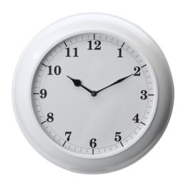
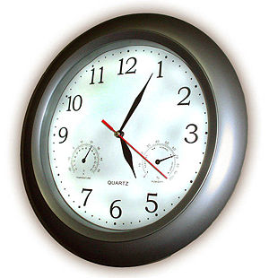
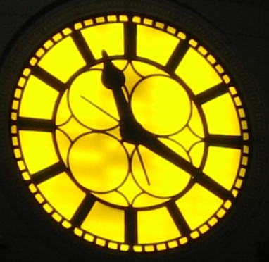
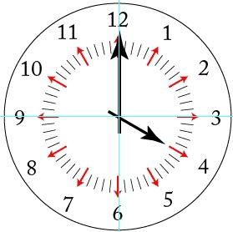
¿Qué hora es?
1.
2.
3.
4.
5.
6.
Notes:
Partner work: Pupils must work out what time it is as the Countdown clock ticks away (click on the COUNTDOWN icon to activate). You may have to click it again as it’s only 30 seconds long – depends how fast the class are! Then click on the individual clocks to hear if pupils are correct or not.

Slide 7
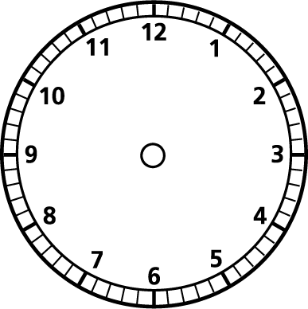
¿Qué hora es?
1.
2.
3.
1
2
3
4.
5.
6.
4
5
6
7
7.
8.
9.
8
9
Notes:
Pupils should use the clock face and hands (on previous slide) to adjust their clocks so that they say the same time as each audio number. Click on the numbered boxes 1-9 to hear the time. Click on white screen to reveal the answers in order.

Slide 8
¿Qué hora es?
1.
2.
3.
1
2
3
4.
5.
6.
4
5
6
7
7.
8.
9.
8
9
Notes:
Pupils should use the clock face and hands (on previous slide) to adjust their clocks so that they say the same time as each audio number. Click on the numbered boxes 1-9 to hear the time. Click on white screen to reveal the answers in order.

