Slide 1
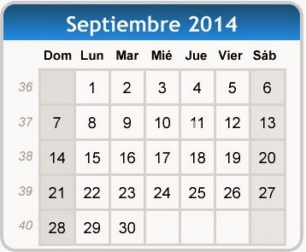
¿Qué día es hoy?
¿Qué fecha es hoy?
martes,
veintitrés de septiembre
mes = ?
día = ?
mes = month
día = day
hoy = ?
fecha = ?
hoy = today
fecha = date
Notes:
Pupils were introduced to this routine in the summer term of Y3 and in Y4 but may need reminding.
This will help remind them of the days of the week, keep working the numbers and help them remember some essential vocabulary e.g. day / month etc. This slide can be adapted obviously to fit the day of the week / month.

Slide 2
Notes:
https://www.youtube.com/watch?v=XcMMerLAhj8 Question words (English and Spanish) set to Jingle bells.
This video is very basic and the Q words don’t have tildes (!!!) but the repetition is useful. There is another version of this which is MUCH nicer visually, but unfortunately there’s an error as the original ‘lyricist’ wanted to have ‘Hay’ meaning ‘Is there?’ instead of the ‘Hey’ which this video maker has put.
It’s still perhaps worth a look as the song is very repetitive and every little helps! https://www.youtube.com/watch?v=IDY3V3OuMEs

Slide 3
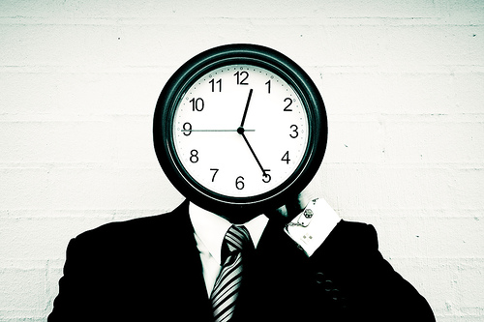
¿Qué hora es?
Notes:
‘What time is it?’

Slide 4
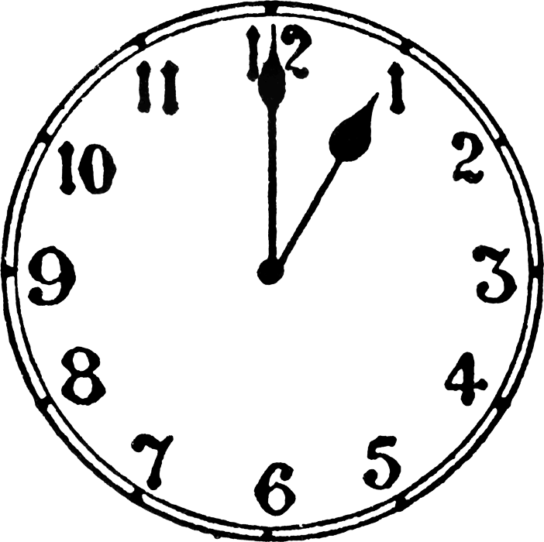
¿Qué hora es?
Es la una.
Notes:
It’s one o’clock.

Slide 5
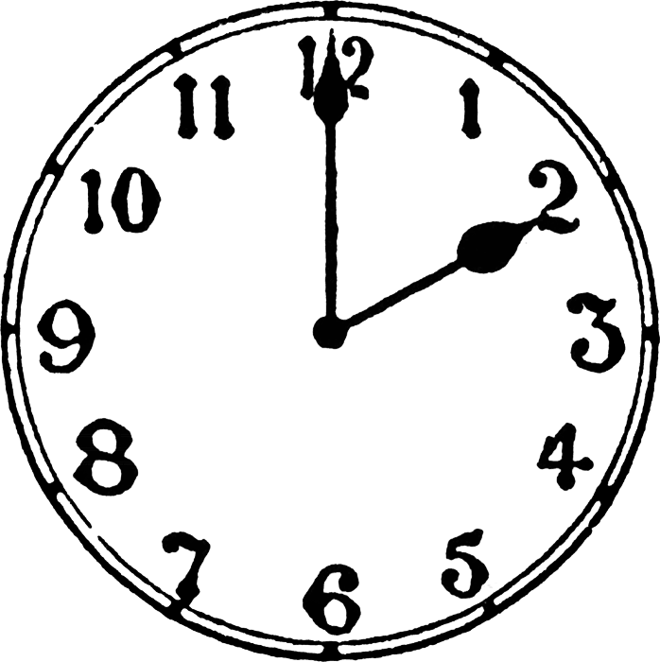
¿Qué hora es?
Son las dos.
Notes:
It’s two o’clock.

Slide 6
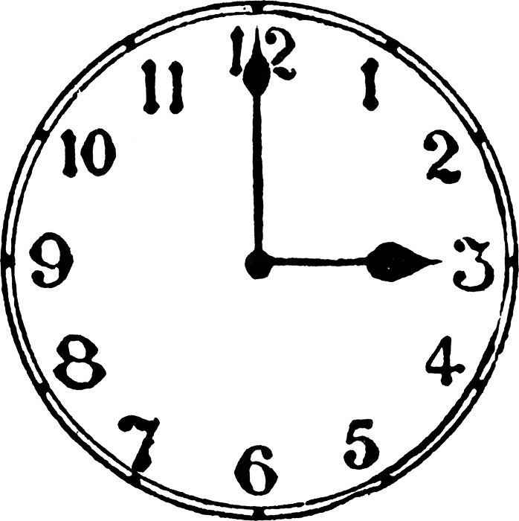
¿Qué hora es?
Son las tres.
Notes:
It’s three o’clock.

Slide 7
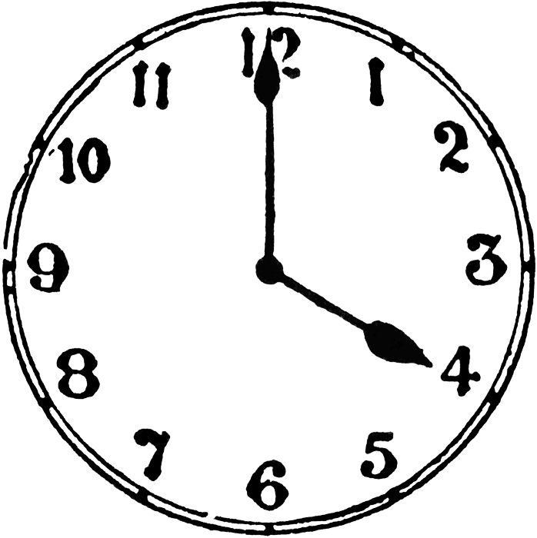
¿Qué hora es?
Son las cuatro.
Notes:
It’s four o’clock.

Slide 8
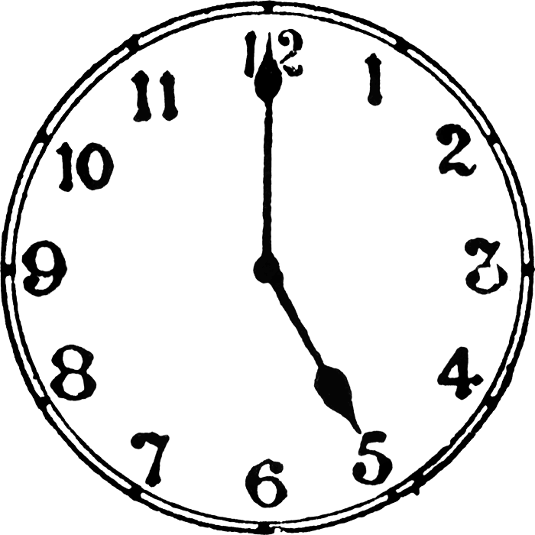
¿Qué hora es?
Son las cinco.
Notes:
It’s five o’clock.

Slide 9
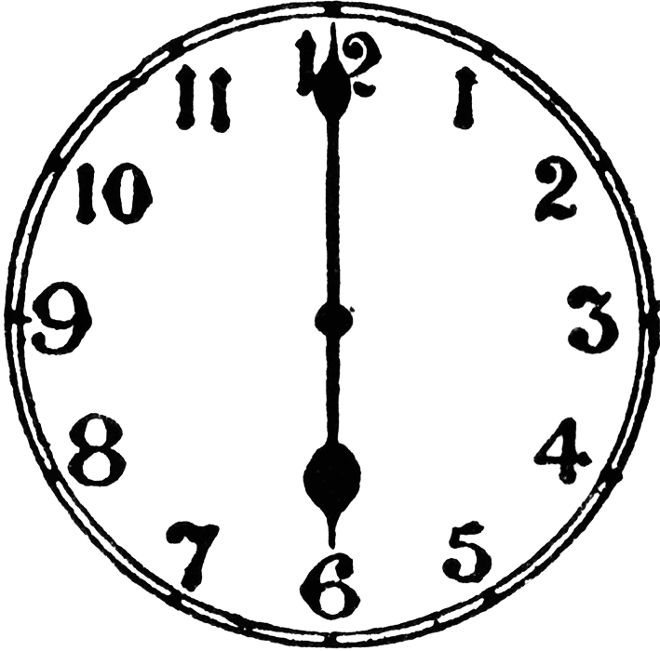
¿Qué hora es?
Son las seis.
Notes:
It’s six o’clock.

Slide 10
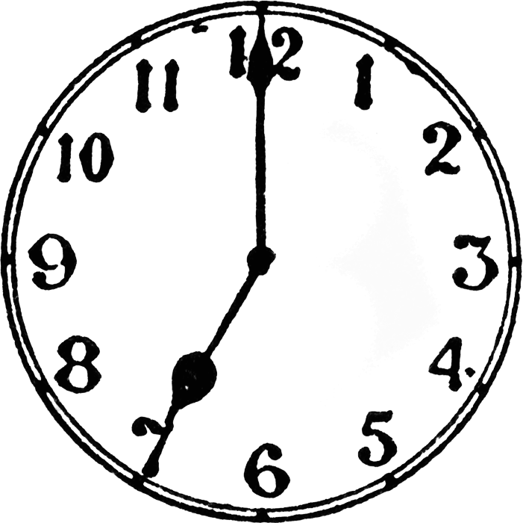
¿Qué hora es?
Son las siete.
Notes:
It’s seven o’clock.

Slide 11
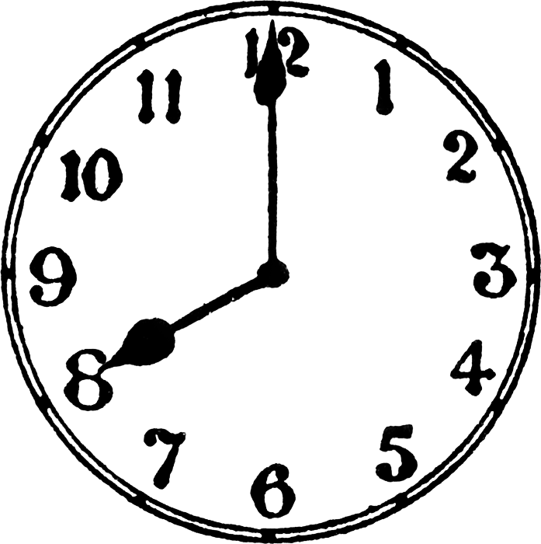
¿Qué hora es?
Son las ocho.
Notes:
It’s eight o’clock.

Slide 12
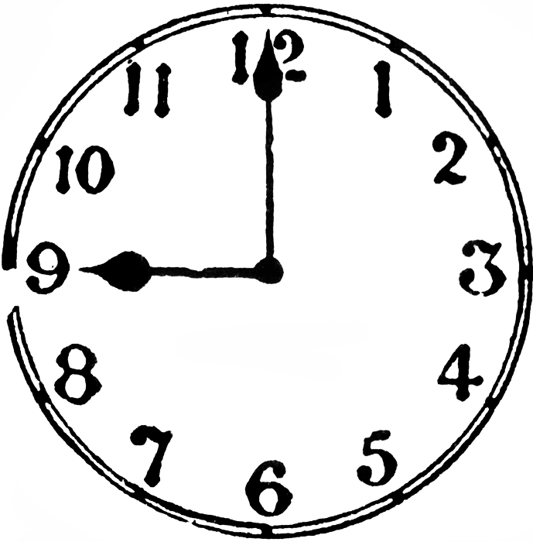
¿Qué hora es?
Son las nueve.
Notes:
It’s nine o’clock.

Slide 13
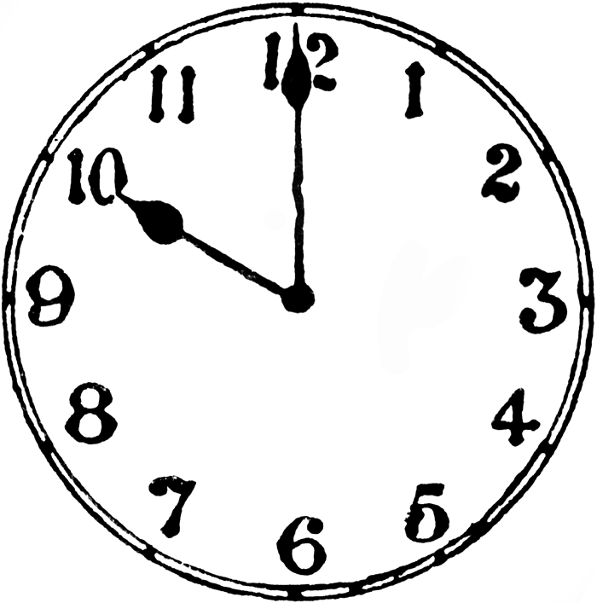
¿Qué hora es?
Son las diez.
Notes:
It’s ten o’clock.

Slide 14
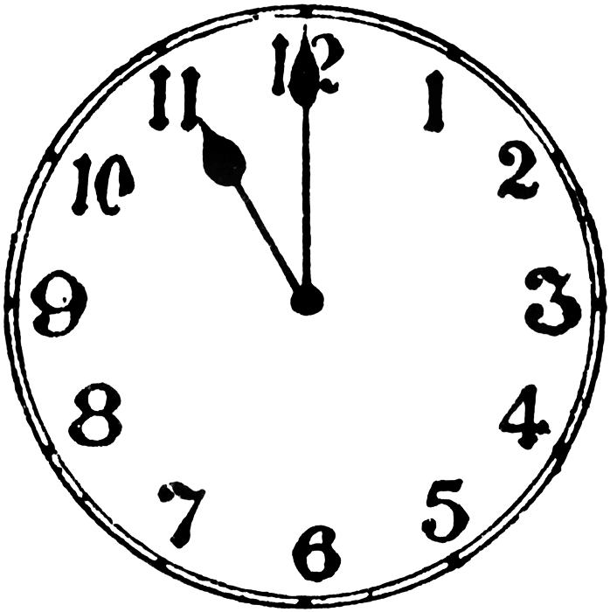
¿Qué hora es?
Son las once.
Notes:
It’s eleven o’clock.

Slide 15
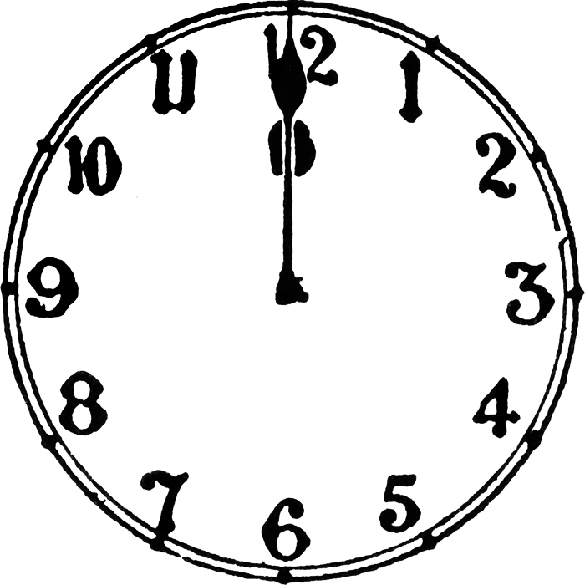
¿Qué hora es?
Son las doce.

Slide 16
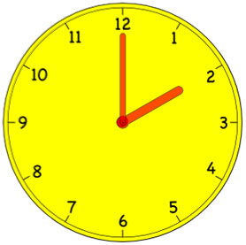
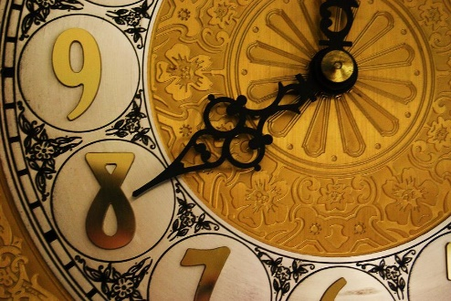
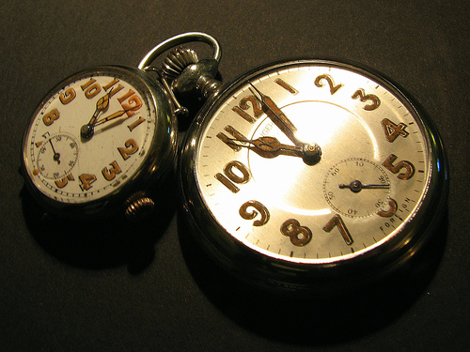
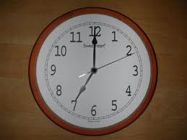
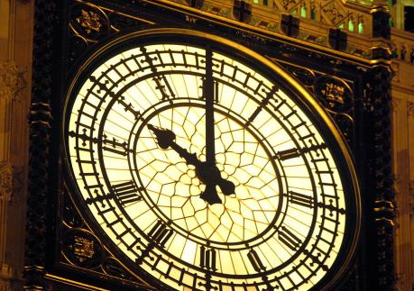
¿Qué hora es?
1.
2.
3.
4.
5.
6.
Notes:
Partner work: Pupils must say out loud to a partner what time it is as the Countdown clock ticks away (click on the COUNTDOWN icon to activate). You may have to click it again as it’s only 30 seconds long – depends how fast the class are!
The answers are not on the slide, but they are straightforward as they are just the ‘on the hour’ times.
When they feed back they should do it in pairs with question and answer. Qué hora es? Son las dos
Etc…

Slide 17
¿Qué hora es?
Son las doce.
Son las doce y cuarto.
Son las doce y media.
Es la una menos cuarto.
Notes:
It’s twelve o’clock. It’s a quarter past twelve.
It’s half past twelve. It’s a quarter to one.

Slide 18
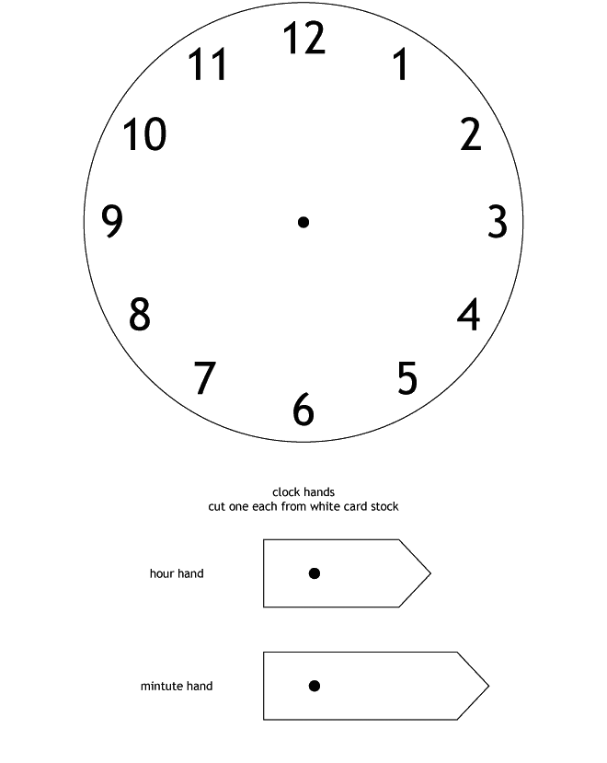
Notes:
Photocopy these for pupils to make their own clock. Pupils will need a butterfly clip to attach the hands so that they can adjust the time according to what they hear on the next slide.

Slide 19
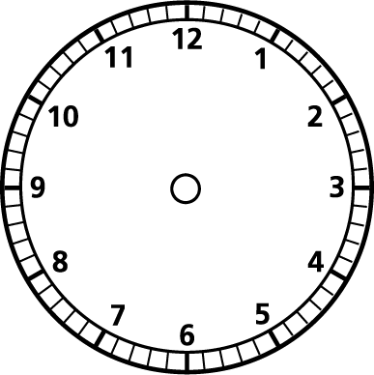
¿Qué hora es? Practica con un amigo.
Ejemplo:
Persona A - ¿Qué hora es? Persona B - Son las nueve.
Persona A
Notes:
Encourage pupils to practise the quarter and half-past times.

