Slide 1
p¡tocado!
Batalla naval
X ¡agua!
toco
tocas
toca
tocamos
tocáis
tocan
Notes:
Batalla naval (battleships) Pupils form sentences to try to find the 5 x hidden battleships. They can do this in two teams until all 5 are found. Click in the middle of the purple rectangle indicated by the phrase given and it will disappear. Pupils say ‘tocado’ when they get a ship and ‘agua’ when there is only water there. There is a black/white slide of the game at the end of this lesson, so pupils can play again, but in pairs.

Slide 2
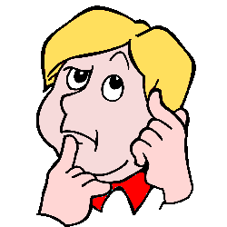
¿Por qué? (Why?) Porque…(because)
¿Por qué te gusta?
¿Por qué no te gusta?
Porque creo que es …
(Because I think it’s …)
Porque me parece …
(Because to me it seems …)
Notes:
¿Por qué (no) te gusta? = Why do you (not) like it?
Pupils are now encouraged to consider reasons why they might like or not like something.
Pupils should repeat the phrases to become familiar with them.
Click on the phrases to hear them pronounced.

Slide 3
Here are some useful words for giving reasons. Use your detective skills and work out the missing Spanish and English word meanings.
Inglés | Español | Inglés | Español
serious |  |  | divertido
modern |  | traditional
pretty |  |  | feo
quiet |  |  | ruidoso
boring |  | exciting | emocionante
international |  | These 4 words don’t have opposites listed, but they are like the English words. See if you can find them all.
touristy
famous
amazing
internacional | bonito | moderno | fun | bonito | tranquilo | impresionante
ugly | famoso | aburrido | serio | turístico | noisy | tradicional
Notes:
Give pupils the sheet to see what they can work out themselves.

Slide 4
Here are some useful words for giving reasons. Use your detective skills and work out the missing Spanish and English word meanings.
Inglés | Español | Inglés | Español
serious | serio | fun | divertido
modern | moderno | traditional | tradicional
pretty | bonito | ugly | feo
quiet | tranquilo | noisy | ruidoso
boring | aburrido | exciting | emocionante
international | Internacional | These 4 words don’t have opposites listed, but they are like the English words. See if you can find them all.
touristy | turístico
famous | famoso
amazing | impresionante
internacional | bonito | moderno | fun | bonito | tranquilo | impresionante
ugly | famoso | aburrido | serio | turístico | noisy | emocionante
Notes:
Show them the answers and allow them to complete any they missed.

Slide 5
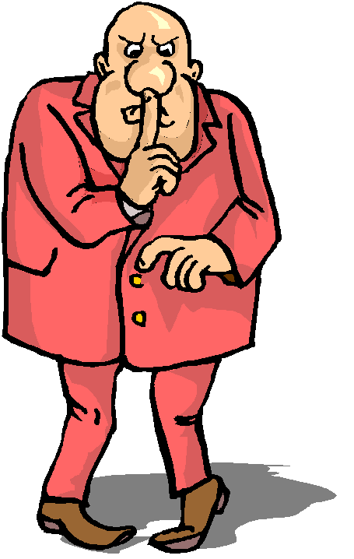
¿Cómo se dice en inglés?
tranquilo
ruidoso
tranquila
ruidosa
Notes:
Blue = masculine, red = feminine; tranquilo = quiet, ruidoso = noisy
Make pupils pronounce these words in both masculine and feminine forms several times. It would be really useful to have an action that you, as teacher, do to trigger pupil memory of the word. Realise this may be challenging …
The next mouse click brings up the question ¿Cómo se dice en inglés? (How do you say that in English?) to make sure that pupils know the meanings of all the words. Click on words to hear audio.

Slide 6
¿Cómo se dice en inglés?
emocionante
aburrido
emocionante
aburrida
Notes:
Blue = masculine, red = feminine; emocionante = exciting, aburrido = boring
Instructions as per previous.

Slide 7
¿Cómo se dice en inglés?
divertido
serio
divertida
seria
Notes:
Blue = masculine, red = feminine; divertido = fun(ny), serio = serious
Instructions as per previous.

Slide 8
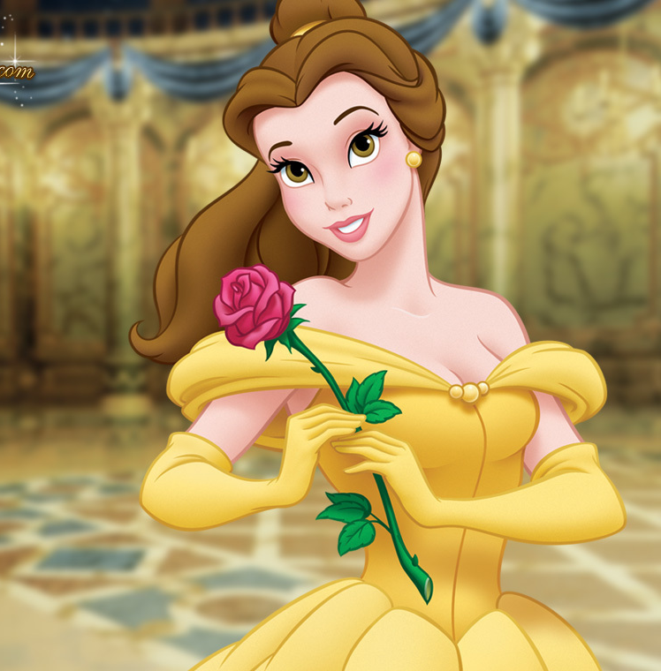
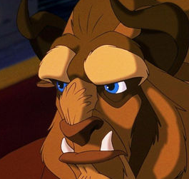
¿Cómo se dice en inglés?
bonito
feo
bonita
fea
Notes:
Blue = masculine, red = feminine; bonito = pretty, feo = ugly
Instructions as per previous.

Slide 9
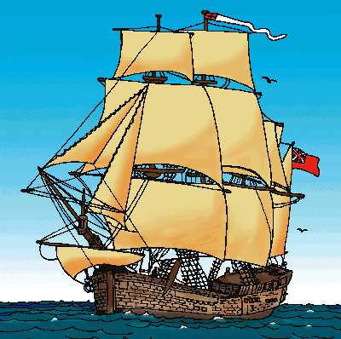
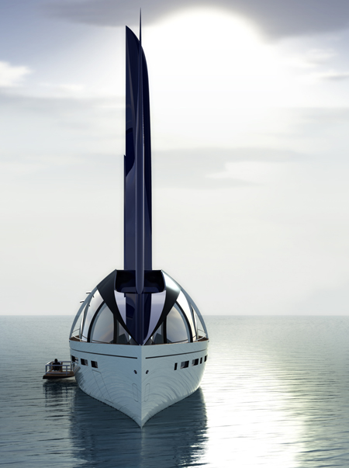
¿Cómo se dice en inglés?
tradicional
moderno
tradicional
moderna
Notes:
Blue = masculine, red = feminine; tradicional = traditional, moderno = modern
Instructions as per previous. Remind pupils of cognates ☺

Slide 10
¿Cómo se dice en inglés?
internacional
internacional
Notes:
Blue = masculine, red = feminine; internacional = international
Instructions as per previous. Pupils will note that there is no difference in masculine & feminine forms for this word (because it doesn’t end in an –o in masculine there is no change.)

Slide 11
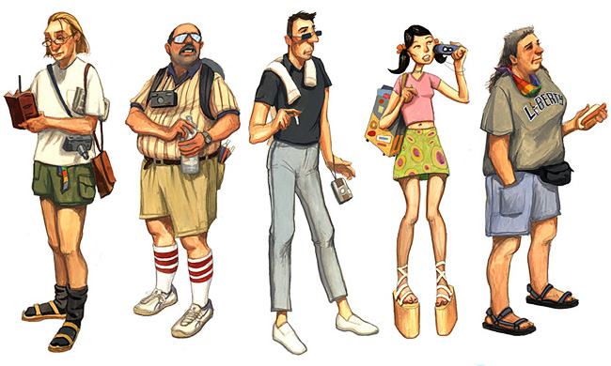
¿Cómo se dice en inglés?
turístico
turística
Notes:
Blue = masculine, red = feminine; turístico = touristy
Instructions as per previous.

Slide 12
¿Cómo se dice en inglés?
famoso
famosa
Notes:
Blue = masculine, red = feminine; famoso = famous
Instructions as per previous.

Slide 13
¿Cómo se dice en inglés?
impresionante
impresionante
Notes:
Blue = masculine, red = feminine; impresionante = striking/impressive
Instructions as per previous. Pupils will note that there is no difference in masculine & feminine forms for this word (because it doesn’t end in an –o in masculine there is no change.)

Slide 14
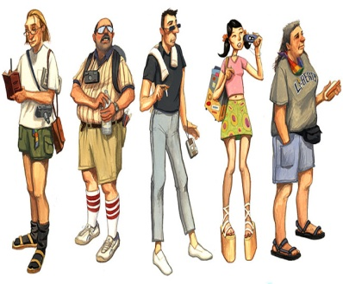
Notes:
Print out sheet, cut up into individual cards and give a set to each pair/pupil. Pupils then put the cards in the order (activities on next 2 slides) they are read out in. Run through the meanings first to check the pupils are on board with this activity.

Slide 15
Notes:
This slide is with them jumbled up – i.e. NOT in the order given. You can do this as a ‘slap the board activity’ and others can mark it.
Click on the sound icon to hear the order. Pupils should put their picture cards in the order they hear them said. The audio is as follows:
una chica bonita (a pretty girl), un sitio turístico ( a touristy place), un príncipe famoso (a famous prince), amigos divertidos (fun/funny friends), un barco moderno (a modern boat), un barco tradicional (a traditional boat), una torre impresionante (an impressive tower), una bestia fea (an ugly beast), un hombre ruidoso (a noisy man), un hombre tranquilo (a quiet man), una persona seria (a serious person), una fiesta emocionante (an exciting party), una fiesta aburrida (a boring party), algo internacional (something international). Then click again to reveal the picture order so that pupils can check they have it right.

Slide 16
Notes:
Click on the sound icon to hear the order. Pupils should put their picture cards in the order they hear them said.
The pictures are animated to appear one by one.
The audio is as follows:
una chica bonita (a pretty girl), un sitio turístico ( a touristy place), un príncipe famoso (a famous prince), amigos divertidos (fun/funny friends), un barco moderno (a modern boat), un barco tradicional (a traditional boat), una torre impresionante (an impressive tower), una bestia fea (an ugly beast), un hombre ruidoso (a noisy man), un hombre tranquilo (a quiet man), una persona seria (a serious person), una fiesta emocionante (an exciting party), una fiesta aburrida (a boring party), algo internacional (something international). Then click again to reveal the picture order so that pupils can check they have it right.

Slide 17
Notes:
2nd round of audio. pictures are NOT in the correct order – answers are on the following slide.
Click on the sound icon to hear the order. Then click again to reveal the picture order so that pupils can check they have it right. una torre impresionante (an impressive tower), un barco moderno (a modern boat), una fiesta emocionante (an exciting party), una bestia fea (an ugly beast), un hombre tranquilo (a quiet man), una fiesta aburrida (a boring party), amigos divertidos (fun/funny friends), un barco tradicional (a traditional boat), un sitio turístico ( a touristy place), una persona seria (a serious person), algo internacional (something international). un hombre ruidoso (a noisy man), una chica bonita (a pretty girl), un príncipe famoso (a famous prince), Then click again to reveal the picture order so that pupils can check they have it right.
You may want to repeat this activity with your own order…

Slide 18
Notes:
2nd round ANSWERS Click on the sound icon to hear the order. Then click again to reveal the picture order so that pupils can check they have it right. una torre impresionante (an impressive tower), un barco moderno (a modern boat), una fiesta emocionante (an exciting party), una bestia fea (an ugly beast), un hombre tranquilo (a quiet man), una fiesta aburrida (a boring party), amigos divertidos (fun/funny friends), un barco tradicional (a traditional boat), un sitio turístico ( a touristy place), una persona seria (a serious person), algo internacional (something international). un hombre ruidoso (a noisy man), una chica bonita (a pretty girl), un príncipe famoso (a famous prince), Then click again to reveal the picture order so that pupils can check they have it right.
You may want to repeat this activity with your own order…

Slide 19
¿Por qué te gusta?
¿Por qué no te gusta?
Porque creo que es …
(Because I think it’s …)
Porque me parece …
(Because to me it seems …)
Notes:
¿Por qué (no) te gusta? = Why do you (not) like it?
Pupils are now encouraged to consider reasons why they might like or not like something.
Pupils should repeat the phrases to become familiar with them.
Click on the phrases to hear them pronounced.

Slide 20
¿Te gusta la rana Gustavo?
¿Por qué (no)?
Me gusta …
No me gusta …
Me encanta …
Odio …
porque me parece …
porque creo que es …
Notes:
¿Te gusta la rana Gustavo? ¿Por qué (no)? Do you like Kermit the Frog? Why (not)?
Pupils are encouraged to give opinions using the language they have covered in lessons 1 & 2, and any other language they can recycle from previous lessons.

Slide 21
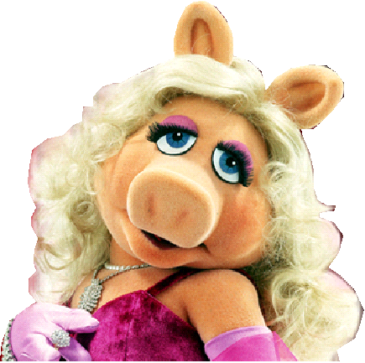
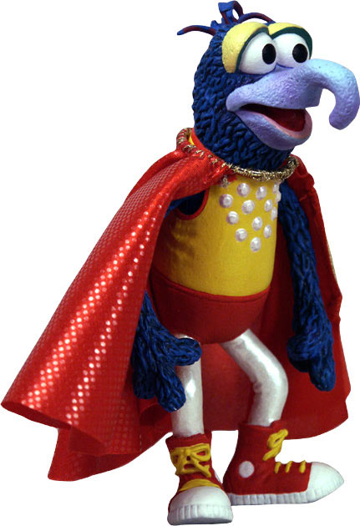
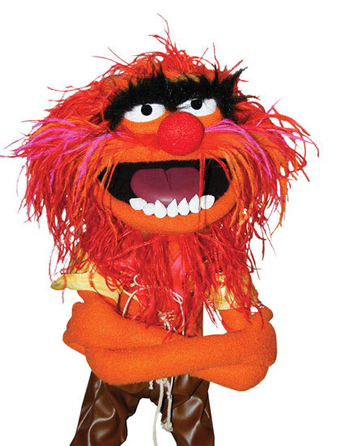
¿Te gusta?
¿Por qué (no)?
1
2
Gonzo
Piggy
3
Animal
Notes:
¿Te gusta? ¿Por qué (no)? Do you like him/her? Why (not)?
Pupils are encouraged to give opinions using the language they have covered in lessons 1 & 2, and any other language they can recycle from previous lessons.
Characters are revealed on mouse-clicks. Encourage pupils to use feminine singular (red) adjectives for Piggy and masculine singular (blue) adjectives for Gonzo & Animal.

Slide 22
¿Te gusta?
¿Por qué?
¿Por qué no?
1
2
3
4
Notes:
¿Te gustan? ¿Qué número prefieres? ¿Por qué? Do you like them? Which number do you prefer and why?
Click on a video box to watch it. When finished watch the next… Hopefully pupils will like them and give an opinion about their favourite etc.

Slide 23
¡Escribe adjetivos apropiados en los espacios!
No me gusta el colegio porque es __________.
Me gustan las fiestas porque son __________.
Prefiero el fútbol porque es ____________.
Mi animal preferido es un gato porque los gatos son __________.
La chica no es ruidosa, es __________.
Mi fiesta de cumpleaños es muy __________.
Me encantan las mariposas porque son __________.
Pocoyó es muy __________.
Me encantan las aventuras porque son ____________.
Me gusta la foto porque es __________.
divertido
emocionante
tranquila
bonitos
divertidas
aburrido
bonita
ruidosa
emocionantes
bonitas
Notes:
¡Escribe adjetivos apropiados en los espacios! Write appropriate adjectives in the spaces. Choose from the list at the bottom of the slide.
The rules for adjectival agreement are the same as for the colours. –o, -a, -os, -as. Alternatively if the adjective doesn’t end in –o in the masculine singular it will be the same for the feminine singular and add –es for masculine & feminine plural. The idea is that pupils will use some of the adjectives they have just been introduced to and have practised.
I don’t like school because it’s … (adjective must be masculine singular and fit in terms of meaning).
I like parties because they are … (feminine plural)
I prefer football because it’s … (feminine singular).
My favourite animal is a cat because cats are … (masculine plural).
The girl isn’t noisy, she’s … (feminine singular).
My birthday party is very … (feminine singular).
I love butterflies because they are … (feminine plural).
Pocoyó is very … (masculine singular).
I love adventures because they are … (feminine plural).
I like the photo because it’s … (feminine singular).
Answers appear on mouse-clicks and fly to spaces.

Slide 24
¡Escribe adjetivos apropiados en los espacios!
No me gusta el colegio porque es __________.
Me gustan las fiestas porque son __________.
Prefiero el fútbol porque es ____________.
Mi animal preferido es un gato porque los gatos son __________.
La chica no es ruidosa, es __________.
Mi fiesta de cumpleaños es muy __________.
Me encantan las mariposas porque son __________.
Pocoyó es muy __________.
Me encantan las aventuras porque son ____________.
Me gusta la foto porque es __________.
divertido
emocionante
tranquila
bonitos
divertidas
aburrido
bonita
ruidosa
emocionantes
bonitas
Notes:
Version for printing out

Slide 25
p¡tocado!
Batalla naval
X ¡agua!
toco
tocas
toca
tocamos
tocáis
tocan
Notes:
Batalla naval (battleships) Pupils form sentences to try to find the 5 x hidden battleships. They can do this in two teams until all 5 are found. Click in the middle of the purple rectangle indicated by the phrase given and it will disappear. Pupils say ‘tocado’ when they get a ship and ‘agua’ when there is only water there. There is a black/white slide of the game at the end of this lesson, so pupils can play again, but in pairs.

