Slide 1
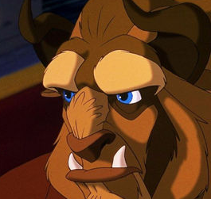
Notes:
Print out sheet, cut up into individual cards and give a set to each pair/pupil. Pupils then put the cards in the order (activities on next 2 slides) they are read out in. Run through the meanings first to check the pupils are on board with this activity.

