Slide 1
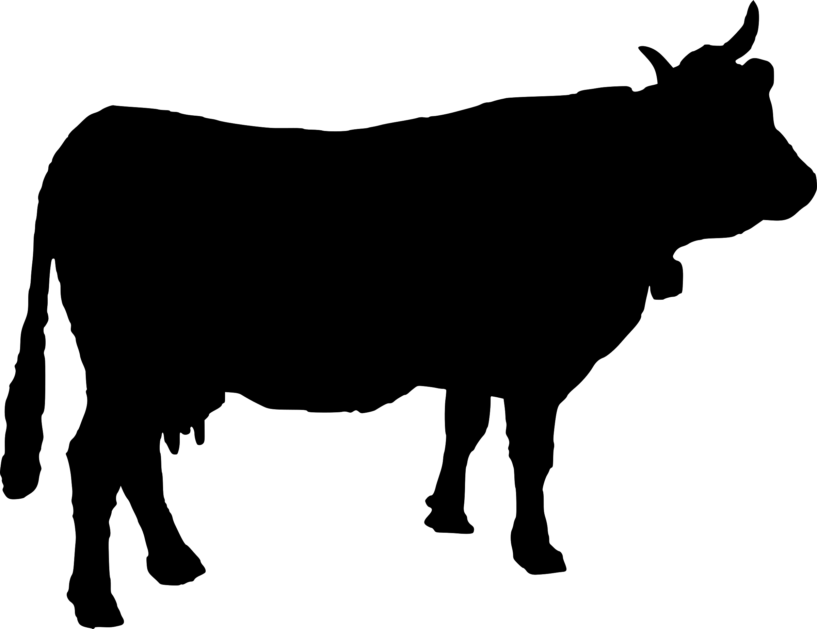
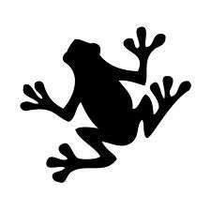
La orquesta de animales
(un macaco)
una vaca
un gato
un mono
un león
un conejo
un oso
una rana
un zorro
¿Cuántos animales hay?
Hay ocho animales.
¿Qué son?
Notes:
This lesson introduces the verb ‘tocar’ in the 3rd person via a story / song called ‘the orchestra of animals’. Pupils know almost all of these animals and almost all the instruments in the story already. Use this slides to elicit how many animales there are on the slide and the names for them, which are animated to appear from left to right. Pupils may need reminding of the names of some of the animals (una vaca, un mono may be new and we need un macaco for the story, un león and un zorro, which may be completely new)
They are going to have the story / song text to read, so they do not need to get to independent production level of knowledge here.

Slide 2
La orquesta de animales
¿Qué instrumento toca un gato?
Un gato toca…
Notes:
This slide is to introduce the idea of the orchestra of animals and which instrument each might play. We are using indefinite articles for the animals and definite articles for the instruments. A cat plays the trumpet, the drum etc… This is how they will encounter them in the song/story.

Slide 3
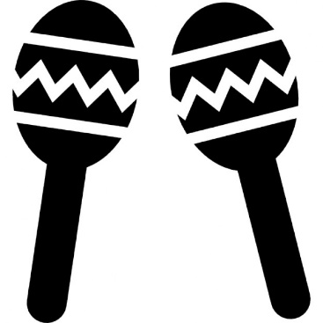
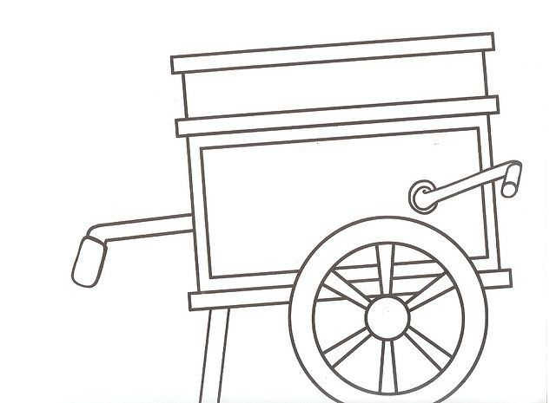
el trombón
las maracas
el organillo
Notes:
Pupils are now given their set of cards (1 x set between two) Ask them to pair them up, imagining which animal will play which instrument. The names for the 3 new instruments (all cognates) are introduced here, too. Give pupils 3-4 minutes in their pairs to decide who plays what.
Use the next slide to elicit their different ideas orally.

Slide 4
una vaca?
¿Qué instrumento toca …
un oso?
un conejo?
un zorro?
un macaco?
un león?
una rana?
Notes:
Ask briefly about each animal in turn? This should not be too long, so just get 2-3 quick suggestions from pupils for each animal.
If required, you can click on each word after it appears to hear the pronunciation.

Slide 5
Notes:
http://www.apoyo-primaria.com/2015/04/la-orquesta-de-animales.html
Tell pupils to listen to the song and read along, changing their pairings of animal + instrument, if necessary, as they go. NB: Click on the audio icon to start the audio. Then leave it playing and move the slide on to match the words, over the next 3 slides.
If pupils need to hear it again, go back to this slide and repeat the process.

Slide 7
Estribillo: La orquesta de animales acaba de llevar pues una lina fiesta aquí tendrá lugar. Escojan su pareja si gustan de bailar que ya los animales teminan de afinar.

Slide 9
Estribillo: La orquesta de animales acaba de llevar pues una linda fiesta aquí tendrá lugar. Escojan su pareja si gustan de bailar que ya los animales terminan de afinar.
Un gatito toca el arpa un macaco el organillo y verás un zorro pillo que ejecuta el saxofón. El del trombón es un fiero y terrible león pero hay también un osito con violón.
la ranita de los charcos toca y toca la trompeta y por ser tan buena orquesta nuestra fiesta se alegró.
Con sus cuernos varias vacas hacen ruido de maracas y un conejo a pie cojuelo salta y salta en el tambor.
¿Qué significa ‘toca’?
Notes:
A copy of the text on one slide to facilitate checking of pairs… Then elicit the meaning of ‘toca’

Slide 10
Mi orquesta de animales
En mi orquesta de animales un / una ……….. toca el / la …………
Notes:
http://changing-phase.blogspot.co.uk/p/mini-books.html
If time allows, get pupils to make their own orchestra of animals mini-book Stress the importance of knowing the gender of animal and instrument and using the correct indefinite and definite articles. They can do some more independent research of animals and instruments if they have access to dictionaries.

