Slide 1
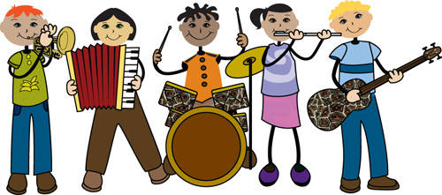
¿Qué más instrumentos hay?

Slide 2
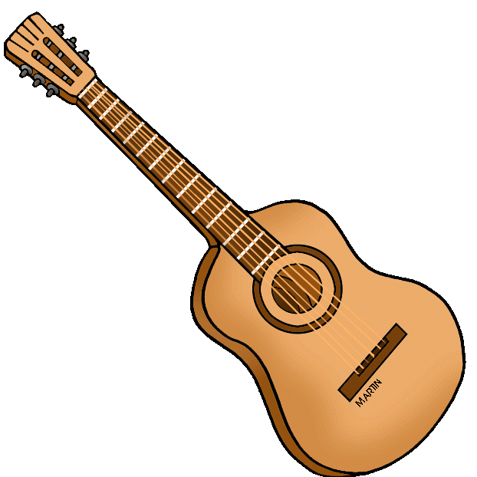
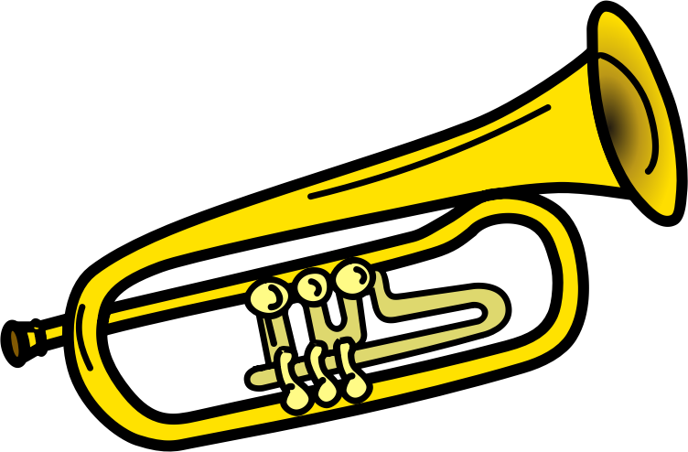
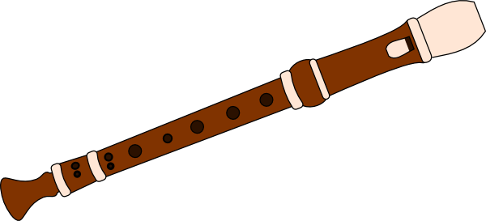
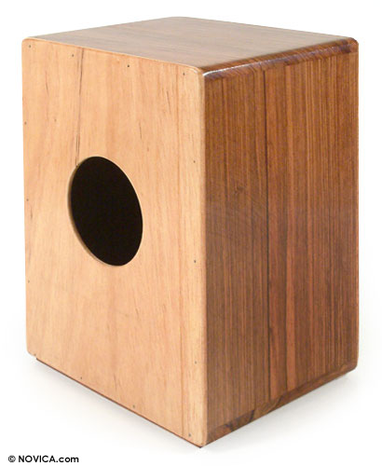
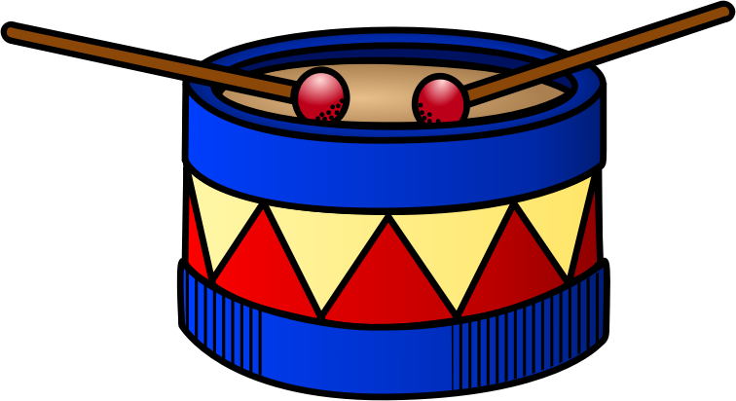
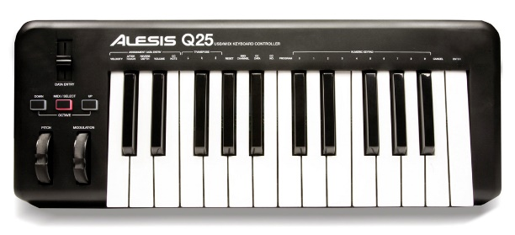
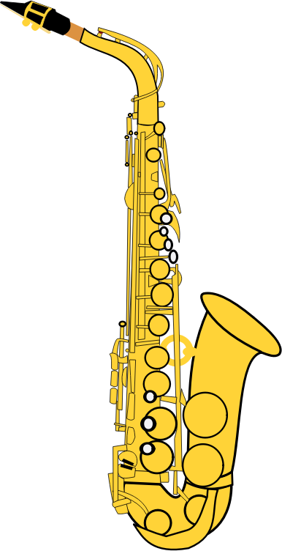
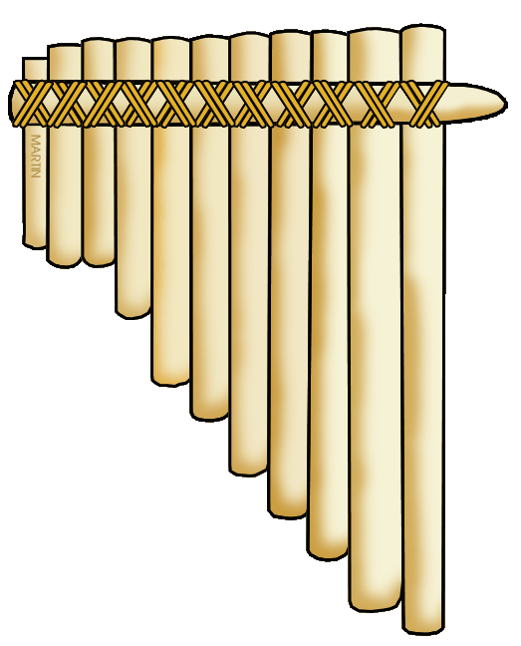
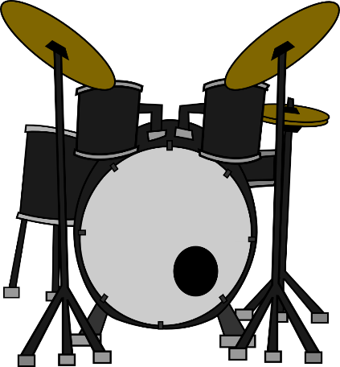
10 | 11 | 12
13 | 14 | 15
16 | 17 | 18
Notes:
Quick revision: Use numbers to elicit the instruments with the correct indefinite article (un / una).

Slide 3
Inglés | Español
Inglés | Español
Inglés | Español
Inglés | Español
Notes:
Pupils are going to identify 7 more instruments (which they are then going to look up in dictionaries – paper or online). They should write down the English as they hear / see each instrument in the video on the following slide. Tell them you will go through their English spelling afterwards, they should just do their best at this point.

Slide 4
Notes:
The answers are: 1 harp 2 violin 3 cello 4 xylophone 5 clarinet 6 double bass 7 cymbal

Slide 5
 | Inglés | Español
5
harp
6
violin
1
cello
7
xylophone
2
clarinet
4
double bass
3
cymbal
Notes:
Elicit the answers, asking pupils to check their spelling carefully because they are going to use dictionaries to find these words in Spanish. Then ask them to number the words (to the left) in alphabetical order 1-7.

Slide 6
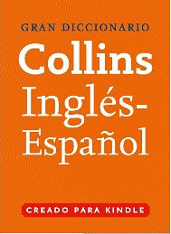
Vamos a usar un diccionario inglés-español
para buscar vocabulario en español.
Es posible usar un diccionario tradicional o un diccionario online.
Notes:
We are going to use an English-Spanish dictionary to look for vocabulary in Spanish.
It’s possible to use a traditional dictionary or an online dictionary.

Slide 7
Vamos a buscar vocabulario español.
Notes:
We are going to look for Spanish vocabulary

Slide 8
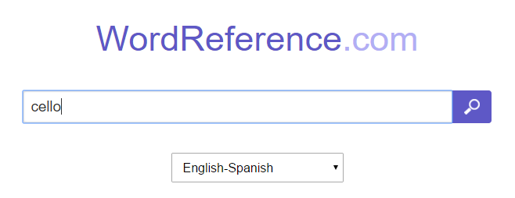
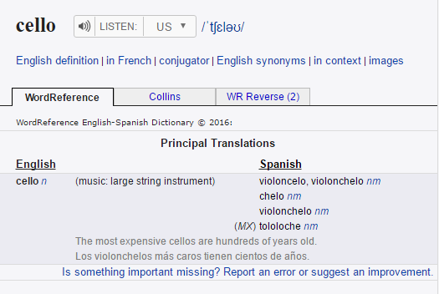

Slide 9
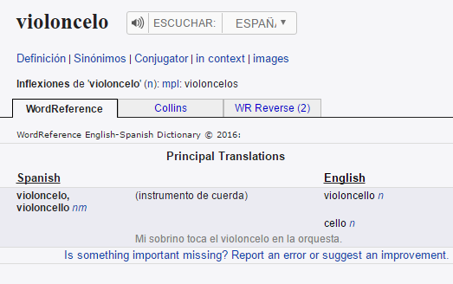
¿Cómo se pronuncia el vocabulario español?
¡Usa la fonética! Pero si es necesario, haz clic aquí…
… para verificar.
Notes:
How do you pronounce the Spanish vocabulary?
Use the phonetics! But if it’s necessary, click here… to check.
I have circled in red what you would click on to hear the word pronounced.
Once again, clicking on the icon will take you to the live web page so that you can hear the audio.

Slide 10
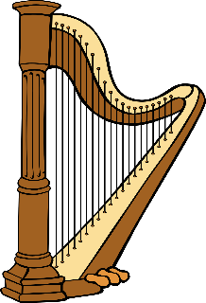
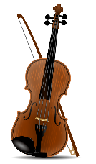
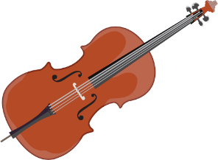
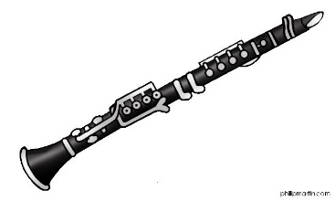
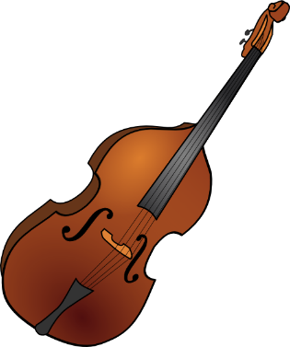
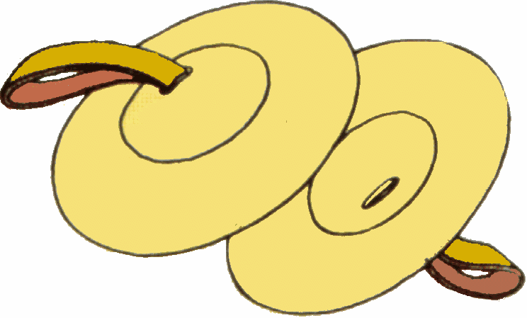
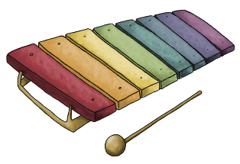
 | Inglés | Español
5
harp
arpa (nf)
6
violin
violín (nm)
1
cello
violoncello (nm)
7
xylophone
xilófono (nm)
2
clarinet
clarinete (nm)
4
double bass
contrabajo (nm)
3
cymbal
platillo / cimbal (nm)
Notes:
Model how to write the word into the list and how to include the gender. NB: Remind them how the gender link to the words for a / them i.e. m = un / el and f = una / la
They need to be really secure with this concept.
Get pupils to look up the remainder of the words and then check them with them. Ask them to identify which ones are cognates. Ask them to pronounce the words – click on the instrument picture to hear each one.

Slide 11
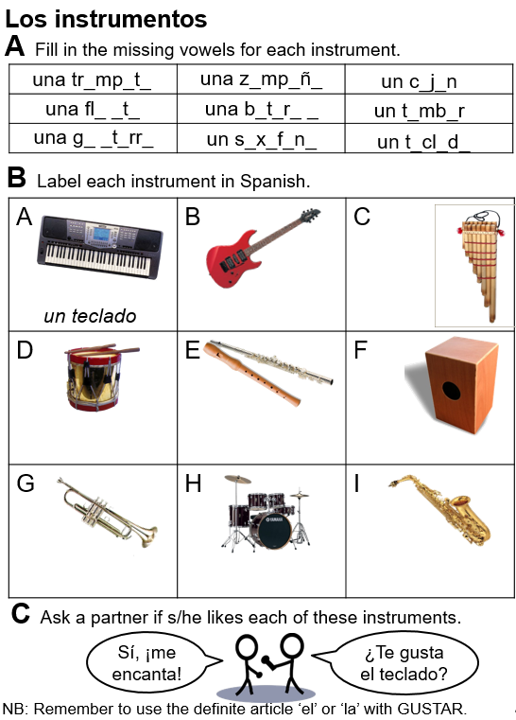
Notes:
This may be a good time to set this task from the workbook.

