Slide 1
¿Te gusta la música?

Slide 2
Número | Ejemplo | Clase de música | Tu opinión
1
2
3
4
5
6
7
8
Reggae
Hip Hop
Clásica
Folclórica
Rock
Jazz
Pop
Tradicional
Hip Hop | Reggae | Clásica | Folclórica
Jazz | Rock | Tradicional | Pop
Notes:
There are 30 secs of each type of music to play to the students.
As they listen they should identify the type of music they think it is, and also write in their own opinion (me gusta, me encanta, no me gusta, odio)
The types of music are animated to appear one by one. Teachers may want to feed back after each excerpt, asking: Qué tipo de música es? Es … Te gusta la música reggae? If you use the noun ‘la música’ in front of each type it keeps the gender / definite article the same (la) which is one way to do it.
On the other hand, the types that are essentially an English word (reggae, hip hop, rock, jazz, pop) can all just be ‘el + word’
el jazz, el rock etc… This is what I’ve done when you click on the words after they have appeared in the answer column.

Slide 3
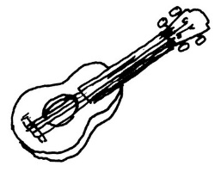
¿Qué tipo de música es?
A
B
C
D
E
F
G
H
¿Te gusta?
Notes:
Click on each picture to hear the audio for each type of music. Slide to practise the new words.

Slide 4
¡Me gusta!
¡No me gusta!
¡Estás loco/a!
¿Qué piensas?
¡Estás loco/a!
¡A mí también!
¡A mí tampoco!
Me, too!
Me, neither!
¡Es fenomenal!
¡Es fatal!
Notes:
A talk routine for giving and asking for opinions. Pupils will need to practise these first, just like any another language, especially the me too, me neither.
When they are confident with having the same opinion as the person who starts (I like → me, too. I don’t like → me, neither.) introduce them to the either of giving an alternative opinion, using ‘estás loco/loca (are you mad?) followed by the alternative ‘me gusta’ or ‘no me gusta’.
Click on each phrase to hear it. NB: None of the sound icons shows when in presentation mode. They should practise in pairs, talking about the different types of music. OR, use the following slide with different musical acts they may know! (Labelled for teachers, more than anything else!)

Slide 5
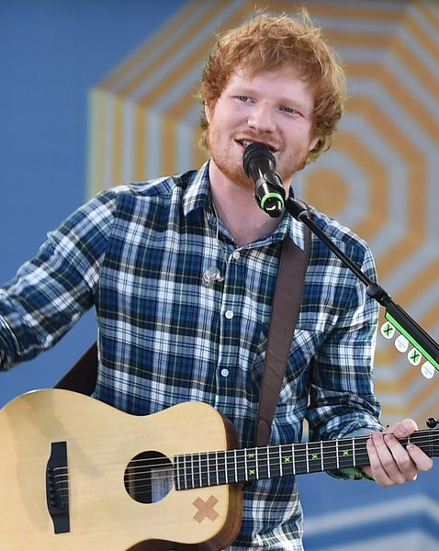
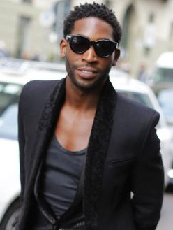
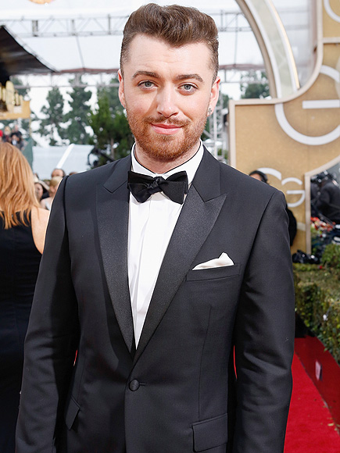
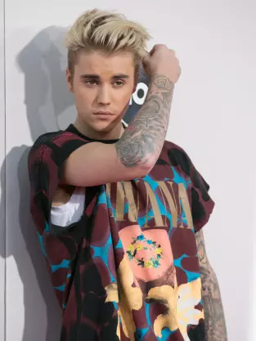
Taylor Swift
Ed Sheeran
One Direction
Tinie Tempah
Sam Smith
Little Mix
Katie Perry
Justin Bieber

Slide 6
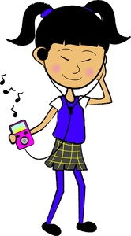
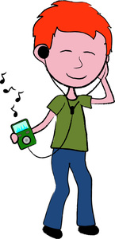
Escribe tus opiniones.
¿Qué grupos y cantantes te gustan?
Me encanta __________ y también me gusta ________ pero no me gusta _________ y odio ______________.
Notes:
Pupils conclude the lesson by writing a summary of their likes and dislikes – if they don’t like pop music at all, they can write instead about the types of music they like and dislike. They could then practise giving their opinions orally, doing look, cover, say and check until they can speak confidently, and from memory. Click on the text to hear it.

Slide 7
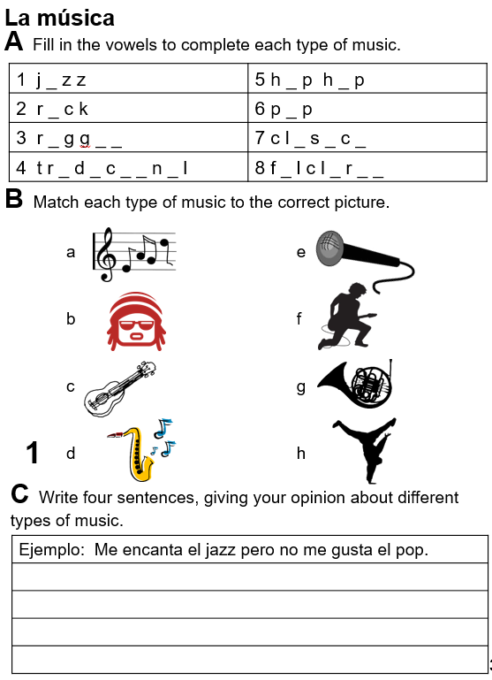
Notes:
Pupils can also complete p.39 from their booklets – for homework or during the week at some point.

