Slide 1
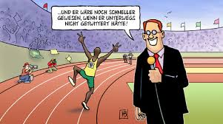
Hoy vamos a repetir y aprender las formas diferentes del verbo ‘practicar’.
Usain Bolt practica atletismo.
Notes:
Today we are going to repeat and learn the different forms of the verb ‘practicar’.
Commentatorl: Usain Bolt does athletics.
(Notice the ending is now –a rather than –o, as we have previously seen, because we are referring to someone else rather than talking about ourself.’)

Slide 2
Notes:
You may choose to mute the audio and lead the repetition of this verb yourself. For the less experienced, I have recorded myself pronouncing the different conjugations of the verb as the emphasis changes. This is to ready the pupils to be able to pronounce the different parts of the verb themselves in the next slides and then towards the end when they can put their repetition to music to get them into a rhythm. Practising in this way will hopefully mean that pupils will not lose the correct emphasis when they are practising all parts of this verb.
The recording runs through the verb 3 times.

Slide 3
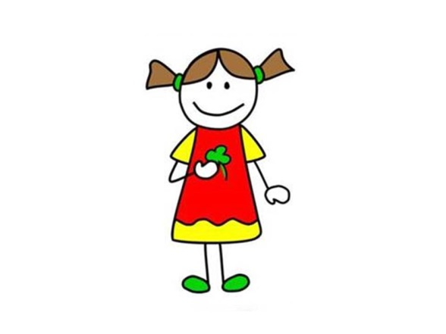
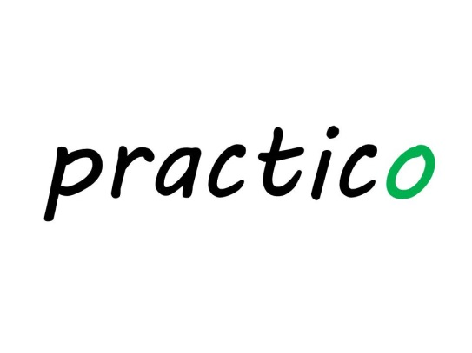
Notes:
Encourage pupils to point to the person being referred to in order to make this a physical memory activity.
I have included the English here to make it perfectly clear what the pictures stand for, in case there is any ambiguity.
I am purposely not introducing the Spanish subject pronouns at the point as they are usually not used and will only be needed to clarify if there is any doubt.
Encourage pupils here to repeat aloud ‘practico’ and point at themselves with one finger. (One finger should be used for singular forms and two for plural.)

Slide 4
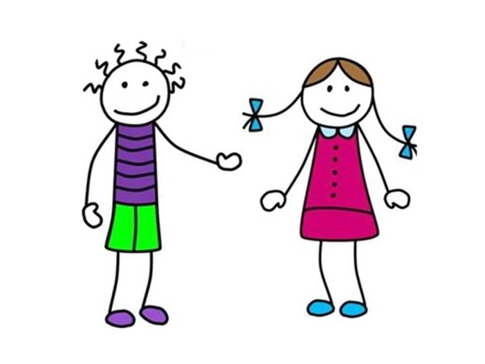
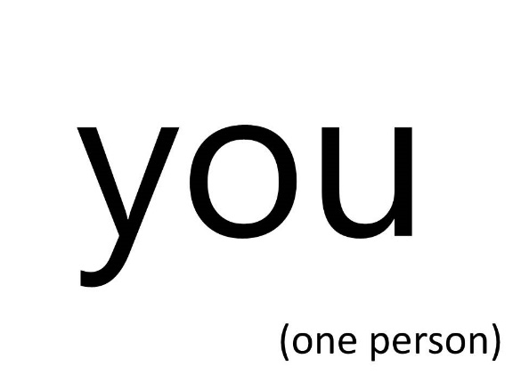
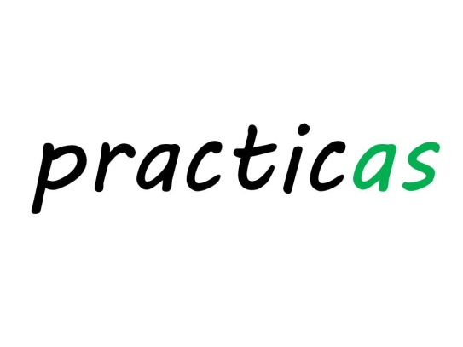
Notes:
Encourage pupils here to repeat aloud ‘practicas’ and point directly at one other person (looking at them) with one finger.

Slide 5
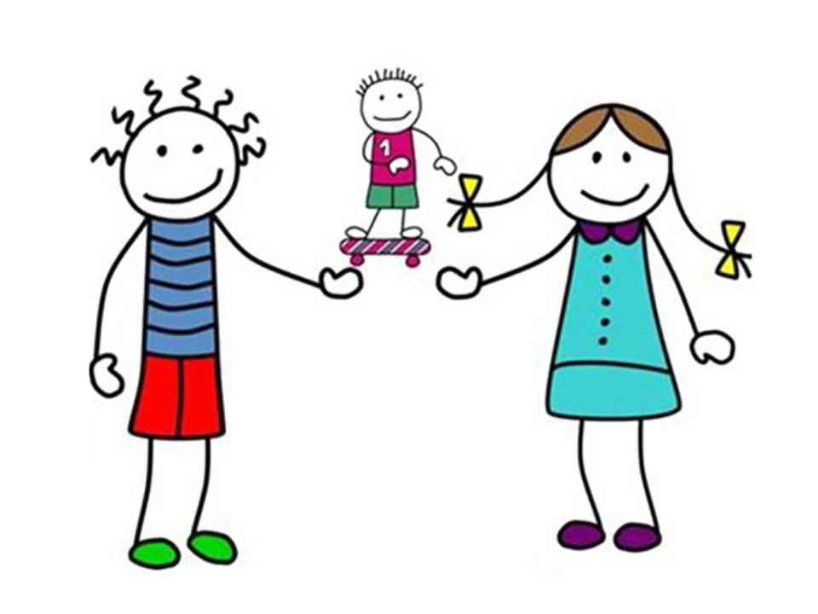
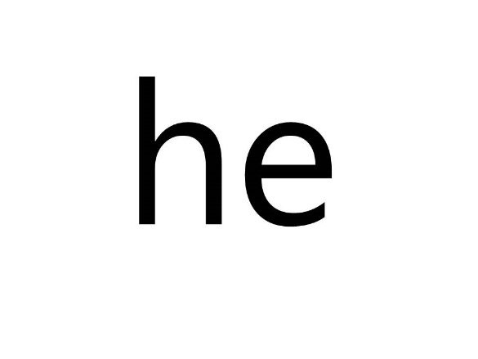
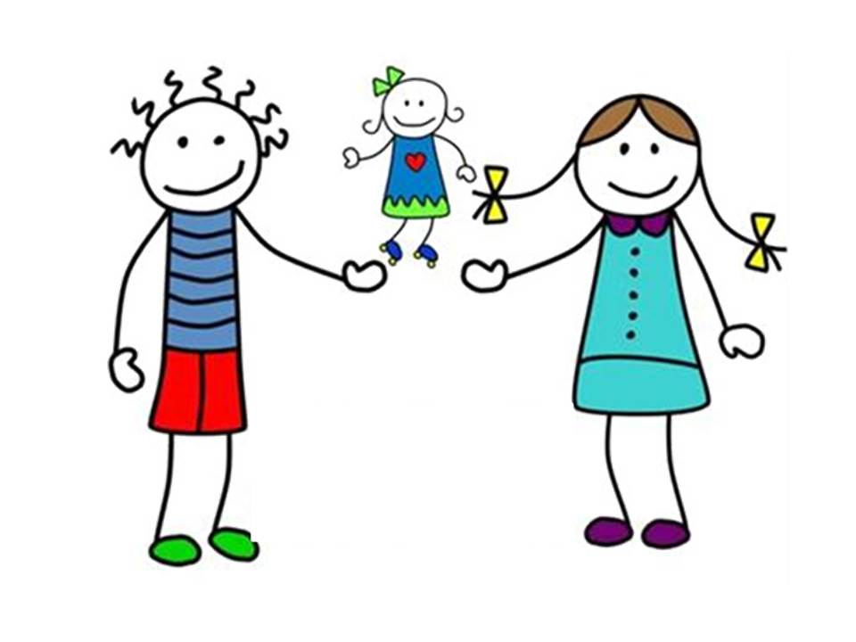
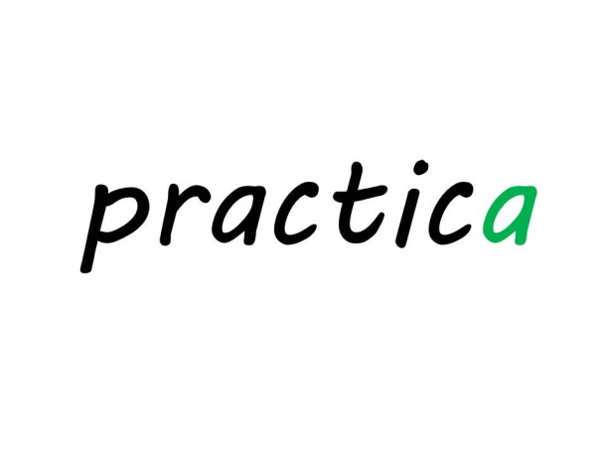
Notes:
Encourage pupils here to repeat aloud ‘practica’ and point away first at a boy (with one finger) and then ‘practica’ again but point away at a girl (with one finger).

Slide 6
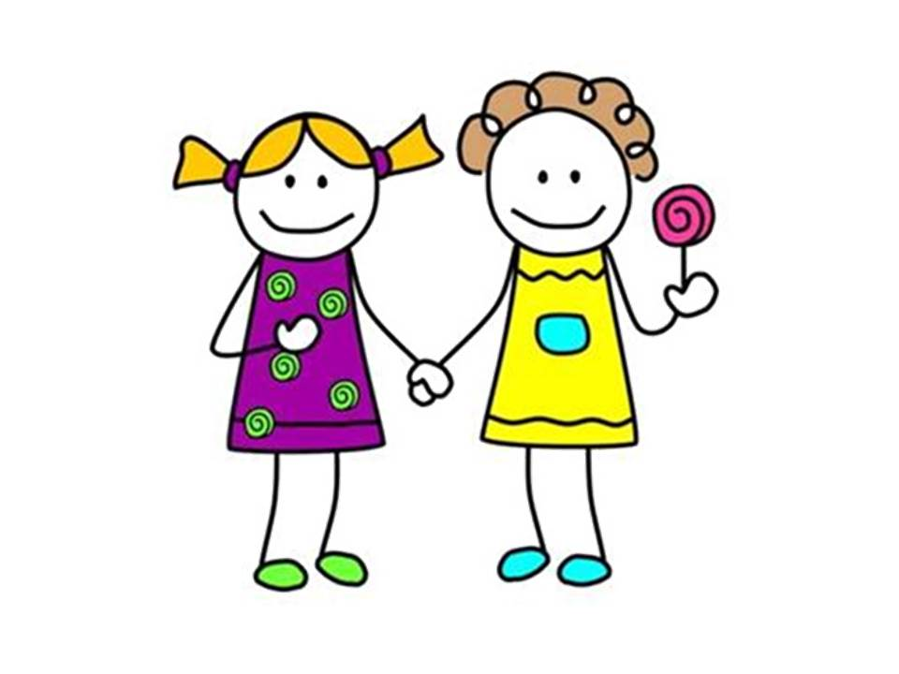
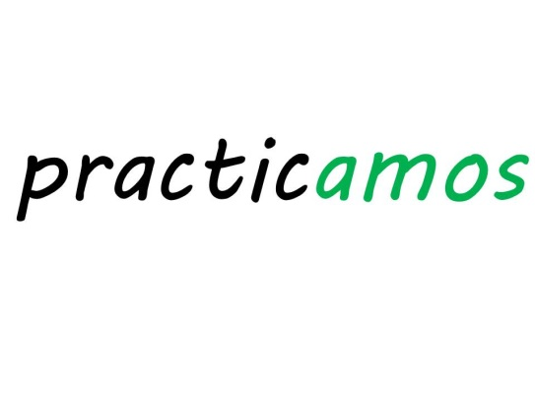
Notes:
Encourage pupils here to repeat aloud ‘practicamos’ and point two fingers (one finger on each hand) at themselves.

Slide 7
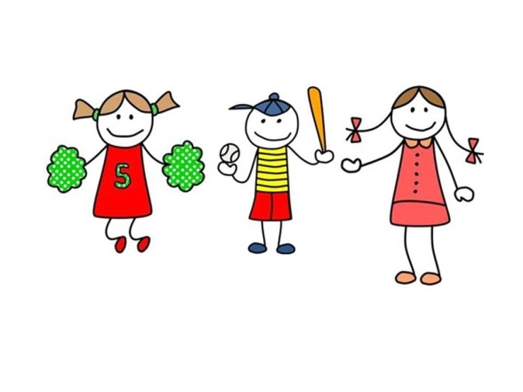
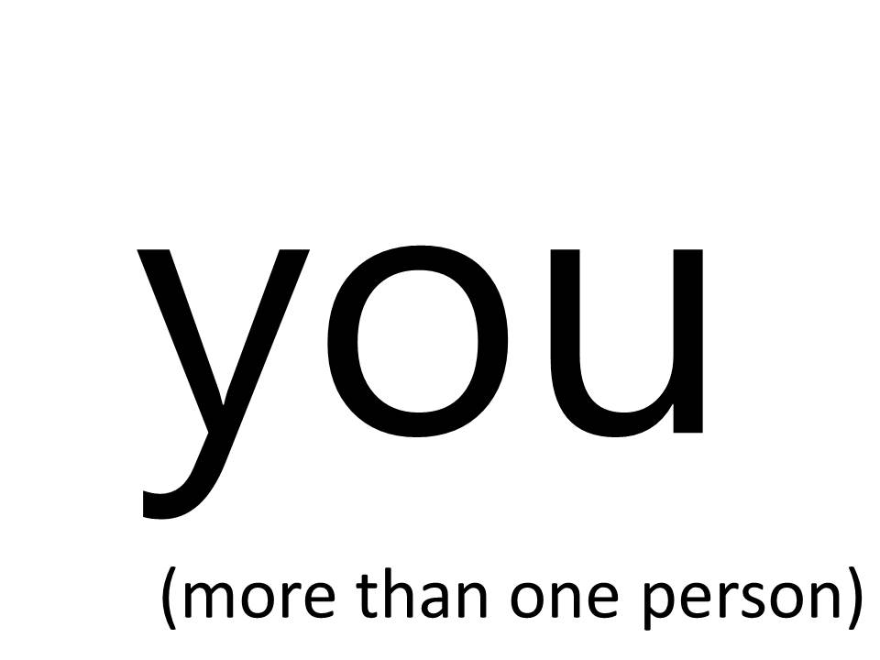
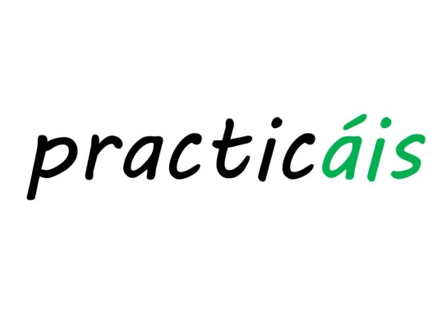
Notes:
Encourage pupils here to repeat aloud ‘practicáis’ and point two fingers (one finger on each hand) directly at other people.

Slide 8
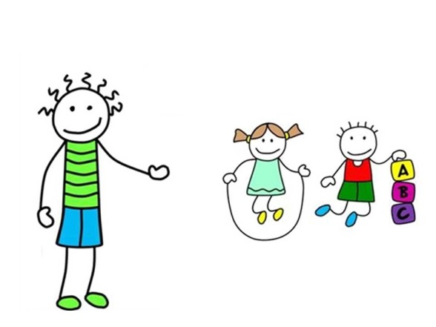
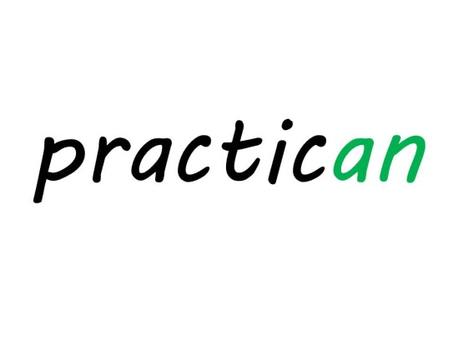
Notes:
Encourage pupils here to repeat aloud ‘practican’ and point two fingers (one finger on each hand) away at other people.

Slide 9
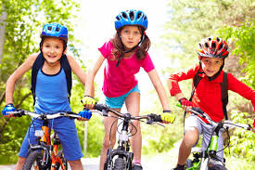
I
do
e.g.
Practico ciclismo.
Notes:
Here I have tried to make it obvious what information each part of the verb is conveying and why therefore it will be so important to get the ending of the verb right.

Slide 10
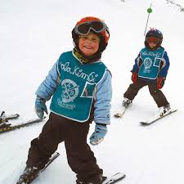
you
do
e.g.
¿Practicas esquí?
Notes:
Here I have tried to make it obvious what information each part of the verb is conveying and why therefore it will be so important to get the ending of the verb right.

Slide 11
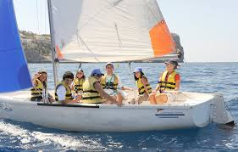
he/she
does
e.g.
Practica vela.
Notes:
Here I have tried to make it obvious what information each part of the verb is conveying and why therefore it will be so important to get the ending of the verb right.

Slide 12
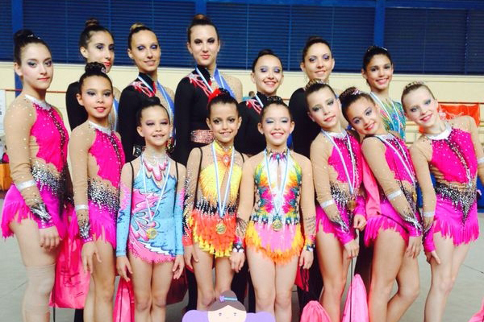
we
do
e.g.
Practicamos gimnasia.
Notes:
Here I have tried to make it obvious what information each part of the verb is conveying and why therefore it will be so important to get the ending of the verb right.

Slide 13
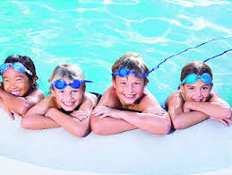
you (more than one)
do
e.g.
Practicáis natación.
Notes:
Here I have tried to make it obvious what information each part of the verb is conveying and why therefore it will be so important to get the ending of the verb right.

Slide 14
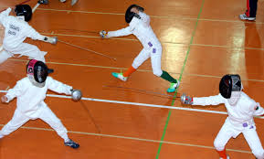
they
do
e.g.
Practican esgrima.
Notes:
Here I have tried to make it obvious what information each part of the verb is conveying and why therefore it will be so important to get the ending of the verb right.

Slide 15
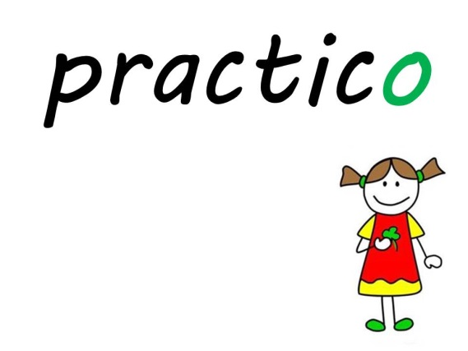
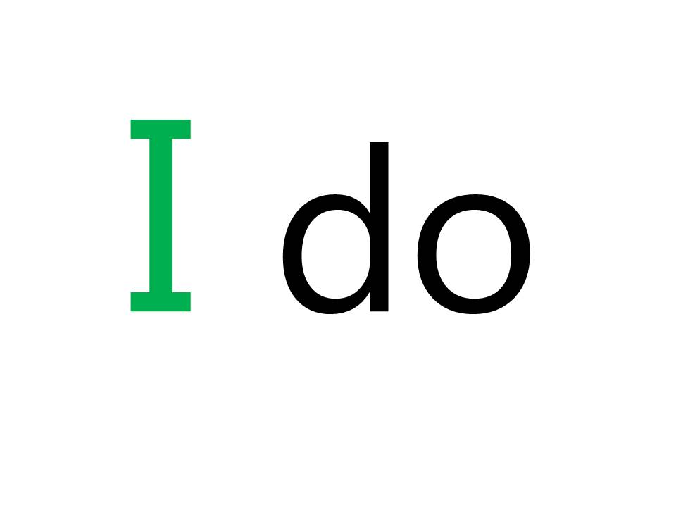
Notes:
Here pupils should be encouraged to see these two items rather like two matching cards in a card game of Snap!
Pupils are shown here what snaps together so that they can later play a game of snap and match up the correct Spanish and English cards.

Slide 16
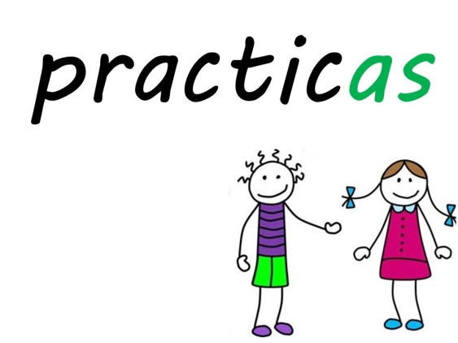
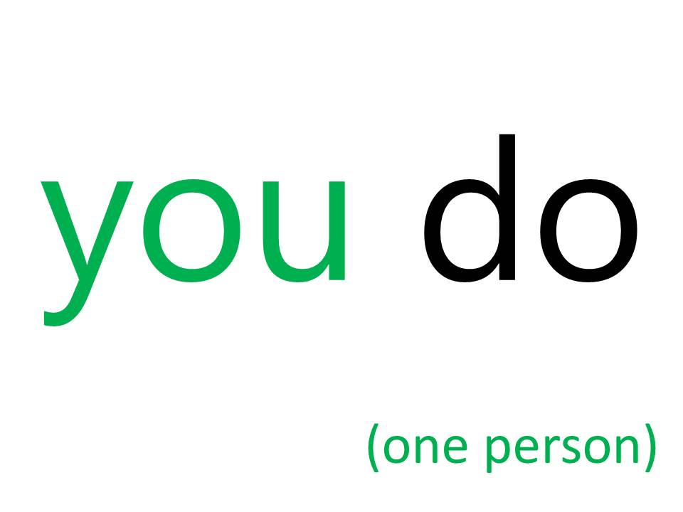

Slide 17
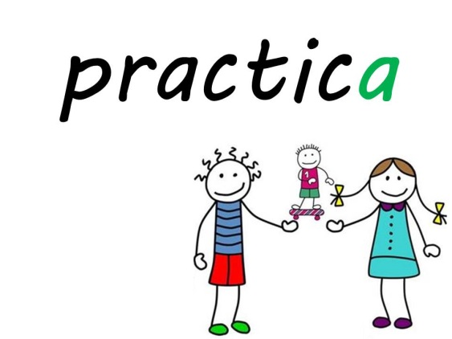
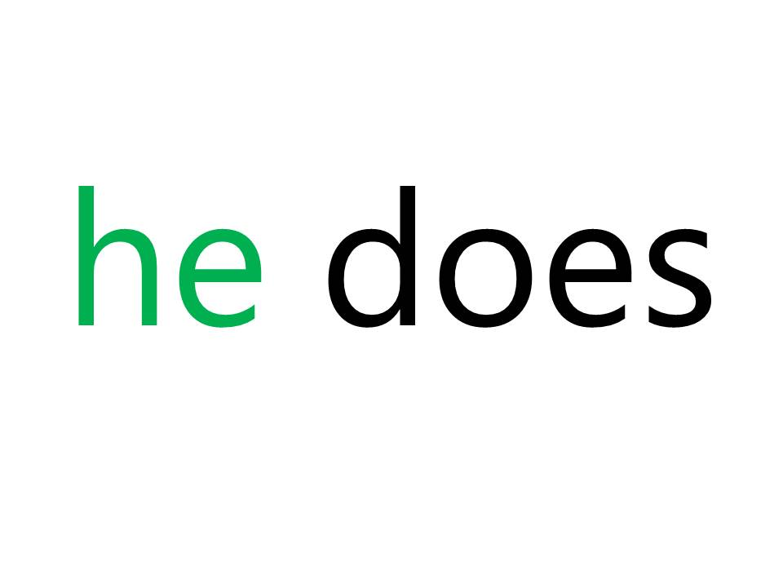
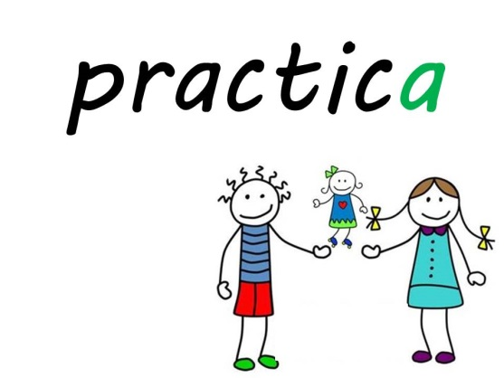
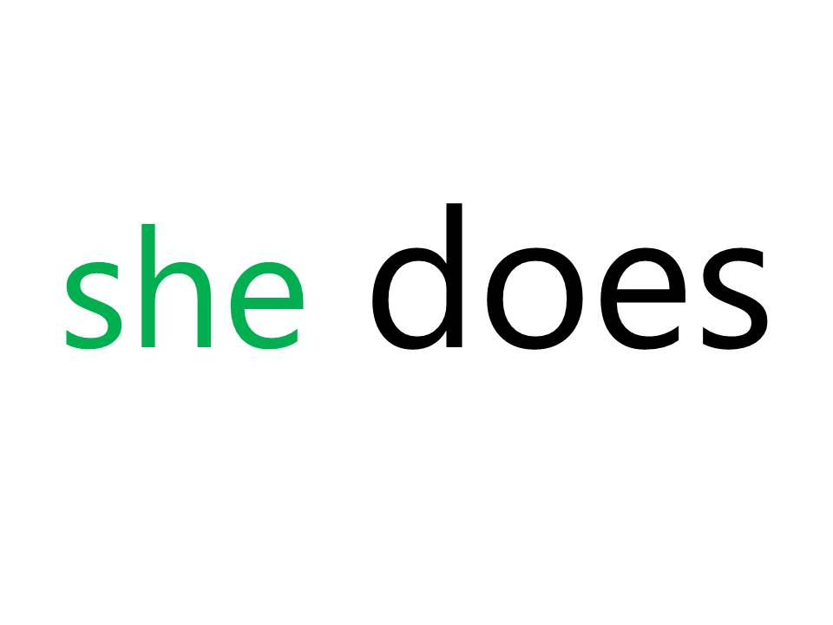

Slide 18
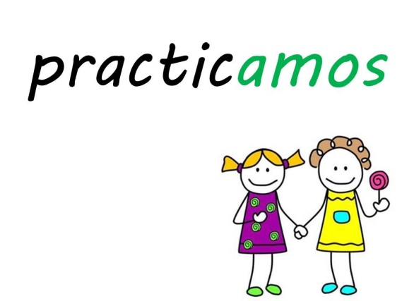
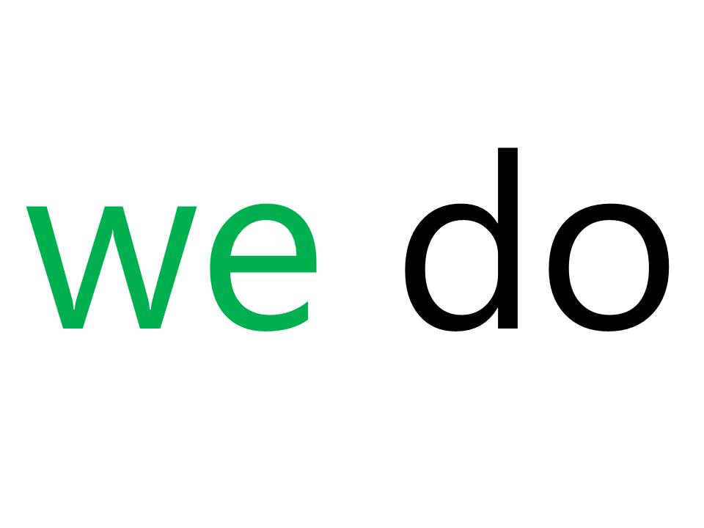

Slide 19
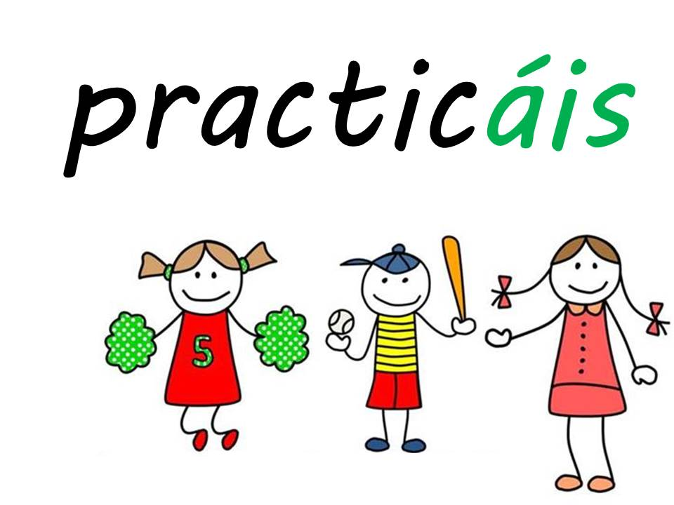
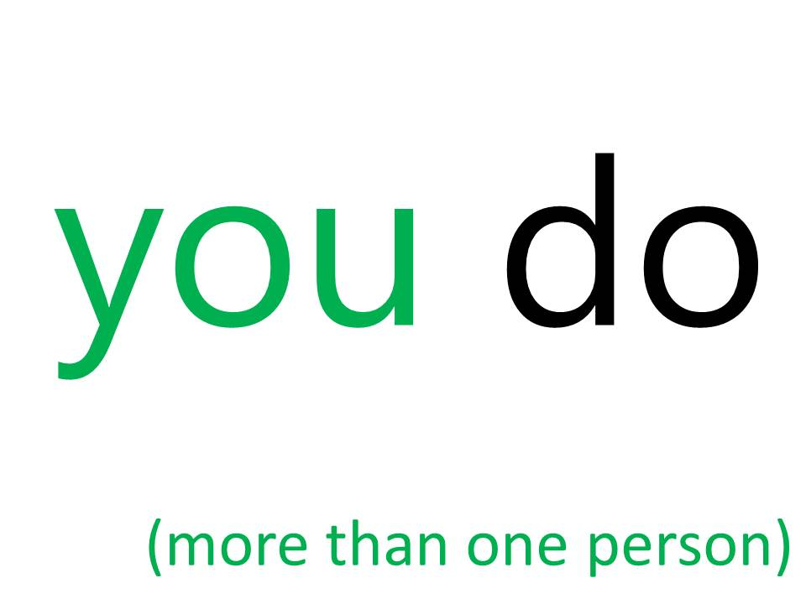

Slide 20
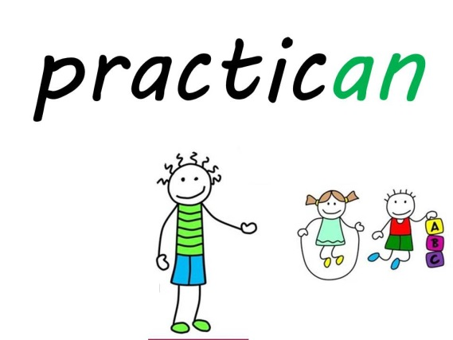
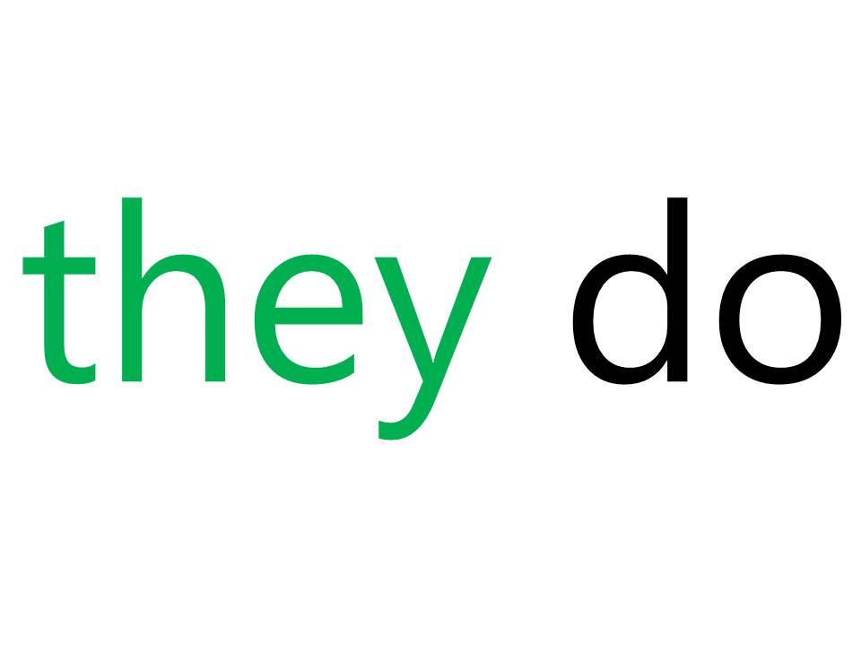

Slide 21
SNAP?
Notes:
Play this as a game against the class. Perhaps give them a count of 3 to then call out whether it is snap or not. A point to the class every time they get it right, and a point to you every time someone calls out ‘Snap!’ incorrectly.

Slide 22
SNAP?
Notes:
Play this as a game against the class. Perhaps give them a count of 3 to then call out whether it is snap or not. A point to the class every time they get it right, and a point to you every time someone calls out ‘Snap!’ incorrectly.

Slide 23
SNAP?
Notes:
Play this as a game against the class. Perhaps give them a count of 3 to then call out whether it is snap or not. A point to the class every time they get it right, and a point to you every time someone calls out ‘Snap!’ incorrectly.

Slide 24
SNAP?
Notes:
Play this as a game against the class. Perhaps give them a count of 3 to then call out whether it is snap or not. A point to the class every time they get it right, and a point to you every time someone calls out ‘Snap!’ incorrectly.

Slide 25
SNAP?
Notes:
Play this as a game against the class. Perhaps give them a count of 3 to then call out whether it is snap or not. A point to the class every time they get it right, and a point to you every time someone calls out ‘Snap!’ incorrectly.

Slide 26
SNAP?
Notes:
Play this as a game against the class. Perhaps give them a count of 3 to then call out whether it is snap or not. A point to the class every time they get it right, and a point to you every time someone calls out ‘Snap!’ incorrectly.

Slide 27
SNAP?
Notes:
Play this as a game against the class. Perhaps give them a count of 3 to then call out whether it is snap or not. A point to the class every time they get it right, and a point to you every time someone calls out ‘Snap!’ incorrectly.

Slide 28
SNAP?
Notes:
Play this as a game against the class. Perhaps give them a count of 3 to then call out whether it is snap or not. A point to the class every time they get it right, and a point to you every time someone calls out ‘Snap!’ incorrectly.

Slide 29
SNAP?
Notes:
Play this as a game against the class. Perhaps give them a count of 3 to then call out whether it is snap or not. A point to the class every time they get it right, and a point to you every time someone calls out ‘Snap!’ incorrectly.

Slide 30
SNAP?
Notes:
Play this as a game against the class. Perhaps give them a count of 3 to then call out whether it is snap or not. A point to the class every time they get it right, and a point to you every time someone calls out ‘Snap!’ incorrectly.

Slide 31
SNAP?
Notes:
Play this as a game against the class. Perhaps give them a count of 3 to then call out whether it is snap or not. A point to the class every time they get it right, and a point to you every time someone calls out ‘Snap!’ incorrectly.

Slide 32
SNAP?
Notes:
Support pictures are taken away.

Slide 33
SNAP?
Notes:
Play this as a game against the class. Perhaps give them a count of 3 to then call out whether it is snap or not. A point to the class every time they get it right, and a point to you every time someone calls out ‘Snap!’ incorrectly.

Slide 34
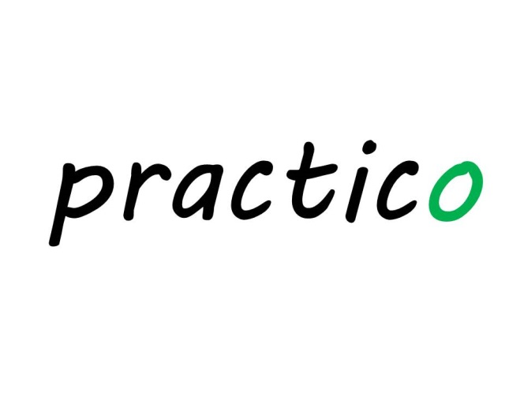
SNAP?
Notes:
Play this as a game against the class. Perhaps give them a count of 3 to then call out whether it is snap or not. A point to the class every time they get it right, and a point to you every time someone calls out ‘Snap!’ incorrectly.

Slide 35
SNAP?
Notes:
Play this as a game against the class. Perhaps give them a count of 3 to then call out whether it is snap or not. A point to the class every time they get it right, and a point to you every time someone calls out ‘Snap!’ incorrectly.

Slide 36
SNAP?

Slide 37
Notes:
You may choose to mute the audio and lead the repetition of this verb yourself. For the less experienced, I have recorded myself pronouncing the different conjugations of the verb as the emphasis changes. This is to ready the pupils to be able to pronounce the different parts of the verb themselves in the next slides and then towards the end when they can put their repetition to music to get them into a rhythm. Practising in this way will hopefully mean that pupils will not lose the correct emphasis when they are practising all parts of this verb.
The recording runs through the verb 3 times.

Slide 38
Notes:
Opportunity to practise the verb pattern & pronunciation over and over with some rhythmic music! Enjoy!

Slide 39
practicar: to do (sports)
(singular)
(plural)
practico
practicamos
I do
we do
practicas
practicáis
you do (1)
you do (2+)
practica
practican
he/she does
they do
Notes:
Here is the full verb pattern.
Now pupils can play snap with cards of their own (see accompanying resource).

