Slide 1
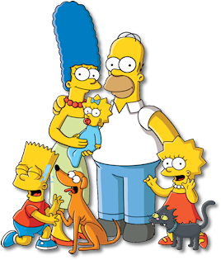
La familia Simpson
Notes:
Pupils have 7 x families to choose from.
They have time to prepare a short presentation giving the names of each family member and any details about hair and eyes that they can.
They spend one lesson thinking, writing and practising and the following lesson presenting their family to the class. (or to others on their table, as appropriate).

Slide 2
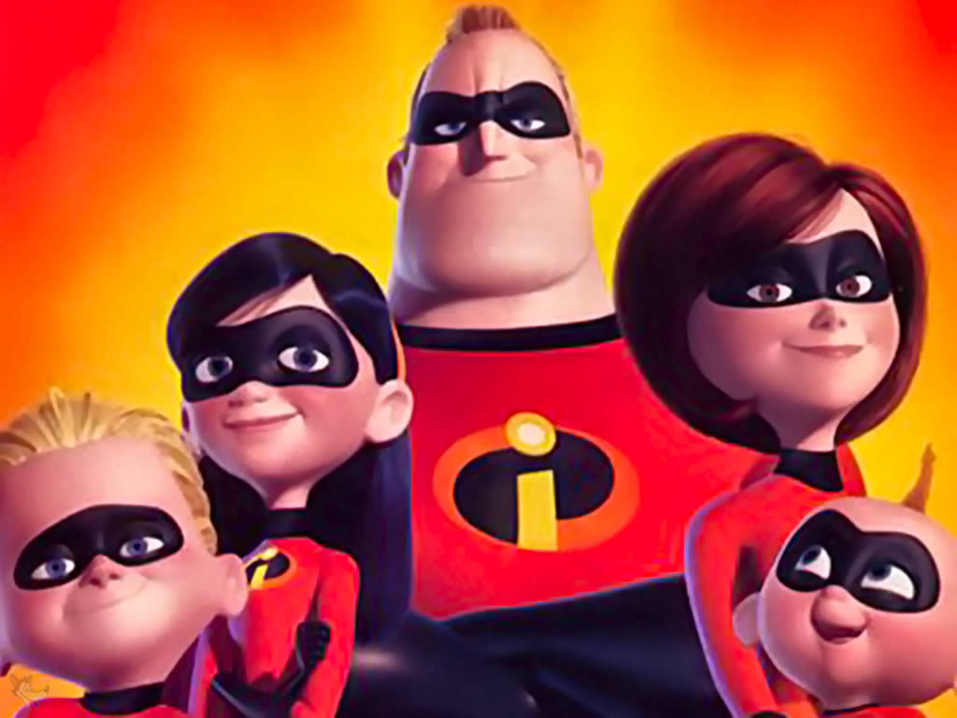
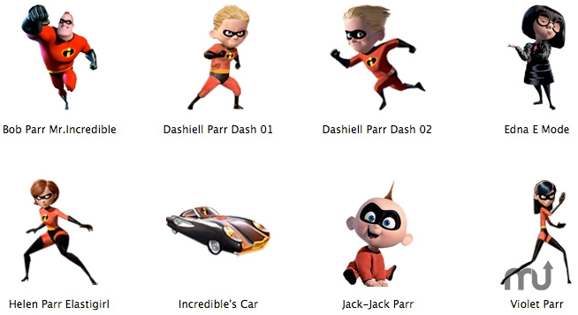
Los increíbles

Slide 3
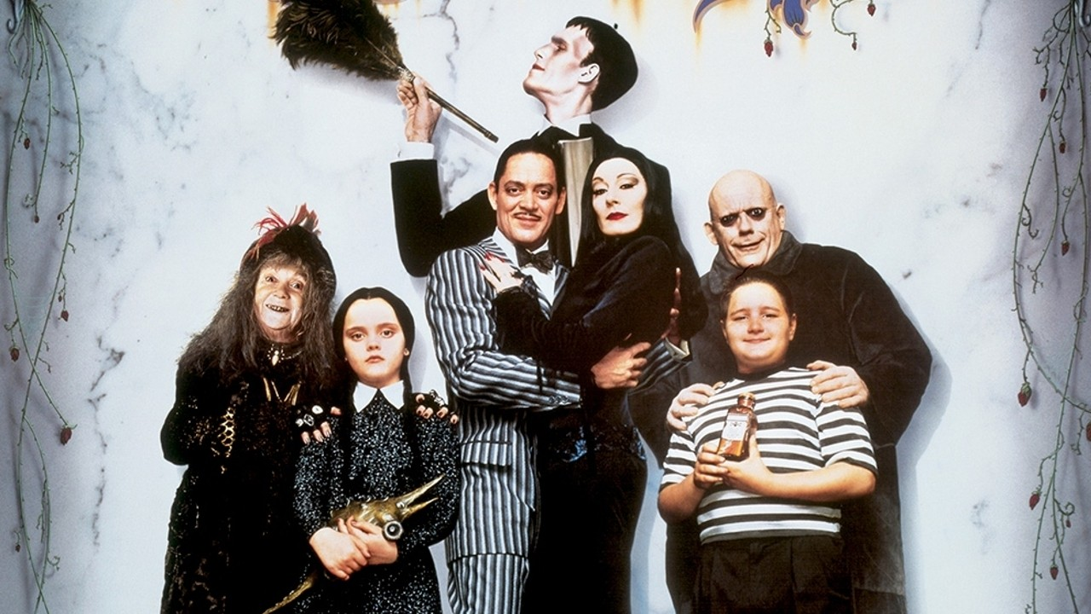
Lurch
Fester
Morticia
Wednesday
Grandmama
Gomez
Pugsley
La familia Addams

Slide 4
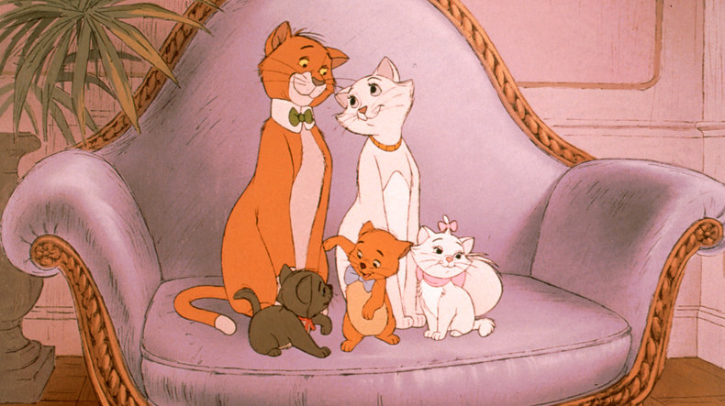
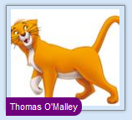
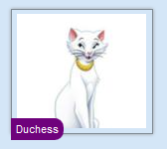
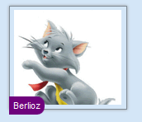
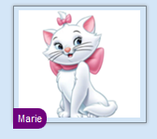
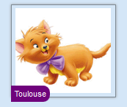
Los aristogatos

Slide 5
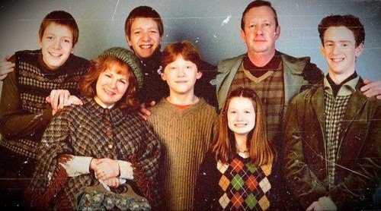
Fred
George
Arthur
Percy
Molly
Ron
Ginny
La familia Weasley

Slide 6
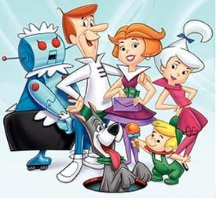
George
Jane
Rosie
Judy
Elroy
Astro
La familia Jetson
Notes:
"Jetsons" by http://www.hogwild.net/images/Misc/jetsons.jpg. Licensed under Fair use of copyrighted material in the context of List of Characters in The Jetsons via Wikipedia - http://en.wikipedia.org/wiki/File:Jetsons.jpg#mediaviewer/File:Jetsons.jpg

Slide 7
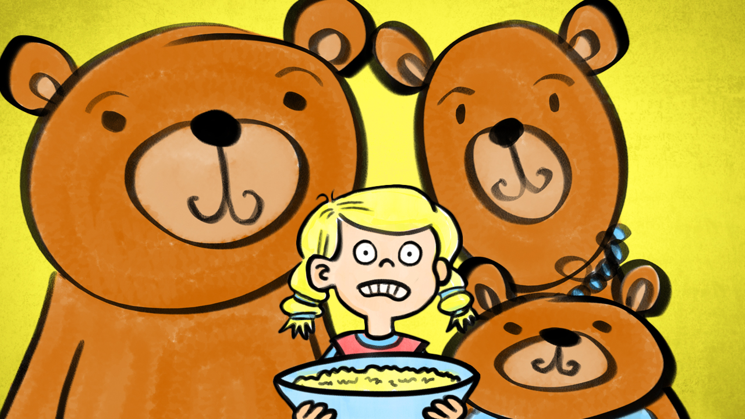
Goldilocks y los tres osos

