Slide 1
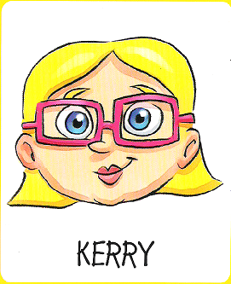
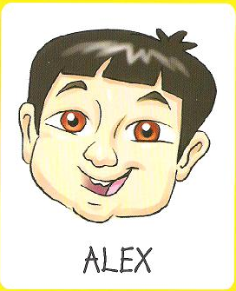
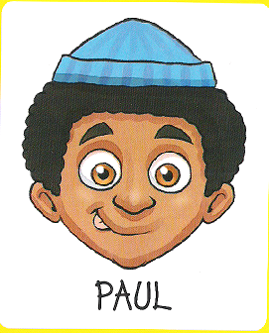
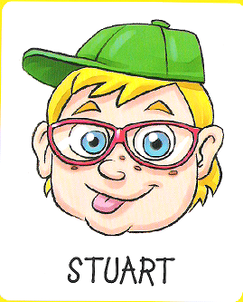
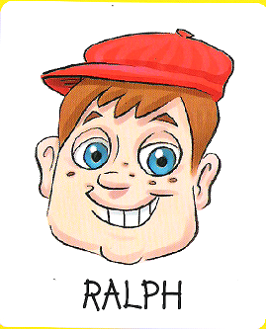
¿Quién es?

Slide 2
vocabulario
¿Es…?
una chica
un chico
¿Tiene…?
los ojos azules/ marrones/ verdes/ grises
el pelo castaño/ rubio/ negro/ rojo
el pelo largo/corto
el pelo liso/ rizado/ ondulado
pecas
coleta (pony tail)
Lleva…?
gafas (glasses)
un sombrero (hat)
una gorra (cap)

Slide 3
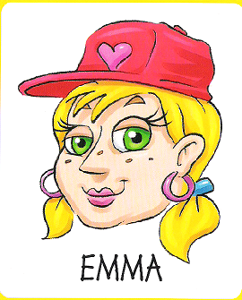
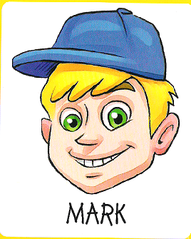
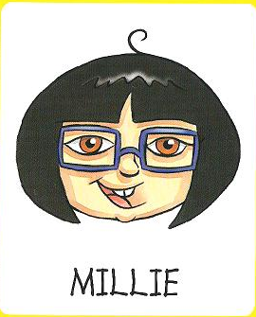
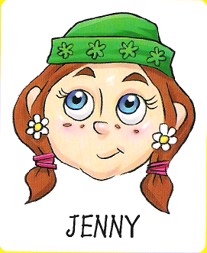
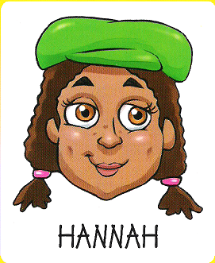
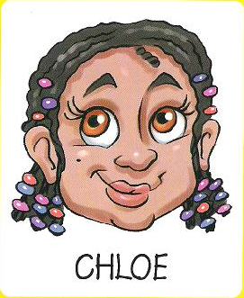
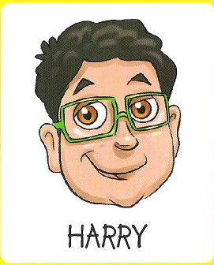
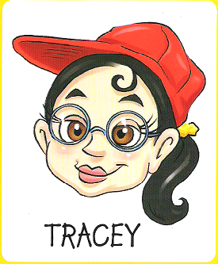
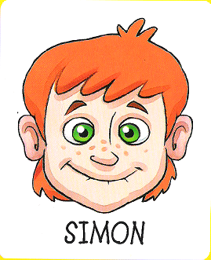
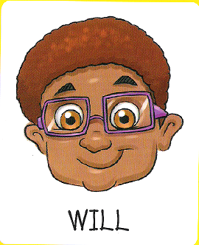
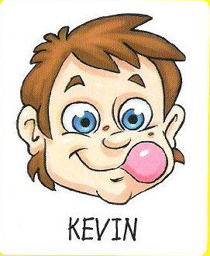
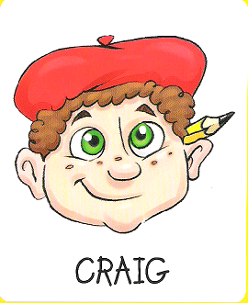
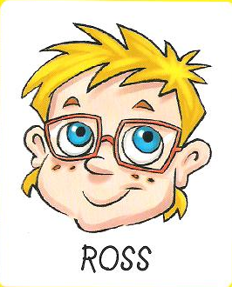
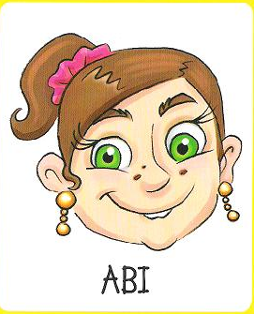
Notes:
This is the game board. To play this whole class, the teacher needs to take the PowerPoint out of presentation mode and remove the characters during the game in response to the pupils’ questions.
When pupils are confident with the whole class version, they could play in pairs (car boot sales often have copies of this game and it is worth trying to get as many as possible!)

