Slide 1
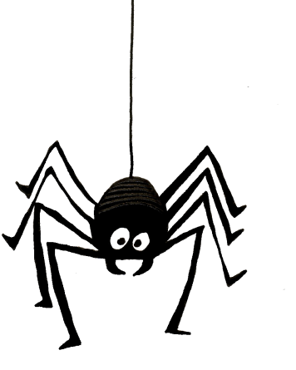

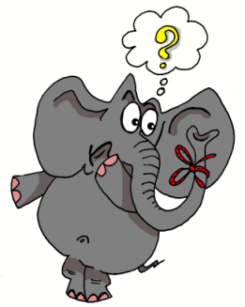
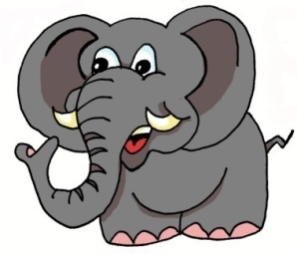
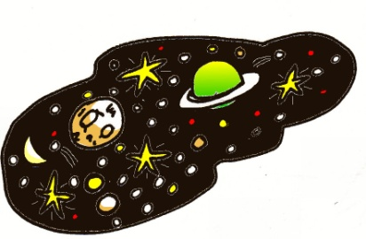
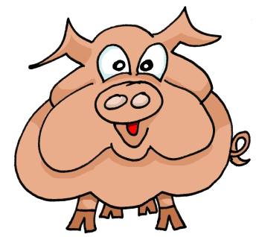
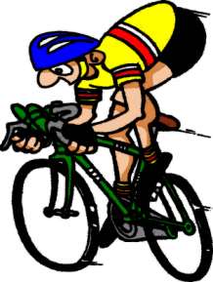
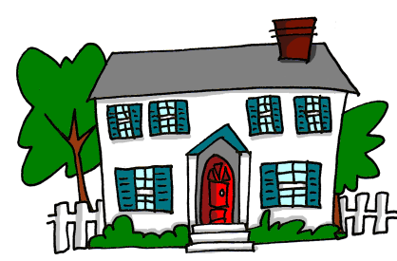
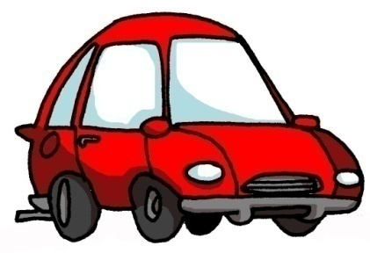
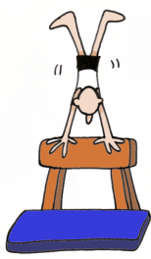
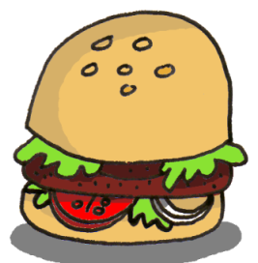
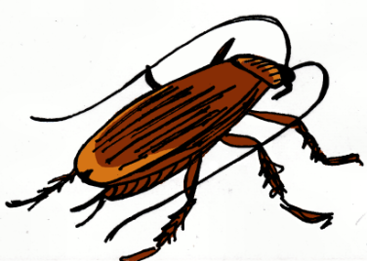
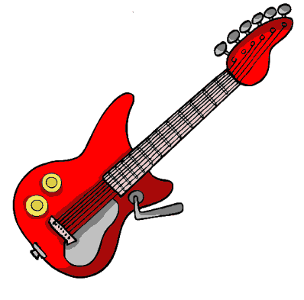
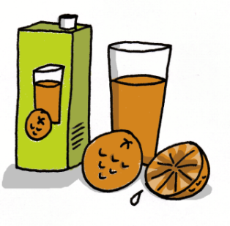
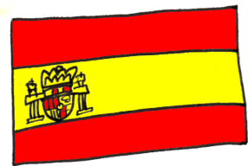
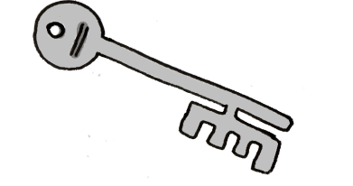
1 | 2 | 3 | 4
5 | 6 | 7 | 8
9 | 10 | 11 | 12
13 | 14 | 15 | 16
Notes:
1
Key phonics slide to start the lesson.

Slide 2

trabalenguas
Notes:
Trabalenguas = Tongue twisters.
The objective here is to try to get pupils to read accurately but to enjoy it and to learn that it’s ok, even funny, to make mistakes. The video of the little girl is supposed to show that even Spaniards find it difficult when it comes to tongue twisters.

Slide 3

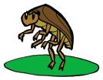
Cuchara, cucaracha
cucharita, cucarachita.

Slide 4
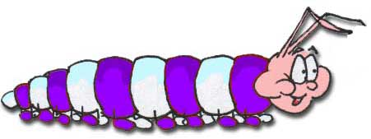

Una cacatrepa que trepa tiene tres cacatrepitos.
(A caterpillar that climbs has three baby caterpillars)

Slide 5
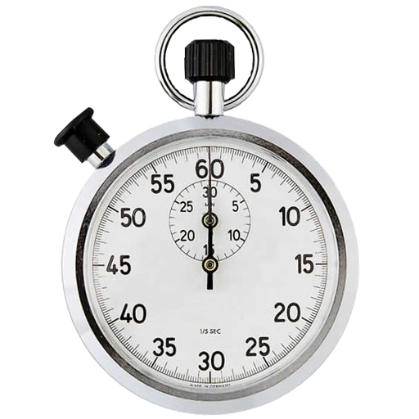
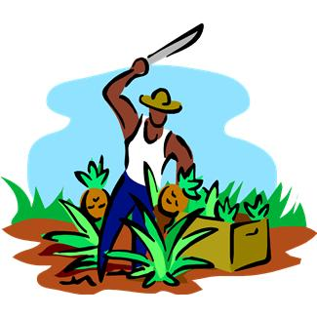
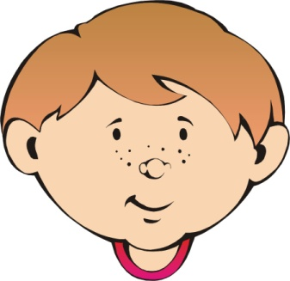
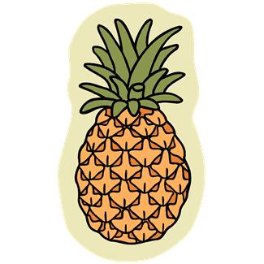

Pepe Peña pela papa, pica piña,
pita un pito,
pica piña, pela papa, Pepe Peña.
(Pepe Peña peels potatoes, cuts pineapple,
blows a whistle,
cuts pineapple, peels potatoes, Pepe Peña.)
Notes:
Here’s the challenge for your pupils. Who can say the tongue twister best/most accurately…?

Slide 6
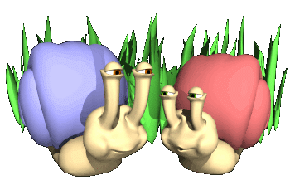
¿Tienes ‘niño’?
Sí, tengo ‘niño’.
¿Tienes ‘piña’?
No, no tengo ‘piña’.
Notes:
This slide models the question ‘Do you have…?’ and answers ‘Yes, I have’ and ‘No, I don’t have’ so that pupils can play a happy families game with the phonics cards. Teachers can decide how many sounds to work with at any one time. For example, if 4 x slide 7 (just the ñ sounds) were in play, then pupils would just be practising the one key ñ sound, trying to get all 4 x pineapples, or Spains or spiders etc….

Slide 7
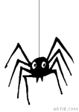
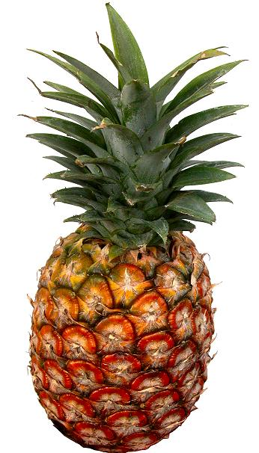
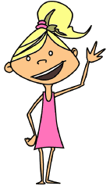

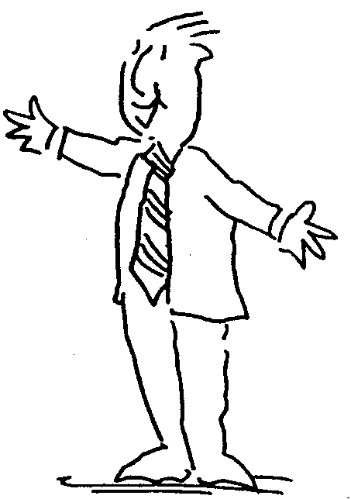
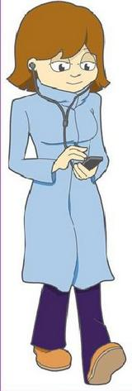
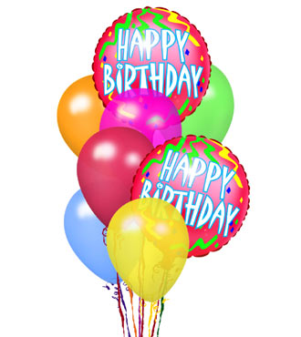

niño
niña
araña
piña
señor
señora
España
cumpleaños
Notes:
You can project these slides on the board and run through pronunciation & meaning first if you feel this will benefit the pupils & give them more confidence.
These slides are designed as cards which will (when photocopied double-sided and cut up) have the phonic on one side and a corresponding word & picture on the other.
Pupils should pronounce the phonic first and then incorporate it into their pronunciation of the word on the other side, recognising the meaning in English at the same time.
Pupils could play snap/happy families etc. by using the cards picture-side up, recognising when the phonic is the same and checking on the other side of the card.
The vocabulary translates as: Young boy, young girl, spider, pineapple
Man, woman, Spain, birthday

Slide 8
ñ | ñ | ñ | ñ
ñ | ñ | ñ | ñ

Slide 9
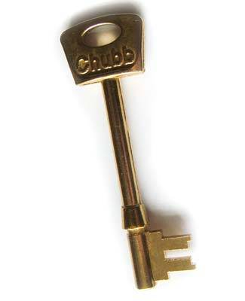
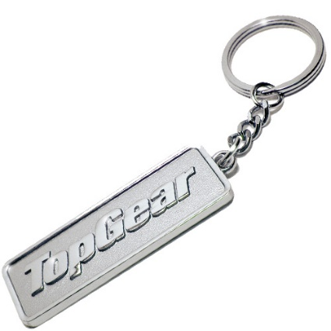

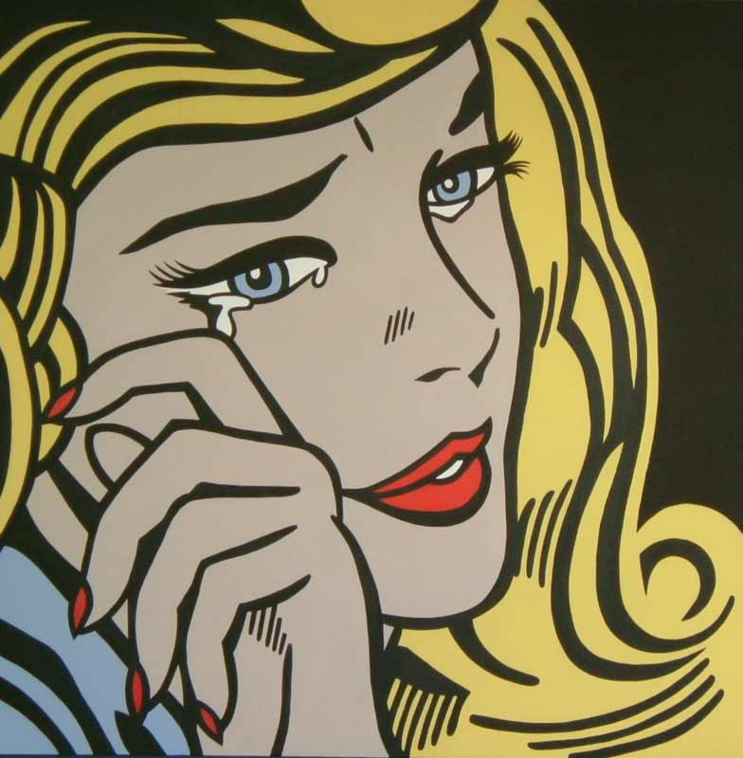
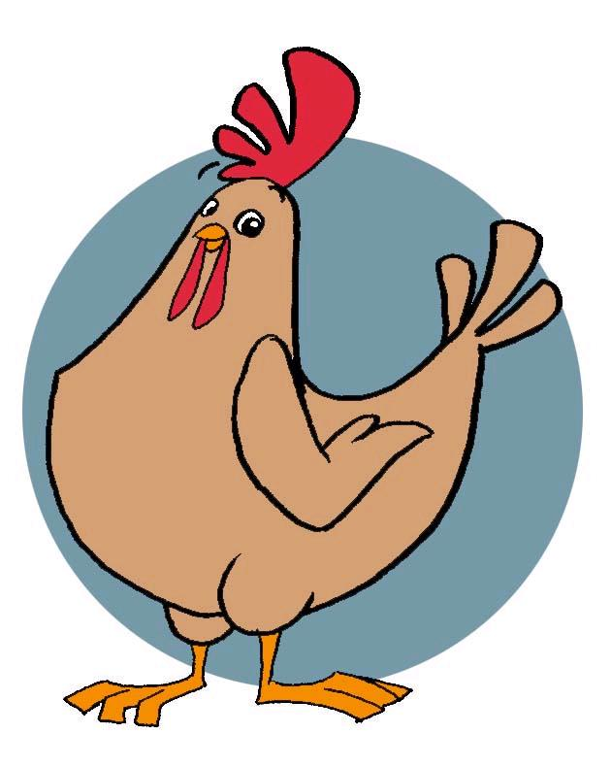

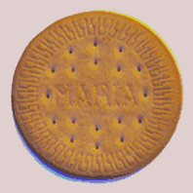
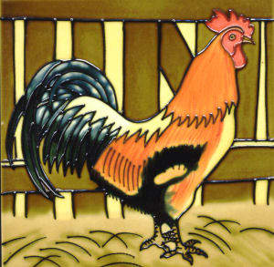
llave
llavero
lluvia
llorar
ballena
galleta
gallina
gallo
Notes:
The vocabulary translates as: key, key ring, rain, to cry
Whale, biscuit, chicken, cockerel

Slide 10
ll | ll | ll | ll
ll | ll | ll | ll

Slide 11


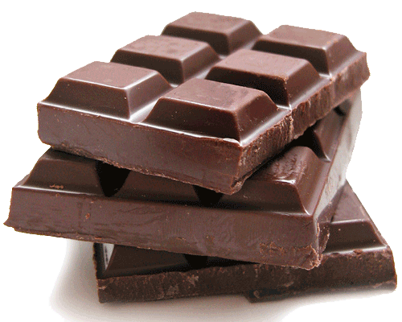

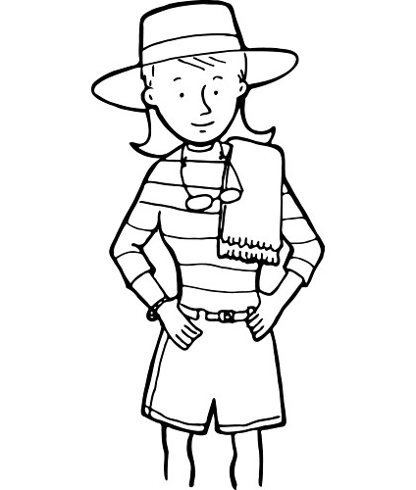
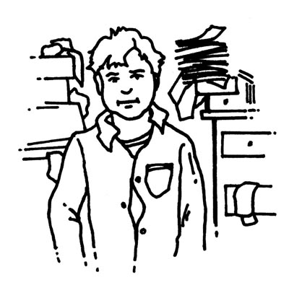


chiste
chicle
chocolate
estuche
chica
chanclas
chico
chica
cha cha cha
Notes:
The vocabulary translates as: joke, chewing gum, chocolate, pencil case
Flip flops, boy, girl, cha cha cha

Slide 12
ch | ch | ch | ch
ch | ch | ch | ch

Slide 13
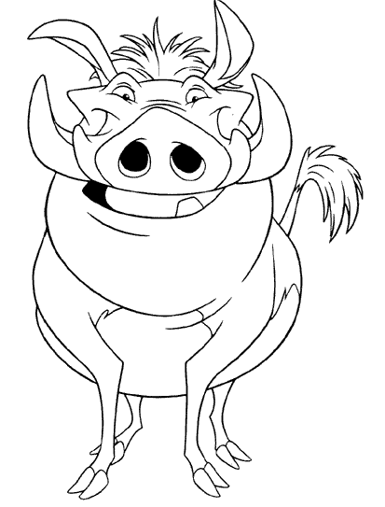


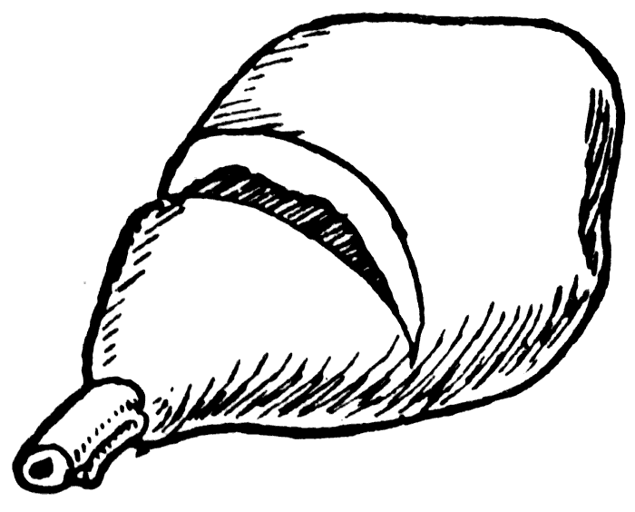
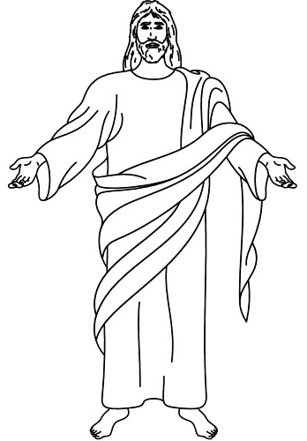
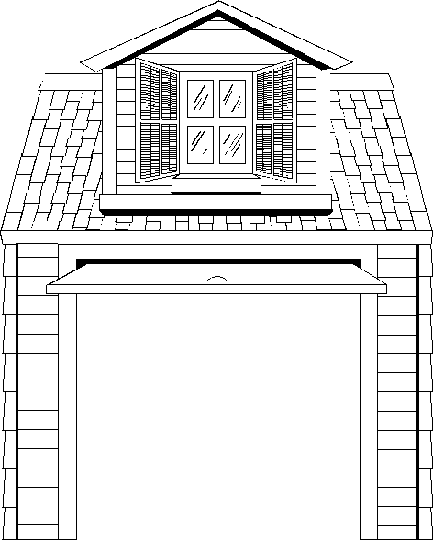
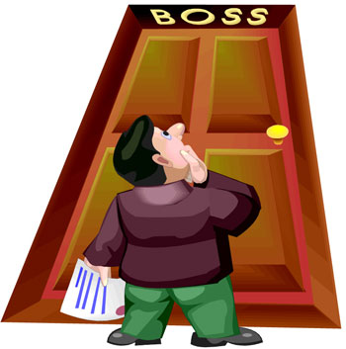
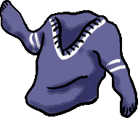
jabón
jardín
jabalí
jamón
jefe
jesús
jersey
garaje
Notes:
The vocabulary translates as: soap, garden, wild boar, ham
Boss, Jesus, sweater, garage

Slide 14
ja | ja | ja | ja
je | je | je | je

Slide 15
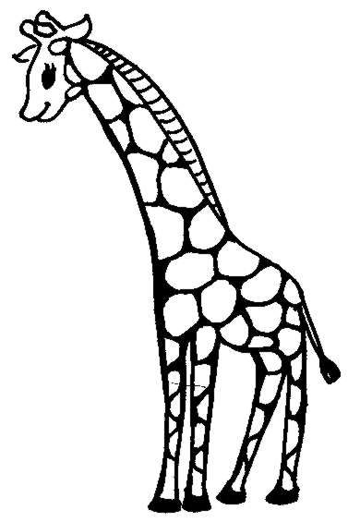

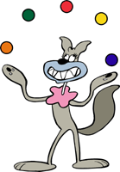

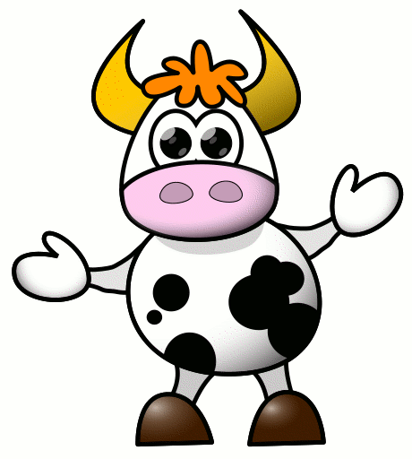

 |  |  | A E I O U
jirafa
jota
juguete
juglar
20
vaca
veinte
vino
vocales
Notes:
The vocabulary translates as: giraffe, J, toy, jongleur
Cow, 20, wine, vowels

Slide 16
ju | ju | jo | ji
v | v | v | v

Slide 17
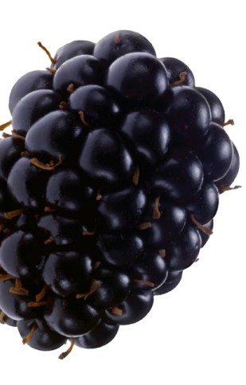
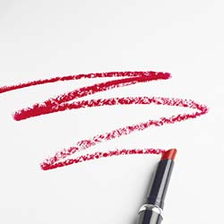
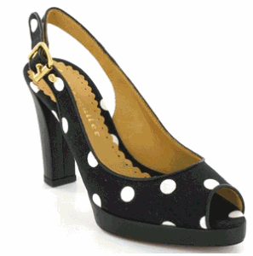
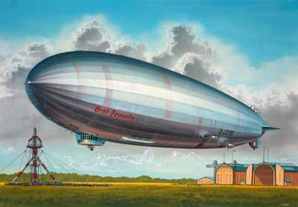




zapato
zarzamora
zepelín
zigzag
zorro
zoo
zuecos
zumo
Notes:
The vocabulary translates as: show, blackberry, zeppelin, zigzag
Fox, zoo, clogs, juice

Slide 18
zi | ze | za | za
zu | zu | zo | zo

Slide 19








hamburguesa
helado
helicóptero
héroe
hielo
hormiga
hoja
hospital
Notes:
The vocabulary translates as: hamburger, ice cream, helicopter, hero
Ice, ant, leaf, hospital

Slide 20
h | h | h | h
h | h | h | h

Slide 21








cabra
caracol
cangrejo
cabeza
cacahuete
café
calabaza
calculadora
Notes:
The vocabulary translates as: goat, snail, crab, head
Peanut, coffee, pumpkin, calculator

Slide 22
ca | ca | ca | ca
ca | ca | ca | ca

Slide 23








cebra
cerdo
cebolla
cerveza
centímetro
cerebro
cepillo
ceja
Notes:
The vocabulary translates as: zebra, pig, onion, beer
Centimetre, brain, brush, eyebrow

Slide 24
ce | ce | ce | ce
ce | ce | ce | ce

Slide 25








cinco
circo
cine
cisne
ciervo
ciencia
ciclista
ciempiés
Notes:
The vocabulary translates as: 5, circus, cinema, swan
Deer, science, cyclist, centipede

Slide 26
ci | ci | ci | ci
ci | ci | ci | ci

Slide 27








coche
colegio
cocodrilo
conejo
cobra
cohete
coliflor
cocina
Notes:
The vocabulary translates as: car, school, crocodile, rabbit
Cobra, rocket, cauliflower, kitchen

Slide 28
co | co | co | co
co | co | co | co

Slide 29






cuadrado
cucaracha
cuaderno
cuarenta
1/4
cuatro
cuarto
cuerpo
cuchara
Notes:
The vocabulary translates as: square, cockroach, exercise book, 40
4, quarter, body, spoon

Slide 30
cu | cu | cu | cu
cu | cu | cu | cu

Slide 31









gambas
gafas
gato
Gales
gente
gemelas
gigante
girasol
Notes:
The vocabulary translates as: prawns, glasses, gat, Wales
People, twins, giant, sunflower

Slide 32
ga | ga | ga | ga
gi | gi | ge | ge

Slide 33








gorila
gol
golosinas
gorra
guantes
guardaropa
guerra
guepardo
Notes:
The vocabulary translates as: gorilla, goal, sweets, baseball hat
Gloves, wardrobe, war, leopard

Slide 34
go | go | go | go
gue | gue | gua | gua

Slide 35








guinda
guiñar
guisantes
guitarra
ESPAÑA
queso
querer
química
¿quién?
Notes:
The vocabulary translates as: morello cherry, to wink, peas, guitar
Cheese, to like/love, Chemistry, who?

Slide 36
gui | gui | gui | gui
qui | qui | que | que

