Slide 1
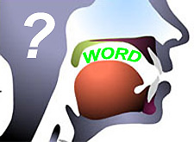
español
la pronunciación
y
la ortografía
Notes:
Pupils have already learnt how to pronounce the vowels. Now they will learn more about the relationship between pronunciation and spelling.

Slide 2
letras especiales
h
ll
ñ
j
v
c
g
z
Notes:
‘letras especiales’ = special letters. Pupils will be introduced to the letters which may cause a speaker of English problems in Spanish. They are listed at the bottom of the slide.

Slide 3
ca ce ci co cu
ga ge gi go gu
Notes:
‘c’ and ‘g’ are pronounced differently (hard or soft) depending on which vowels they are followed by.
Pupils should predict how they think the letter combinations will be pronounced.
It’s important that pupils learn to have a go, using previous knowledge to make predictions about new materials they come across.
Click on the row of letter combinations to hear how they actually do sound when pronounced accurately.

Slide 4
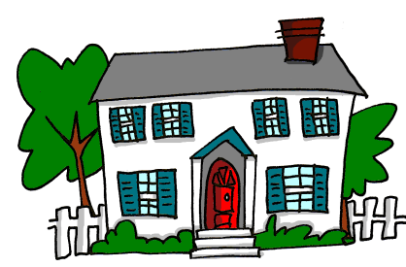
ca
casa
Notes:
Very much like in presentation 1, pronounce the letter combination in the yellow box first, then click to reveal the picture which should be introduced orally, then click to reveal the word which you should accompany with an syllable-numbered action, shown by clicking on the video box top left. Click on the word to hear it pronounced in isolation.

Slide 5
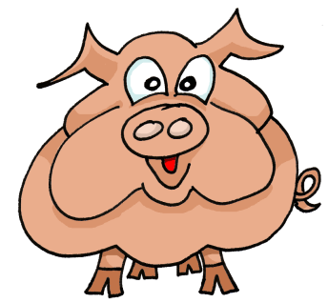
ce
!
cerdo
Notes:
Instructions as per slide 4. The red exclamation mark pops up to remind pupils that this sound will not be pronounced as they might expect. Three ‘c’ sounds (ca, co, cu) are pronounced in the same way and two (ce, ci) are not so I have added exclamations to the ce, ci slides.

Slide 6
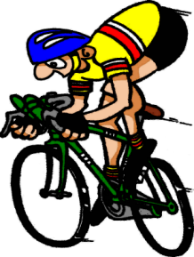
ci
!
ciclista
Notes:
Instructions as per slide 4. The red exclamation mark pops up to remind pupils that this sound will not be pronounced as they might expect.
Three ‘c’ sounds (ca, co, cu) are pronounced in the same way and two (ce, ci) are not so I have added exclamations to the ce, ci slides.

Slide 7
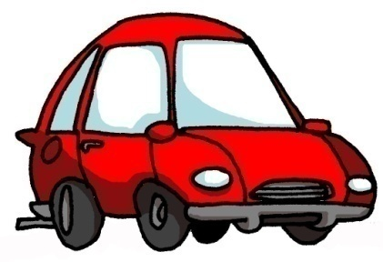
co
ch
coche
Notes:
Instructions as per slide 4.
This word highlights to pronunciation of two key sounds in Spanish.

Slide 8
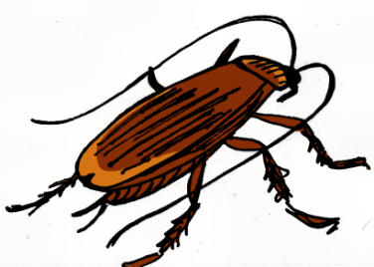
cu
ch
cucaracha
Notes:
Instructions as per slide 4. This word highlights to pronunciation of two key sounds in Spanish. Pupils have seen the ‘ch’ sound in the previous slide so should quickly be able to assimilate.

Slide 9
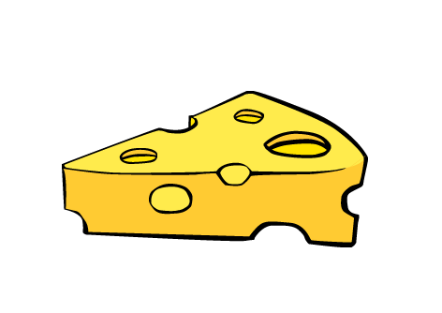
que
queso
Notes:
Main instructions as per slide 4. I have included the ‘que’ combination here because I want pupils to see that this is how the hard sound [k] is produced when followed by an ‘e’.

Slide 10
qui
15
quince
Notes:
Main instructions as per slide 4. I have included the ‘qui’ combinations here because I want pupils to see that this is how the hard sound [k] is produced when followed by an ‘i’.

Slide 11
ca
ce
ci
co
cu
que
qui
Notes:
Pupils should be encouraged to practise these sounds in isolation as well. Click on each yellow square to hear the pronunciation and point to the squares out of sequence so that pupils learn how to recognise & reproduce the sounds quickly.

Slide 12
ga
gato
Notes:
Instructions as per slide 4.

Slide 13
!
ge
gemelas
Notes:
Main instructions as per slide 4. The red exclamation mark pops up to remind pupils that this sound will not be pronounced as they might expect. Three ‘g’ sounds (ga, go, gu) are pronounced in the same way and two (ge, gi) are not so I have added exclamations to the ge, gi slides to draw attention to this.

Slide 14
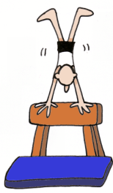
gi
!
gimnasia
Notes:
Main instructions as per slide 4. The red exclamation mark pops up to remind pupils that this sound will not be pronounced as they might expect. Three ‘g’ sounds (ga, go, gu) are pronounced in the same way and two (ge, gi) are not so I have added exclamations to the ge, gi slides to draw attention to this.

Slide 15
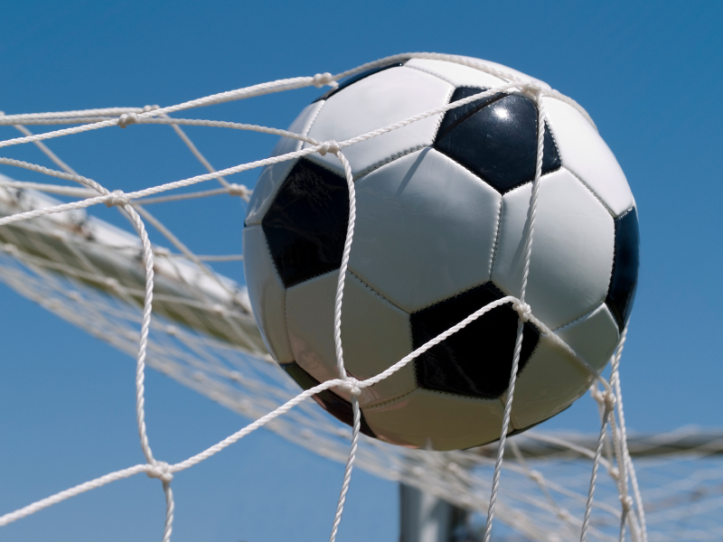
go
gol
Notes:
Instructions as per slide 4.

Slide 16
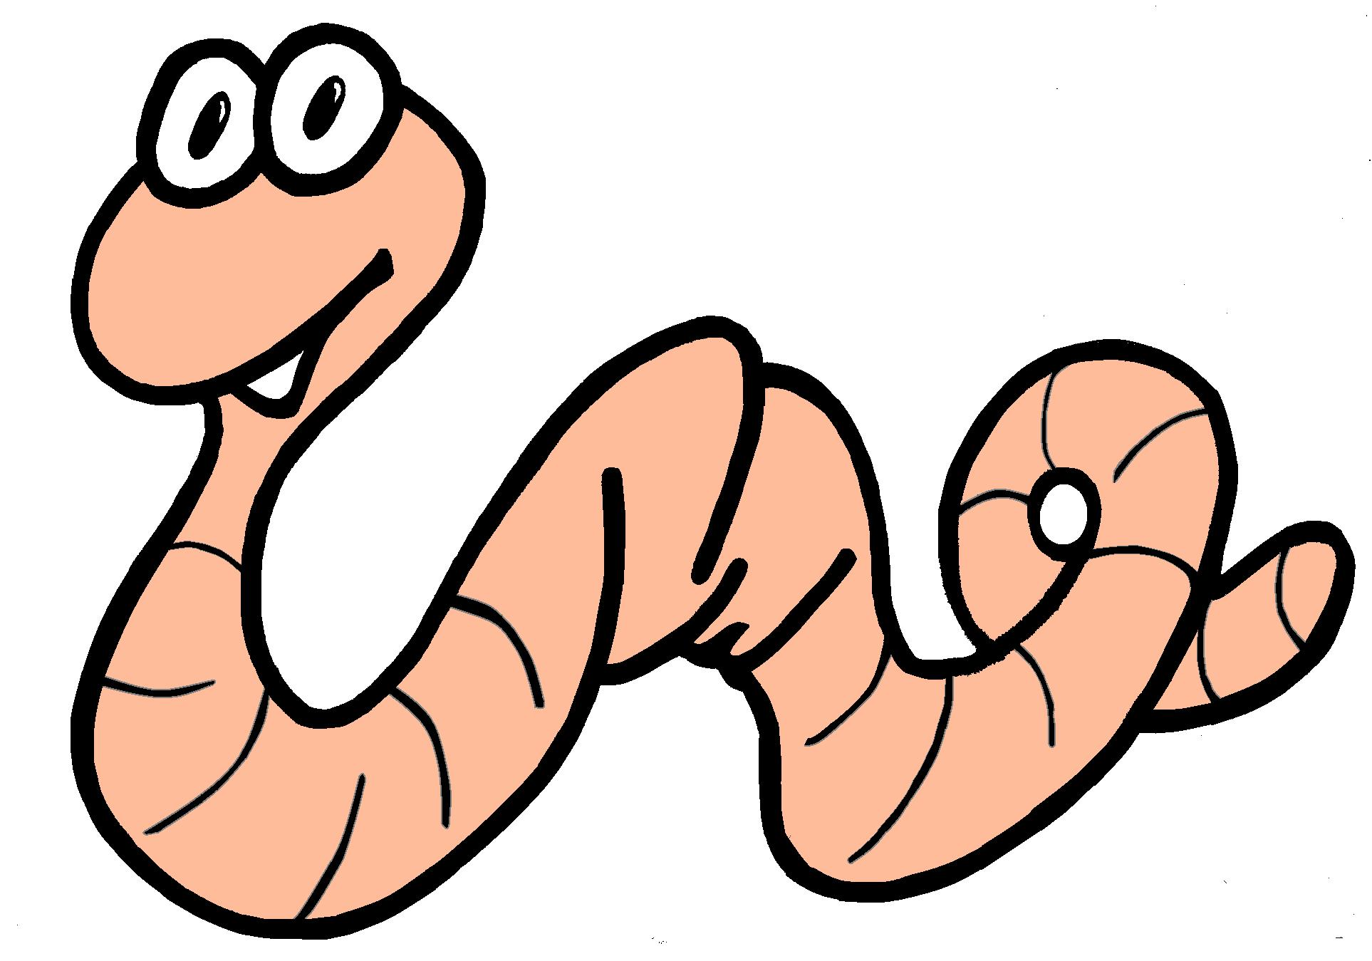
gu
gusano
Notes:
Instructions as per slide 4.

Slide 17
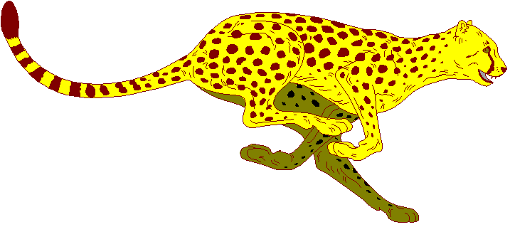
gue
guepardo
Notes:
Main instructions as per slide 4. I’ve included the ‘gue’ combination here because I want pupils to see that this is how the hard sound [g] is produced when followed by an ‘e’.

Slide 18
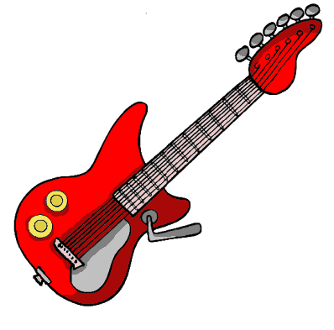
gui
guitarra
Notes:
Main instructions as per slide 4. I’ve included the ‘gui’ combination here because I want pupils to see that this is how the hard sound [g] is produced when followed by an ‘i’.

Slide 19
ga
ge
gi
go
gu
gue
gui
Notes:
Pupils should be encouraged to practise these sounds in isolation. Click on each yellow square to hear the pronunciation and point to the squares out of sequence so that pupils learn how to recognise & reproduce the sounds quickly.

Slide 20
j
jota
Notes:
Instructions as per slide 4.

Slide 21
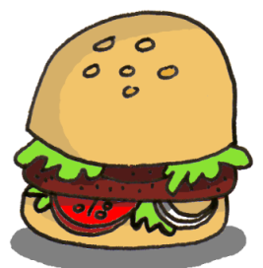
h
hamburguesa
Notes:
Instructions as per slide 4.

Slide 22
ñ
España
Notes:
Instructions as per slide 4.

Slide 23
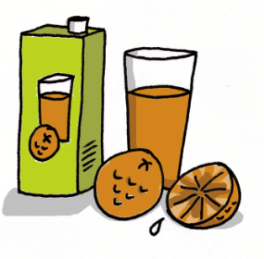
z
zumo
Notes:
Instructions as per slide 4.

Slide 24
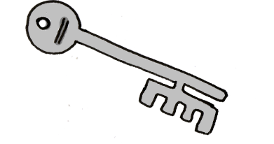
ll
v
llave
Notes:
Instructions as per slide 4. This word highlights the pronunciation of two key sounds in Spanish.

Slide 25
j
h
ñ
z
ll
v
Notes:
Pupils should practise these sounds in isolation, although they are often easier to ‘hear’ and pronounce in combination with other letters. Click on each yellow square to hear the pronunciation and point to the squares out of sequence so that pupils learn how to recognise & reproduce the sounds quickly. Remember that the ‘h’ is always a silent letter in Spanish.

Slide 26
ha he hi ho hu
lla lle lli llo llu
ña ñe ñi ño ñu
va ve vi vo vu
za ze zi zo zu
Notes:
Now pupils can combine the new sounds with the previously learnt vowels. Pupils should predict how they think the letter combinations are pronounced. It’s important that pupils learn to have a go, using previous knowledge to make predictions about new words they encounter. Click on the row of letter combinations to hear how they should sound when pronounced accurately.

Slide 27
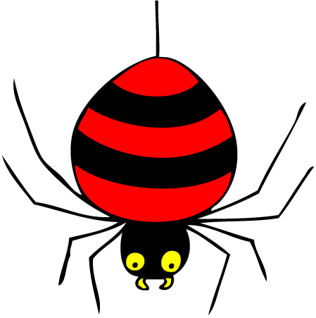
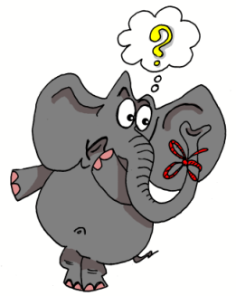
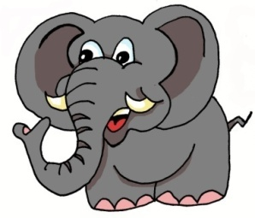
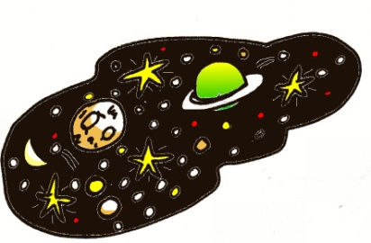
1 | 2 | 3 | 4
5 | 6 | 7 | 8
9 | 10 | 11 | 12
13 | 14 | 15 | 16
idea
araña
elefante
olvidar
universo
cerdo
ciclista
casa
coche
cucaracha
gimnasia
hamburguesa
España
zumo
gusano
llave
Notes:
27
Layering memory of the key phonics sounds – iconic word, image, gesture to represent each key sound, chosen for its difference to English pronunciation. Pupils pronounce the words they see and then produce the actions they have learnt to prompt the meaning of the words.

Slide 28
1 | 2 | 3 | 4
5 | 6 | 7 | 8
9 | 10 | 11 | 12
13 | 14 | 15 | 16
Notes:
28
Pupils produce the Spanish words when they see the pictures and/or do the actions. These words/actions will be the ‘triggers’, ‘hooks’ or ‘prompts’ to help pupils to remember accurate pronunciation in future.

