Slide 1
Los días de la semana
Notes:
Play the silent video clip and use the sound files (yellow icons) to provide the pronunciation for the days of the week, starting with Monday and ending with Sunday.

Slide 2
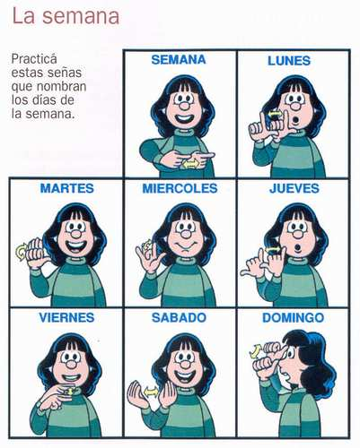
Los días de la semana.
Notes:
Use gestures to introduce and practise the days of the week. It is really effective for getting pupils to remember them. Ask me for a demo of the gestures as they are not completely clear from these images. (Please note that the tildes are not written on the words on this slide, as is quite common practice with capital letters.)

Slide 3
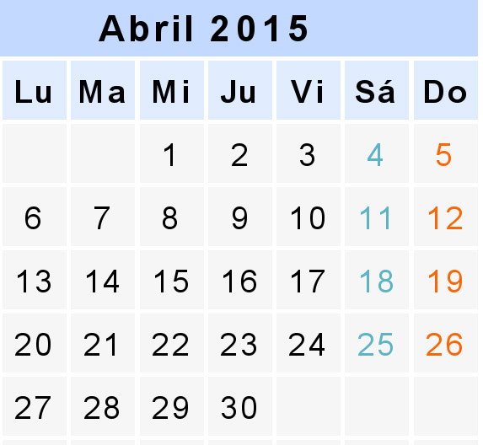
¿Qué día es hoy?
¿Qué fecha es hoy?
martes,
siete de abril
mes = ?
día = ?
mes = month
día = day
hoy = ?
fecha = ?
hoy = today
fecha = date
Notes:
This routine needs building in during the summer term of Year 3. Asking the class what day and date it is will be a regular feature from now on. NB – the date will need changing on this slide to reflect the date / day of the lesson.

Slide 4
una
¿Cuántas frutas hay?
dos
Hay …
tres
cuatro
cinco
seis
siete
ocho
nueve
Notes:
Revise the fruits from the previous lesson to finish.

