Slide 1
Notes:
This is a comic called ‘Martin speaks’ about a dog who eats alphabet soup and can talk. It is a story full of cognates which I hope that pupils, with teacher’s help, with be able to make sense of. Their task is to fill in what Martin might say in the last two speech bubbles of the comic. ‘Woof! Woof!’ Martin is a very normal dog… …but one day he eats a delicious soup… a special soup. It’s a alphabet letter soup! The letters affect Martin… in a very strange way.

Slide 2
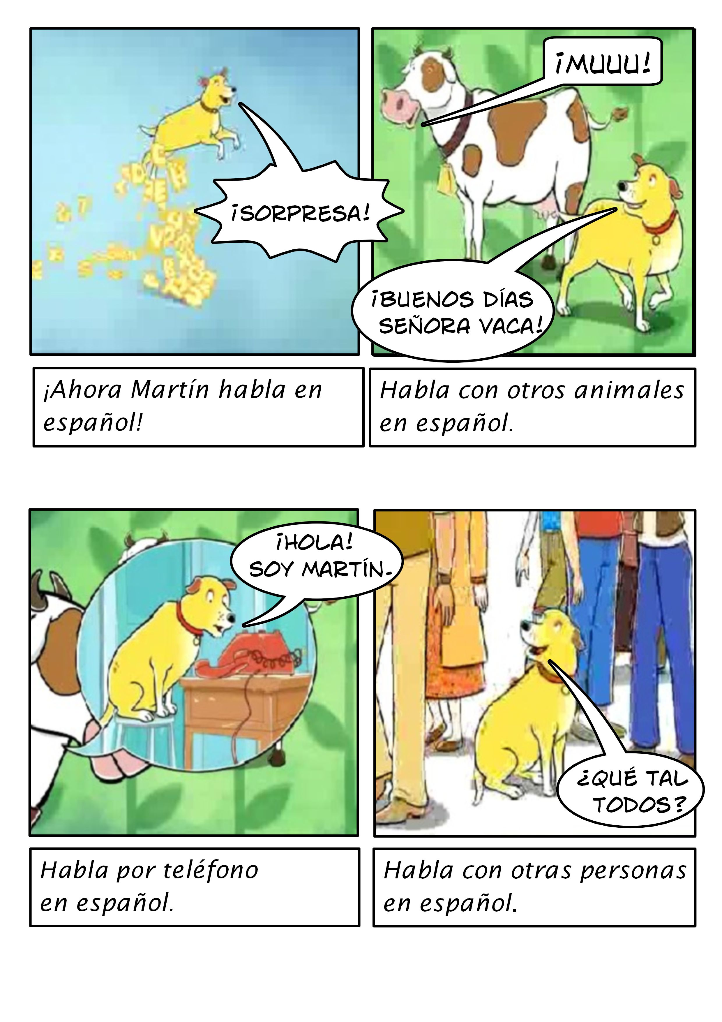
Notes:
‘Surprise!’ Now Martin speaks Spanish! ‘Mooo!’ ‘Hello Mrs Cow!’ He speaks with other animals in Spanish. ‘Hello! I’m Martin.’ He speaks on the phone in Spanish. ‘How are you all?’ He speaks with other people in Spanish.

Slide 3
Notes:
‘A dog who speaks Spanish?’ But people are afraid. Martin is now very famous.

