Slide 1
¿Verdad o mentira?
Notes:
¿Verdad o mentira? = True or false?

Slide 2
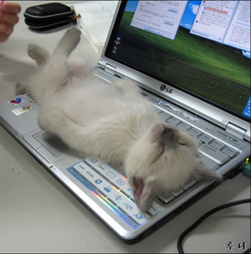
¿Verdad o mentira?
Verdad
Mentira
Notes:
Click on the photo to hear a statement in Spanish. Pupils must decide whether statements are true or false. Click on ‘Verdad’ if pupils believe that it’s true – you will hear ‘Muy bien’ if they are correct – or ‘Mentira’ if pupils believe that the statement is false – you will hear ‘Mala suerte’ (Bad luck) if they are wrong.

Slide 3
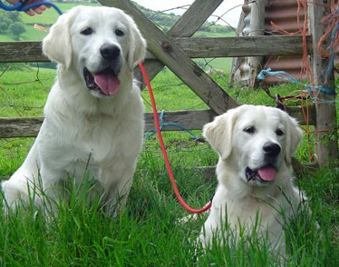
¿Verdad o mentira?
Verdad
Mentira
Notes:
Click on the photo to hear a statement in Spanish. Pupils must decide whether the statements are true or false. Click on ‘Verdad’ if pupils believe that it’s true – you will hear ‘Muy bien’ if they are correct – or ‘Mentira’ if pupils believe that the statement is false – you will hear ‘Mala suerte’ (Bad luck) if they are wrong.

Slide 4
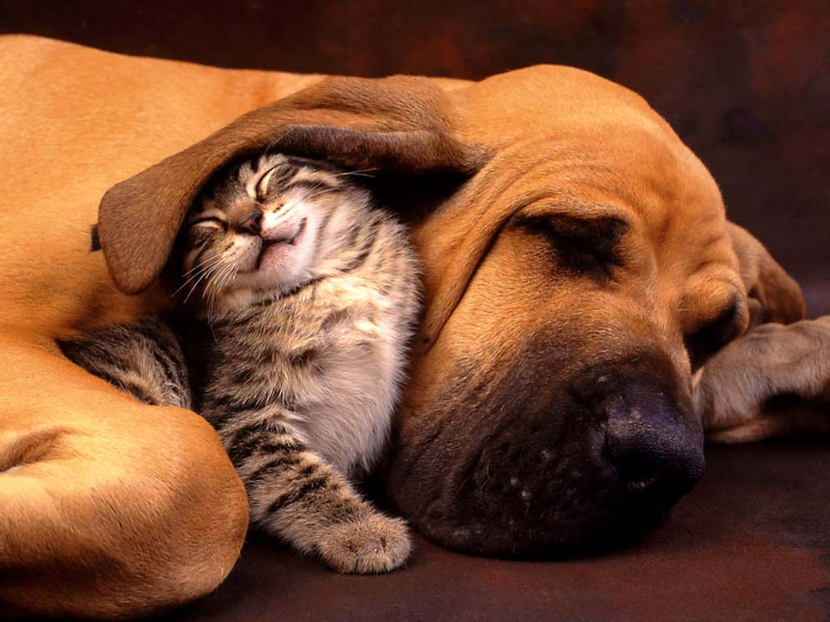
¿Verdad o mentira?
Verdad
Mentira
Notes:
Click on the photo to hear a statement in Spanish. Pupils must decide whether the statements are true or false. Click on ‘Verdad’ if pupils believe that it’s true – you will hear ‘Muy bien’ if they are correct – or ‘Mentira’ if pupils believe that the statement is false – you will hear ‘Mala suerte’ (Bad luck) if they are wrong.

Slide 5
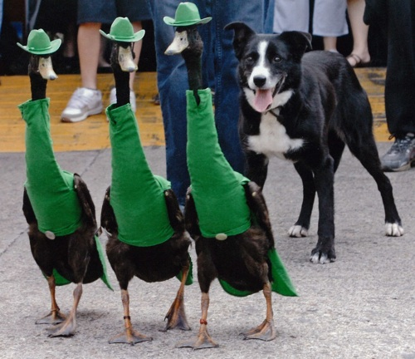
¿Verdad o mentira?
Verdad
Mentira
Notes:
Click on the photo to hear a statement in Spanish. Pupils must decide whether the statements are true or false. Click on ‘Verdad’ if pupils believe that it’s true – you will hear ‘Muy bien’ if they are correct – or ‘Mentira’ if pupils believe that the statement is false – you will hear ‘Mala suerte’ (Bad luck) if they are wrong.

Slide 6
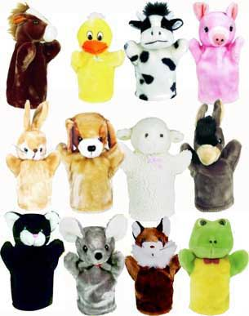
¿Verdad o mentira?
Verdad
Mentira
Notes:
Click on the photo to hear a statement in Spanish. Pupils must decide whether the statements are true or false. Click on ‘Verdad’ if pupils believe that it’s true – you will hear ‘Muy bien’ if they are correct – or ‘Mentira’ if pupils believe that the statement is false – you will hear ‘Mala suerte’ (Bad luck) if they are wrong.

Slide 7
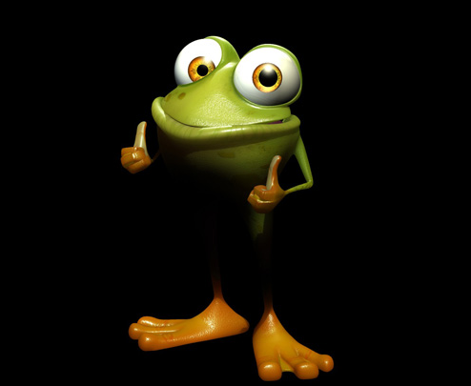
¿Verdad o mentira?
Verdad
Mentira
Notes:
Click on the photo to hear a statement in Spanish. Pupils must decide whether the statements are true or false. Click on ‘Verdad’ if pupils believe that it’s true – you will hear ‘Muy bien’ if they are correct – or ‘Mentira’ if pupils believe that the statement is false – you will hear ‘Mala suerte’ (Bad luck) if they are wrong.

Slide 8
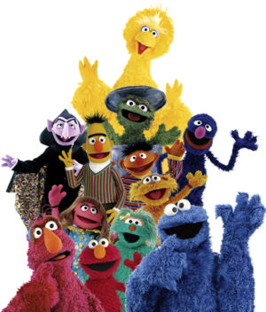
¿Verdad o mentira?
Verdad
Mentira
Notes:
Click on the photo to hear a statement in Spanish. Pupils must decide whether the statements are true or false. Click on ‘Verdad’ if pupils believe that it’s true – you will hear ‘Muy bien’ if they are correct – or ‘Mentira’ if pupils believe that the statement is false – you will hear ‘Mala suerte’ (Bad luck) if they are wrong.

Slide 9
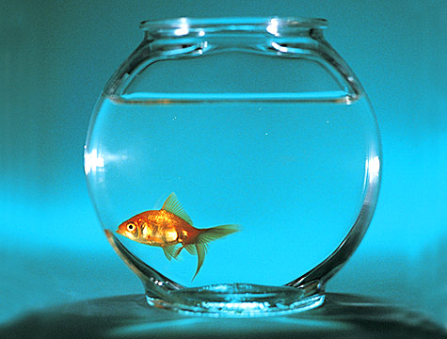
¿Verdad o mentira?
Verdad
Mentira
Notes:
Click on the photo to hear a statement in Spanish. Pupils must decide whether the statements are true or false. Click on ‘Verdad’ if pupils believe that it’s true – you will hear ‘Muy bien’ if they are correct – or ‘Mentira’ if pupils believe that the statement is false – you will hear ‘Mala suerte’ (Bad luck) if they are wrong.

Slide 10
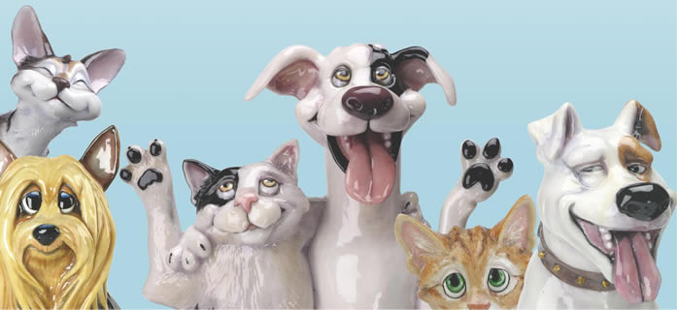
¿Verdad o mentira?
En la foto hay tres gatos pero solamente hay dos perros.
Verdad
Mentira
Notes:
Pupils must now read the statement in Spanish and decide whether the statement is true or false.

Slide 11
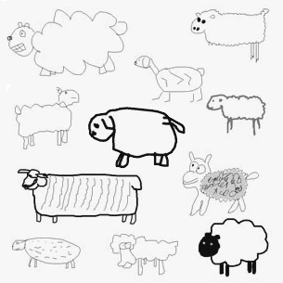
¿Verdad o mentira?
En la foto hay unas ovejas y una rana.
Verdad
Mentira
Notes:
Pupils must now read the statement in Spanish and decide whether the statement is true or false.

Slide 12
¿Verdad o mentira?
En la foto hay un gato muy inteligente.
Verdad
Mentira
Notes:
Pupils must now read the statement in Spanish and decide whether the statement is true or false.

Slide 13
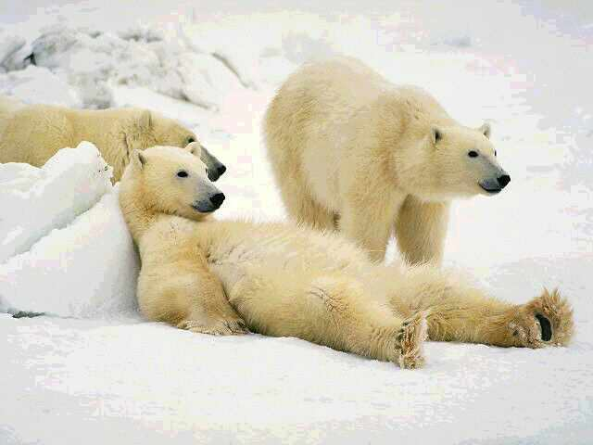
¿Verdad o mentira?
En la foto hay dos osos y un perro.
Verdad
Mentira
Notes:
Pupils must now read the statement in Spanish and decide whether the statement is true or false.

Slide 14
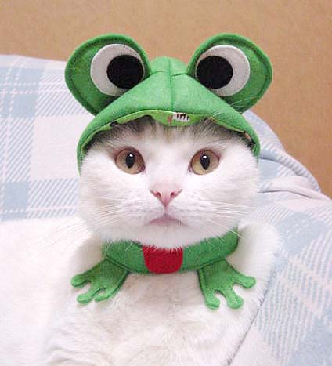
¿Verdad o mentira?
En la foto hay un gato y una rana.
Verdad
Mentira
Notes:
Pupils must now read the statement in Spanish and decide whether the statement is true or false.

Slide 15
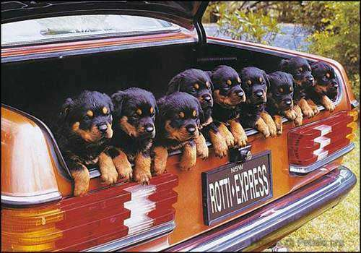
¿Verdad o mentira?
En la foto hay nueve perros dentro de un coche.
Verdad
Mentira
Notes:
Pupils must now read the statement in Spanish and decide whether the statement is true or false.

Slide 16
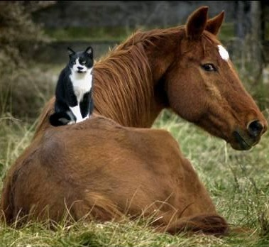
¿Verdad o mentira?
En la foto hay un caballo y un pato.
Verdad
Mentira
Notes:
Pupils must now read the statement in Spanish and decide whether the statement is true or false.

Slide 17
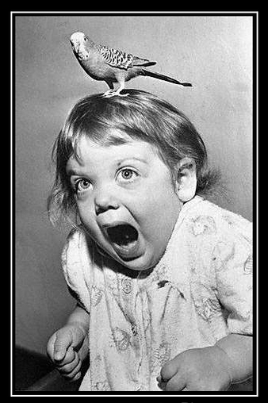
¿Verdad o mentira?
En la foto hay un pájaro y una chica.
Verdad
Mentira
Notes:
Pupils must now read the statement in Spanish and decide whether the statement is true or false.

Slide 18
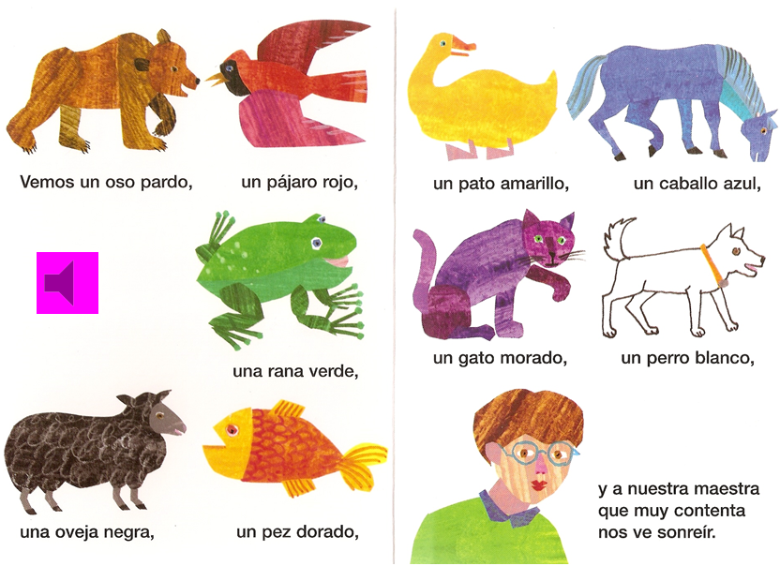
1 Vemos un oso pardo, un pájaro rojo,
2 un pato amarillo, un caballo azul
3 una rana verde, un gato morado,
4 un perro blanco, una oveja negra,
5 un pez dorado y a nuestra maestra que muy contenta nos ve sonreír.
Notes:
Re-read the familiar story. On the next slide are 3 x possible activities to follow up with pupils, giving them the opportunity to create some new language using colour and animal combinations.

Slide 19
Re-writing – individual words / substitution | ¿Cómo se dice ‘a red cat’ en español? Change the animal / colour details
Re-writing – different ending / different point of view / similar piece in the style of | Pupils tell a different story. In this case it would be one with different animal/colour combinations.
Creating in a new genre – a dialogue / a letter / a diary entry / narrative / rap | ¿Tienes un animal? Sí, tengo un… Y¿cómo es? Es …

