Slide 1
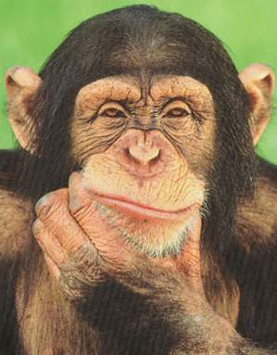
Decisiones
Notes:
Slides 1-7 revise the 9 animals. Slide 8 begins the new learning – how to create the plural form in Spanish. Decisions. In this activity pupils must choose between two animal options to identify the correct animal asked for in the question.

Slide 2
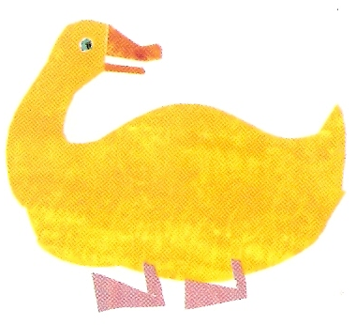
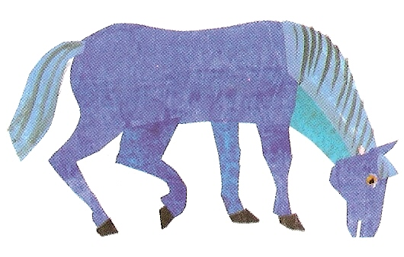
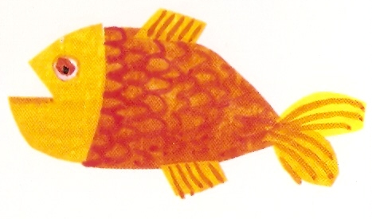
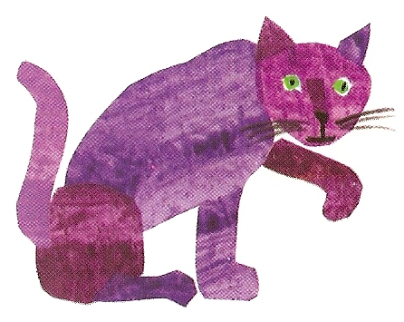
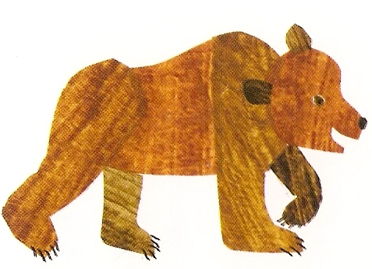
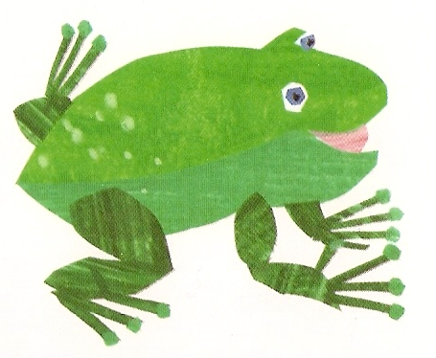
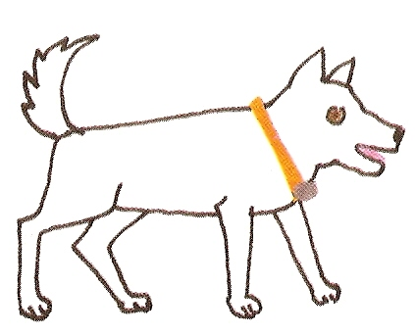
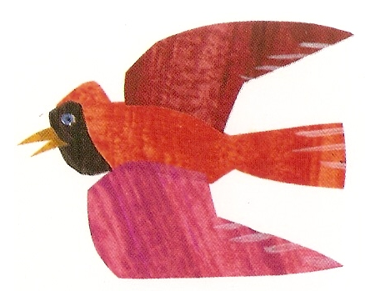
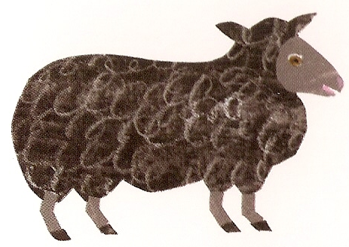
¡Haz clic sobre la imagen correcta!
el pez
el oso
el gato
el pato
el perro
la oveja
la rana
el pájaro
el caballo
Notes:
Pupils should click on the animal when the Spanish word appears (on your click). They can check that they are right by listening to the correct pronunciation of the animal.

Slide 3
¿Qué ves?
Veo …
Notes:
¿Qué ves? = What do you see? Veo = I see … Animals will fly onto the screen and off again on your click. Pupils must say what the animal was. They should use ‘Veo …’ to answer.

Slide 4
¿Cuál de los 9 animales es tu animal preferido?
Mi animal preferido es …
Notes:
¿Cuál de los 9 animales es tu animal preferido? = Which of the 9 animals is your favourite? Mi animal preferido es …= My favourite animal is … Pupils choose which is their favourite and volunteer a sentence using the prompt provided. Click on the animal in question to check answer.

Slide 5
¡Desaparición!
Notes:
¡Desaparición! = Disappearance! Pupils will see all 9 animals on the next screen, then, on your click, one will have disappeared. Pupils must volunteer which animal was the latest to disappear.

Slide 6
¿Qué desaparece?
Notes:
¿Qué desaparece? = What disappears? Click on the question to hear it pronounced.

Slide 7
Fui a la tienda de animales y compré …
Notes:
Fui a la tienda de animales y compré …= I went to the pet shop and I bought …. Pupils have to play this game building up the list of animals they bought as the animals appear. Click on the latest animal to hear the list so far. Pupils should say the Spanish prompt as well.

Slide 8
Vamos a aprender…
los plurales de los animales
Notes:
Vamos a aprender los plurales de los animales = We are going to learn the plurals of the animals. Pupils will learn how to form the plurals of nouns, 9 animals in this case. They are introduced with the number 2 (‘dos’) in front of them to avoid any distraction from digesting the main rule of plural forming (adding an ‘s’).

Slide 9
un gato
Notes:
As a revision, pupils are presented with the same pictures they learnt the main animal vocabulary with.

Slide 10
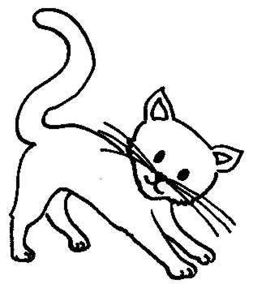
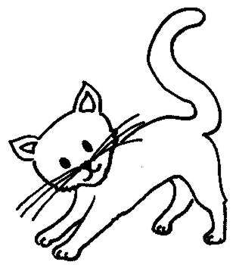
dos gatos
Notes:
Then pupils see the plural form of each noun, presented as ‘two …s’. Pupils will quickly realise that the rule is similar to the rule for forming plurals in English, although even more straightforward, which is to add an –s. I’ve presented the plural form on a green/blue background to show that even though the noun is now plural, green, it still retains the masculine gender, blue.

Slide 11
un perro
Notes:
Instructions as per slides 2&3.

Slide 12
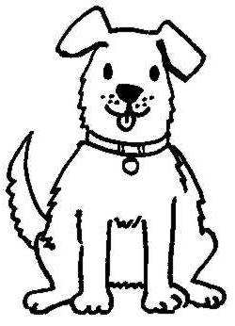
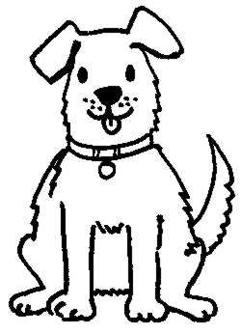
dos perros
Notes:
Instructions as per slides 2&3.

Slide 13
un pez
Notes:
Instructions as per slides 2&3.

Slide 14
dos peces
Notes:
Instructions as per slides 2&3. Pupils may notice that the spelling changes from ‘pez’ to ‘peces’ – this happens often in the plural, swapping a ‘z’ for a ‘c’.

Slide 15
un oso
Notes:
Instructions as per slides 2&3.

Slide 16
dos osos
Notes:
Instructions as per slides 2&3.

Slide 17
un pájaro
Notes:
Instructions as per slides 2&3.

Slide 18
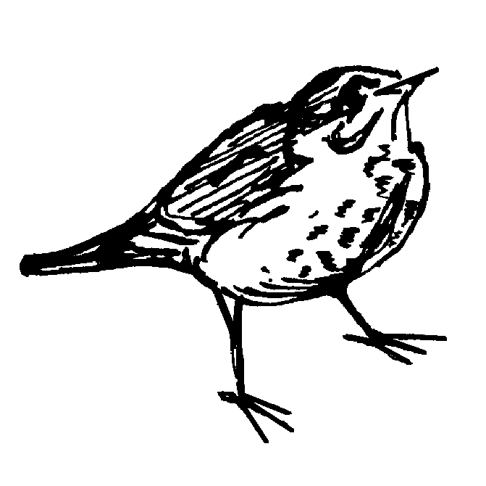
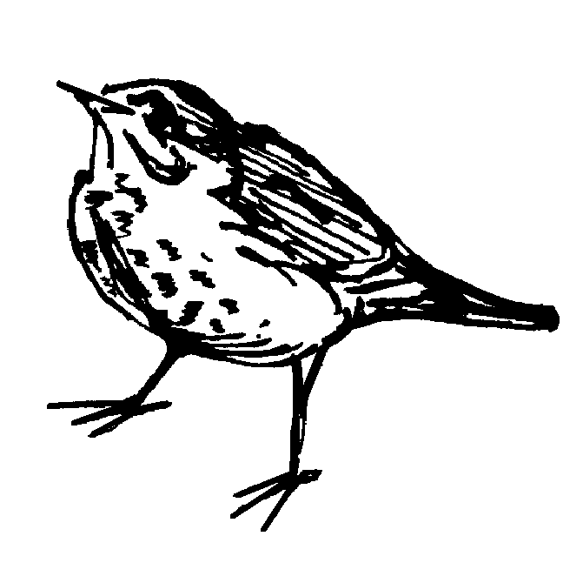
dos pájaros
Notes:
Instructions as per slides 2&3.

Slide 19
un pato
Notes:
Instructions as per slides 2&3.

Slide 20
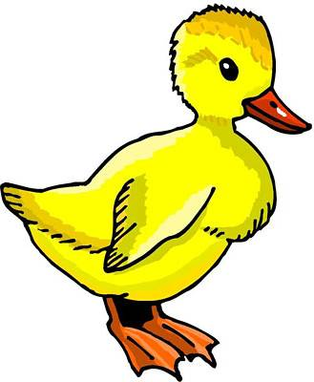
dos patos
Notes:
Instructions as per slides 2&3.

Slide 21
un caballo
Notes:
Instructions as per slides 2&3.

Slide 22
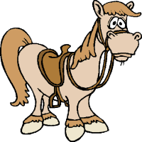
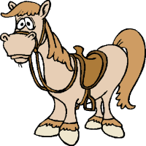
dos caballos
Notes:
Instructions as per slides 2&3.
Instructions as per slides 2&3.

Slide 23
una rana

Slide 24
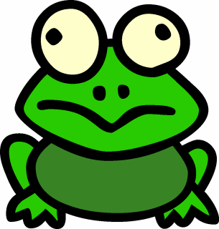
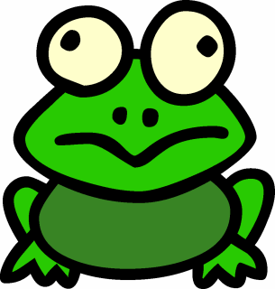
dos ranas
Notes:
I’ve presented the plural form on a green/red background to show that even though the noun is now plural, green, it still retains the feminine gender, red.

Slide 25
una oveja
Notes:
Instructions as per slide 16&17.

Slide 26
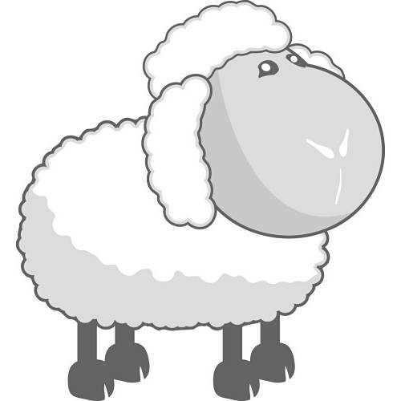
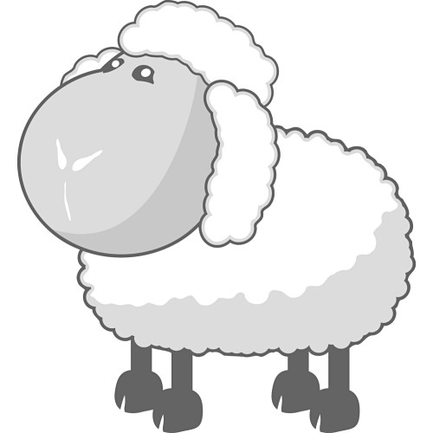
dos ovejas
Notes:
Instructions as per slide 16&17.

Slide 27
¿Qué son?
Son gatos.
Notes:
¿Qué son? = What are they? (As opposed to the singular question ¿Qué es? = What is it?) Encourage pupils to use the verb ‘Son…’ to begin their answer – getting them familiar with commonly-used vocabulary & phrases which will be invaluable to them in the future. Click to reveal plural animals & click again to see a written answer.

Slide 28
¿Qué son?
Son ranas.

Slide 29
¿Qué son?
Son patos.

Slide 30
¿Qué son?
Son ovejas.

Slide 31
¿Qué son?
Son caballos.

Slide 32
¿Qué son?
Son pájaros.

Slide 33
¿Qué son?
Son perros.

Slide 34
¿Qué son?
Son peces.

Slide 35
¿Qué son?
Son osos.

Slide 36
¿Qué son los plurales?
casa
elefante
cerdo
araña
guitarra
coche
gusano
llave
idea
guepardo
casas
elefantes
cerdos
arañas
guitarras
coches
gusanos
llaves
ideas
guepardos
Notes:
An exercise to apply the new plural rule to other nouns pupils already know (from unit 1). Click on pink buttons to hear the words pronounced as a list (therefore don’t click on right-hand button in class until answers have been volunteered by pupils).

