Slide 1
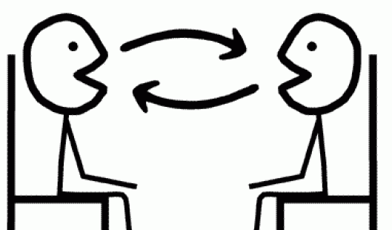
Révision!
Notes:
This lesson is about consolidating all the language learnt so far about music, likes, dislikes and reasons and bringing it together so that pupils end up being confident in have a short exchange of up to a max. of 6 questions and answers. We are going to begin with some game activities to rehearse the language they have met, develop fluency, memory, pronunciation and confidence in speaking.

Slide 2
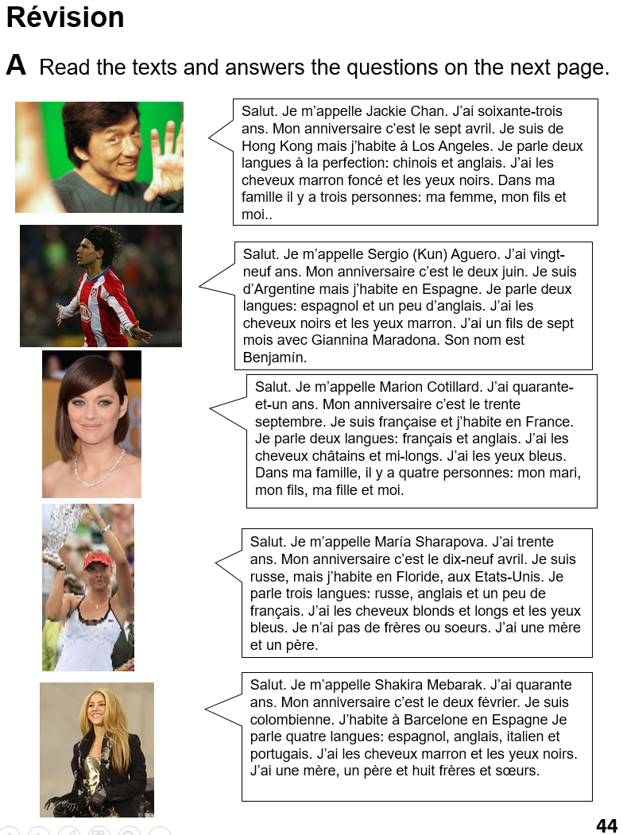
B Read the texts again. Write down any questions in French that you know would get the information given. E.g. Je m’appelle Jackie Chan. → Comment tu t’appelles?
C Use your questions to interview your partner, who will be one of the five people.

Slide 3
