Slide 1
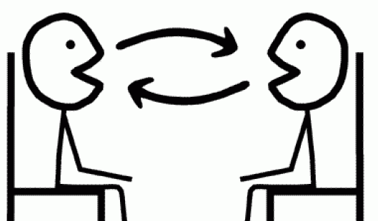
Révision!
Notes:
This lesson is about consolidating all the language learnt so far about music, likes, dislikes and reasons and bringing it together so that pupils end up being confident in have a short exchange of up to a max. of 6 questions and answers. We are going to begin with some game activities to rehearse the language they have met, develop fluency, memory, pronunciation and confidence in speaking.

Slide 2
Comment?
Qui?
Pourquoi?
Que?
Combien?
Où?
Quel/s/ Quelle/s?
Quand?
Notes:
Teach the key question words with gestures.

Slide 3
C_______?
Q__?
P_______?
Q__?
C______?
O_?
Q____ Q_____?
Q____?
Notes:
Teach the key question words with gestures.

Slide 4
Questions
Où?
Qui?
Quand ?
Que ?
Comment ?
Pourquoi?
Combien ?
Quel/s Quelle/s?
Where?
Who?
When?
What?
How?
Why?
How much?
Which?
Notes:
Use this to check pupils recall the English for each question word.

Slide 5
Révision
Comment tu t’appelles?
Comment ça va?
Quel âge as-tu?
Quelle est la date de ton anniversaire?
Où habites-tu?
Pourquoi Cambridge est célèbre?
Quel temps fait-il?
Qui est ton professeur de français?

Slide 6
Y6 Conversation
1. Comment tu t’appelles?
Je m’appelle ……………………..
2. Ça va ?
……………………………………………………………..
3. Quel âge as-tu?
J’ai ……………………ans
4. Quelle est la date de ton anniversaire?
Mon anniversaire c’est le ……………………………………….
5. Tu as des frères ou des sœurs?
……………………………………………………………………………… 6. Tu as un animal?
……………………………………………………………………………….
7. Où habites-tu? (Say where you live. Which country?
Is it in the north/south/west/east?)
J’habite à………………………………………………………………………
8. Qu’est-ce qu’il y a à _________________?
À ……………………………...il y a ……………………………………………………………
9. Quelles langues parles-tu?
Je parle ………………………………………………………………………

