Slide 1
Nous allons…
réviser les pronoms sujet (je, tu, il, elle, on, nous, vous, ils, elles)
pratiquer le verbe ‘danser’
appliquer le motif à d’autres verbes (e.g. porter, regarder, chanter, manger)

Slide 2
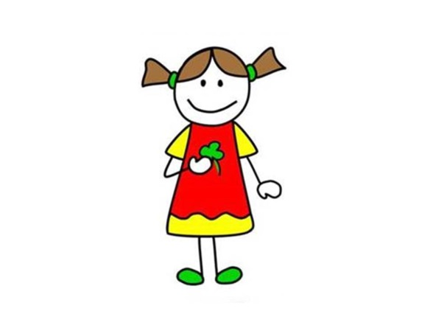
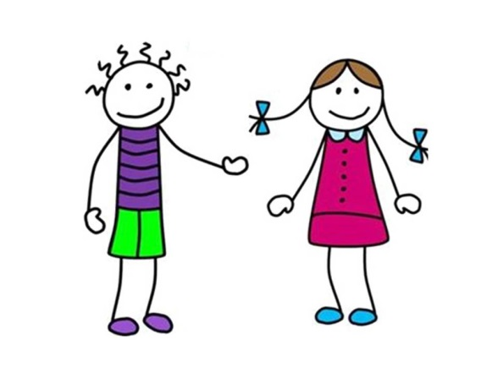
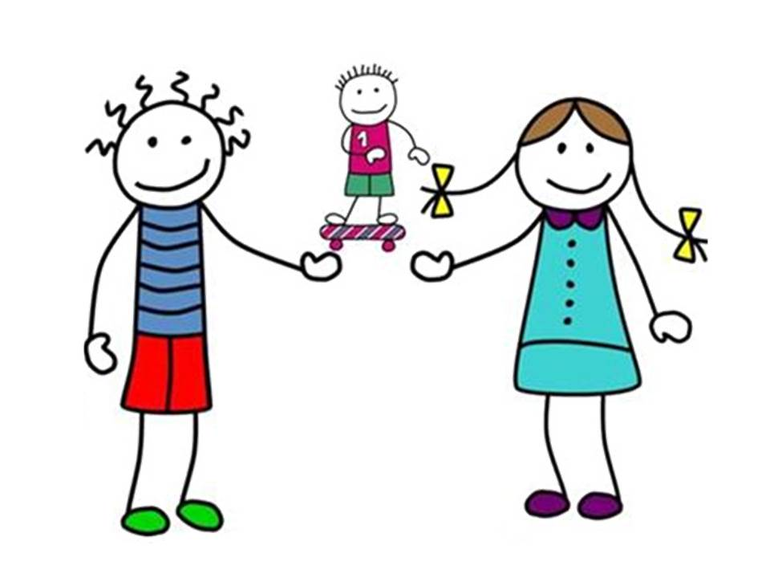
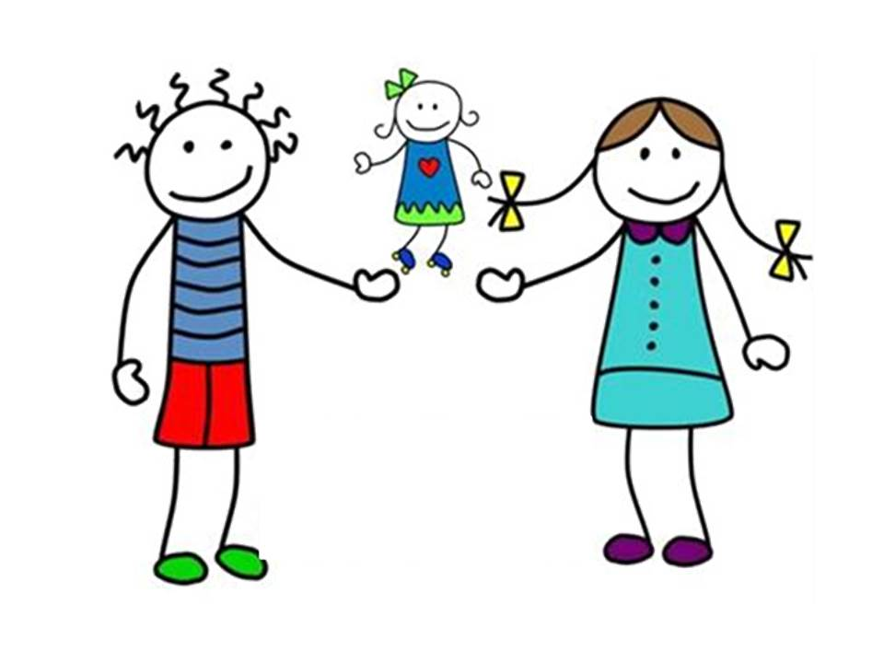
je
tu
il
elle
Notes:
Encourage pupils to point to the person being referred to in order to make this a physical memory activity.
Pupils were introduced to these all together in Y5.
Encourage pupils here to repeat aloud ‘je ’ and point at themselves with one finger. (One finger should be used for singular forms and two for plural as we go through all of the subject pronouns.) GESTURES are the most important tool for learning these pronouns!

Slide 3
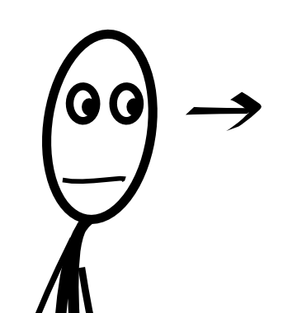
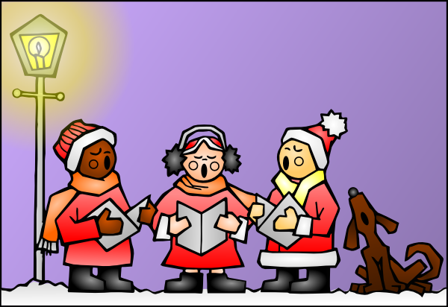
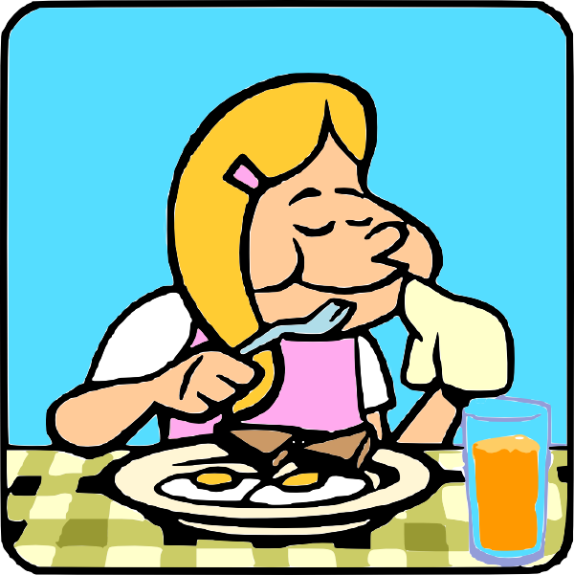
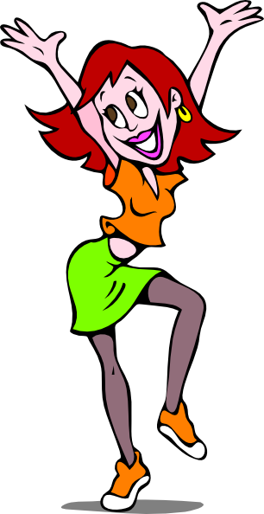
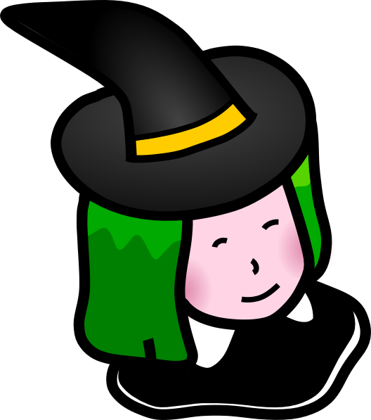
on chante
on regarde
on
on mange
on danse
One/People/ Someone/We
on porte
Notes:
On is new to pupils this term (they have been introduced to it lots of times in the festival lessons).
This slide recaps what they already know and have used with ‘on’

Slide 4
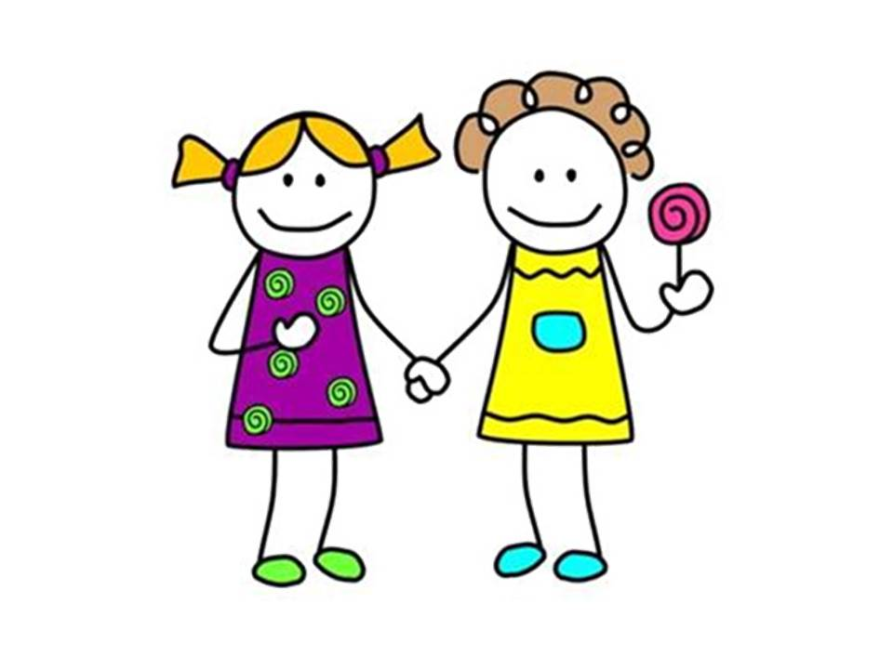
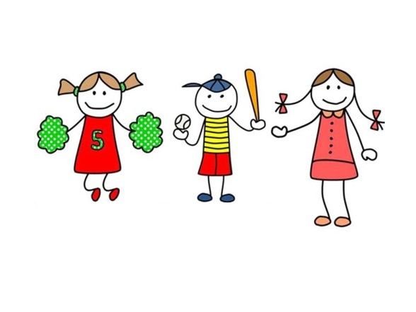
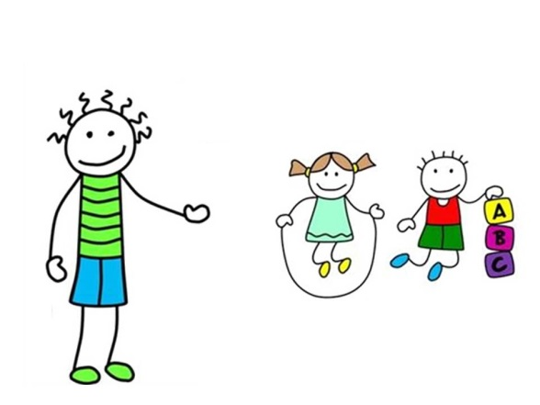
nous
vous
ils
elles

Slide 5
Les pronoms sujet
en français
en anglais
je
tu
il
elle
on
nous
vous
ils
elles
I
you (singular/informal)
he
she
one/people/someone/we
we
you (plural / formal)
they (masculine)
they (feminine)
Notes:
Bring them all together and elicit from the English – still use the gestures to reinforce meaning.

Slide 6
Les verbes
A _______ is a ‘doing word’ e.g. to play, to eat, to dance but also ‘he plays’, ‘we eat’, ‘they dance’
Verbs you find in a dictionary are called ‘infinitive’ verbs (e.g. to watch, to wear)
Most infinitive verbs in French end in –er (e.g. manger, danser, chanter)

Slide 7
La conjugaison
To say ‘who’ is doing something, you need to put a subject pronoun (I, you, he, she…) in front of the verb
AND change the verb
This is called conjugation.
E.g. jouer = to play je joue = I play elle joue = she plays

Slide 8
Look at the verb danser (to dance):
To say who is doing the action of the verb, in English we add a pronoun to the front, and for he / she / it we add an –s to the verb. In French, we add a different ending for each person.
I dance | Je danse
You (sg) dance | Tu danses
He / She / It dances | Il / Elle danse
We dance | Nous dansons
You (pl) dance | Vous dansez
They dance | Ils / elles dansent
 | - ER verb endings
I | - e
You (sg) | - es
He / She / It | - e
We | - ons
You (pl) | - ez
They | - ent
Summary To say what someone does or is doing in French, remove the –ER from the infinitive and add the endings for each person, as in the table left:
dans
e r
Notes:
The most important thing is that pupils get the opportunity to connect the verb ending with the meaning.
Stick to the verb danser and doing some mini whiteboard practice will really help here.

Slide 9
